Slide 1

Human Resource management Strategy in Family Business
Prof. Giulia Flamini

Slide 2

Who I am?
Prof.ssa Giulia Flamini, giulia.flamini@uniroma2.it
I am committed to make this course a valuable learning experience for you
I welcome your feedback at any time in the semester
I endeavor to answer emails within 1 day

Slide 3
Agenda
What is a family business?
The strategic elements of the family business
Change and succession processes
Managing conflicts in the family business
Human Resource Management in the family business
Professional HR manager
Configurational theory for the family business
HRM configurations in the family business
Performance and goals of HRM in family business

Slide 4
The nature, importance, and uniqueness of the family business
Lecture 10

Slide 5
Agenda
Definitions of the family business
The distinction between family and nonfamily firms
Definition of family business by type of family involvement
The theory of Circle models of family influence

Slide 6
Definitions of the family business
Family business definition used in the course:
A family firm is a firm dominantly controlled by a family
with the vision to potentially sustain family control across generations
This definition of family business emphasizes two central features:
  Dominant control in the hands of family: The channels through which this control is exercised may vary significantly depending on the complexity, size and age of the firm and on the particular value system and goals of the family, as shown above
  Transgenerational outlook: This aspect is critical when distinguishing between any closely held company and a family firm. It points to the particular relevance of succession and long-term value creation, aspects that are either absent or less relevant in nonfamily firms

Slide 7
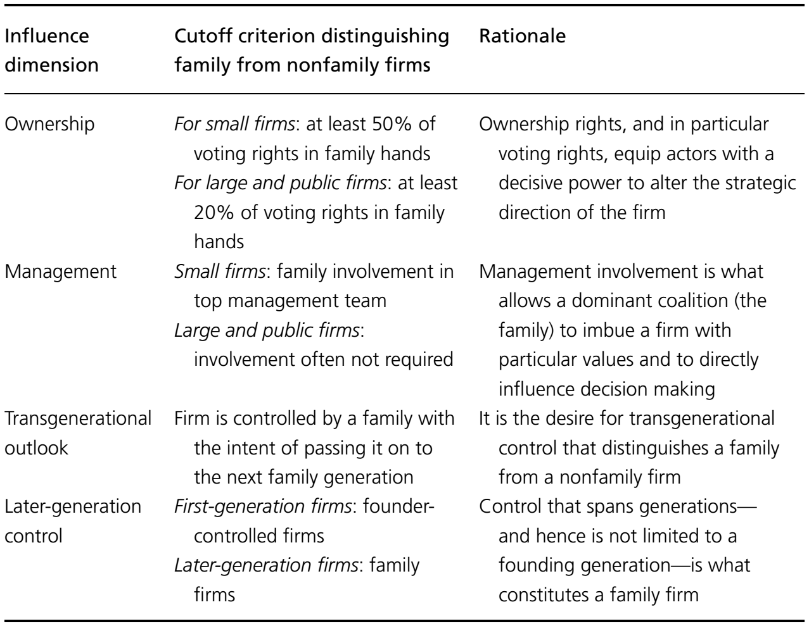
The distinction between family and nonfamily firms
What distinguishes family firms from other types of organisations is the influence of the family on the firm
There is no a clear demarcation between family and nonfamily firms
Three simplifications may be particularly problematic:
  Overlooking the heterogeneity of family firms
  Simplifying the definition of family
  Underestimating the value of studying family involvement along various dimensions
We should ask ourselves: what are the specific ways families influence their firms?

Slide 8
Defining family business by type of family involvement: the F-PEC model
The F-PEC model (Astrachan, Klein and Smyrnios 2002) suggests that family influence stems from three dimensions:
  The Power dimension captures the degree of ownership control in family hands, the extent of management control in family hands and the degree to which the family controls a governance body (i.e., the board)
  The Experience dimension is represented mainly by the number of generations for which the firm has been under family control
  The Cultural dimension accommodates the degree of cultural overlap between the family and business systems, that is, the degree of overlap between family and business values
Building on the F-PEC model, we can identify five dimensions of family involvement:
  The amount of family control
  The complexity of family control
  The setup of the business activities
  The family owner’s philosophy and goals
  The stage of control in terms of the family’s history with the firm

Slide 9
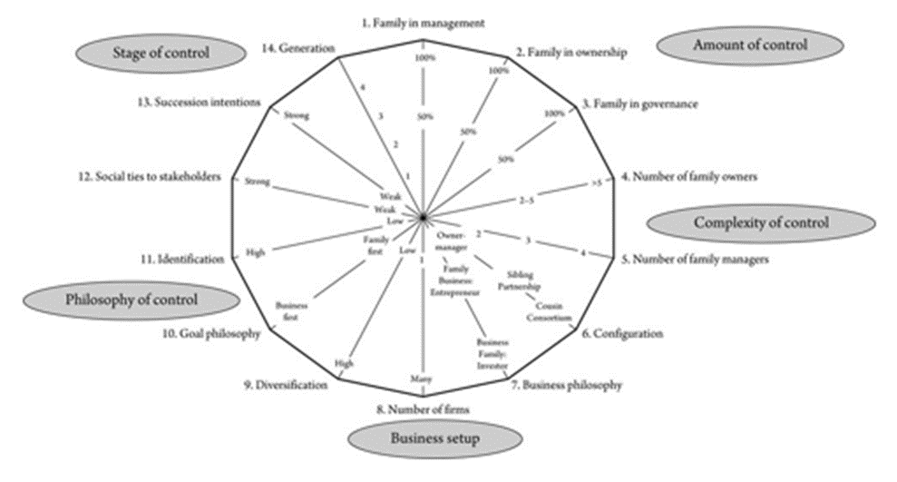
Defining family business by type of family involvement: the FB assessment tool
The family business assessment tool does not suggest an optimal positioning along the five dimensions
The benefit of assessing family involvement according to these dimensions should be twofold:
  The five dimensions are meant to shed light on the sources of family firm heterogeneity, and in particular the opportunities and challenges that come with various types and levels of family involvement
  The tool allows to open a discussion not only about the current state of family involvement, but also about the family’s future involvement, and the opportunities and challenges the firm will likely face when altering its positioning along the various dimensions of influence
The family business assessment tool

Slide 10
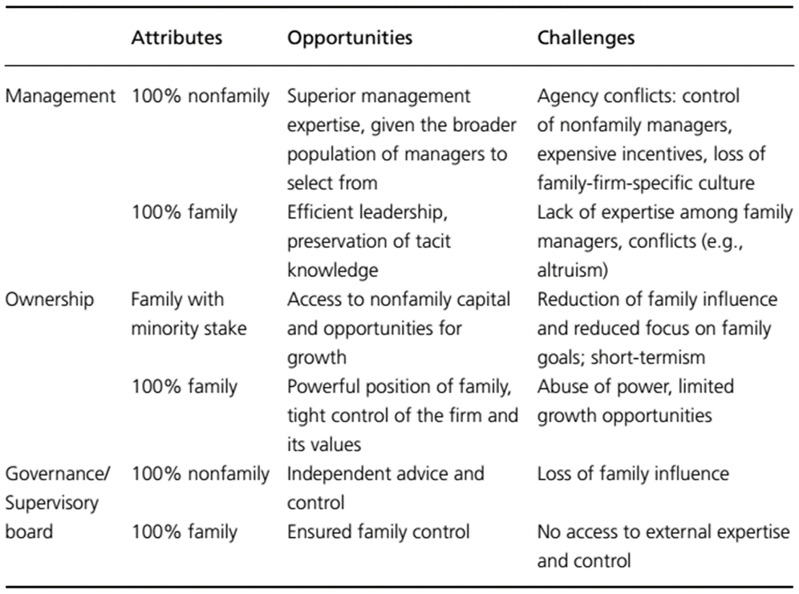
Defining family business by type of family involvement: the amount of family control

Slide 11
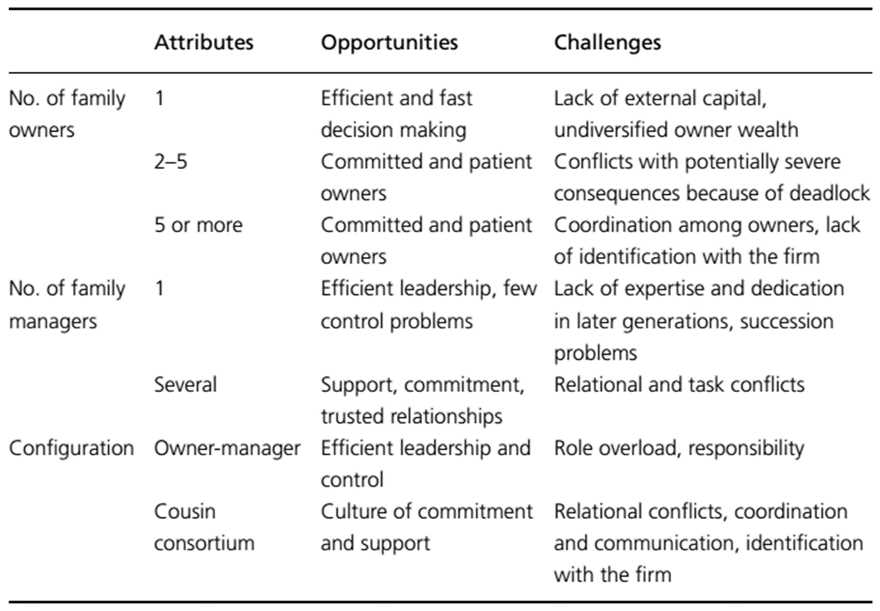
Defining family business by type of family involvement: the complexity of family control

Slide 12
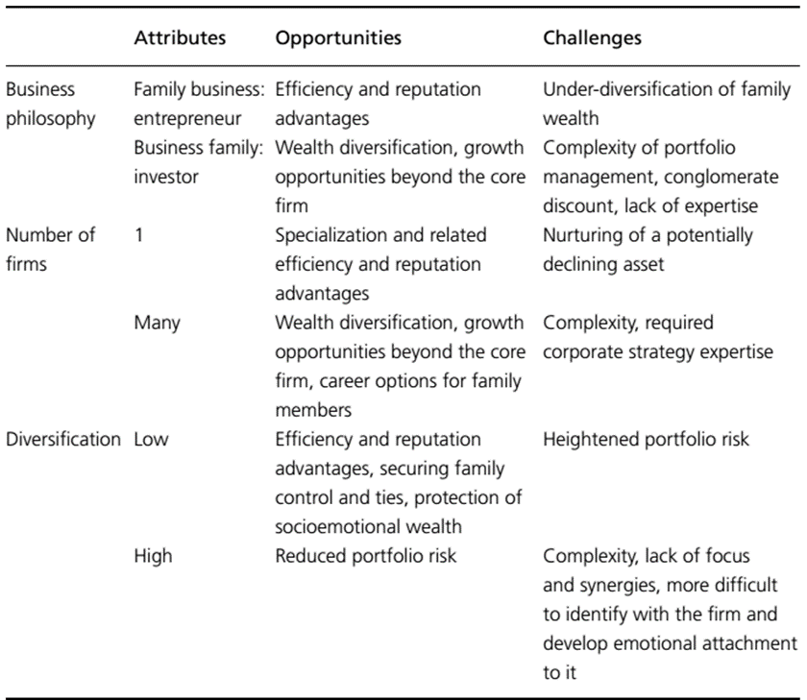
Defining family business by type of family involvement: the setup of the business activities

Slide 13
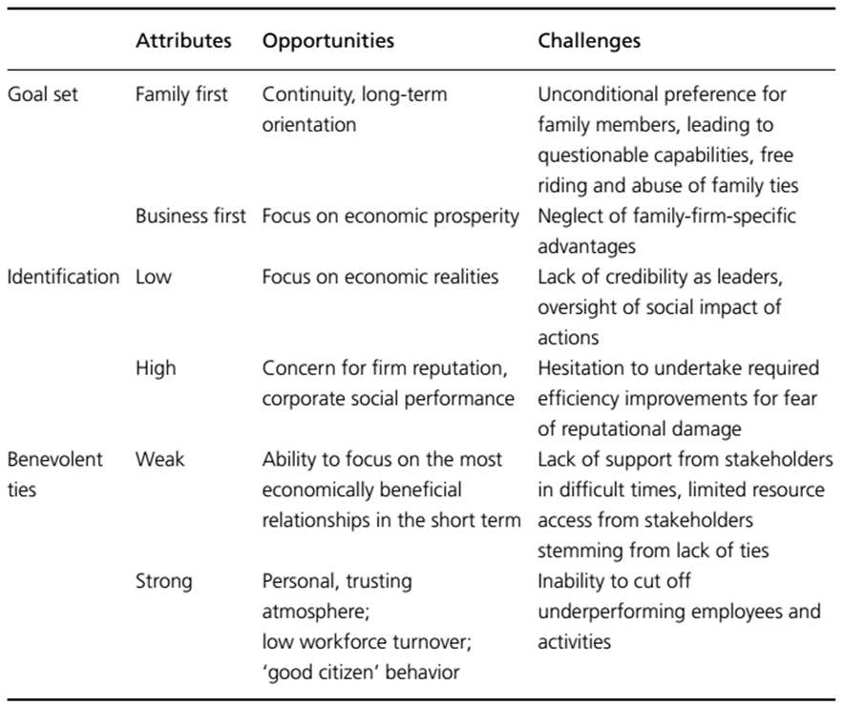
Defining family business by type of family involvement: the family owner’s philosophy and goals

Slide 14
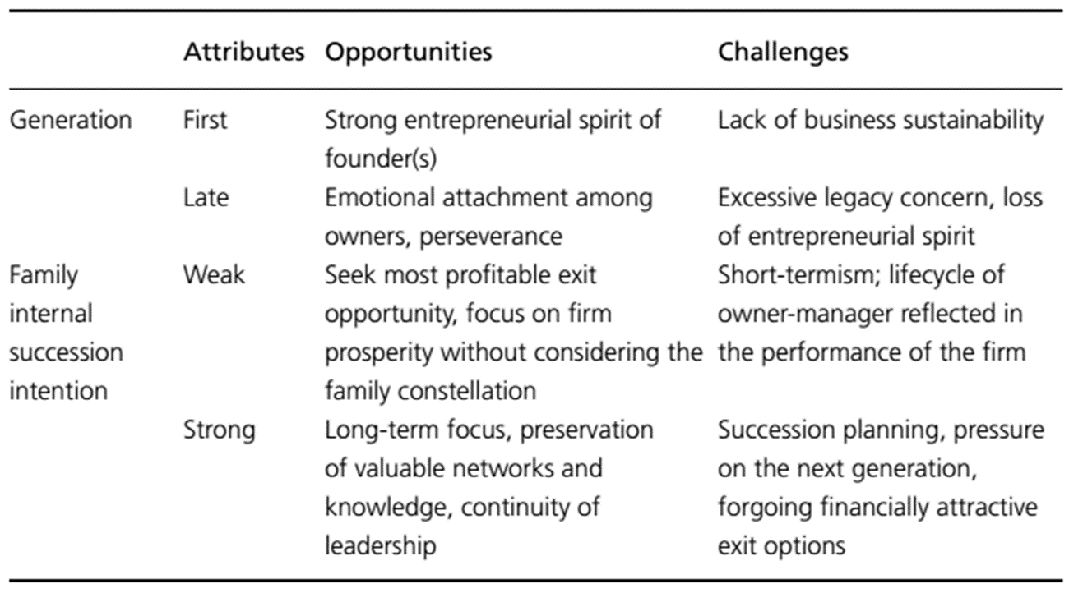
Defining family business by type of family involvement: the stage of control

Slide 15
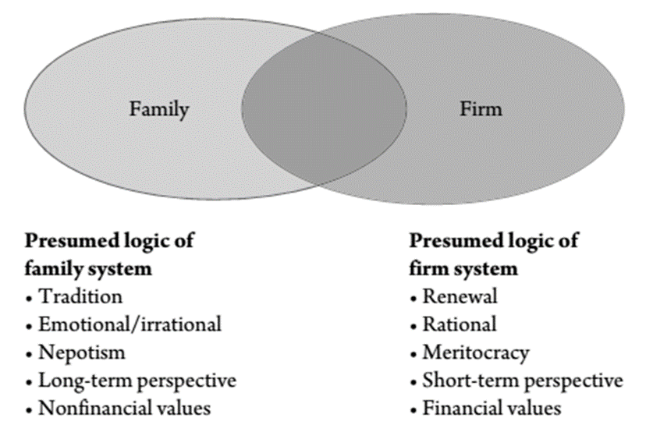
The theory of Circle models of family influence
The depiction of the family business as a combination of largely incompatible subsystems brings to the fore the tensions inherent in this form of organization
It suggests that the management of family firms can be equated with the management of tensions among the business and family systems that compete for influence
The two-circle model thus helps us in making sense of the underlying reasons for the tensions we observe

Slide 16
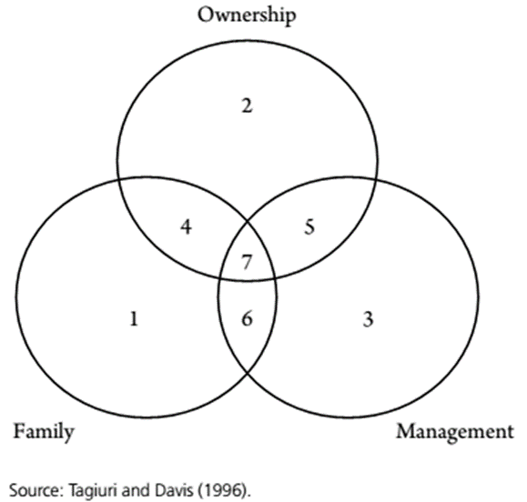
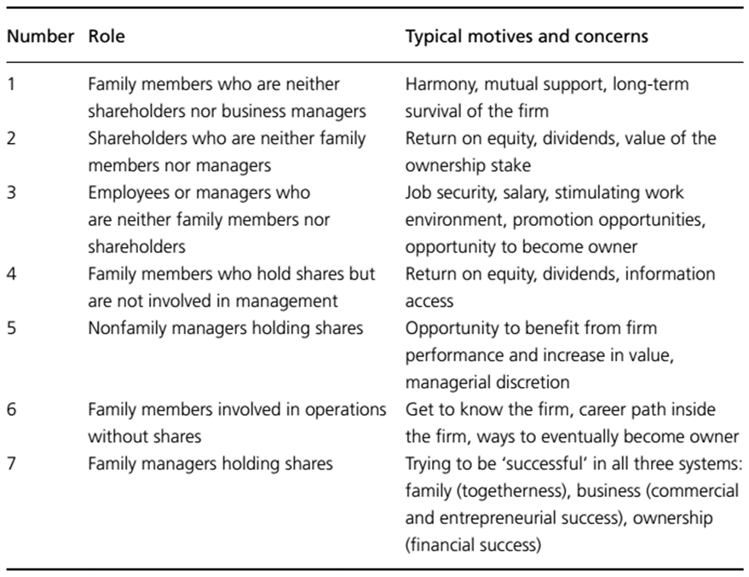
The theory of Circle models of family influence
Roles and motives in the three-circle model

