Slide 1
Cartels: Standard of proof and how to assess evidence

Slide 2
Proving a theory of harm: standard of proof
Various standard of proofs
  Preponderance of the evidence (more likely than not)
  Clear and convincing evidence (highly probable)
  The most likely outcome
  The only plausible explanation
  Beyond reasonable doubts
Wood pulp: Coordination must be the only plausible explanation of the observed behavior

Slide 3
Theory: Prior and posterior
Let P(I) the unconditional probability of an infringement (i.e. the probability that I occurred before collecting any evidence) – it is the “prior”
Suppose E is observed, and we can compute the conditional probability P(I│E) – the “posterior” ; 3 cases are possible:
1) P(I│E) = P(I) → E is irrelevant
2) P(I│E) > P(I) → E is inculpatory (contributes to prove that the infringement occurred)
3) P(I│E) < P(I) → E is exculpatory (contributes to disprove that the infringement occurred)

Slide 4
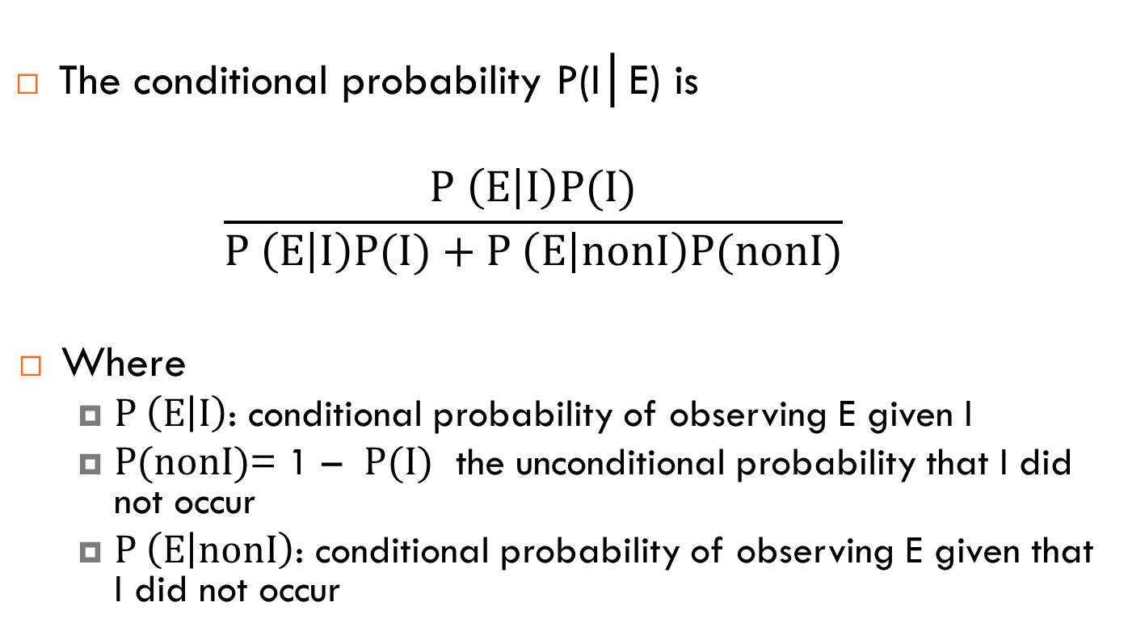
Theory: The Bayes Theorem
The conditional probability P(I│E) is
$$\frac{P \left(E | I\right)P(I)}{P \left(E | I\right)P(I)+P \left(E | nonI\right)P(nonI)}$$
Where
  $P \left(E | I\right)$: conditional probability of observing E given I
  $P(nonI)$= 1 – $P(I)$ the unconditional probability that I did not occur
  $P \left(E | nonI\right)$: conditional probability of observing E given that I did not occur

Slide 5
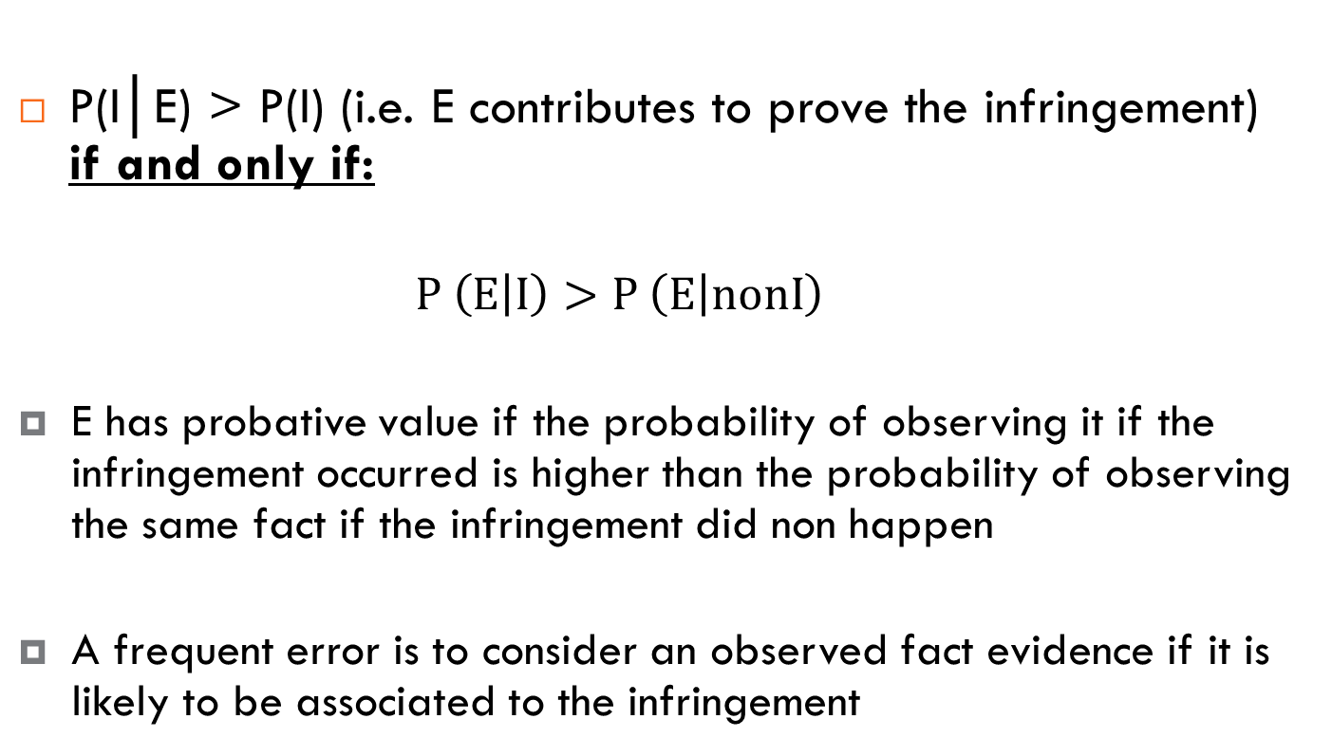
Theory: Applying the Bayes Theorem
P(I│E) > P(I) (i.e. E contributes to prove the infringement) if and only if:
  $$P \left(E | I\right)>P \left(E | nonI\right)$$
  E has probative value if the probability of observing it if the infringement occurred is higher than the probability of observing the same fact if the infringement did non happen
  A frequent error is to consider an observed fact evidence if it is likely to be associated to the infringement

Slide 6
A case: Istituti di Vigilanza Sardegna
Market: Security Services (Guards) in the province of Cagliari
Market structure
Company | Market Share
Vigilanza Sardegna (VS) | 51.4%
Sicurezza Notturna (SN) | 25.0%
Sicurvis | 8,6%
Cannas | 9.2%
S. Elena | 4.4%
Gerrei | 1.4%
Total | 100.0%

Slide 7
Pricing behavior
 | 1990
Pres. | S.N. | V. S.
A | 22.184 | 22.477
B | 22.358 | 22.177
C | 22.358 | 22.177
D | 22.358 | 22.177
E | 22.358 | 22.177
F | 22.358 | n.o.
G | 22.184 | 22.477
H | 22.184 | 22.477
I | n.o. | 22.477
L | 22.184 | 22.477
M | 22.184 | 22.477
1991
S. N | V.S | Cannas
25.200 | 25.477 | 26.000
25.800 | 25.477 | 26.000
25.800 | 25.477 | 26.000
25.800 | 25.477 | 26.000
25.800 | 25.477 | 26.000
25.200 | 25.477 | 26.000
25.200 | 25.477 | 26.000
25.200 | 25.477 | 26.000
25.800 | 25.477 | 26.000
25.200 | 25.477 | 26.000
25.200 | 25.477 | 26.000
 | 1992
S.N.. | V. S.. | S. El.
26.500 | n.o. | n.o.
n.o. | 26.350 | n.o.
n.o. | 26.350 | n.o.
n.o. | 26.350 | n.o.
n.o. | 26.350 | n.o.
26.500 | n.o. | n.o.
26.500 | n.o. | n.o.
26.500 | n.o. | n.o.
n.o. | 26.350 | 16.950
26.500 | n.o. | 16.950
26.500 | n.o. | n.o.
 | 1993
S.N. | V. S . | S. El. | Gerrei
8.900 | 8.950 | n.o. | n.o.
9.000 | 8.950 | 16.000 | n.o.
9.000 | 8.950 | 15.500 | n.o.
9.000 | 8.950 | 14.700 | n.o.
9.000 | 8.950 | n.o. | n.o.
8.900 | 8.950 | n.o. | n.o.
8.900 | 8.950 | n.o. | 17.945
8.900 | 8.950 | n.o. | 17.945
9.000 | 8.950 | 12.200 | 17.945
8.900 | 8.950 | 12.200 | 17.945
8.900 | 8.950 | n.o. | 17.945

Slide 8
IVS: evidence
Suppliers bids are higher for a particular lot than the same supplier's bid for another similar lot
Significant reductions from past price levels after a bid from a new or infrequent supplier, e.g. the new supplier may have disrupted an existing bidding cartel
There is a clear allocation of winning tenders. Firms submitted tenders that always win the same lots
Regular suppliers fail to bid on a lot they would normally be expected to bid for, but have continued to bid for other lots

Slide 9
IVS: decision
On the basis of the evidence described above the Italian Competition Authority issued an infringement decision
The decision was upheld by the administrative courts in the subsequent appeals!

