Slide 1
f0reclosure
(predatory pricing and refusal to deal)

Slide 2
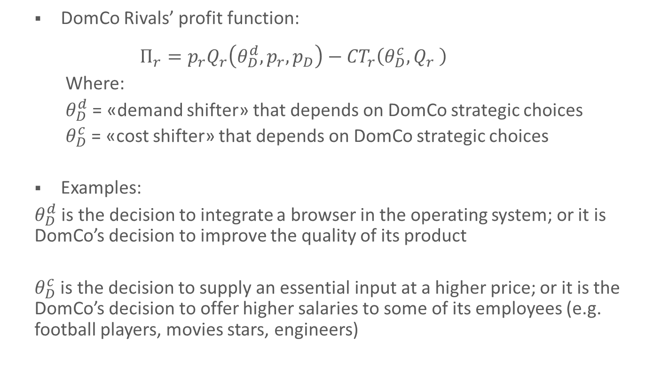
Foreclosure: general representation
DomCo Rivals’ profit function:
  $$Π_{r}=p_{r}Q_{r}\left(θ_{D}^{d},p_{r},p_{D}\right)−{CT}_{r}\left(θ_{D}^{c},Q_{r} \right)$$
  Where:
  $θ_{D}^{d}$ = «demand shifter» that depends on DomCo strategic choices
  $θ_{D}^{c}$ = «cost shifter» that depends on DomCo strategic choices
Examples:
$θ_{D}^{d}$ is the decision to integrate a browser in the operating system; or it is DomCo’s decision to improve the quality of its product
$θ_{D}^{c}$ is the decision to supply an essential input at a higher price; or it is the DomCo’s decision to offer higher salaries to some of its employees (e.g. football players, movies stars, engineers)

Slide 3
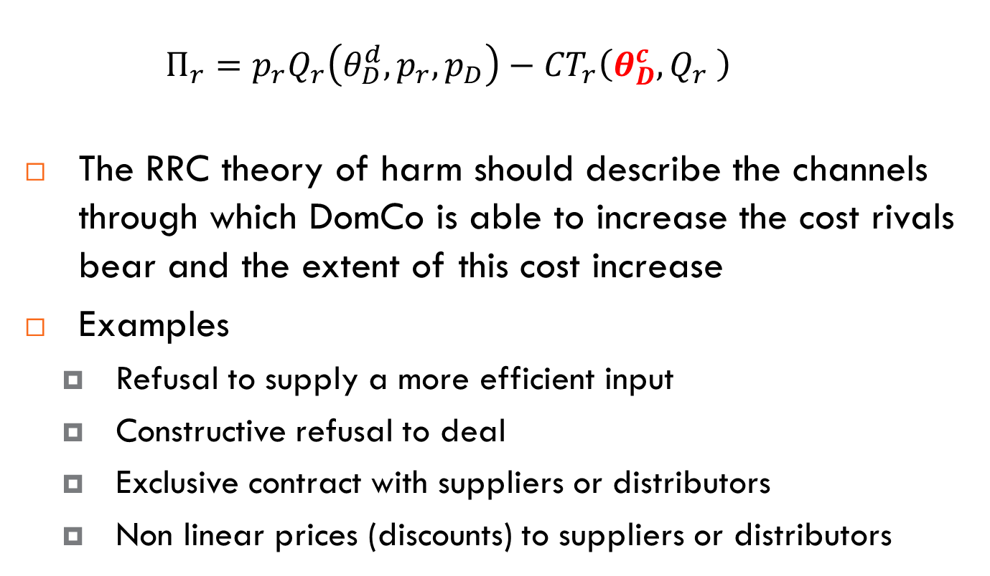
Raising Rivals’ Costs
  $$Π_{r}=p_{r}Q_{r}\left(θ_{D}^{d},p_{r},p_{D}\right)−{CT}_{r}\left(θ_{D}^{c},Q_{r} \right)$$
The RRC theory of harm should describe the channels through which DomCo is able to increase the cost rivals bear and the extent of this cost increase
Examples
  Refusal to supply a more efficient input
  Constructive refusal to deal
  Exclusive contract with suppliers or distributors
  Non linear prices (discounts) to suppliers or distributors

Slide 4
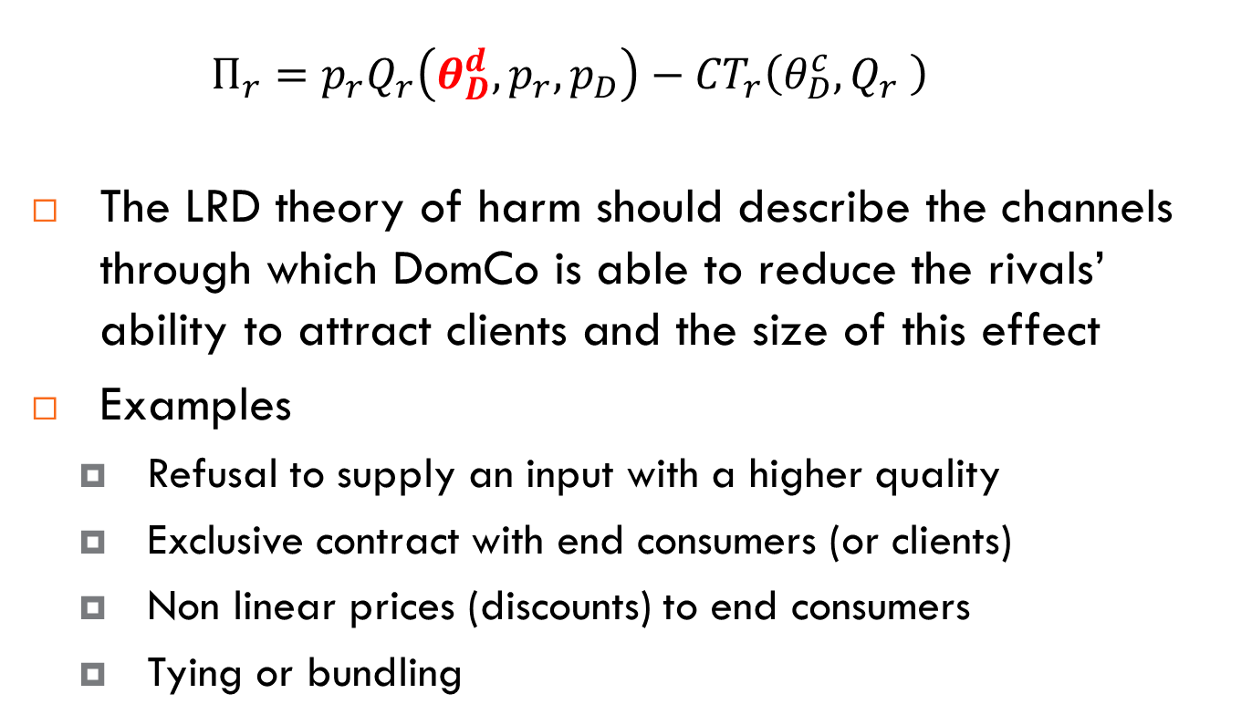
Lowering Rivals’ Demand
  $$Π_{r}=p_{r}Q_{r}\left(θ_{D}^{d},p_{r},p_{D}\right)−{CT}_{r}\left(θ_{D}^{c},Q_{r} \right)$$
The LRD theory of harm should describe the channels through which DomCo is able to reduce the rivals’ ability to attract clients and the size of this effect
Examples
  Refusal to supply an input with a higher quality
  Exclusive contract with end consumers (or clients)
  Non linear prices (discounts) to end consumers
  Tying or bundling

Slide 5
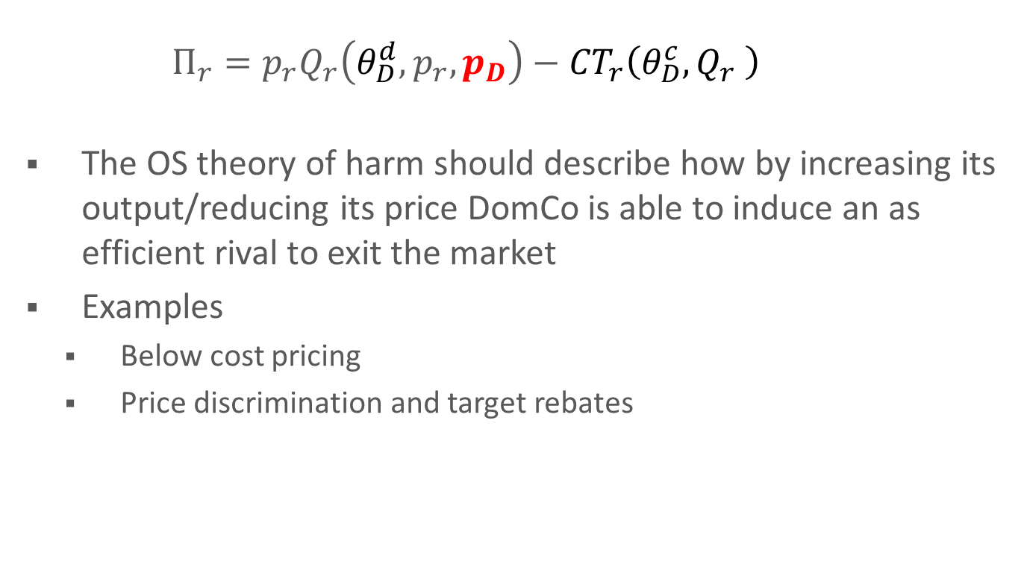
Output strategies
  $$Π_{r}=p_{r}Q_{r}\left(θ_{D}^{d},p_{r},p_{D}\right)−{CT}_{r}\left(θ_{D}^{c},Q_{r} \right)$$
The OS theory of harm should describe how by increasing its output/reducing its price DomCo is able to induce an as efficient rival to exit the market
Examples
  Below cost pricing
  Price discrimination and target rebates

Slide 6
Predatory pricing
Exclusionary practices: deter entry or forcing exit of a rival
Possible violation of Art. 102 TFEU
Difficult to identify – not easily distinguished from competitive actions that benefit consumers

Slide 7
Deep Pocket Theory
The main explanation of predation has been “Deep Pocket” predation:
  A dominant firm may drive out a small firm with a price-war causing losses to both, but the small one has not the financial resources to resist a price-war (a “small pocket”)
This only considers firms ability… what about the incentive?

Slide 8
McGee (1958) criticisms
Due to its larger market share a large firm will suffer greater losses than a small one
Predation is rational only if the predator raises prices, after the prey exits from the market but the small firm can re-enter after the price increase or sell the assets to another firm becoming a new rival
If the small firm could obtain funding from banks, predation cannot be successful and anticipating the result the incumbent will avoid it
Predation is inefficient as it destroys profits, better to merge with the rival to preserve high profits

Slide 9
Counterarguments
The incumbent can price-discriminate and decrease price only in those markets where the small firm is competing, the predator can preserve high margin on most units and reduce the cost of predation
Enter-Exit-Re-entering can imply sunk costs
Capital markets are imperfect, predation affects the risk of lending money reducing financial resources available
Merger is not an alternative: a)New competitors will be attracted by the perspective of being bought; b)Antitrust laws may not allow the merger; c) Predation and mergers are not mutually exclusive options

Slide 10
Entry game
If information is perfect a predatory conduct is not rational
A dominant firm does not have an incentive to fight entry once this is occurred
The only sub-game perfect equilibrium of the entry game is (Entry, Accommodate if Entry)
Entrant
Entry
Out
Dom
Fight
Accommodate
0,4
0,0
2,2

Slide 11
The chain-store paradox (Selten, 1978)
Entry game repeated N times, in N separate markets. The incumbent is the same in every market (it is a chain store) while each entrant is a separate firm. The incumbent cares about the sum of its payoffs across all N markets, while each entrant cares only about their payoff in that market
We might think that we can create a “tough-guy” reputation by fighting early entrants in order to deter entry in later markets
But this strategy unravels. Consider the Nth market. The only rational strategy in that market is to accommodate, because there are no future entrants to deter. Knowing this, the entrant in the Nth market will enter. So, there is no point in fighting in the N-1th market, because we know that the N-market entrant will enter anyway. So, the N-1 entrant will enter
We can use this logic recursively all the way back to the initial market. The unique subgame perfect Nash equilibrium is for all entrants to enter and to be accommodated

Slide 12
Post-Chicago theories of predation
Imperfect information
  Reputation
    The incumbent may be “strong” or ”weak”
    If the incumbent fights entry, the entrant updates his belief about the incumbent’s type and increases the probability that he attaches to the incumbent being “strong”
  Signalling
    Fighting is a costly strategy that only a “strong” incumbent can afford
    By fighting the incumbent signals his type

Slide 13
The sacrifice test
The dominant firm is deliberately incurring losses or foregoing profits in the short term (referred to hereafter as ‘sacrifice’), so as to foreclose one or more of its actual or potential competitors with a view to strengthening or maintaining its market power

Slide 14
Price/cost test
Price above ATC (or LRIC) lawful
Price below AVC (or AAC) unlawful
Price between AVC and ATC (or between AAC or LRIC) lawful unless there is convincing evidence of an exclusionary intent

Slide 15
Efficiency justifications for below-cost pricing
A firm may price below cost to:
  compensate for switching costs,
  reach a critical mass of consumers if network externalities exist
  achieve economies of scale or move along the learning curves
  sell complementarity products
Remember: a decision to lower the price can improve allocative efficiency

Slide 16
Essential facility and refusal to deal
Two complementary markets
  Upstream and downstream
Examples
  Network industries
  IPRs (patents, copyrights)

Slide 17
When is a facility essential?
An input is indispensable where there is no actual or potential substitute on which competitors in the downstream market could rely so as to counter – at least in the long term - the negative consequences of the refusal
Duplicability of the input
  Technical
  Economic

Slide 18
Chicago’s critique: single monopoly profit
A monopolist in the upstream market cannot increase its profit by monopolizing the downstream market
A simple model
  Downstream demand Q = 1 – p
  Upstream market monopolized, Domco sets w, the unit price of the input; 1 unit of the input is required to produce 1 unit of output
  Betrand competition in the downstream market

Slide 19
Chicago’s critique: single monopoly profit
Equilibrium in the downstream market is p = w
Upstream demand is Q = 1 – w
The monopolist maximizes its profits setting w = (1+c)/2
Monopolist profits are (1-c)²/4
If the upstream monopolist monopolizes the downstream market it has to set p
Its profits are (p – c) (1 – p) and are mazimized for p = (1 + c)/2
Hence its profits are (1-c)²/4

Slide 20
Post-Chicago’s theories
Defensive exclusion: the objective of the exclusionary conduct is not to extend market power in the downstream market but to allow the Domco to exert or defend its market power in the upstream market
  Example: the Microsoft case
Offensive exclusion: if products are not perfect complements, extending market power in the downstream market may be profitable

