Slide 1
Human Rights and European Citizenship
European Institutions, Law and Markets
Agnese Colucci
agnese.colucci@students.uniroma2.eu
*Material produced exclusively for educational reasons and not on behalf of my employer. All rights are reserved.

Slide 2
The values of the European Union
Art. 2 TUE
The Union is founded on the values of respect for human dignity, freedom, democracy, equality, the rule of law and respect for human rights, including the rights of persons belonging to minorities. These values are common to the Member States in a society in which pluralism, non-discrimination, tolerance, justice, solidarity and equality between women and men prevail.

Slide 3
Three sources of European human rights: art. 6 TEU
1. The Union recognises the rights, freedoms and principles set out in the Charter of Fundamental Rights of the European Union of 7 December 2000, as adapted at Strasbourg, on 12 December 2007, which shall have the same legal value as the Treaties.
The provisions of the Charter shall not extend in any way the competences of the Union as defined in the Treaties.
The rights, freedoms and principles in the Charter shall be interpreted in accordance with the general provisions in Title VII of the Charter governing its interpretation and application and with due regard to the explanations referred to in the Charter, that set out the sources of those provisions.
2. The Union shall accede to the European Convention for the Protection of Human Rights and Fundamental Freedoms. Such accession shall not affect the Union's competences as defined in the Treaties.
3. Fundamental rights, as guaranteed by the European Convention for the Protection of Human Rights and Fundamental Freedoms and as they result from the constitutional traditions common to the Member States, shall constitute general principles of the Union's law.

Slide 4
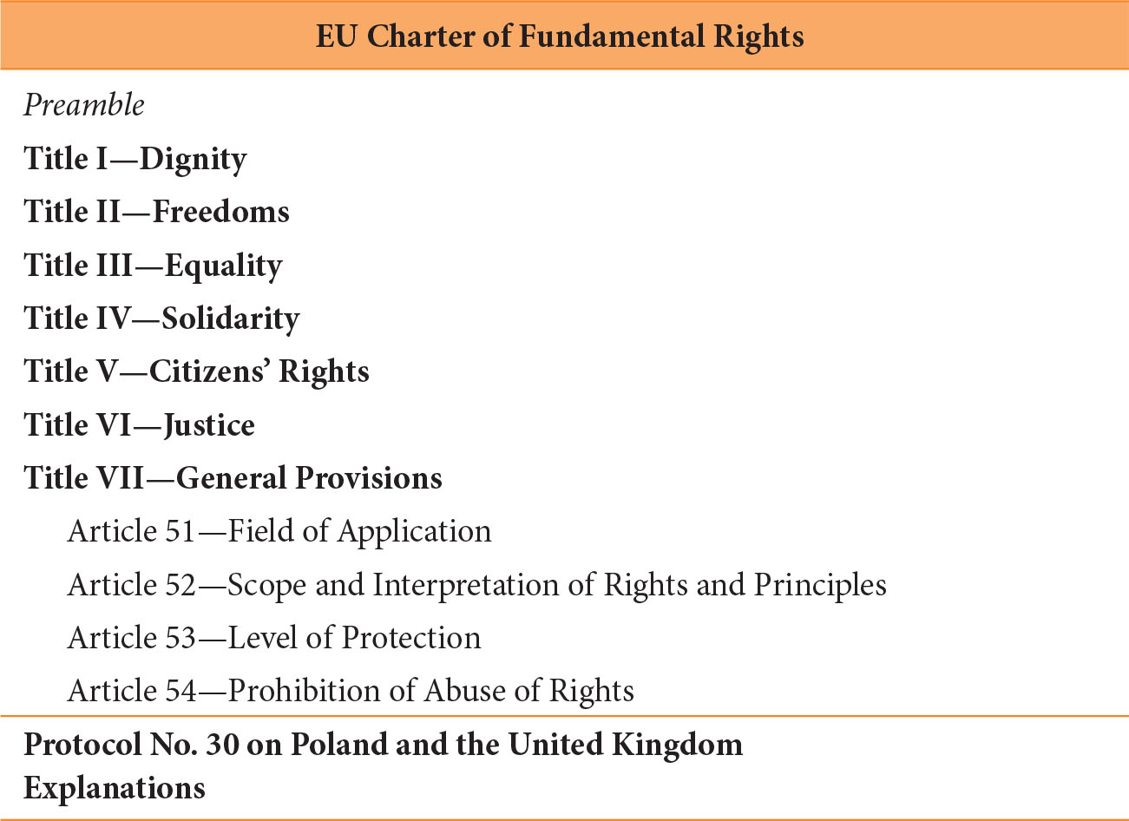
The structure of the Charter of Fundamental Rights of the European Union

Slide 5
The EU citizenship: introduction
Union citizenship is a legal institution granted to EU citizens independently of any economic activity. In contrast, the four classical fundamental freedoms are linked to economic activity and therefore are not accessible to all Union citizens. The concept of Union citizenship was introduced into the treaties with the Maastricht Treaty; the earlier European Economic Community (EEC) focused solely on economic rights. Union citizenship is intended to symbolically emphasize the shift from economic integration toward political integration.
Article 25 of the Treaty on the Functioning of the European Union (TFEU) explicitly provides for the further development of Union citizenship, thereby paving the way for deeper integration.

Slide 6
Union Citizenship Rights in the EU
Foundations and Legal Framework
The legal basis is found in:
Articles 18–25 TFEU (non-discrimination and citizenship)
Articles 39–46 CFR (citizens’ rights)
Article 20(2) TFEU lists key rights: free movement and residence, voting rights, consular protection, petition, contact the Ombudsman, communicate with Union institutions

Slide 7
Two pillars define Union citizenship rights:
1) Freedom of movement (Art. 21 TFEU, Art. 45 CFR) and Non-discrimination based on nationality (Art. 18 TFEU, Art. 21 CFR)
2) Political and participatory rights (Art. 10(2) TEU, art. 10(3) TEU, Art. 14(3) TEU, Artt. 22 and 223 TFEU, Artt. 39 and 40 CFR, Art. 24(2) and 227 TFEU, Art. 44 CFR, Art. 11(4) TEU, Art. 24(1) TFEU)
+
Subsidiary right of Union citizens to receive protection abroad in third countries. This right entitles them to be treated by the diplomatic and consular authorities of other Member States as if they were nationals of those states (Article 23 TFEU, Article 46 CFR).

Slide 8
Union citizenship rights are the individual legal embodiment of the principle of democracy
Art. 9 TEU
In all its activities, the Union shall observe the principle of the equality of its citizens, who shall receive equal attention from its institutions, bodies, offices and agencies. Every national of a Member State shall be a citizen of the Union. Citizenship of the Union shall be additional to and not replace national citizenship.

Slide 9
Universal rights
In addition to Union citizenship rights in the narrower sense, primary law also grants rights that, as universal rights, are not exclusively limited to Union citizens.
These general civic rights—or Union citizenship rights in a broader sense—include in particular the broadly defined right to good administration (Article 41 CFR), including the right to correspond in one of the treaty languages (Article 24(4) TFEU, Article 41(4) CFR), the right of access to documents (Article 15 TFEU, Article 42 CFR), and the right to lodge complaints with the European Ombudsman (Article 228 TFEU, Article 43 CFR).

Slide 10
Status and Exclusivity
Union citizenship is a complementary status to national citizenship (Art. 9 TEU, Art. 20 TFEU). It is reserved for nationals of Member States, with nationality determined by national law but subject to EU constraints—especially regarding withdrawal of citizenship, which must respect proportionality.

Slide 11
GRZELCZYK (C-184/99)
“Union citizenship is destined to be the fundamental status of nationals of the Member States, enabling those who find themselves in the same situation to enjoy the same treatment in law irrespective of their nationality, subject to such exceptions as are expressly provided for.”

Slide 12
RUIZ ZAMBRANO (C-34/09 )
“Article 20 TFEU precludes national measures which have the effect of depriving citizens of the Union of the genuine enjoyment of the substance of the rights conferred by virtue of their status as citizens of the Union.”

Slide 13
COMMISSION V. MALTA (C-181/23 )
“It is clear from the Court’s settled case-law that the bedrock of the bond of nationality of a Member State is formed by the special relationship of solidarity and good faith between that State and its nationals and the reciprocity of rights and duties.”
“Transactional naturalisation, which is granted in exchange for predetermined payments or investments, is not only contrary to the principle of sincere cooperation, but is also liable, by its nature, to call into question the mutual trust which underlies that requirement of recognition, since that trust relates to the premiss that the grant of the nationality of a Member State must be based on a special relationship of solidarity and good faith justifying the grant of rights resulting, in particular, from Union citizenship.”

