Slide 1
ECONOMICS FOR BUSINESS (MICROECONOMICS)
Lesson 2
Prof. Paolo Buccirossi

Slide 2
Table of Contents
Perfect competition in the short run
Perfect competition in the long run
Competition and welfare

Slide 3
Perfect Competition
Characteristic # 1. Large Number of Buyers and Sellers
  If the sellers in a market are small and numerous, no single firm can raise or lower the market price.
Characteristic # 2. Identical (Homogeneous) Products
  Buyers perceive firms sell identical or homogeneous products. Granny Smith apples are identical, all farmers charge the same price.
Characteristic # 3. Full Information
  Buyers know the prices charged by all firms and that products are identical. No single firm can unilaterally raise its price above the market equilibrium price.

Slide 4
Perfect Competition
Characteristic # 4. Negligible Transaction Costs
  Buyers and sellers do not have to spend much time and money finding each other or hiring lawyers to write contracts to make a trade.
  Perfectly competitive markets have very low transaction costs.
Characteristic # 5. Free Entry and Exit
  The ability of firms to enter and exit a market freely in the long run leads to a large number of firms in a market and promotes price taking.

Slide 5
Competition in the Short-Run
How Much to Produce
  Reminder: to maximize profit find q where MR(q)=MC(q)
  A competitive firm has a horizontal demand, so MR=p
  A profit-maximizing competitive firm produces the amount of output, q, at which p=MC(q)

Slide 6
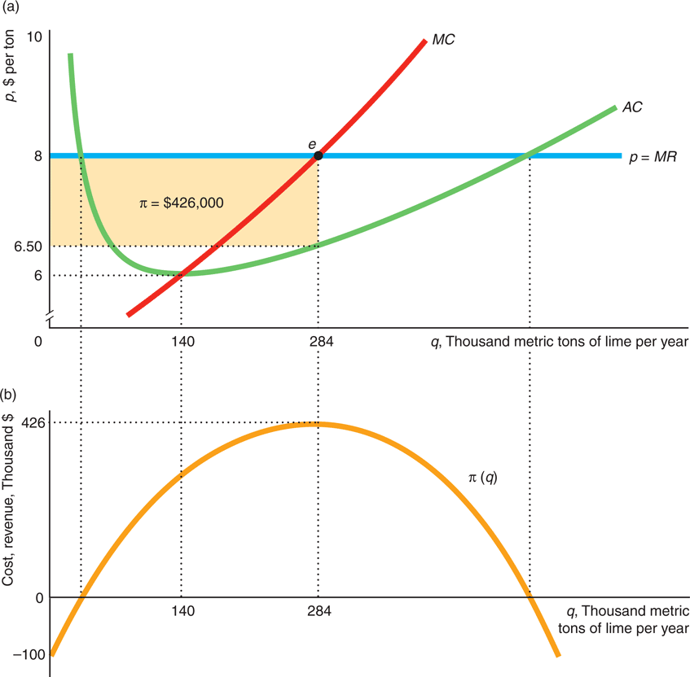
Competition in the Short-Run
  The market price is p = $8 (horizontal demand). The MC curve crosses the horizontal demand curve at point e where the firm’s output is 284 units.
  The π = $426,000, shaded rectangle in panel a. Panel b shows that this is the maximum profit.

Slide 7
Competition in the Short-Run
Whether to Produce
  Shutdown rule: R < VC
  Shutdown rule for a competitive firm: p < AVC = VC/q

Slide 8
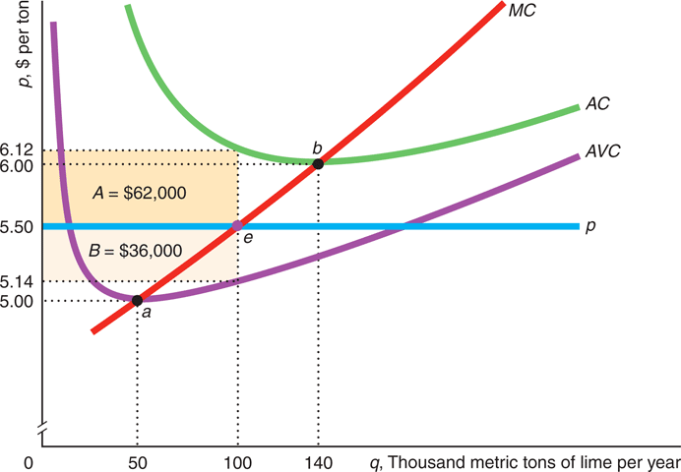
Competition in the Short-Run
  Graphical Presentation of Shutdown Decision
  Price above AC: price above b, positive profit.
  Price between min AVC and min AC: the competitive firm still operates if price is between a and b.
  Price below min AVC: the competitive firm shuts down if market price is below a

Slide 9
Competition in the Short-Run
Short-Run Firm Supply Curve
  A competitive firm chooses its output to maximize profit or minimize losses when p = MC(q).

Slide 10
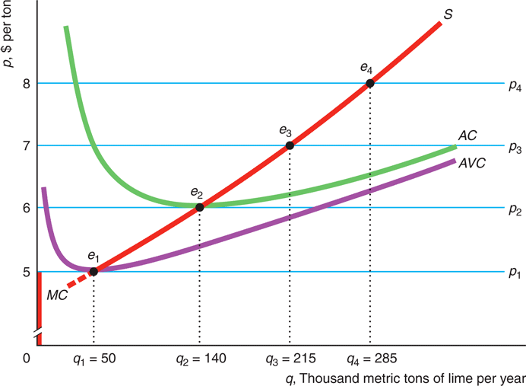
Competition in the Short-Run
  Graphical Presentation
  In Figure the market price increases from p1 = $5 to p2 = $6 to p3 = $7 to p4 = $8. The respective profit-maximizing outputs are e1 through e4.
  As the market price increases, the equilibria trace out the marginal cost curve.
  Competitive firm’s short-run supply curve: marginal cost curve above its minimum average variable cost (red line)

Slide 11
Competition in the Short-Run
The Short-Run Market Supply Curve
  Market supply curve: horizontal sum of the supply curves of all the individual firms in the market.
Graphical Presentation
  In the short run, the maximum number of firms in a market, n, is fixed. In panel a of Figure , there is one firm and in panel b, there are 4 firms identical to the one in panel a.
  If all firms are identical, each firm’s costs are identical, supply curves are identical. The market supply at any price is n times the supply of an individual firm. In panel b of Figure , S⁵ is the market supply of 4 identical firms.

Slide 12
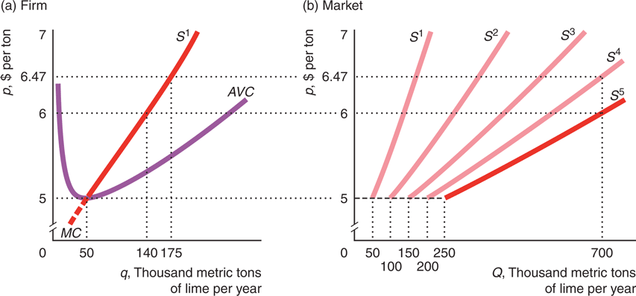
Competition in the Short-Run
Short-Run Market Supply with Five Identical Lime Firms

Slide 13
Competition in the Short-Run
Short-Run Competitive Equilibrium
  By combining the short-run market supply curve and the market demand curve, we can determine the short-run competitive equilibrium.
Graphical Presentation
  Suppose that there are five identical firms in the industry. Panel a of the next Figure shows the short-run cost curves and the supply curve, S¹, for a typical firm, and panel b shows the corresponding short-run competitive market supply curve, S.
  If the market demand curve is D¹, then the short-run equilibrium is E₁, the market price is 7, and market output is Q₁ = 1.075 units (panel a). Each firm takes the market price, maximizes profit at e₁, and no firm wants to change its behavior, so e₁ is the firm’s equilibrium.
  If the demand curve shifts to D², the market equilibrium is p = 5 and Q₂ = 250 units (panel a). At that price, each firm produces q = 50 units and loses 98,500, area A + C. However, they do not shut down.

Slide 14
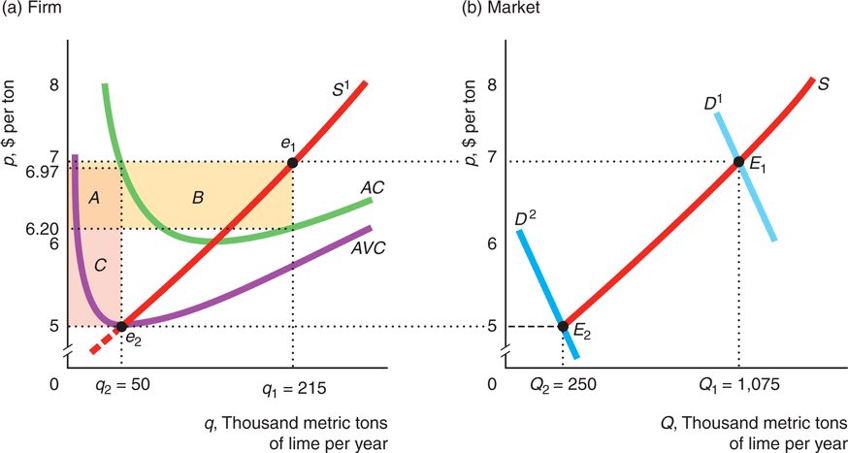
Competition in the Short-Run
Short-Run Competitive Equilibrium

Slide 15
Competition in the Long-Run
Long-Run Competitive Profit Maximization
  Objective: Firms want to maximize long run profit and all costs are variable or avoidable.
Decision 1: How Much to Produce
  To maximize profit or minimize a loss, firm operates where long-run marginal profit is zero―where MR (price) equals long-run MC.
Decision 2: Whether to Produce
  After determining the output level, q*, the firm shuts down if its revenue is less than its avoidable cost (all costs). So, it shuts down if it would make an economic loss by operating.

Slide 16
Competition in the Long-Run
The Long-Run Firm Supply Curve
  The competitive market supply curve is the horizontal sum of the supply curves of the individual firms.
  However in the long run, firms can enter or leave the market.
  Thus, before the horizontal sum, we need to determine how many firms are in the market at each possible market price.
Free Entry and Exit
  In the long run, each firm decides whether to enter or exit depending on whether it can make a long-run profit.
  In perfectly competitive markets, firms can enter and exit freely in the long run.
  A shift of the market demand curve to the right attracts firms to enter the market (π > 0) until the last firm to enter makes zero long run profit.
  A shift of the market demand curve to the left forces firms to exit the market (π < 0) until the last firm to exit makes zero long run profit.

Slide 17
Competition in the Long-Run
Long-Run Market Supply: Identical Firms & Free Entry
  The long-run market supply curve is flat at the minimum of long-run average cost if firms can freely enter and exit the market, an unlimited number of firms have identical costs, and input prices are constant.
Graphical Presentation
  In the following Figure, panel a, the individual supply starts at the minimum long run average cost ($10) and each firm produces 150 units. The market supply curve is horizontal at $10 (panel b), n firms will produce 150n units.

Slide 18
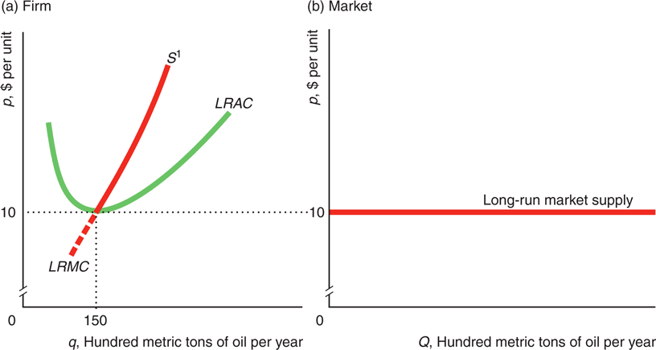
Competition in the Long-Run
Long-Run Firm and Market Supply with Identical Firms

Slide 19
Competition in the Long-Run
Long-Run Market Supply: Entry is Limited
  When entry is limited, long-run market supply curves slope upward (horizontal sum of few individual supply curves).
  The number of firms is limited because of government restrictions, resource scarcity, or high entry cost.
Long-Run Market Supply: Firms Differ
  When firms are not identical, long-run market supply curves slope upward.
  Firms with relatively low minimum long-run average costs are willing to enter the market at lower prices than others.
  Low cost firms cannot dominate the market because of their limited capacity.

Slide 20
Competition in the Long-Run
Long-Run Competitive Equilibrium
  Equilibrium at the intersection of the long-run market supply and demand curves
  With identical firms, constant input prices, free entry/exit: equilibrium price equals minimum long-run average cost.
  A shift in the demand curve affects only the equilibrium quantity and not the equilibrium price.
Short-Run and Long-Run Equilibrium Comparison
  In the short run, if the demand is as low as D¹, the market price in the short-run equilibrium, F₁, is $7 (Figure 8.8). At that price, individual firms lose money and some exit in the long run. In the long-run equilibrium, E₁, price is $10, and each firm produces 150 units, e, and breaks even.
  If demand expands to D², in the short run, firms make profits at F₂. These profits attract entry in the long run, quantity increase and price falls, E_{2.}

Slide 21
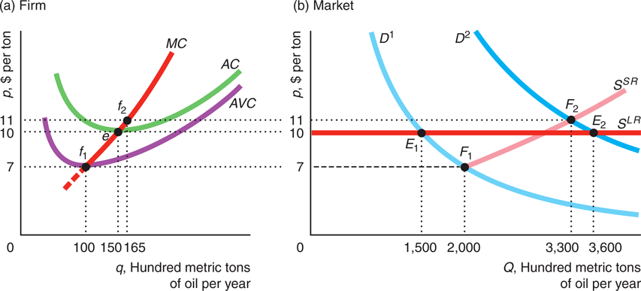
Long Run Competitive Equilibrium
The Short-Run and Long-Run Equilibria

Slide 22
Competition in the Long-Run
The long-run supply curve is horizontal if firms are free to enter the market, firms have identical cost, and input prices are constant. All firms in the market are operating at minimum long-run average cost (cost efficient).
That is, they are indifferent between shutting down or not because they are earning zero economic profit
Any firm that does not maximize profit loses money. So, to survive in a competitive market in the long run, a firm must maximize its profit (P=MC and be cost efficient).

Slide 23
Competition & Economic Welfare
Measures of Welfare
Consumer Surplus
CS
Producer Surplus
PS
Total Surplus
CS + PS = TS
Consumer Surplus (CS), monetary difference between what a consumer is willing to pay for the quantity of the good purchased and what the consumer actually pays.
Producer Surplus(PS), monetary difference between the amount a good sells for (Revenue) and the minimum amount necessary for the producers to be willing to produce the good.
Total Surplus (TS), monetary measure of the total benefit to all market participants from market transactions (gains from trade). Total surplus implicitly weights the gains to consumers and producers equally.

Slide 24
Competition & Economic Welfare
Consumer Surplus
  The demand curve reflects a consumer’s marginal willingness to pay: the maximum amount a consumer will spend for an extra unit (marginal value for the last unit).
Graphical Presentation
  Graphically, the consumer surplus is the area below the demand curve and above the market price up to the quantity actually consumed.
  In the next Figure, panel a, the consumer surplus from the 1st, 2nd and 3rd magazines is $3 ($2+$1+$0).
  In panel b, the consumer surplus, CS, is the area under the demand curve and above the horizontal line at the price p₁ up to the quantity he buys, q₁.

Slide 25
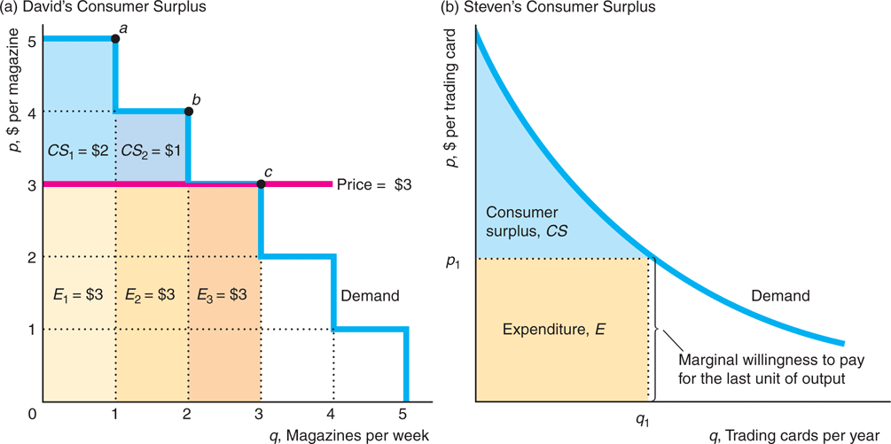
Competition & Economic Welfare
Consumer Surplus

Slide 26
Competition & Economic Welfare
Producer Surplus
  By definition, the total producer surplus is the area above the supply curve and below the market price up to the quantity actually produced.
Graphical Presentation
  The firm’s producer surplus in panel a of the next Figure is the area below the market price, $4, and above the marginal cost (supply curve) up to the quantity sold, 4. The area under the marginal cost curve up to the number of units actually produced is the variable cost of production
  The market producer surplus in panel b is the area above the supply curve and below the market price, p*, line up to the quantity sold, Q*. The area below the supply curve and to the left of the quantity produced by the market, Q*, is the variable cost.

Slide 27
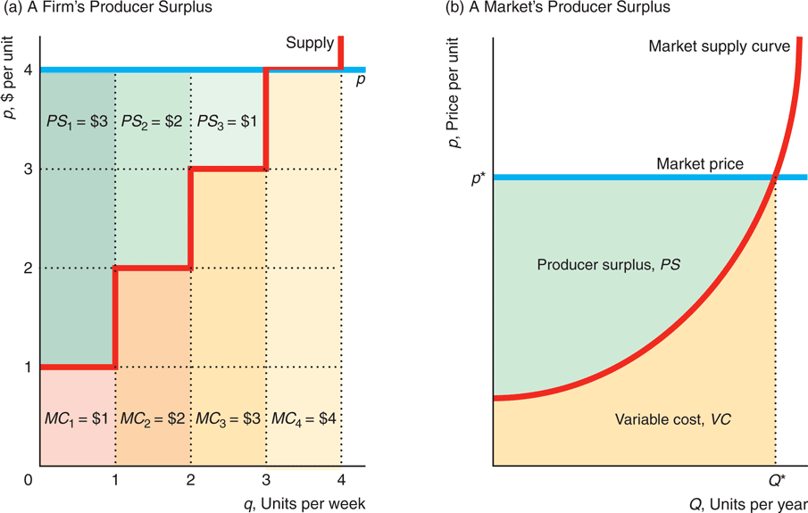
Competition & Economic Welfare
Producer Surplus

Slide 28
Competition & Economic Welfare
Competition Maximizes Total Surplus
  By definition, total surplus is the sum of the areas of CS and PS.
  Perfect competition maximizes total surplus. Producing less or more than the competitive output lowers total surplus.

Slide 29
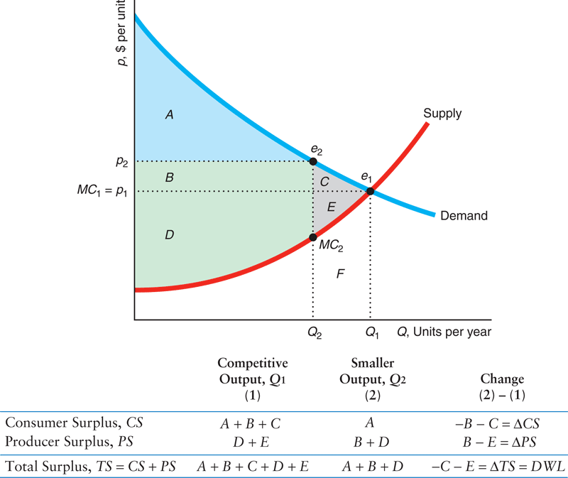
Competition & Economic Welfare
  At the competitive equilibrium e₁, with Q₁ and p₁, TS₁ = A + B + C + D + E.
  Producing less at e₂, Q₂ and p₂, TS₂ = A + B + D. TS₂< TS₁.
  As a consequence of producing less, C + E are lost.
  C + E is the deadweight loss (DWL)

Slide 30
Competition & Economic Welfare
Deadweight Loss (DWL)
  DWL is the net reduction in total surplus from a loss of surplus by one group that is not offset by a gain to another group from an action that alters a market equilibrium.
Graphical Presentation
  The deadweight loss results because consumers value extra output by more than the marginal cost of producing it. Between Q₂ and Q₁ in Figure 8.12, consumers value the extra output by C + E more than it costs to produce it.
  Society would be better off producing and consuming extra units of this good than spending this amount on other goods.

