Slide 1
ECONOMICS FOR BUSINESS (MICROECONOMICS)
Lesson 3
Prof. Paolo Buccirossi

Slide 2
Table of Contents
Monopoly Profit Maximization
Market Power
Market Failure & Monopoly Pricing
Price discrimination

Slide 3
Monopoly Profit Maximization
Marginal Revenue: MR = ΔR/Δq
  A firm’s marginal revenue, MR, is the change in its revenue from selling one more unit.
Marginal Revenue and Price
  A competitive firm that faces a horizontal demand and Δq=1, can sell more without reducing price. So, MR = ΔR = B = p₁
Marginal Revenue and Downward Demand
  A monopoly that faces a downward-sloping market demand and Δq=1, can sell more if price goes down. So, MR = ΔR = R₂-R₁ = B-C = p₂ - C

Slide 4
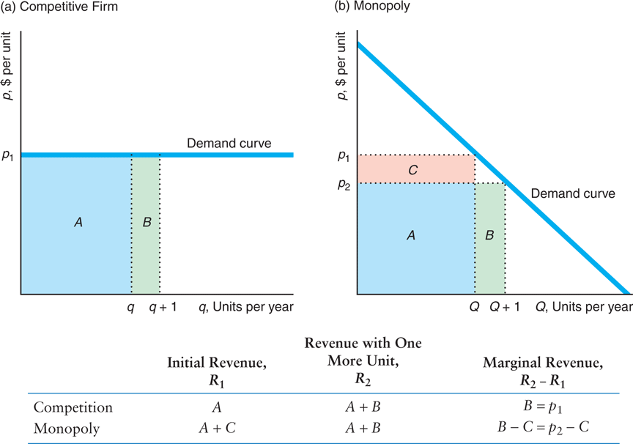
Monopoly Profit Maximization
Average and Marginal Revenue

Slide 5
Monopoly Profit Maximization
MR Curve for a Linear Demand
  The MR curve is a straight line that starts at the same point on the vertical (price) axis as the demand curve but has twice the slope. In the next Figure , the demand and MR curves have slopes –1 and -2, respectively.
MR Function: MR = p + (Δq/ΔQ) Q
  The monopolist MR function is lower than p because the last term is negative.
  When inverse demand p = 24 – Q, MR = 24 – 2Q
MR Function with Calculus: MR(Q)=dR(Q)/dQ
  When inverse demand p = 24 – Q, R(Q) = (24 – Q)Q = 24Q – Q², MR(Q)=24 – 2Q

Slide 6
Monopoly Profit Maximization
MR & Price Elasticity of Demand
  The MR at any given quantity depends on the demand curve’s height (the price) and shape.
  The shape of the demand curve at a particular quantity is described by the price elasticity of demand, ε = (∆Q/Q)/(∆p/p) < 0 (percentage change in quantity demanded after a 1% change in price).
MR & Elasticity Relationship: MR = p (1 + 1/ε)
  This key relationship says MR is closer to price as demand becomes more elastic.
  Where the demand elasticity is unitary, ε = –1, MR is zero.
  Where the demand curve is inelastic, –1 < ε ≤ 0, MR is negative.
  Where the demand cure is perfectly elastic, ε = -∞, MR is p.

Slide 7
Monopoly Profit Maximization
Choosing Price or Quantity
  Any firm maximizes profit where its marginal revenue and marginal cost are equal.
  Rule for monopoly maximization: MR(Q)=MC(Q)
  A monopoly can adjust its price or its quantity to maximize profit.
Monopolist Sets One, Market Decides the Other
  Whether the monopoly sets its price or its quantity, the other variable is determined by the downward sloping market demand curve.
  The monopoly faces a trade-off between a higher price and a lower quantity or a lower price and a higher quantity.
Either Maximize Profit
  Setting price or quantity are equivalent for a monopoly. We will assume it sets quantity.

Slide 8
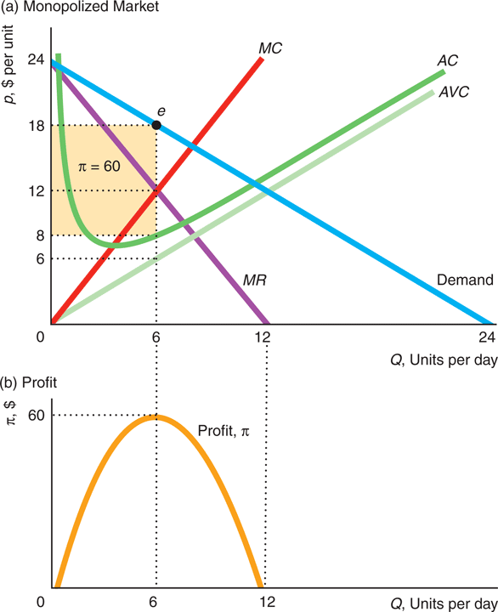
Monopoly Profit Maximization
1st Step: Output Decision
  Profit is maximized where marginal profit equals zero, or MR(Q)=MC(Q)
  In panel a, this occurs at point e, Q=6, p=18, π=60. This is the maximum profit in panel b.
  At quantities smaller than 6 units, the monopoly’s MR > MC, so its marginal profit is positive. By increasing its output, it raises its profit.
  At quantities greater than 6 units, the monopoly’s MC > MR, so its marginal profit is negative. By reducing its output, it raises its profit.
  A monopoly’s profit is maximized in the elastic portion of the demand curve. In panel a of Figure , the elasticity of demand at point e is –3.
  A profit-maximizing monopoly never operates in the inelastic portion of its demand curve

Slide 9
Monopoly Profit Maximization
2nd Step: Shutdown Decision
  A monopoly shuts down to avoid making a loss in the short run if its price is below its average variable cost at its profit-maximizing (or loss minimizing) quantity.
  The previous Figure illustrates a short run case. At the profit-maximizing output, the average variable is less than the price (Q=6, AVC = 6, p = 18). So, the monopoly chooses to produce and it makes a positive profit (p > AC).
  In the long run, the monopoly shuts down if the price is less than its average cost.

Slide 10
Market Power
Market Power & the Shape of the Demand Curve
  If the monopoly faces a very inelastic demand curve (steep) at the profit-maximizing quantity, it would lose few sales if it raises its price.
  However, if the demand curve is very elastic (flat) at that quantity, the monopoly would lose substantial sales from raising its price by the same amount.
Profit-Maximizing Price: p = [1/(1+1/ε)] MC
  The monopoly’s profit-maximizing price is a ratio times the marginal cost and the ratio depends on the elasticity.
  If ε = -1.01, only slightly elastic, the ratio is 101 and p = 101 MC
  If ε = -3, more elastic, the ratio is only 1.5 and p = 1.5 MC
  If ε = - ∞, perfectly elastic, the ratio shrinks to 1 and p = MC

Slide 11
Market Power
The Lerner Index or Price Markup: (p - MC)/p
  The Lerner Index measures a firm’s market power: the larger the difference between price and marginal cost, the larger the Lerner Index.
  This index can be calculated for any firm, whether or not the firm is a monopoly.
Lerner Index and Elasticity: (p – MC)/p = - 1/ε
  The Lerner Index or price markup for a monopoly ranges between 0 and 1.
  If ε = -1.01, only slightly elastic, the monopoly markup is 0.99 (99%)
  If ε = -3, more elastic, the monopoly markup is 0.33 (33%)
  If ε = - ∞, perfectly elastic, the monopoly markup is zero

Slide 12
Market Power
Sources of Market Power
  Availability of substitutes, number of firms and proximity of competitors determine market power.
Less Power with …
  Less power with better substitutes: When better substitutes are introduced into the market, the demand becomes more elastic (Xerox pioneered plain-paper copy machines until …)
  Less power with more firms: When more firms enter the market, people have more choices, the demand becomes more elastic (USPS after FedEx and UPS entered the market).
  Less power with closer competitors: When firms that provide the same service locate closer to this firm, the demand becomes more elastic (Wendy’s, Burger King, and McDonald’s close to each other).

Slide 13
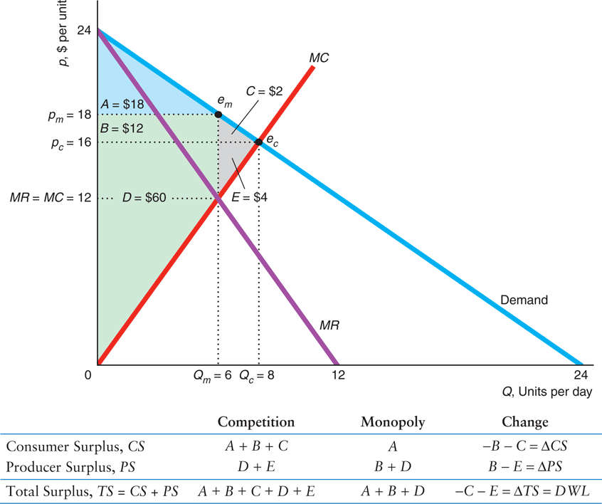
Market Failure & Monopoly Pricing
Monopoly and DWL
  Market Failure: non-optimal allocation of goods & services with economic inefficiencies (price is not marginal cost)
  A monopoly sets p > MC causing consumers to buy less than the competitive level of the good. So society suffers a deadweight loss.
  In Figure 9.5, the monopolist’s maximizing q and p are 6 and $18. The competitive values would be 8 and $16.
  The deadweight loss of monopoly is –C – E. Potential surplus that is wasted because less than the competitive output is produced.
Deadweight Loss of Monopoly

Slide 14
Price Discrimination
1st Condition, A Firm Must Have Market Power
  A monopoly, an oligopoly, or a monopolistically competitive firm might be able to price discriminate. A perfectly competitive firm cannot.
2nd Condition, A Firm Must Identify Groups with Different Price Sensitivity
  If consumers have different demands, a firm must identify how they differ.
  Disneyland knows tourists and local residents differ in their willingness to pay and use driver licenses to identify them.
3rd Condition, A Firm Must Prevent Resale
  If resale is easy, price discrimination doesn’t work because of only low-price sales.
  The biggest obstacle to price discrimination is a firm’s inability to prevent resale.

Slide 15
Price Discrimination
Type 1, Perfect Price Discrimination
  The firm sells each unit at the maximum amount any customer is willing to pay.
  Price differs across consumers, and may differ too for a given consumer.
Type 2, Group Price Discrimination
  The firm charges each group of customers a different price, but it does not charge different prices within the group.
Type 3, Nonlinear Price Discrimination
  The firm charges a different price for large purchases than for small quantities so that the price paid varies according to the quantity purchased.

Slide 16
Perfect Price Discrimination
How a Firm Perfectly Price Discriminates
  A firm with market power that can prevent resale and has full information about its customers’ willingness to pay price discriminates by selling each unit at its reservation price—the maximum amount any consumer would pay for it.
  The maximum price for any unit of output is given by the height of the demand curve at that output level.
Perfectly Price Discrimination: Price = MR
  A perfectly price-discriminating firm’s marginal revenue is the same as its price.
  So, the firm’s marginal revenue curve is the same as its demand curve

Slide 17
Perfect Price Discrimination
Efficient But Consumer Surplus Equal to Zero
  Perfect price discrimination is efficient: It maximizes the sum of consumer surplus and producer surplus.
  But, all the surplus goes to the firm, consumer surplus is zero.
  In the next Figure at the competitive market equilibrium, e_{c}, consumer surplus is A + B + C and producer surplus is D + E. At the perfect price discrimination equilibrium, Qd=Qc, no deadweight loss occurs, all surplus goes to the monopoly.
  Consumer surplus is greatest with competition, lower with single-price monopoly, and eliminated by perfect price discrimination

Slide 18
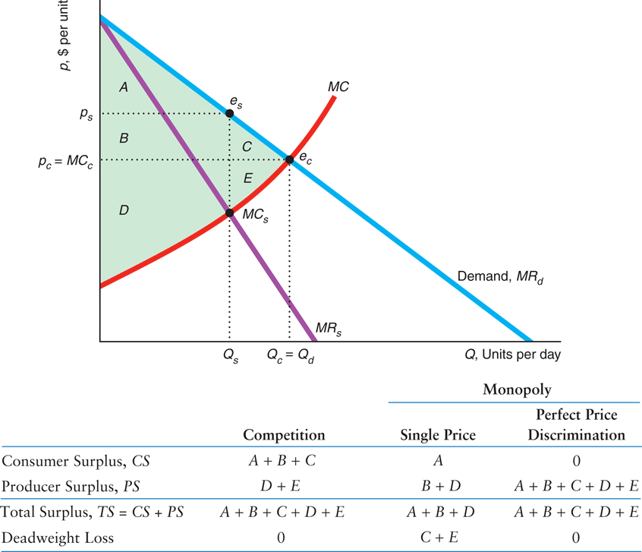
Perfect Price Discrimination
Competitive, Single-Price, and Perfect Price Discrimination Outcomes

Slide 19
Perfect Price Discrimination
Individual Price Discrimination
  Perfect price discrimination is rarely fully achieved in practice.
  Firms can still increase profits with imperfect individual price discrimination: charge individual-specific prices to different consumers, which may or may not be the consumers’ reservation prices.
Transaction Costs and Price Discrimination
  It is often too difficult or costly to gather information about each customer’s reservation price for each unit of the product (high transaction costs).
  However, recent advances in computer technologies have lowered these transaction costs.

Slide 20
Group Price Discrimination
Conditions for Group Price Discrimination
  Group price discrimination: potential customers are divided into two or more groups with different prices for each group (single price within a group).
  Consumer groups may differ by age, location, or in other ways.
  A firm must have market power, be able to identify groups with different reservation prices, and prevent resale.

Slide 21
Group Price Discrimination
Two Group Price Discrimination and Elasticities
  We know MR^{A} = m = MR^{B}
  We also know from that MR = p (1 + 1/ε)
  So, MR^{A} = p_{A} (1 + 1/ε_{A}) = m = p_{B} (1 + 1/ε_{B}) = MR^{B}
Implication: p_{B} / p_{A} = (1 + 1/ε_{A}) / (1 + 1/ε_{B})
  The ratio of prices depend on the elasticity values in these two markets.

Slide 22
Group Price Discrimination
Identifying Groups: Divide Buyers Based on Observable Characteristics
  The firm believes observable characteristics are associated with unusually high or low reservation prices or demand elasticities.
  Movie theaters price discriminate using the age of customers. Higher prices for adults than for children.
Identifying Groups: Divide Buyers Based on Their Actions
  Allow consumers to self-select the group to which they belong depending on their opportunity cost of time.
  Customers may be identified by their willingness to spend time to buy a good at a lower price or to order goods and services in advance of delivery.

Slide 23
Nonlinear Price Discrimination
Characteristics and Conditions
  Many firms, with market power and no resale, are unable to determine high reservation prices. However, such firms know a typical customer’s demand curve is downward sloping.
  Such a firm can price discriminate by letting the price each customer pays vary with the number of units the customer buys (nonlinear price discrimination).
Block Pricing vs. Single Price
  A firm charges one price per unit for the first block purchased and a different price per unit for subsequent blocks. Used by gas, electric, water, and other utilities.
  In panel a of next Figure the firm charges a price of $70 on any quantity between 1 and 20— 1st block—and $50 for the 2nd block. In panel b, the firm can set only a single price of $30. When block pricing consumer surplus is lower, total surplus is higher and deadweight loss is lower. The firm and society are better off but consumers lose.
  The more block prices that a firm can set, the closer the firm gets to perfect price discrimination.

Slide 24
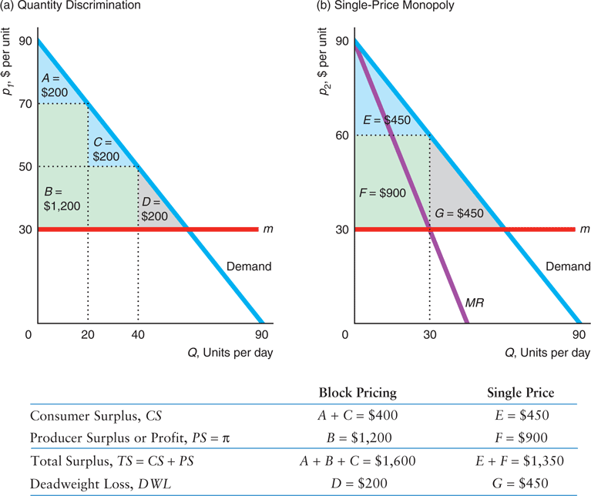
Nonlinear Price Discrimination
Block Pricing

Slide 25
Two-Part Pricing
Characteristics and Conditions
  Two-part pricing: a firm charges each consumer a lump-sum access fee for the right to buy as many units of the good as the consumer wants at a per-unit price.
  A consumer’s overall expenditure for amount q consists of two parts: an access fee, A, and a per-unit price, p. Therefore, expenditure is E = A + pq.
  To do it, a firm must have market power, know how individual demand curves vary across its customers, and prevent resale.
Two Part Pricing with Identical Consumers
  With identical customers, a firm can set a two-part price that is efficient (p = MC) and all total surplus goes to the firm (CS = 0).
  In panel a of next Figure the monopoly charges a per-unit fee price, p, equal to the marginal cost of 10, and an access fee, A = 2,450 = CS. The firm’s total profit is 2,450 times the number of identical customers.
  If the firm were to charge a price above its marginal cost of 10, it would sell fewer units and make a smaller profit. For instance, p = 20 in panel b.

Slide 26
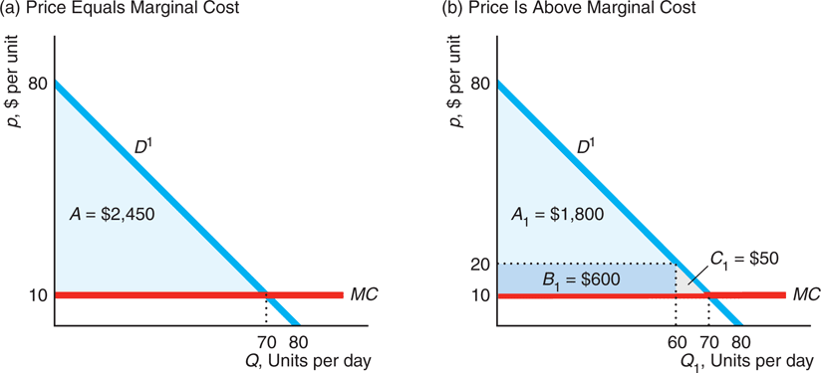
Two-Part Pricing
Two-Part Pricing with Identical Consumers

