Slide 1
ECONOMICS FOR BUSINESS (MICROECONOMICS)
Lesson 4
Prof. Paolo Buccirossi

Slide 2
Table of Contents
Price discrimination
Bundling
Advertising
Bargaining

Slide 3
Two-Part Pricing
Two-Part Pricing with Different Consumers
  Two-part pricing is more complex if consumers have different demand curves.
  Having two different demands implies consumers have different consumer surpluses. Two-part pricing would require the monopolist to charge different access fees, and this may not be possible.
Example
  In the next Figure, the monopoly faces two consumers. Valerie’s demand curve is D¹ in panel a, and Neal’s demand curve is D² in panel b.
  If the monopoly can charge different prices, it sets price for both customers at p = MC = 10 and access fee of 2,450 to Valerie and 4,050 to Neal. π = 6,500
  If the monopoly cannot charge its customers different access fees, it sets its per-unit price at p = 20, where Valerie purchases 60 and Neal buys 80 units. It charges both the same access fee of 1,800 = A₁ , which is Valerie’s CS. π = 5,000

Slide 4
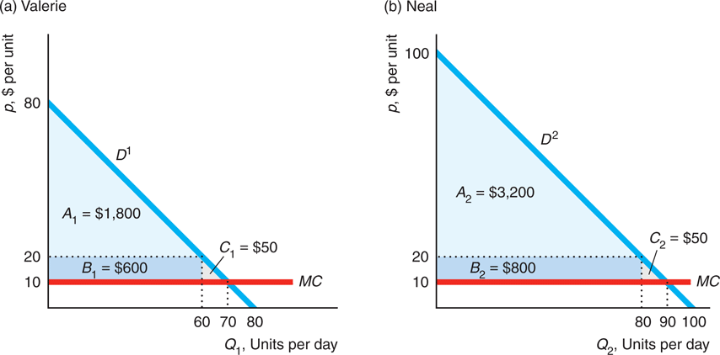
Two-Part Pricing
Two-Part Pricing with Different Consumers

Slide 5
Bundling
Bundling and Types of Bundling
  Firms with market power often pursue a pricing strategy called bundling: selling multiple goods or services for a single price.
  Most goods are bundles of many separate parts. However, firms sometimes bundle even when there are no production advantages and transaction costs are small.
  Bundling allows firms to increase their profit by charging different prices to different consumers based on the consumers’ willingness to pay.
  Some firms engage in pure bundling: only a package deal is offered (a cable company sells a bundle of Internet, phone, and television for a single price, no service separately)
  Other firms use mixed bundling: goods are available as a package or separately.

Slide 6
Bundling
Pure Bundling
  Microsoft Works is a pure bundle. Word and Excel programs are not sold individually but only as part of the bundle Works.
  Whether it pays for Microsoft to sell a bundle or sell the programs separately depends on how reservation prices for the components vary across customers.
  Bundling increases profits if reservation prices are negatively correlated and it reduces profits it they are positively correlated.
  We assume the marginal cost of producing an extra copy of either type of software is essentially zero; fixed cost is negligible so that the firm’s revenue equals its profit; the firm must charge all customers the same price—it cannot price discriminate.

Slide 7
Bundling
Profitable Pure Bundling: Reservation Prices Negatively Correlated
  Table 10.2 shows the reservation prices for two customers and two products.
  The reservation prices are negatively correlated: the customer who has the higher reservation price for one product has the lower reservation price for the other product.
  If the firm sells the two products separately, it maximizes its profit by charging $90 for the word processor and selling it to both consumers, and selling the spreadsheet program for $50 to both consumers. The firm’s total profit from selling the programs separately is $280 (= $180 + $100).
  If the firm sells the two products in a bundle, it maximizes its profit by charging 160, selling to both customers, and earning $320. Pure bundling is more profitable.
  Pure bundling is more profitable because the firm captures more of the consumers’ potential consumer surplus—their reservation prices.

Slide 8
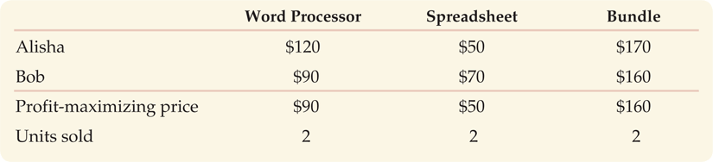
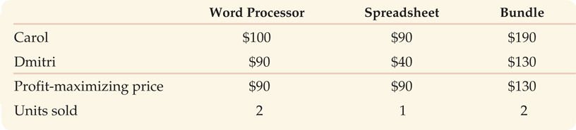
Bundling
Tables 10.2 Negatively Correlated Reservation Prices
Table 10.3 Positively Correlated Reservation Prices

Slide 9
Bundling
Non-Profitable Pure Bundling: Reservation Prices Positive Correlated
  Table 10.3 shows the reservation prices for two customers and two products.
  The reservation prices are positively correlated: a higher reservation price for one product is associated with a higher reservation price for the other product.
  If the programs are sold separately, the firm charges $90 for the word processor, sells to both consumers, and earns $180. However, it makes more charging $90 for the spreadsheet program and selling it only to Carol. The firm’s total profit if it prices separately is $270 (= $180 + $90).
  If the firm uses pure bundling, it maximizes its profit by charging $130 for the bundle, selling to both customers, and making $260.
  Because the firm earns more selling the programs separately, $270, than when it bundles them, $260, pure bundling is not profitable in this example. As long as reservation prices are positively correlated, pure bundling cannot increase the profit.

Slide 10
Bundling
Mixed Bundling
  Under mixed bundling, consumers are allowed to buy the pure bundle or to buy any of the bundle’s components separately.
  Table 10.4 shows the reservation prices of four potential customers for two products.
  Aaron, a writer, places high value on the word processing program but has relatively little use for a spreadsheet. Dorothy, an accountant, has the opposite pattern of preferences. Brigitte and Charles have intermediate reservation prices that are negatively correlated.
  If the firm prices each program separately, it maximizes its profit by charging $90 for each product and selling each to three customers. It earns $540 total.
  If the firm engage in pure bundling, it can charge $150 for the bundle, sell to all four consumers, and earns $600 total.
  If the firm does mixed bundling, it can charge $160 for the bundle to two consumers and $120 for each product separately to the other two consumers. It earns $640 total.

Slide 11
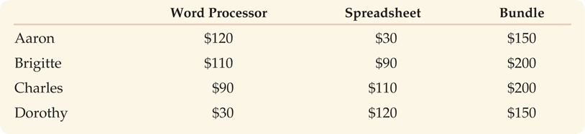
Bundling
Table 10.4 Reservation Prices and Mixed Bundling

Slide 12
Bundling
Requirement Tie-In Sales
  Requirement tie in sales is another form of bundling: requires customers who buy one product from a firm to make all concurrent and subsequent purchases of a related product from that firm.
  This requirement allows the firm to identify heavier users and charge them more per unit.
Example
  If a printer manufacturer can require that consumers buy their ink cartridges only from the manufacturer, then that firm can capture most of the consumers’ surplus.
  Heavy users of the printer, who presumably have a less elastic demand for it, pay the firm more than light users because of the high cost of the ink cartridges.
  Printer firms such as Hewlett-Packard (HP) write their warranties to strongly encourage consumers to use only their cartridges and not to refill them.

Slide 13
Advertising
Advertising and Net Profit
  A successful advertising campaign shifts the monopolist market demand curve outward and makes it less elastic. In the next Figure, D₂ is to the right and less elastic than D₁.
Deciding Whether to Advertise
  Do it only if firm expects net profit (gross profit minus the cost of advertising) to increase. In the Figure, gross profit is B.
How Much to Advertise
  Do it until its marginal benefit (gross profit or marginal revenue) equals its marginal cost

Slide 14
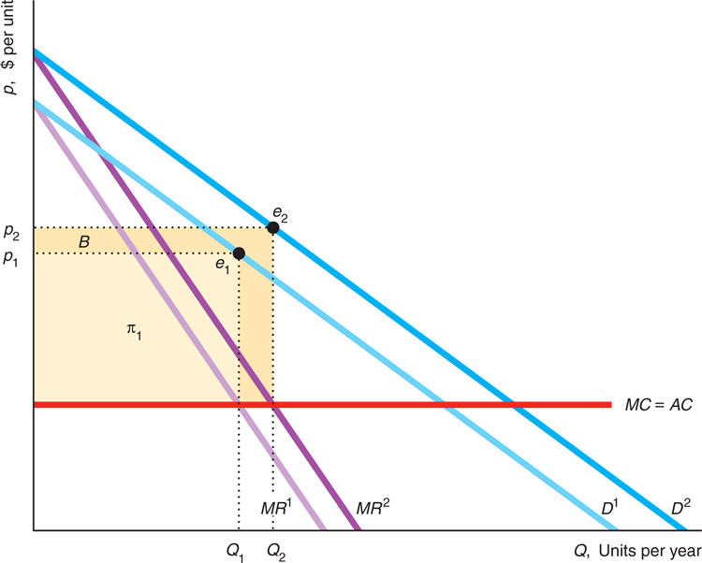
Advertising

Slide 15
Advertising
Using Calculus: π (Q,A) = R (Q,A) – C (Q) - A
  Profit is revenue minus cost. Advertising, A, is a fixed cost and affects revenue, R, R(Q, A) = p(Q, A)Q. The monopoly maximizes its profit by choosing Q and A.
First Order Condition: ∂π (Q,A) / ∂Q = 0
  ∂R (Q,A) /∂Q – ∂C (Q) /∂Q = 0
  The monopoly should set its output so that MR = MC
First Order Condition: ∂π (Q,A) / ∂A = 0
  ∂R (Q,A) /∂A – 1 = 0
  The monopoly should advertise to the point where its marginal revenue or marginal benefit from the last unit of advertising, ∂R/∂A, equals the marginal cost of the last unit of advertising, $1.

Slide 16
Bargaining
Bargaining Situations
  Bargaining is important in our personal lives.
  Bargaining is also common in business situations. Managers and employees bargain over wages and working conditions, firms bargain downstream with suppliers and bargain upstream with distributors.
Bargaining Games
  Bargaining game: any situation in which two or more parties with different interests or objectives negotiate voluntarily over the terms of some interaction, such as the transfer of a good from one party to another.
  For simplicity we will focus on two-person bargaining games
Bargaining Game Solution
  The solution for bargaining games is called Nash Bargaining Solution.

Slide 17
Bargaining
The Nash Bargaining Solution
  The Nash bargaining solution to a cooperative game is efficient in the sense that there is no alternative outcome that would be better for both parties or strictly better for one party and no worse for the other.
Case
  1 Buyer whose evaluation of the product is V
  1 Seller whose cost of production is C
  Buyer and Seller bargain over the price for 1 unit
  Disagreement points are D_{B} and D_{S}
Finding a Nash Bargaining Solution
  The Nash product, (NP) (CS - D_{B}) x (PS - D_{S}) = (V - P - D_{B}) x (P - C - D_{S})
  Find the value of P that maximizes NP; this is:
  P = (V+C)/2 + (D_{B} - D_{S})/2

Slide 18
Bargaining
Inefficiency in Bargaining
  The Nash bargaining solution presumes that the parties achieve an efficient outcome where neither party could be made better off without harming the other party.
  However in the real world, bargaining frequently yields inefficient outcomes.
Reasons for Inefficient Outcomes
  The bargaining process takes time, which delays the start of the benefit flow and therefore reduces the value of benefits overall, for instance a strike.
  Usually in a strike, negotiators fail to quickly reach an agreement due to bounded rationality or incomplete information about the other side’s payoffs. The parties do the best they can but are unable to determine the best possible strategies and therefore they make mistakes that are costly to both parties.

