Slide 1
ECONOMICS FOR BUSINESS (MICROECONOMICS)
Prof. Paolo Buccirossi
Lesson 6
Dott.ssa Alessia Marrazzo

Slide 2
Table of Contents
The oligopoly game
Dominant strategies
Nash Equilibrium
Multiple Nash Equilibria
Mixed strategy Equilibria

Slide 3
Introduction
Managerial Problem
When deciding how to price its products or how much to advertise, oligopolistic firms should take into account that their actions significantly affect each other’s profit (strategic interdependence). Firms’ actions will depend on how they think their rivals will act.
Solution Approach
Need to focus on game theory, a set of tools used to analyze strategic decision-making. In deciding how much to invest in advertising, firms take into account the safety investments of rivals.

Slide 4
Oligopoly game: definitions
A game is an interactions between players (firms)
A strategy specifies the actions that a player will make
The payoffs are the benefits (profits for firms) received by players from the game’s outcome. Players’ payoffs depends on the strategies chosen by all players
players choose the strategy that maximize their profits
Each game has rules, usually setting the timing of players’moves and the actions available
Games can be:
  Static or dynamic
  With complete or incomplete information
The game optimal solution is a Nash Equilibrium
Notes:
Today we focus on static games.
A static game is a single – period game in which players act only once and simultaneously (or at least they act without knowing rivals’actions). Example: simultaneous one time only decision on where to locate its new factory
Games are dynamic when players move either sequentially or repeatedly
We focus on games with complete information, a situation in which the strategies and payoffs of the games are common knowledge.
An example of games with incomplete information: firms do not know the demand and the cost functions of their rivals, hence they do not know the payoffs of their rivals

Slide 5
Oligopoly game: an example
Players and Rules
  Two players, American Airlines and United Airlines, play a static game (only once) to decide how many passengers per quarter to fly between Chicago and Los Angeles. Their objective is to maximize profit.
  Rules: Other than announcing their output levels simultaneously, firms cannot communicate (no side-deals or coordination allowed). Complete information (both firms know all strategies and corresponding payoffs for each firm)
Strategies
  Each firm’s strategy is to take one of the two actions, choosing either a low output (48 k passengers per quarter) or a high output (64 k).
Payoffs are described in the payoff matrix (next slide)
  The payoff matrix shows the profits for each of the four possible strategic output combinations that the firms may choose.

Slide 6
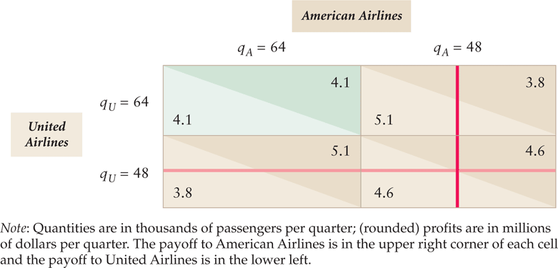
Oligopoly game: an example
Payoff Matrix or Profit Matrix:
How to read it: If American chooses high output (qA=64) and United low output (qU=48), American’s profit is $5.1 million and United’s $3.8 million.
* This is from your textbook: Table 12.1 Dominant Strategies in a Quantity Setting, Prisoners’ Dilemma Game

Slide 7
Dominant strategies (1/2)
Definition:
  If one is available, a rational player always uses a dominant strategy: a strategy that produces a higher payoff than any other strategy the player can use no matter what its rivals do.
Dominant Strategy for American and United
  If United chooses the high-output strategy (qU = 64), American’s high-output strategy maximizes its profit.
  If United chooses the low-output strategy (qU = 48), American’s high-output strategy maximizes its profit.
  Thus, the high-output strategy is American’s dominant strategy.
Dominant Strategy Solution in the American and United game
  Similarly, United’s high-output strategy is also a dominant strategy.
  Because the high-output strategy is a dominant strategy for both firms, we can predict the dominant strategy solution of this game is qA = qU = 64 (green cells)
Notes:
If American Airlines has a dominant strategy, then no action that United Airlines could take would make American prefer a different strategy. We hence draw a vertical red line through American’s low output cells.
Because both players have a dominant strategy, we can call the outcome a dominant strategy solution.

Slide 8
Dominant strategies (2/2)
Dominant Strategy Solution is not the Best Solution:
  A striking feature of this game is that the players choose strategies that do not maximize their joint or combined profit.
  In the American-United game, each firm could earn $4.6 million if each chose low output (q_{A} = q_{U} = 48) rather than the $4.1 million they actually earn by setting q_{A} = q_{U} = 64.
Prisoner’s Dilemma Game
  Prisoners’ dilemma game: all players have dominant strategies that lead to a payoff that is inferior to what they could achieve if they cooperated.
  Given that the players must act independently and simultaneously in this static game, their individual incentives cause them to choose strategies that do not maximize their joint profits.

Slide 9

Prisoner’s Dilemma game
It takes its name form a classic cops-and-robbers example.
The police arrests two suspect and put them in separate rooms so that they cannot talk to each other (cannot coordinate). The normal form representation can be depicted as a 2x2 table (where the first coordinate for each pair of payoffs corresponds to the row player)
The dominant strategy solution is for both to confess and get two years in jail (even though they would be better off, getting just one year in jail, if they both kept quiet)
Notes:
Both suspects are told the following policy:
If neither confesses then both will be convicted of a minor offense and sentenced to one month in jail.
If both confess then both will be sentenced to jail for six months.
If one confesses but the other does not, then the confessor will be released but the other will be sentenced to jail for nine months.

Slide 10
Nash Equilibrium: definitions
Best Responses
  Best response: the strategy that maximizes a player’s payoff given its beliefs about its rivals’ strategies
  A dominant strategy is a strategy that is a best response to all possible strategies that a rival might use. In the absence of a dominant strategy, each firm can determine its best response to any possible strategies chosen by its rivals
Strategy and Nash Equilibrium
  A set of strategies is a Nash equilibrium if, when all other players use these strategies, no player can obtain a higher payoff by choosing a different strategy
  A Nash equilibrium is self-enforcing: no player would want to deviate by choosing a different strategy → “given the strategies chosen by my rivals, I made the best possible choice”
A dominant strategy solution is a Nash Equilibrium
Notes:
Introduced by John Nash 1951
The Nash equilibrium is the primary solution concept used by economists and allow us to find solutions to more games than just those with a dominant strategy solution

Slide 11
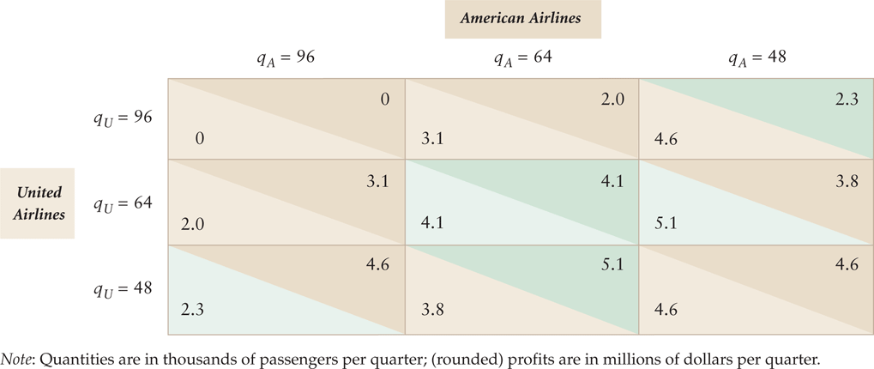
Nash Equilibrium: an example
Neither American nor United has a single, dominant strategy
How to solve it: First identify the best responses, dark and light green
* This is from your textbook: Table 12.2 Best Responses in a Quantity Setting, Prisoners’ Dilemma Game
Notes:
The Nash equilibrium is the pair of strategies where both firms are using a best-response strategy, so that neither firm would want to change its strategy (inly one cell have both the upper and lower triangles green) → qa=64 and qu=64
For instance at qa=qu=48, either firms could raise its profits by deviating to qa (or qu) =64

Slide 12
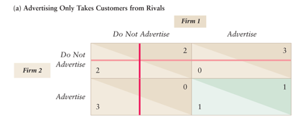
Failure to maximize joint profits (1/2)
Noncooperative firms may not reach the joint-profit maximizing outcome:
Two firms play an static game where a firm’s advertising does not bring new customers into the market but only has the effect of stealing business from the rival firm.
  → Solution does not maximize joint profits
* This is from your textbook: Table 12.3 Advertising Games: Prisoners’ Dilemma or Joint-Profit Maximizing
Outcome? (panel a)
Notes:
Firms decide simultaneously to ‘advertise’ or ‘do not advertise.’ Advertising is a dominant strategy for both firms (red lines). In the resulting dominant strategy solution and Nash equilibrium, each firm earns 1 but would make 2 if neither firm advertised. Solution does not maximize joint profits.
The red lines indicate the dominated strategies

Slide 13
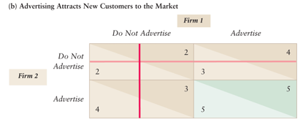
Failure to maximize joint profits (2/2)
Failure to maximize profits depends on the profit matrix
Two firms play a static game in which advertising by a firm brings new customers to the market and consequently helps both firms.
  → Solution does maximize joint profits
* This is from your textbook: Table 12.3 Advertising Games: Prisoners’ Dilemma or Joint-Profit Maximizing
Outcome? (panel b)
Notes:
Firms decide simultaneously to ‘advertise’ or ‘do not advertise.’ Advertising is a dominant strategy for both firms. In the resulting dominant strategy solution and Nash equilibrium, each firm earns 4. Solution does maximize joint profits.

Slide 14
Types of Nash Equilibria
Unique Nash Equilibrium
  All games played so far have a unique Nash equilibrium
  Bertrand and Cournot models
Multiple Nash Equilibria
  Many oligopoly games have more than one Nash equilibrium.
  To predict the likely outcome of multiple equilibria we may use additional criteria.
Mixed Strategy Nash Equilibria
  In the games we played so far, players were certain about what action to take at each rival’s decision (pure strategy).
  When players are not certain they use a mixed strategy: a rule telling the player how to randomly choose among possible pure strategies.

Slide 15
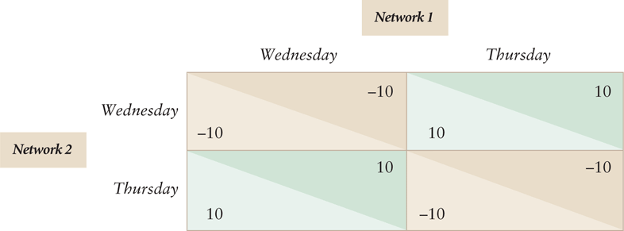
Multiple Nash Equilibria (1/2)
Two firms play a static game. Each firm chooses simultaneously & independently to schedule a show on Wed or Thu.
  → We predict the networks would schedule shows on different nights. But, we have no basis for forecasting which night each network will choose.
* This is from your textbook: Table 12.4 Network Scheduling: A Coordination Game
Notes:
If firms schedule it on different days, both earn 10. Otherwise, each loses 10 (the number of people who wathc reality shows is enough for only one show to be profitable on a given night)
Best Responses
Neither network has a dominant strategy. For each network, its best choice depends on the choice of its rival. If Network 1 opts for Wed, then Network 2 prefers Thu, but if Network 1 chooses Thu, then Network 2 prefers Wed. Best responses are colored green in Table 12.4.
Two Nash Equilibrium Solutions
The Nash equilibria are the two cells with both firms’ best responses (green cells)
These Nash equilibria have one firm broadcast on Wed and the other on Thu.
The red lines indicate the dominated strategies

Slide 16
Multiple Nash Equilibria (2/2)
Cheap Talk to Coordinate Which Nash Equilibrium
  Firms can engage in credible cheap talk if they communicate before the game and both have an incentive to be truthful (higher profits from coordination).
  If Network 1 announces in advance that it will broadcast on Wed, Network 2 will choose Thu and both networks will benefit. The game becomes a coordination game.
Pareto Criterion to Coordinate Which Nash Equilibria
  If cheap talk is not allowed or is not credible, it may be that one of the Nash equilibria provides a higher payoff to all players than the other Nash equilibria.
  If so, we expect firms acting independently to select a solution that is better for all parties (Pareto Criterion), even without communicating.
Notes:
The firms engage in cheap talk (or pre-play communication) if they communicate before the game starts but the communication does not affect the payoffs of the game – managers can say anything but, until decision are actually made, claims made by firms may lack credibility. Sometimes players have an incentive to be truthful so the cheap talk is credible.
Imagine the following variant of the game in the previous slides
Both firms receive higher profits if Network 1’s show airs on Thursday and Network 2 chooses Wed because of other programming in place on those nights.
Even without cheap talk, the networks might opt for the NE with the higher profits because each network expects its rival to have a similar understanding of the situation. Pareto criterion: selecting a solution that is better for all parties

Slide 17
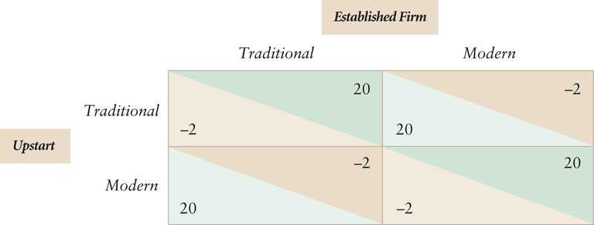
Mixed strategies (1/2)
Sometimes there’s no NE in pure strategies
Two firms compete for an architectural contract and simultaneously decide if their proposed designs are traditional or modern
  → Given the best responses, no cell in the table have both triangles green. For each cell, one firm or the other regrets their design choices.
* This is from your textbook: Table 12.6 Mixed Strategies in a Design Competition
Notes:
The payoff matrix is in Table 12.6. If both firms adopt the same design then the established firm wins in view of its stronger reputation and longer track record. However, if the firms adopt different designs, the upstart wins the contract.
In Table 12.6, the upstart’s best responses are a modern design if the established firm uses a traditional design, and a traditional design if the rival picks modern.
For the established firm, the best responses are a modern design if the upstart firm uses a modern design, and a traditional design if the rival picks traditional

Slide 18
Mixed strategies (2/2)
Mixed Strategy and Nash Equilibrium
  However this design game has a mixed-strategy Nash equilibrium in which each firm chooses a traditional design with probability ½,
  The established firm’s expected profit—the firm’s profit in each possible outcome times the probability of that outcome—is 9, the highest possible. The firm just flips a coin to chose between its two possible actions.
  Similarly, the upstart’s expected profit is 9 and flips a coin too.
Why would each firm use a mixed strategy of 1/2?
  Check if there exists a profitable deviation: if the upstart firm knows the established firm will choose traditional design with probability > ½ or 1, then the upstart picks modern for certain and wins the contract. So, it is best for the traditional firm to flip a coin (probability = ½).
Notes:
While a pure strategy specifies the action that a player will take in every possible situation, a mixed strategy specifies a set of pure strategies among which the player will choose according to a set of probabilities.
A pure strategy can be viewed as a special case of a mixed strategy in which a player assigns a probability of zero to all other possible pure strategies.

Slide 19
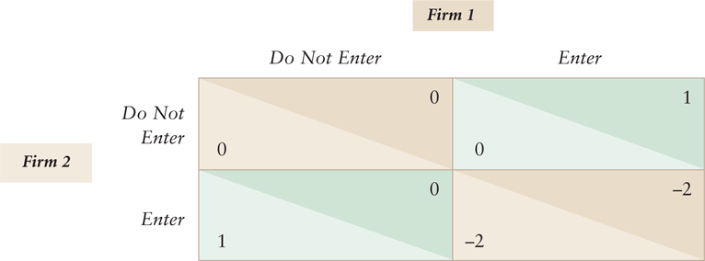
Entry game (1/2)
  Two firms are considering opening gas stations at the same location but only one station would operate profitably (small demand). If both firms enter, each loses 2.
  → There are three Nash Equilibria
* This is from your textbook: Table 12.7 Nash Equilibria in an Entry Game
Notes:
Neither firm has a dominant strategy. Each firm’s best action depends on what the other firm does. There are 3 Nash Equilibria.
Given that firm 2 did not enter, firm 1 would not regret its decision to enter, if it changed its behavior it would go from earning 1 to earning nothing. Similarly given firm 1 enters, firm 2 does not regret staying out because entering would have cost it 2

Slide 20
Entry game (2/2)
Pure Strategy Equilibria
  Two Nash Equilibria with pure strategies: Firm 1 enters and Firm 2 does not enter, or Firm 2 enters and Firm 1 does not enter.
  How do the players know which outcome will arise? They don’t know. Cheap talk is no help.
Mixed Strategy Equilibria
  One mixed-strategy Nash equilibrium: Each firm enters with probability 1/3.
  No firm could raise its expected profit by changing its strategy.

