Slide 1
ECONOMICS FOR BUSINESS (MICROECONOMICS)
Lesson 9
Prof. Paolo Buccirossi

Slide 2
Table of Contents
Mechanisms to create a collusive equilibrium
  MFNs, Parity rates (Across-Platform parity Agreement)
  Price matching guarantees
Foreclosing strategies
  Deterring entry through exclusive contracts
  Investing in cost reduction
  Raising rivals’ costs

Slide 3
APPAs: Definition
Agreement between a seller and an (electronic) trade platform whereby the seller undertakes to charge on that platform a price that is not higher than the price charged on other platforms (including new entrants or its own platform)

Slide 4
A famous interview
Question: “Why would someone buy a book from Apple for $14.99 if the same book was offered for $9.99 from Amazon?”
  Steve Jobs: “Well, that won’t be the case .... Prices will be the same”
  The contractual obligation to charge the same price on the two platforms was called MFN; since then this type of clause is referred to as retail-MFN
  The price on Apple is a function of the price charged on Amazon

Slide 5


Price Relationship Agreements
Price Relationship Agreement
p^{A}
p^{A} = f(p^{B}, p^{C}, …)
Where B, C,… are the same product as A or similar competing products

Slide 6
Across-customers price relationship agreements
A
John
Mario
The price charged by seller A to
John is a function of (it is the same as, it is not higher than…) the price charged to Mario

Slide 7
Across-sellers price relationship agreements
A
B
John
The price charged by seller A to
John is a function of (it is the same as, it is not higher than…) the price charged by seller B to John

Slide 8
Across-customers and across-sellers: examples
Company X represents and warrants to Company Y that the prices offered to Company Y under this Agreement are no less favourable than the prices offered to any other party purchasing or licensing similar quantities. (Most Favoured Customer Clause) (Across-Customers)
If you find a lower price on a new, identical item at another store, show us the lower price at the time of the purchase and we will match it on the spot, or show us the lower price within 14 days of your purchase and we will pay you the difference. (Price Matching Guarantee) (Across-Sellers)

Slide 9
Strategic effects of across-sellers PRAs
Firm A adopts a price-matching guarantee
Three questions:
  Does the PMG affect the behavior of A’s rivals?
  Does the PMG affect A’s behavior?
  Does the PMG affect consumers’ behavior?

Slide 10
Pricing decision 1: Monopoly
p
P*
P*
MC
D
MR
q

Slide 11
Pricing decision 2: Duopoly – Optimal price
p_{B}
P_{B}*
MC_{B}
RD_{B}(p_{A})
MR
q_{B}

Slide 12
Pricing decision 2: Duopoly – Residual demand curve
p_{B}
p_{A1} > p_{A2}
RD_{B}(p_{A2})
RD_{B}(p_{A1})
q_{B}

Slide 13
Pricing decision 2: Duopoly with a “price-matching guarantee”
Suppose firm A sets a price p_{A} and adopts a price-matching guarantee
How this strategy affects B’s residual demand curve (and therefore its optimal pricing decision)?

Slide 14
Pricing decision 2: Duopoly with a “price-matching guarantee”
p_{B}
If p_{B2} > p_{A}
If p_{B1} = p_{A}
If p_{B3} < p_{A}
RD_{B}
q_{B2}
q_{B1}
q_{B3}
q_{B3}
q_{B}

Slide 15
Pricing decision 2: Duopoly with a “price-matching guarantee”
p_{B}
The price-matching guarantee reduces B’s demand elasticity when B undercuts
B makes pricing decisions that are less aggressive
B sells a lower quantity
RD_{B}
q_{B}

Slide 16
Across-sellers and APPAs
Suppose A and B are two platforms and A adopts an APPA
B’s demand depends on the price that sellers set on B
If B undercuts A (lowers the platform fee) it would obtain a higher demand if sellers passed on the lower fee on B
An APPA prevents this pass-on
The APPA reduces B’s demand elasticity when B undercuts

Slide 17
Deterring Entry
Exclusive Contracts
  A mall has a single shoe store, the incumbent firm. The incumbent may pay the mall’s owner b to add a clause to its rental agreement that guarantees exclusivity. If b is paid, the landlord agrees to rent the remaining space only to a no-shoe firm.
  The game tree, Figure 13.2, shows the two stages of the game. In the 1st stage, the incumbent decides whether to pay b to prevent entry. In the 2nd stage, the potential rival decides whether to enter. If it enters, it incurs a fixed fee of F to build its store in the mall.
Backward Induction for Subgame Perfect Nash-Equilibrium
  Last decision made by potential rival in 2nd stage: to the right in Figure 13.2, the rival only plays one subgame. It enters if F ≤ 4 because π_{r} = 4 – F. Otherwise, stays out with π_{r} = 0.
  Decision made by incumbent in 1st stage knowing what potential rival will do in 2nd stage: to the left in next Figure, the incumbent has one subgame, but the decision to pay depends on the values of the exclusivity fee b and fixed cost F.

Slide 18
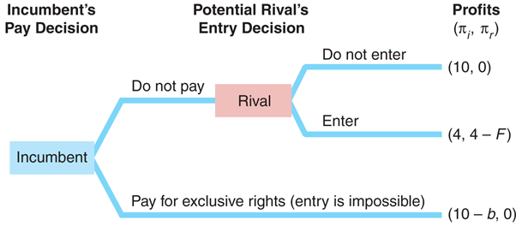
Deterring Entry
Paying to Prevent Entry

Slide 19
Deterring Entry
Three Possible Outcomes that Depend on b and F
  Blockaded entry (F > 4): Potential rival will stay out ensuring π_{r} = 0. So, the incumbent avoids paying b and still earns the monopoly profit, π_{i} = 10.
  Deterred entry (F ≤ 4, b ≤ 6): Potential rival will enter unless the incumbent pays the exclusivity fee. The incumbent chooses to pay b because b ≤ 6 ensures a profit at least as large as the duopoly profit of 4 (π_{i} = 10 – b ≥ 4).
  Accommodated entry (F ≤ 4, b > 6): Potential rival will enter to earn a positive profit of π_{r} = 4 – F. The incumbent does not pay the exclusivity fee because b is so high that it is better to ensure π_{i} = 4 than earn less (π_{i} = 10 – b < 4).
When to Pay the Exclusivity Fee?
  In short, the incumbent does not pay for an exclusive contract if the potential rival’s cost of entry is prohibitively high (F > 4) or if the cost of the exclusive contract is too high (b > 6).

Slide 20
Deterring Entry
Limit Pricing
  A firm is limit pricing if it sets its price (or, equivalently, its output) so that another firm cannot enter the market profitably.
  To successfully limit price, a firm must have an advantage over its rivals.
Limit Pricing Example
  An incumbent firm is making a large monopoly profit, which attracts the interest of a potential rival. The incumbent could announce that, after entry, it will charge a price so low that the other firm will make a loss.
  This threat is credible only if the incumbent has a cost advantage over its rival.
Predatory pricing
  Pricing below cost in the short run
  Price increase after the rival’s exit

Slide 21
Deterring Entry
Entry Deterrence in a Repeated Game
  A grocery chain with a monopoly in many small towns faces potential entry by other firms in some or all of these towns.
  Next figure shows the game in only one town. In the 1st stage, the rival decides to enter the town or not. In the 2nd stage, the incumbent decides between fighting with the rival (price war) or accommodating the rival.
Accommodation if Game Played only Once
  If this game is played only once and if the profits are common knowledge, then the only subgame perfect Nash equilibrium is for entry to occur and for the incumbent to accommodate entry.
Price War if Repeated and Incomplete Information
  If the chain’s profits are not common knowledge and the game will be played in many towns, the incumbent may want to fight back to build reputation.
  Fighting the first rival is part of a rational long-run strategy and can be part of a subgame perfect Nash equilibrium in which entry is successfully deterred.

Slide 22
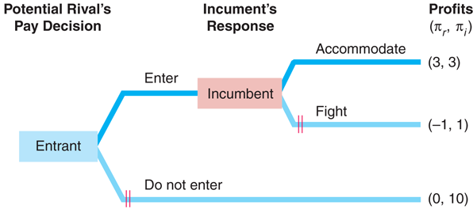
Deterring Entry
A Constituent Game of a Repeated Entry Game

Slide 23
Cost Strategies
Moving First
  A firm may be able to gain a cost advantage over a rival by moving first.
  We start by examining two cases.
Moving First and Own Marginal Cost
  A firm moves first to gain a marginal cost advantage over its rivals.
  It can lower its own marginal cost by using a capital investment.
Raising Rival’s Marginal Cost
  A firm moves first to increase the rivals’ marginal cost by more than its own.

Slide 24
Cost Strategies
Investing to Lower Marginal Cost
  A monopoly considers installing robots on its assembly line that would lower its MC. Under normal conditions, this investment does not pay (investment cost > extra profit). But, a rival threatens to enter the market.
  In next Figure ’s game tree, the incumbent decides whether to invest in the first stage and the potential rival decides whether to enter in the second stage.
Backward Induction
  First, rival decides entry decision in 2nd stage: rival plays two subgames and decides the best action for each subgame based on highest profit values π_{r}.
  Second, incumbent decides investment decision in 1st stage after rival decided in 2nd stage: incumbent plays one subgame and decides to invest (π_{i} = 8 > π_{i} = 4).
Subgame Perfect Nash Equilibrium
  The incumbent makes the ‘unprofitable’ investment to deter the entry of potential rivals and earns π_{i} = 8.

Slide 25
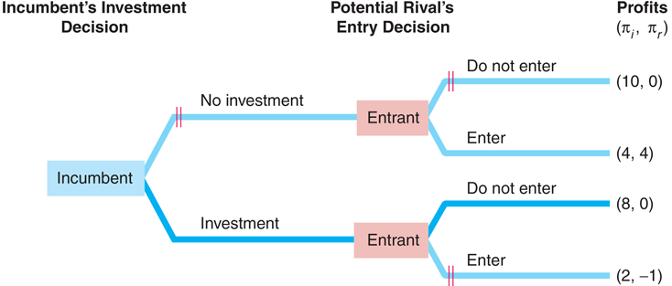
Cost Strategies
Investing to Prevent Entry

Slide 26
Cost Strategies
Raising Rival’s Costs
  A firm may benefit from using a strategy that raises its own cost but raises its rivals’ costs by more.
  Such strategies usually favor the first mover or incumbent against the rivals.
Strategies for Incumbents to Raise Rival’s Costs
  Lobby the government for more industry regulations that raise costs, as long as the legislation grandfathers existing firms’ plants (exemption).
  Increase the cost of switching by imposing a switching fee to customers that take their business elsewhere or designing products that don’t work with the rival’s.
  Use patents to prevent rivals entering the market and increasing competition.

