Slide 1
ECONOMICS FOR BUSINESS (MICROECONOMICS)
Lesson 8
Prof. Paolo Buccirossi
Alessia Marrazzo

Slide 2
Table of Contents
Dynamic games: definition
Repeated game: indefinite horizon
Repeated game: finite horizon
Sequential games
Subgame perfect Nash Equilibrium
Stackelberg oligopoly game

Slide 3
Introduction
We move from static games (firms play only once and simultaneously) to dynamic games
In a static game, each firm must choose its action before observing the rival’s action. Firms choose their best response given what they expect the rivals to do
In a dynamic game, firms’ strategy depends on the observed actions played by their rivals in the previous period
→ Given a game and its payoff matrix, the equilibrium arising with a static interaction may be different from the one prevailing with a dynamic interaction
Dynamic games can be repeated game or sequential games

Slide 4
Repeated Games
The static constituent game might be repeated a finite and pre-specified number of times, or repeated indefinitely
Indefinitely means that players do not anticipate a definite end point and each period they believe the game may be repeated in the next period
Firm choose form the same set of possible actions again and again
Difference between strategies and actions becomes relevant
Notes:
Strategies & Actions in Repeated Games
An action is a single move that a player makes at a specified time, such as choosing an output level or a price.
A strategy is a battle plan that specifies the full set of actions that a player will make throughout the game. It may involve actions that are conditional on prior actions of other players or on new information available at a given time. For example a firm could set a high price in the first period and then, in subsequent periods, it could set its price at the same level that its rival chose in the previous period.
In a static game, an action an a strategy are identical. The game lasts for only one period so the action taken in that period represent the full battle plan or strategy

Slide 5
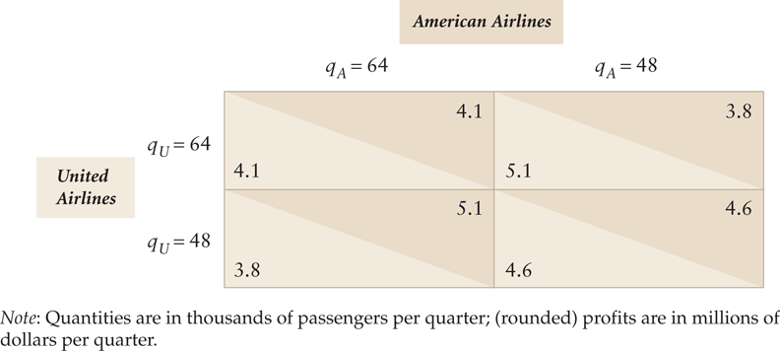
Indefinitely Repeated Games (1/2)
Assume the American-United games in repeated indefinitely
* This is from your textbook: Table 13.1 An Airlines Prisoners’ Dilemma Game with Two Actions
Notes:
Each firm has the dominant strategy of selecting the larger output. In the Nash Equilibrium in which both firm use their dominant strategy each firm receives a profit of 4.1, which is less than 4.6 that they would earn if they both produced the smaller output

Slide 6
Indefinitely Repeated Games (2/2)
The Nash equilibrium solution, if played only once, is both firms producing high (64 passengers) and making only $4.1 (Prisoner’s Dilemma game).
When the game is repeated indefinitely, firms must consider current and future profits and observe the action taken by the rival in the previous period
Firms may use strategies to avoid the prisoner’s dilemma outcome
Each airline may use a strategy where it threatens to punish its rivals by producing high level of output if its rival produces a high level of output in an early period → trigger strategy
Notes:
Note that in a static game, the low level of output is not a NE because there is a profitable deviation

Slide 7
Trigger strategy
A trigger strategy is a strategy in which a rival’s defection from a collusive outcome triggers a punishment
Suppose American cheap-talks United that it will produce the 48 collusive or cooperative quantity in the 1st period, but then it will use the following two-part strategy to determine its output in the subsequent periods:
  if United produces 48 in period t, American will produce 48 in t + 1;
  if United produces 64 in period t, American will produce 64 in t + 1 and all subsequent periods.
United’s best response strategy is to produce 48 in each period: the incremental profit from producing 64 one time does not compensate the total losses in the subsequent periods
Notes:
United knows it will make 4.6 each period if it produces the smaller quantity at time t
If it produces the larger quantity, it makes 5.1 at t, but by doing so it lowers its profit to 4.1 in each following period even if it continues to produce the high quantity
Thus United gains 0.5 = 5.1 -4.6 at time t when it defects from the cooperative output but it loses half a million dollars relative to cooperation in each subsequent period (-0.5=4.1-4.6)
After two punishment period the loss would be much larger in magnitude than the initial gains

Slide 8
Trigger strategy (1/3)
If both firms follow the trigger strategy, the outcome is a Nash-Equilibrium in which both firms choose the low output and obtain the collusive profits in every period
→ Nash-Equilibrium with no Prisoner’s Dilemma
Less extreme trigger strategies can also be used: the period of punishment may be shorter
In this example, the punishment period has to involve at least two periods of punishment
Notes:
With two period of punishment, losses from deviation will be higher than the one period gain and deviation becomes not attractive

Slide 9
Trigger strategy (2/3)
In reality, cooperation may fail:
if a firm cares little about future profits: United/American may not be a patient player and may value current profits more than future profits
because of antitrust and competition law
because of limited information: if United/American cannot observe its rival’s sales directly, it will try to infer its rival’s behavior from observing the demand for its own product
Notes:
if a firm cares little about future profits: United/American is not a patient player and value current profits much than future profits, the one-period gain from deviating might be valued more than losses from reduced profits in future period (which the punishment American will impose)
if United/American cannot observe its rival’s sales directly, it may try to infer its rival’s behavior from observing the demand for its own product: the firm may not be able to tell if a dip in the demand for its products is due to its rival producing more or from a reduction in market deman

Slide 10
Tit for tat strategy (3/3)
A tit-for-tat strategy for repeated prisoners’ dilemma games sets cooperation in the 1st round, then copies the rival’s previous action in each subsequent round.
A tit-for-tat strategy is a punishment strategy weaker than the previous trigger strategy.
Tit-for-Tat may not induce cooperation in the Airline repeated game (the extra profit in period t is equal tothe loss from the punishment in period t + 1)
… but this also depends on how much firms discount future gains and losses relative to those in the current period
Notes:
However, if the tit-for-tat strategy is modified to extend the punishment for more than one period (enough to more than compensate the one time extra profit), then it may ensure cooperation.

Slide 11
Implicit versus Explicit Collusion
In most modern economies, explicit collusion among firms in an industry is illegal
But antitrust laws do not strictly prohibit implicit or tacit collusion (choosing the cooperative (cartel) quantity or price as long as no explicit agreement is reached)
Trigger, tit-for-tat, or other similar strategies enable firms to reach tacit collusion (as long as firms do not explicitly communicate each other)
Tacit collusion lowers society’s total surplus just as explicit collusion does

Slide 12
Finitely Repeated Games
Suppose now that the United/American games is repeated a finite number of times
Going Backwards from the Last to the 1st Period
  Period T: Firms know they are not going to play again. Each firm ‘cheats’ and produces high quantity
  Period T - 1: Nothing that each firm does will avoid the punishment in period T. The firm views the game as a static prisoners’ dilemma game. It is better to ‘cheat’, produce 64 and earn extra profit.
  Period T - 2: Each firm cheats because they know both will cheat in T – 1 anyway.
  Period T - 3 up to the 1st period: Same logic
Notes:
Period T: Firms know they are not going to play again. Each firm ‘cheats’ and produces high quantity without fear of punishment
Period T - 1: Nothing that each firm does will avoid the punishment in period T. They have no incentive to produce the low output in period T-1 because they cannot avoid subsequent punishment in period T. The dominant strategy is to produce the large output because that output maximizes firm’s return in period T-1 regardless of what rivals does.

Slide 13
Finitely Repeated Games
The only Nash Equilibrium is for the static, high-output equilibrium to occur in every period
→ No Cooperation Again!
Thus, maintaining an agreement to cooperate in any prisoners’ dilemma game is more difficult if there is a known end point and players have complete foresight.

Slide 14
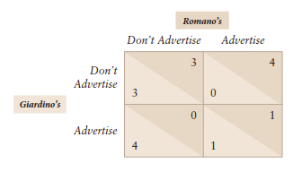
Exercise

Slide 15
Sequential Games
In a sequential game, one player moves before another
  A game is also sequential if players have a sequence of different decisions to make, even if moves are made simultaneously at each stage
A sequential game has many stages or decision points, at which each player decides what action to take given the action taken by the rivals in the previous stage
It can be illustrated using an extensive form diagram (decision tree or game tree) which shows the orders of the players’ moves, each firm’s possible actions at the time of its move and the resulting profits at the end of the game

Slide 16
Stackelberg oligopoly game (1/3)
The Stackelberg model is similar to the Cournot model (firms compete in quantities) but instead of being a static game, it is a sequential game
One firm, the leader, sets its output in the first stage of the game. The rival, the follower, cannot choose its output until the second stage of the game
The leader realizes that once it sets its output, the rival firm will make its best response to the leader’s output decision
→ Using this knowledge, the leader chooses its output level to manipulate the follower, thereby benefiting at the follower’s expenses

Slide 17
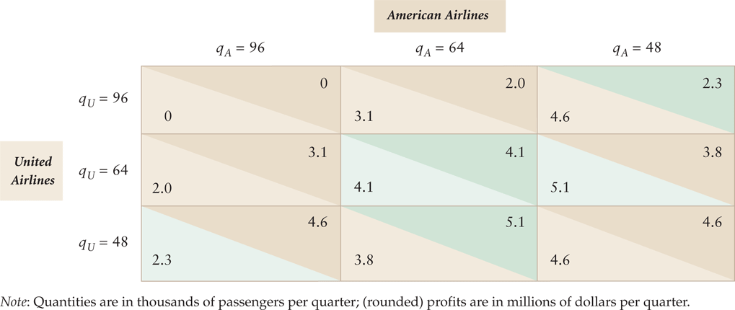
Stackelberg oligopoly game (2/3)
Two-stage, sequential-move oligopoly game: American, the leader firm, chooses its output level first. Given American’s choice, United, the follower, picks an output level
* This is from your textbook: Table 13.2 An Airlines Prisoners’ Dilemma Game with Three Actions

Slide 18
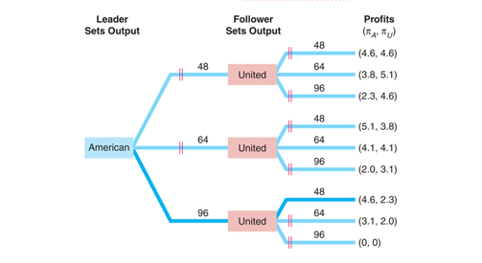
Stackelberg oligopoly game (3/3)
Airlines’ Stackelberg Game Tree
* This is from your textbook: Table 13.3 Airlines’ Stackelberg Game Tree
Notes:
Extensive form: a branched diagram that shows the players, the sequence of moves, the actions players can take at each move, the information that each player has about previous moves, and the payoff function over all possible strategy combinations

Slide 19
Subgame-perfect Nash Equilibrium
A subgame consists of all the subsequent actions that players can take and the corresponding payoffs. The entire game is also a subgame
The outcome of a sequential game is a Subgame Perfect Nash-Equilibrium
A set of strategies forms a Subgame perfect Nash equilibrium if the players’ strategies form a Nash equilibrium in every subgame (including the overall game)
How do we find it? Backward Induction:
  First determine the best response by the last player to move, then determine the best response for the player who made the next-to-last move, and so on until we reach the first move of the game.
Notes:
The entire game is a subgame because it is the set of subsequent decisions arising at the beginning of the game.

Slide 20
Stackelberg oligopoly game: the SNE
Four subgames, three of these arise in the second stage
Backward Induction
American determines what United, the follower, will do in the 2nd stage at the tree subgames: q_{U} with highest profit at each node.
American determines its best action in the 1st stage given the choices of United in the 2nd stage: q_{A} with the highest profit.
Subgame Perfect Nash-Equilibrium
Thus, American chooses q_{A} = 96 in the 1st stage and United chooses q_{U} = 48 in the 2nd stage. In this equilibrium, neither firm wants to change its strategy.

Slide 21
Credible Threats
The Nash equilibrium of the American-United static simultaneous game (Cournot with 3 options) was q_{A} = q_{U} = 64 and both firms earned $4.1 million
The Subgame Perfect Nash Equilibrium of the American-United sequential game (Stackelberg) is qA = 96 , qU = 48. American earns $4.6 million, but United only $2.3 million
→Why different solutions?
For a firm’s announced strategy to be a credible threat, rivals must believe that the firm’s strategy is rational (works in the firm’s best interest)
In the simultaneous-move game, United will not believe a threat by American that it will produce 96. However, in the sequential game because American makes the 1st move, its commitment to produce 96 is credible

Slide 22
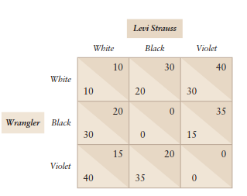
Exercise

Slide 23
A case study
Intel and Advanced Micro Devices (AMD) dominate the central processing unit (CPU) market for personal computers, making 95% of total sales.
Intel uses aggressive advertising—its very successful Intel Inside campaign—and charges relatively high prices, while AMD uses little advertising and relies on lower prices.
Even though their products are comparable in quality, Intel controls more than three-quarters of the market
Intel was founded in 1968 and created the first commercial microprocessor chip in 1971. AMD was founded in 1969, but didn’t compete in the microchip market until 1975 when it started selling a clone of the Intel microprocessor.

Slide 24
A case study
→Why have Intel’s managers chosen to advertise aggressively while AMD engages in relatively little advertising?

Slide 25
A case study
Since Intel acts first and can commit to advertising aggressively, it can place AMD in a position where it makes more with a low-key advertising campaign.

