Slide 1
ECONOMICS FOR BUSINESS (MICROECONOMICS)
Lesson 7
Prof. Paolo Buccirossi

Slide 2
Table of Contents
Cournot model
  Duopoly
  With n firms
  Market power and concentration
Betrand model
  Duopoly with symmetric costs

Slide 3
Cournot Oligopoly
Cournot Model
  Assumptions: small number of firms and no entry, identical costs and identical products, firms set their quantities independently and simultaneously.
  Because the firms set quantities, the price adjusts as needed until the market clears and profits are interdependent.
Residual Demand and Best Responses
  Firms use their residual demand curves: market demand that is not met by other sellers at any given price, D^{r}(p) = D(p) – Sº(p).
  A firm maximizes profit with best responses that come from MR^{r} = MC.
Equilibrium called Nash-Cournot Equilibrium
  A set of quantities chosen by firms such that, holding the quantities of all other firms constant, no firm can obtain a higher profit by choosing a different quantity.
  The quantity of equilibrium must be on the best response curve for all firms.

Slide 4
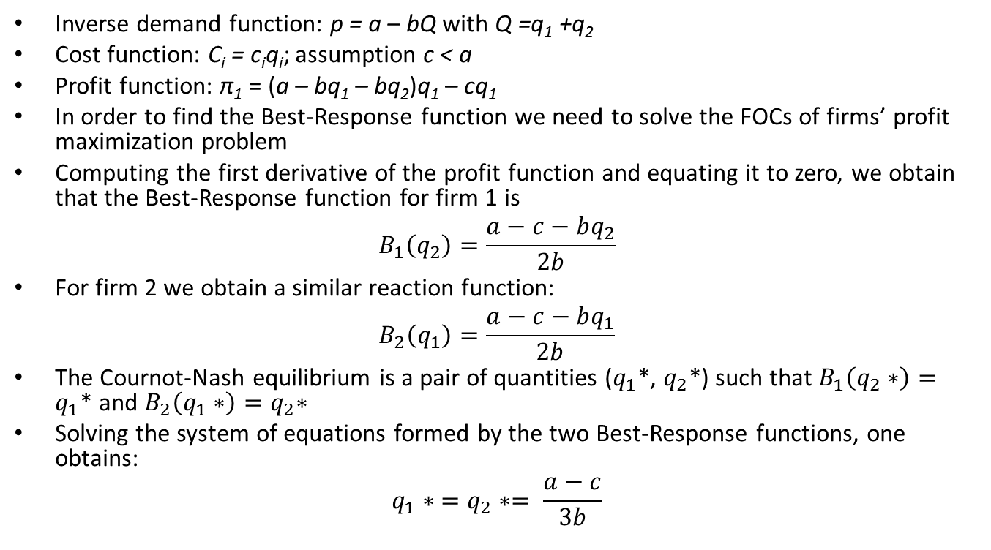
Cournot Oligopoly
Inverse demand function: p = a – bQ with Q =q₁ +q₂
Cost function: C_{i} = c_{i}q_{i}; assumption c < a
Profit function: π₁ = (a – bq₁ – bq₂)q₁ – cq₁
In order to find the Best-Response function we need to solve the FOCs of firms’ profit maximization problem
Computing the first derivative of the profit function and equating it to zero, we obtain that the Best-Response function for firm 1 is
$$B_{1}\left(q_{2}\right)=\frac{a−c−bq_{2}}{2b}$$
For firm 2 we obtain a similar reaction function:
$$B_{2}\left(q_{1}\right)=\frac{a−c−bq_{1}}{2b}$$
The Cournot-Nash equilibrium is a pair of quantities ($q_{1}$*, $q_{2}$*) such that $B_{1}\left(q_{2}∗\right)=q_{1}\text{*}$ and $B_{2}\left(q_{1}∗\right)=q_{2}\text{∗}$
Solving the system of equations formed by the two Best-Response functions, one obtains:
$$q_{1}∗ =q_{2}∗= \frac{a−c}{3b}$$

Slide 5
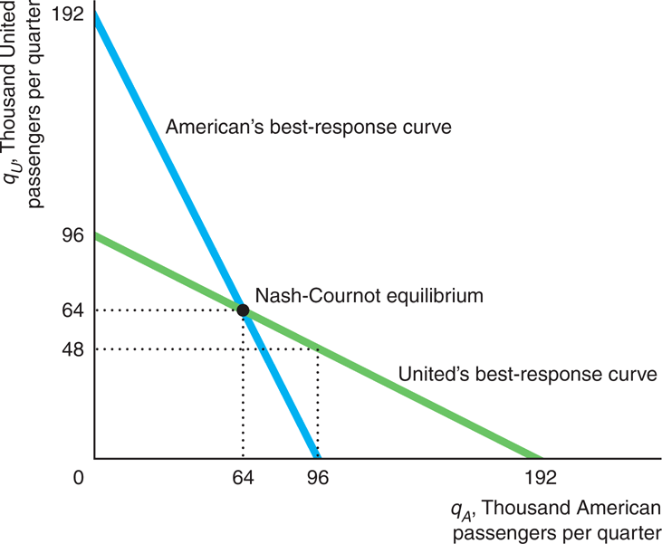
Cournot Oligopoly
Best-Response Curves for American and United Airlines

Slide 6
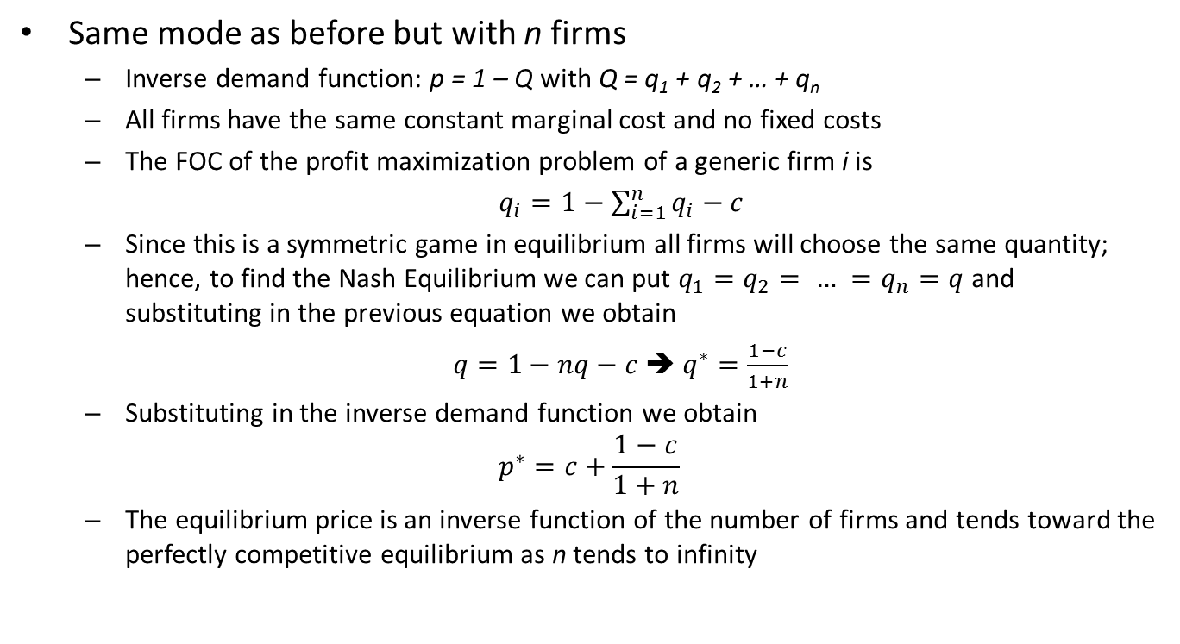
Cournot Oligopoly
Same mode as before but with n firms
  Inverse demand function: p = 1 – Q with Q = q₁ + q₂ + … + q_{n}
  All firms have the same constant marginal cost and no fixed costs
  The FOC of the profit maximization problem of a generic firm i is
  $q_{i}=1−\sum_{i=1}^{n}{q_{i}−c}$
  Since this is a symmetric game in equilibrium all firms will choose the same quantity; hence, to find the Nash Equilibrium we can put $q_{1}=q_{2}= … =q_{n}=q$and substituting in the previous equation we obtain
  $q=1−nq−c$ ➔ $q^{∗}=\frac{1−c}{1+n}$
  Substituting in the inverse demand function we obtain
$$p^{∗}=c+\frac{1−c}{1+n}$$
  The equilibrium price is an inverse function of the number of firms and tends toward the perfectly competitive equilibrium as n tends to infinity

Slide 7
Cournot Oligopoly
The Number of Firms Matter
  If two Cournot firms set output independently, the price to consumers is lower than the monopoly price. If there are more than two, the price is even lower.
Individual Output and Total Output
  Consider the airlines’ inverse market demand function p = 339 – Q and n identical firms with MC=AC=$147.
  The best response for any firm is q = 96 – [n – 1]q. So, q= 192/(n+1)
  Total output is Q = qn = 192n/(n+1)
Number of Firms and Nash-Cournot Equilibrium
  If n = 1, Q = (192 × 1)/2 = 64, p = 243, a monopoly outcome.
  If n = 2, Q = (192 × 2)/3 = 128, p = 211, a duopoly outcome as we found earlier.
  If n is very large, Q = 192 and p = 147 = MC. The Nash-Cournot equilibrium approaches the competitive outcome.

Slide 8
Bertrand Oligopoly
Setting Prices
  Oligopoly firms set prices and then consumers decide how many units to buy.
  The Bertrand equilibrium differs from the Cournot equilibrium; firms produce identical or differentiated products.
Best Responses
  In a duopoly setting, Firm 1’s best response curve comes from answering “What is Firm 1’s best response—what price should it set—if Firm 2 sets a price of p₂ = x?” for all possible values of x.
  Similarly, Firm 2’s best response curve: “What is Firm 2’s best response (p₂) if Firm 1 sets a price of p₁ = y?” for all possible values of y.
Nash-Bertrand Equilibrium
  Nash-Bertrand equilibrium: a set of prices such that no firm can obtain a higher profit by choosing a different price if the other firms continue to charge these prices.

Slide 9
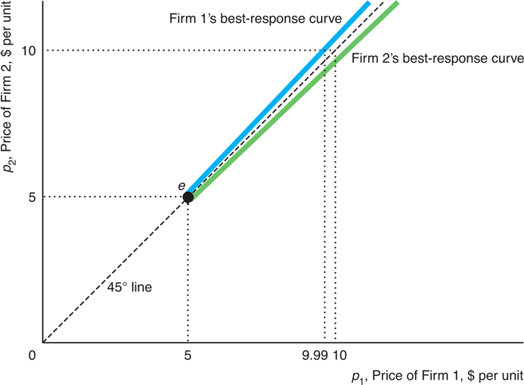
Bertrand Oligopoly
Figure 11.5 Nash-Bertrand Equilibrium with Identical Products
Identical Products
  Two firms with identical costs and identical products, MC = AC = $5.
  In Figure 11.5, Firm 1’s best-response curve starts at $5 and then lies slightly above the 45° line. That is, Firm 1 undercuts its rival’s price as long as its price remains above $5.
  Firm 2’s best response curve also starts at $5 and undercuts its rival’s price if p₂ > 5.
  Nash-Bertrand Equilibrium at intersection point e, p₂ = p₁ = $5 = MC. Same as perfect competition equilibrium.

Slide 10
Bertrand Oligopoly
Bertrand versus Cournot with Identical Products
    The Nash-Bertrand equilibrium differs substantially from the Nash-Cournot equilibrium. Zero profits (p = MC) versus positive profits (p > MC).
    The Cournot model seems more realistic than the Bertrand model in two ways.
Bertrand’s “Competitive” Equilibrium is Implausible
  In a market with few firms, why would the firms compete so vigorously that they would make no profit?
  Oligopolies typically charge a higher price than competitive firms. So, the Nash-Cournot equilibrium is more plausible.
Bertrand’s Equilibrium Price Depends on Cost Only
  The Nash-Cournot equilibrium price is sensitive to demand conditions and the number of firms as well as on cost. So, it is better to study homogeneous goods markets.

Slide 11
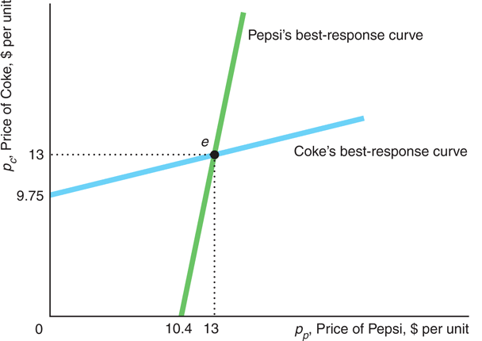
Bertrand Oligopoly
Figure 11.6 Nash-Bertrand Equilibrium with Differentiated Products
Differentiated Products
  Two firms, identical costs MC = AC = $5 and differentiated products
  In Figure 11.6, neither firm’s best-response curve lies along a 45° line through the origin because Coke and Pepsi are similar but some consumers prefer one to the other independently of the price. So neither firm has to exactly match a price cut by its rival.
  Nash-Bertrand Equilibrium at intersection point e, p₂ = p₁ = $13 > MC
  Plausible: Firms set p > MC, and prices are sensitive to demand conditions and number of firms

