Slide 1
A Tour of the Book
Chapter 2

Slide 2
Chapter 2 Outline
A Tour of the Book
2-1 Aggregate Output
2-2 The Unemployment Rate
2-3 The Inflation Rate
2-4 Output, Unemployment, and the Inflation Rate: Okun’s Law and the Phillips Curve
2-5 The Short Run, the Medium Run, and the Long Run
APPENDIX The Construction of Real GDP and Chain-Type Indexes

Slide 3
A Tour of the Book
The words output, unemployment, and inflation appear daily in newspapers and on the evening news.
In this chapter, we define these words more precisely.
The chapter also introduces concepts around which the book is organized: the short run, the medium run, and the long run.

Slide 4
2-1 Aggregate Output
National income and product accounts were developed at the end of World War II as measures of aggregate output.
The measure of aggregate output is called gross domestic product (GDP)
How would you define aggregate output in the economy?

Slide 5
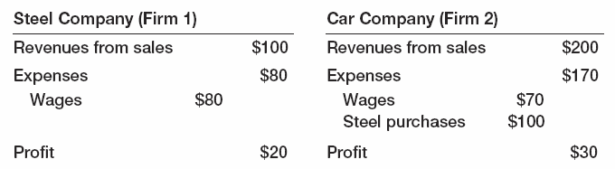
2-1 Aggregate Output
Consider an economy with two firms, Firm 1 and Firm 2.
Is aggregate output the sum of the values of all goods produced, i.e., $300? Or just the value of cars, i.e., $200?
Steel is an intermediate good, which is a good used in the production of another good.

Slide 6
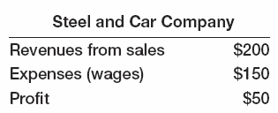
2-1 Aggregate Output
GDP is the value of final goods and services produced in the economy during a given period.
  We want to count only final goods, not intermediate goods.
  If we merge the two firms in the previous example, the revenues of the new firm equal $200.

Slide 7
2-1 Aggregate Output
GDP is the sum of value added in the economy during a given period.
  The value added by a firm is the value of its production minus the value of the intermediate goods used in production.
  In the two-firm example, the value added equals $100 + $100 = $200.
So far, we have looked at GDP from the production side.

Slide 8
2-1 Aggregate Output
GDP is the sum of incomes in the economy during a given period.
  Aggregate production and aggregate income are always equal.
  From the income side, valued added in the two-firm example is equal to the sum of labor income ($150) and capital or profit income ($50), i.e., $200.

Slide 9
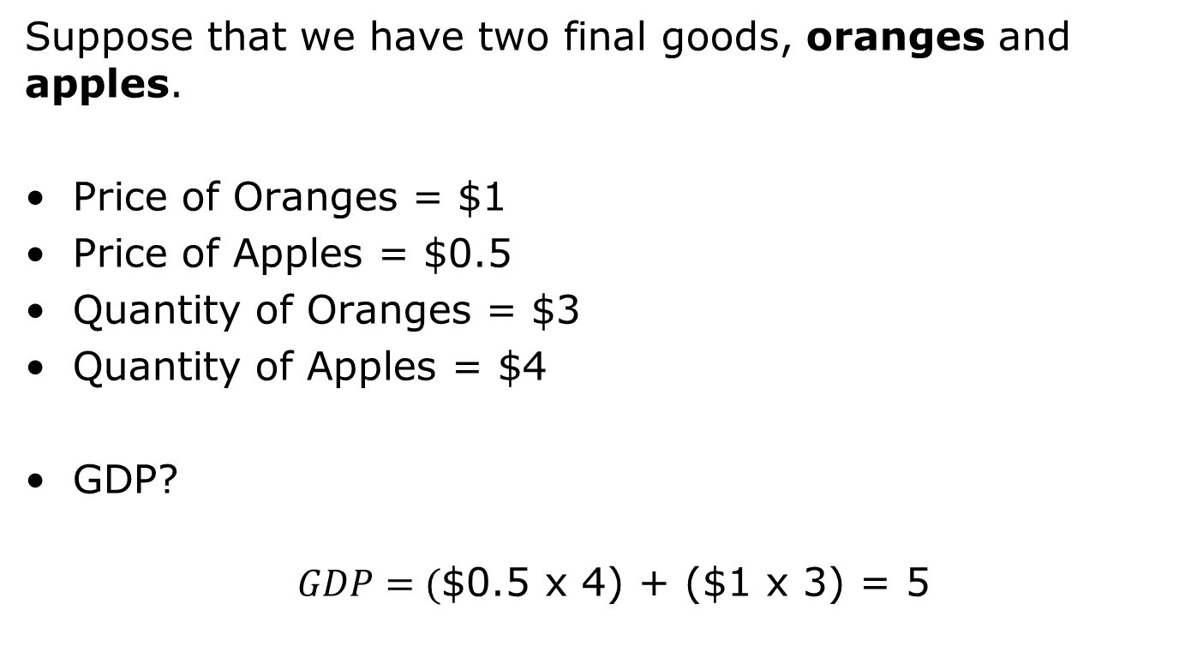
2-1 Aggregate Output
Suppose that we have two final goods, oranges and apples.
Price of Oranges = $1
Price of Apples = $0.5
Quantity of Oranges = $3
Quantity of Apples = $4
GDP?
$$GDP=\text{(}\text{\$}\text{0.5 }\text{x}\text{ 4) + (}\text{\$}\text{1 }\text{x}\text{ 3) = 5}$$

Slide 10
2-1 Aggregate Output
Nominal GDP is the sum of the quantities of final goods produced times their current price.
Nominal GDP increases for two reasons:
  The production of most goods increases
  The price of most goods increases
Real GDP is the sum of quantities of final goods times constant (not current) prices.
  allows for a better year-to-year comparison
  is a better measure of well-being

Slide 11
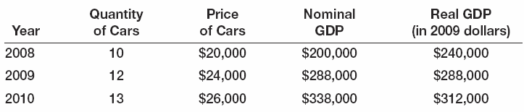
2-1 Aggregate Output
Example:
Real GDP in 2008 (in 2009 dollars) = 10 cars x $24,000 per car = $240,000.
Real GDP in 2009 (in 2009 dollars) = 12 cars x $24,000 per car = $288,000.
Real GDP in 2010 (in 2009 dollars) = 13 cars x $24,000 per car = $312,000.

Slide 12
2-1 Aggregate Output
For more than one good, relative prices of the goods are natural weights for constructing the weighted average of the output of all final goods.
Real GDP in chained (2009) dollars reflects relative prices that change over time.
The year used to construct prices is called the base year.

Slide 13
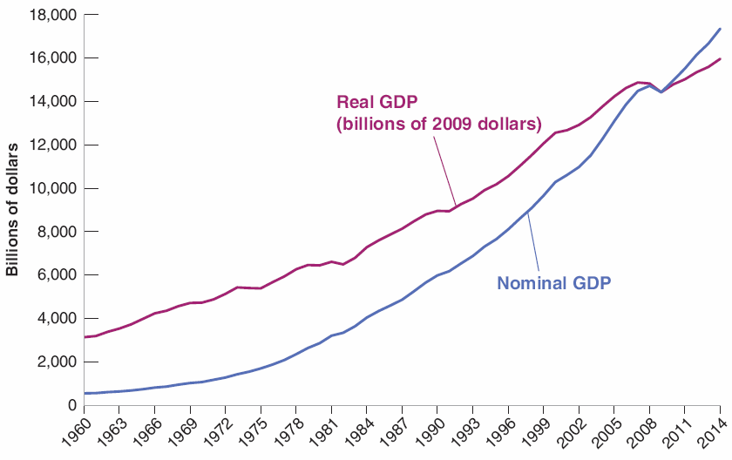

2-1 Aggregate Output
Figure 2-1 Nominal and Real U.S. GDP, 1960–2014
From 1960 and 2014, nominal GDP increased by a factor of 32. Real GDP increased by a factor of about 5.

Slide 14
2-1 Aggregate Output
Nominal GDP is also called dollar GDP, or GDP in current dollars.
Real GDP is also called GDP in terms of goods, GDP in constant dollars, GDP adjusted for inflation, or GDP in chained (2009) dollars, or GDP in 2009 dollars.
GDP will refer to real GDP.
Y_{t} will denote real GDP in year t.
Nominal GDP and variables in current dollars will be denoted by a dollar sign in front of them, e.g., $Y_{t}.

Slide 15
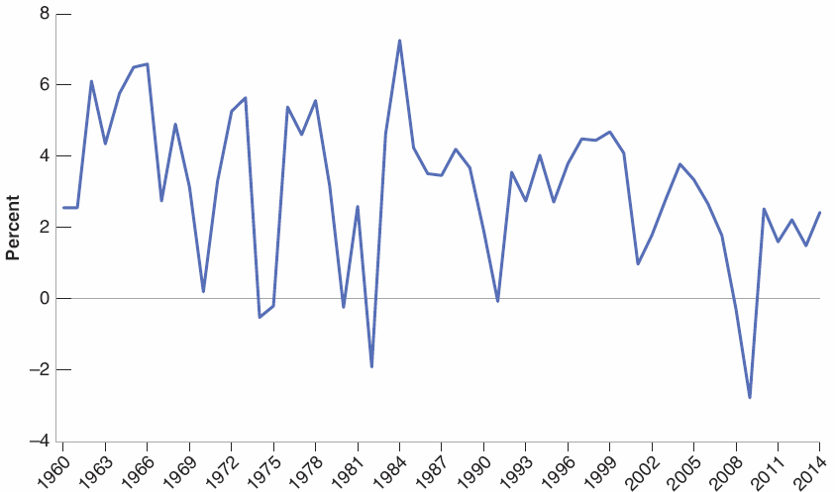

2-1 Aggregate Output
Figure 2-2 Growth Rate of U.S. GDP, 1960–2014
GDP growth in year t is (Y_{t} − Y_{t-1})/Y_{t-1}.
Since 1960, the U.S. economy has gone through a series of expansions, interrupted by short recessions. The 2008−2009 recession was the most severe recession in the period from 1960 to 2014.

Slide 16
FOCUS: Real GDP, Technological Progress, and the Price of Computers
The Department of Commerce deals with changes in the quality of existing goods like computers with an approach called hedonic pricing, which treats goods as providing a collection of characteristics.
The quality of new laptops (computing services) has increased on average by 18% a year since 1995.
The dollar price of a typical laptop has also declined by about 7% a year since 1995.
This implies that laptops’ quality-adjusted price has fallen at an average rate of 18% + 7% = 25% per year.

Slide 17

2-2 The Unemployment Rate
Employment is the number of people who have a job.
Unemployment is the number of people who do not have a job but are looking for one.
The labor force is the sum of employment and unemployment.

Slide 18
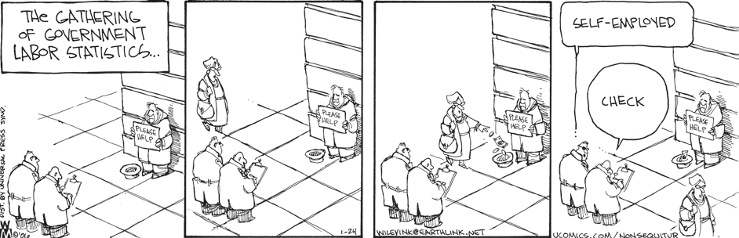
2-2 The Unemployment Rate

Slide 19
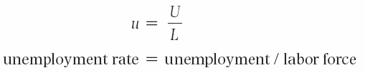
2-2 The Unemployment Rate
The unemployment rate is the ratio of the number of people who are unemployed to the number of people in the labor force.

Slide 20
2-2 The Unemployment Rate
Most rich countries rely on large surveys of households to compute the unemployment rate.
The U.S. Current Population Survey (CPS) relies on interviews of 60,000 households every month. In Europe, Labour Force Survey
A person is unemployed if he or she does not have a job and has been looking for a job in the last four weeks.
Those who do not have a job and are not looking for one are counted as not in the labor force.

Slide 21
2-2 The Unemployment Rate
In the US, Bureau of Labor Statistics (Government) Conducts a monthly “Current Population Survey (CPS)”
since 1940
about 60,000 eligible households in the sample
a sample of about 800 out of 2000 geographic areas
every month, one-fourth of the households are changed
excludes people living in institutions and those on active duty in the Armed Forces.
The survey is designed so that each person age 16 and over (no upper age limit) is counted and classified as employed, unemployed, or not in the labor force.

Slide 22
2-2 The Unemployment Rate
Discouraged workers are those who give up looking for a job and so no longer counted as unemployed.
The participation rate is the ratio of the labor force to the total population of working age.
Because of discouraged workers, a higher unemployment rate is typically associated with a lower participation rate.

Slide 23
2-2 The Unemployment Rate
Why Do Economists Care about Unemployment?
  Direct effect on the welfare of the unemployed, especially those remaining unemployed for long periods of time.
  A signal that the economy is not using its human resources efficiently.
Very low unemployment can also be a problem as the economy runs into labor shortages.
  In 2000 unemployment in U.S. was 4%. Government policies led to a recession.

Slide 24
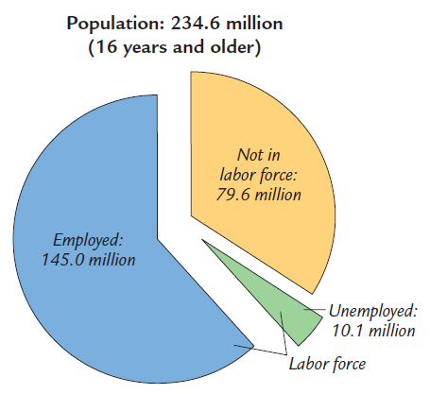
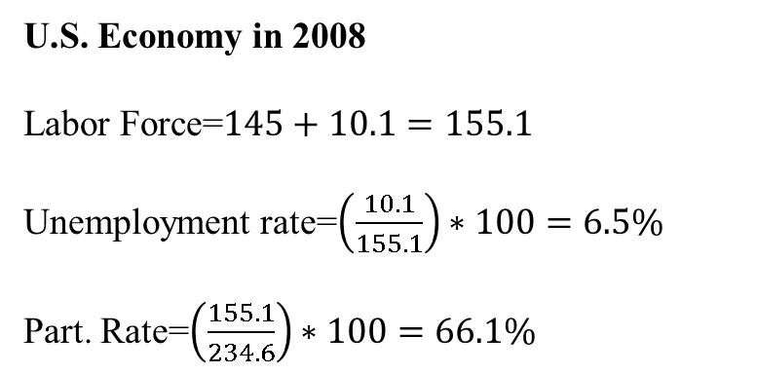
2-2 The Unemployment Rate
U.S. Economy in 2008
Labor Force=$145+10.1=155.1$
Unemployment rate=$\left(\frac{10.1}{155.1}\right)∗100=6.5\%$
Part. Rate=$\left(\frac{155.1}{234.6}\right)∗100=66.1\%$
Notes:
If the participation rate in an economy is equal to 80%, the adult population is 10 million people and the number of unemployed is 2 million people, calculate the unemployment rate.

Slide 25
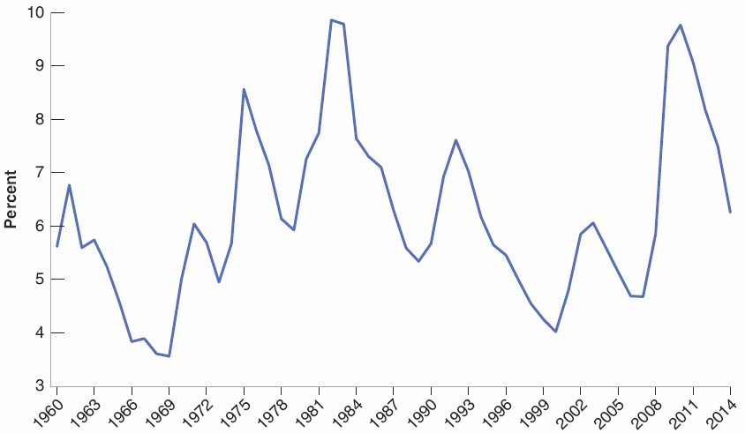

2-2 The Unemployment Rate
Figure 2-3 U.S. Unemployment Rate, 1960−2014
Since 1960, the U.S. unemployment rate has fluctuated between 3 and 10%, going down during expansions and going up during recessions.
The effect of the recent crisis is highly visible, with the unemployment rate reaching close to 10% in 2010, the highest such rate since the early 1980s.

Slide 26
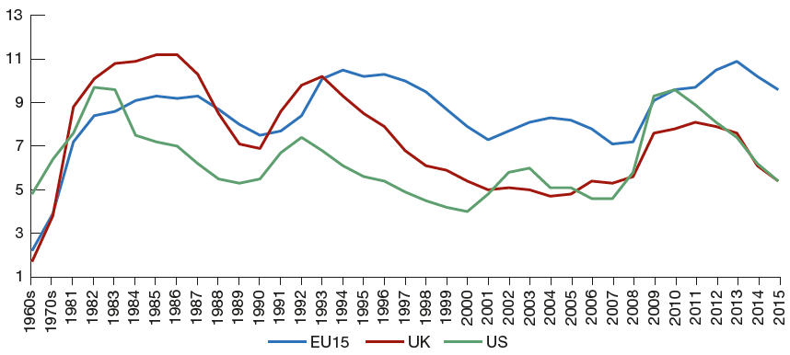
2-2 The Unemployment Rate

Slide 27
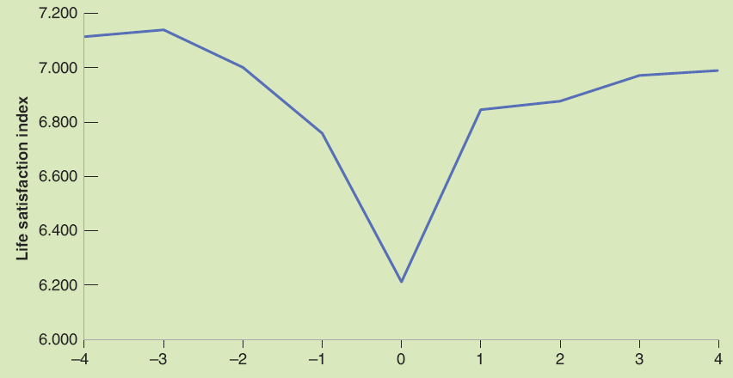
FOCUS: Unemployment and Happiness
Results of the German Socio-Economic Panel survey suggest that (1) becoming unemployed leads to a large decrease in happiness, (2) happiness declines before the actual unemployment spell, and (3) happiness does not fully recover even four years later.
Unemployment benefits are less important than psychological support
Figure 1 Effects of Unemployment on Happiness
Source: Winkelmann 2014.
Notes:
The survey has followed about 11,000 households each year since 1984, asking each member of the household a number of questions about their employment status, their income and their happiness. The specific question in the survey about happiness is the following: ‘How satisfied are you at present with your life as a whole?’; the answer is rated from 0 (‘completely dissatisfied’) to 10 (‘completely satisfied’).

Slide 28
2-3 The Inflation Rate
Inflation is a sustained rise in the general level of prices—the price level.
The inflation rate is the rate at which the price level increases.
Deflation is a sustained decline in the price level (negative inflation rate).
Disinflation is a decrease in the (positive) rate of inflation

Slide 29

2-3 The Inflation Rate
The GDP deflator in year t (P_{t}) is the ratio of nominal GDP to real GDP in year t:
It is called an index number (1 in 2009), which has no economic interpretation.
The rate of change has a clear interpretation: the rate of inflation.
π_{t} = (P_{t} − P_{t-1})/P_{t-1}

Slide 30
2-3 The Inflation Rate
Defining the price level as the GDP deflator implies a simple relation between nominal GDP, real GDP, and the GDP deflator:
$Y_{t} = P_{t}Y_{t}
Nominal GDP is equal to the GDP deflator times real GDP.
The rate of growth of nominal GDP is equal to the rate of inflation plus the rate of growth of real GDP.

Slide 31
2-3 The Inflation Rate
The set of goods produced in the economy is not the same as the set of goods purchased by consumers because:
  Some of the goods in GDP are sold not to consumers but to firms, to the government, or to foreigners.
  Some of the goods bought by consumers are not produced domestically but are imported from abroad.
The Consumer Price Index (CPI) is a measure of the cost of living (in Europe, HICP).
The CPI is published monthly by the Bureau of Labor Statistics (BLS), which collects price data for 211 items in 38 cities.
The CPI gives the cost in dollars of a specific list of goods and services over time.

Slide 32
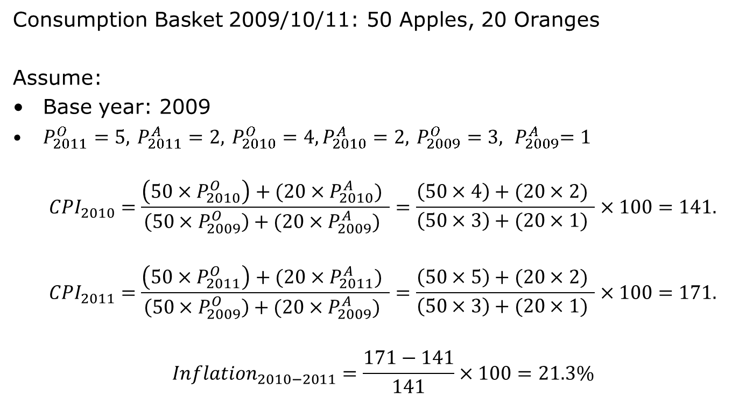
2-3 The Inflation Rate
Consumption Basket 2009/10/11: 50 Apples, 20 Oranges
Assume:
Base year: 2009
$P_{2011}^{O}=5,$ $P_{2011}^{A}=2,$ $P_{2010}^{O}=4,P_{2010}^{A}=2,$ $P_{2009}^{O}=3,$ ${ P}_{2009}^{A}=1$
$${CPI}_{2010}=\frac{\left(50×P_{2010}^{O}\right)+(20×P_{2010}^{A}) }{\left(50×P_{2009}^{O}\right)+(20×P_{2009}^{A}) }=\frac{\left(50×4\right)+(20×2) }{\left(50×3\right)+(20×1) }×100=141.$$
$${CPI}_{2011}=\frac{\left(50×P_{2011}^{O}\right)+(20×P_{2011}^{A}) }{\left(50×P_{2009}^{O}\right)+(20×P_{2009}^{A}) }=\frac{\left(50×5\right)+(20×2) }{\left(50×3\right)+(20×1) }×100=171.$$
$${Inflation}_{2010−2011}=\frac{171−141}{141}×100=21.3\%$$

Slide 33
2-3 The Inflation Rate
CPI | GDP Deflator
Basket of consumer goods | All goods and services
Also imported goods | Produced Domestically
Fixed basket | Changing basket
Laspeyres Index | Paasche Index
Overstates price increases | Understates price increases

Slide 34
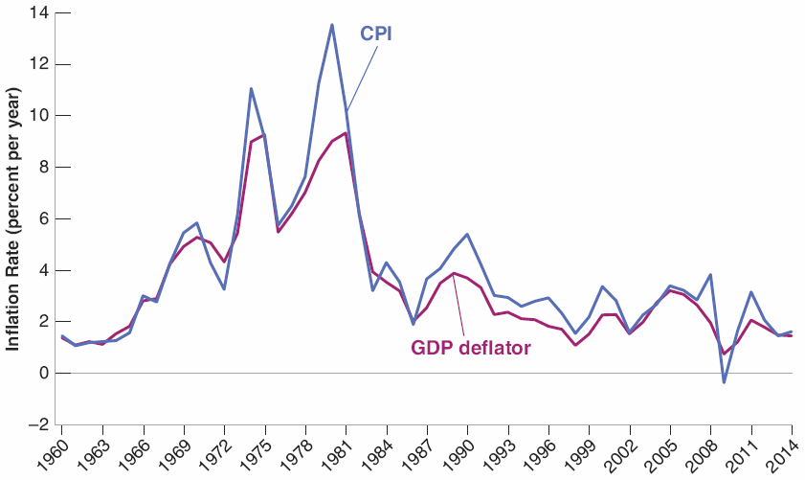
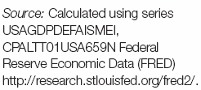
2-3 The Inflation Rate
Figure 2-4 Inflation Rate, Using the CPI and the GDP Deflator, 1960–2014
The inflation rates, computed using either the CPI or the GDP deflator, are largely similar.

Slide 35
2-3 The Inflation Rate
The CPI and GDP deflator moved together most of the time.
Exception: In 1979 and 1980, the increase in the CPI was significantly larger than the increase in the GDP deflator due to the price of imported goods increasing relative to the price of domestically produced goods.

Slide 36
2-3 The Inflation Rate
Pure inflation is proportional increase in all prices and wages.
  This type of inflation causes only a minor inconvenience as relative prices are unaffected.
  Real wage (wage measured by goods rather than dollars) would be unaffected.
  There is no such thing as pure inflation (some prices are not flexible).

Slide 37
2-3 The Inflation Rate
Why Do Economists Care about Inflation?
  Inflation affects income distribution when not all prices and wages rise proportionally.
  Inflation leads to distortions due to uncertainty, some prices that are fixed by law or by regulation, and its interaction with taxation (bracket creep in taxes).
Most economists believe the “best” rate of inflation to be a low and stable rate of inflation between 1 and 4%.

Slide 38
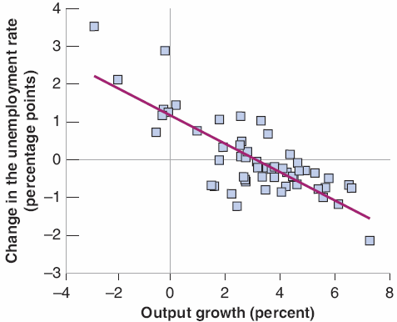
2-4 Output, Unemployment, and the Inflation Rate: Okun’s Law and the Phillips Curve
Figure 2-5 Changes in the Unemployment Rate versus Growth in the United States, 1960–2014
Output growth that is higher than usual is associated with a reduction in the unemployment rate.
Output growth that is lower than usual is associated with an increase in the unemployment rate.
Slope=0.4
Hor. Int.=3

Slide 39
2-4 Output, Unemployment, and the Inflation Rate: Okun’s Law and the Phillips Curve
Okun’s law is a relation first examined by U.S. economist Arthur Okun.
In Figure 2-5, the line that best fits the points is downward sloping.
The slope of the line is –0.4, which imples that, on average, an increase in the growth rate of 1% decreases the unemployment rate by –0.4%.
The line crosses the horizontal axis where output growth is 3%, meaning that it takes a growth rate of 3% to keep unemployment constant.

Slide 40
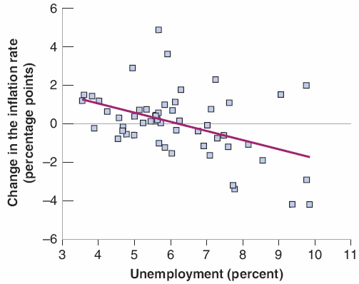
2-4 Output, Unemployment, and the Inflation Rate: Okun’s Law and the Phillips Curve
Figure 2-6 Changes in the Inflation Rate versus the Unemployment Rate in the United States, 1960–2014
A low unemployment rate leads to an increase in the inflation rate.
A high unemployment rate leads to a decrease in the inflation rate.
Hor. Int.=6

Slide 41
2-4 Output, Unemployment, and the Inflation Rate: Okun’s Law and the Phillips Curve
The Phillips curve is a relation first explored in 1958 by New Zealand economist A.W. Phillips.
Figure 2-6 plots the change in the inflation rate against the unemployment rate, along with the line that best fits the points.
The line is downward sloping, meaning that higher unemployment leads, on average, to a decrease in inflation, and vice versa.
The line crosses the horizontal axis where the unemployment rate is equal to about 6%, meaning that inflation typically increased when unemployment was below 6%.

Slide 42
2-5 The Short Run, the Medium Run, and the Long Run
In the short run (e.g., a few years), year-to-year movements in output are primarily driven by movements in demand.
In the medium run (e.g., a decade), the economy tends to return to the level of output determined by supply factors, such as the capital stock, the level of technology, and the size of the labor force.
In the long run (e.g., a few decades or more), the economy depends on its ability to innovate and introduce new technologies, and how much people save, the quality of the county’s education system, the quality of the government, and so on.

Slide 43
2-6 A Tour of the Book
The Core
  Chapters 3 to 6: The short run and the role of demand
  Chapters 7 to 9: The medium run and the supply side
  Chapters 10 to 13: The long run
Extensions
  Chapters 14 to 16: Expectations and implications for fiscal and monetary policy
  Chapters 17 to 20: Open economy and implications for fiscal and monetary policy

Slide 44
2-6 A Tour of the Book
Back to Policy
  Chapter 21: General issues of policy
  Chapters 22 & 23: The role of fiscal and monetary policies.
Epilogue
  Chapter 24: History of macroeconomics and how macroeconomists have come to believe what they believe today

Slide 45
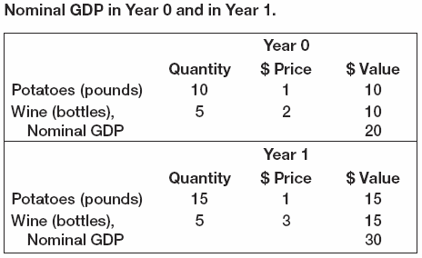
APPENDIX: The Construction of Real GDP and Chain-Type Indexes
Suppose that an economy produces two final goods, wine and potatoes:
The rate of growth or nominal GDP from year 0 to year 1 is ($30 − $20)/$20 = 50%.

Slide 46
APPENDIX: The Construction of Real GDP and Chain-Type Indexes
Suppose year 0 is the base year:
  Real GDP in year 0: (10 x $1) + (5 x $2) = $20
  Real GDP in year 1: (15 x $1) + (5 x $2) = $25
  The rate of growth of real GDP from year 0 to year 1 is ($25 − $20)/$20 = 25%.
Suppose year 1 is the base year:
  Real GDP in year 0: (10 x $1) + (5 x $3) = $25
  Real GDP in year 1: (15 x $1) + (5 x $3) = $30
  The rate of growth of real GDP from year 0 to year 1 is ($30 − $25)/$25 = 20%.
Problem: Which base year should one choose?
The rate of growth or nominal GDP from year o to year 1 is ($30 − $20)/$20 = 50%.

Slide 47
APPENDIX: The Construction of Real GDP and Chain-Type Indexes
In December 1995, the U.S. Bureau of Economic Analysis shifted to a new method with four steps:
  Construct the rate of change of real GDP between two years in two different ways:
    Using the price from year t as the set of common prices
    Using the price from year t+1 as the set of common prices
  Construct the rate of change of real GDP as the average of the these two rates of change
  Construct an index of the level of real GDP by linking or chaining the constructed rates of change for each year
  Multiply this index by nominal GDP to derive real GDP in chained dollars

Slide 48
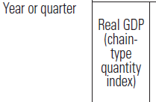



APPENDIX: The Construction of Real GDP and Chain-Type Indexes

