Slide 1
Goods and Financial Markets;
The IS-LM Model
Chapter 5

Slide 2
Chapter 5 Outline
Goods and Financial Markets; The IS-LM Model
5-1 The Goods Market and the IS Relation
5-2 Financial Markets and the LM Relation
5-3 Putting the IS and the LM Relations Together
5-4 Using a Policy Mix
5-5 How Does the IS-LM Model Fit the Facts?

Slide 3
Goods and Financial Markets; The IS-LM Model
We looked at the goods market in Chapter 3, and financial markets in Chapter 4.
In this chapter, we look at goods and financial markets together, and understand how output and the interest rate are determined in the short run.
John Hicks and Alvin Hansen called this framework the IS-LM model.

Slide 4

5-1 The Goods Market and the IS Relation
In the model developed in Chapter 3, investment was assumed to be constant for simplicity.
In fact, investment depends on production Y (or sales) and the interest rate i.
So equilibrium in the goods market becomes:
which is the IS relation.

Slide 5
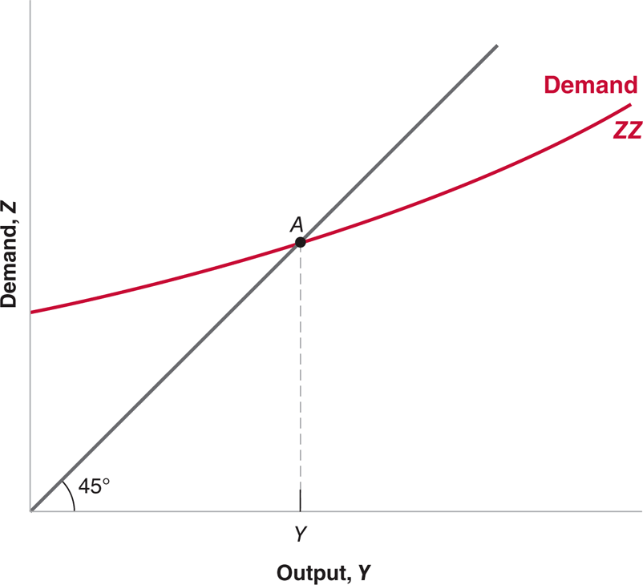
5-1 The Goods Market and the IS Relation
Figure 5-1 Equilibrium in the Goods Market
The demand for goods is an increasing function of output.
Equilibrium requires that the demand for goods be equal to output.

Slide 6
5-1 The Goods Market and the IS Relation
ZZ is upward-sloping because, for a given value of the interest rate, an increase in output leads to an increase in the demand for goods through its effects on consumption and investment.
ZZ is a curve rather than a line because we have not assumed that the consumption and investment relations in equations (5.2) are linear.
ZZ is flatter than the 45-degree line because we have assumed that an increase in output leads to a less than one-for-one increase in demand.
The intersection of ZZ and the 45-degree line (point A) is the equilibrium level of output.

Slide 7
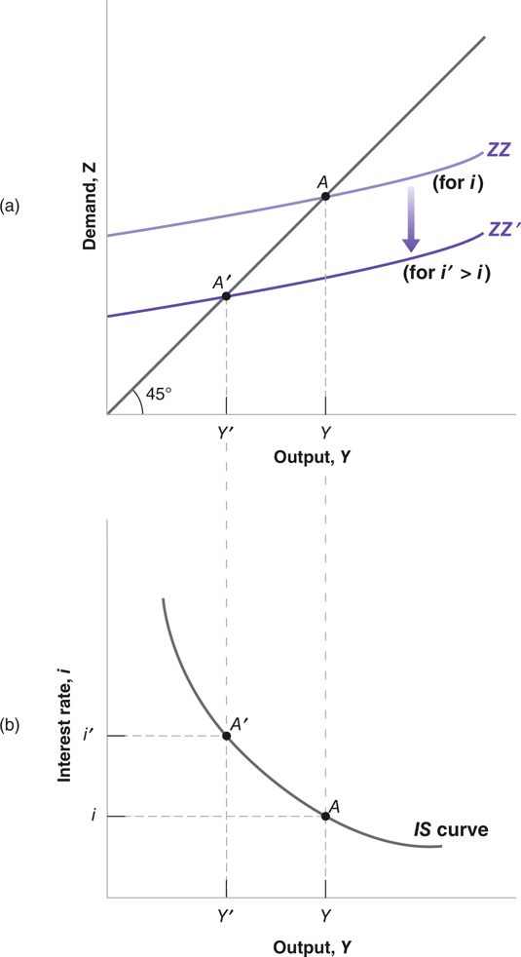
5-1 The Goods Market and the IS Relation
Figure 5-2 The Derivation of the IS Curve
(a) An increase in the interest rate decreases the demand for goods at any level of output, leading to a decrease in the equilibrium level of output.
(b) Equilibrium in the goods market implies that an increase in the interest rate leads to a decrease in output.
The IS curve is therefore downward sloping.

Slide 8
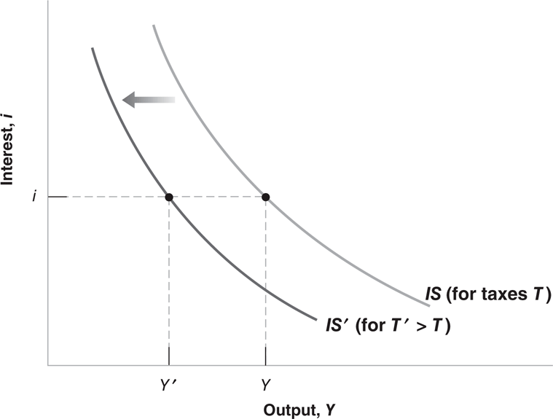
5-1 The Goods Market and the IS Relation
Figure 5-3 Shifts of the IS Curve
An increase in taxes shifts the IS curve to the left.

Slide 9
5-1 The Goods Market and the IS Relation
Downward-sloping IS curve: Equilibrium in the goods market implies that an increase in the interest rate leads to a decrease in output.
Shifting the IS curve: Changes in factors that decrease (increase) the demand for goods given the interest rate shift the IS curve to the left (right).

Slide 10

5-2 Financial Markets and the LM Relation
Recall Chapter 4: M = $Y L(i)
Divide both sides of the equation by the price level P:
which is the LM relation.
In equilibrium, real money supply equals the real money demand, which depends on real income Y, and the interest rate i.

Slide 11
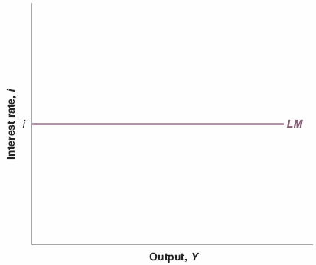
5-2 Financial Markets and the LM Relation
Figure 5-4 The LM Curve
The central bank chooses the interest rate (and adjusts the money supply so as to achieve it).

Slide 12
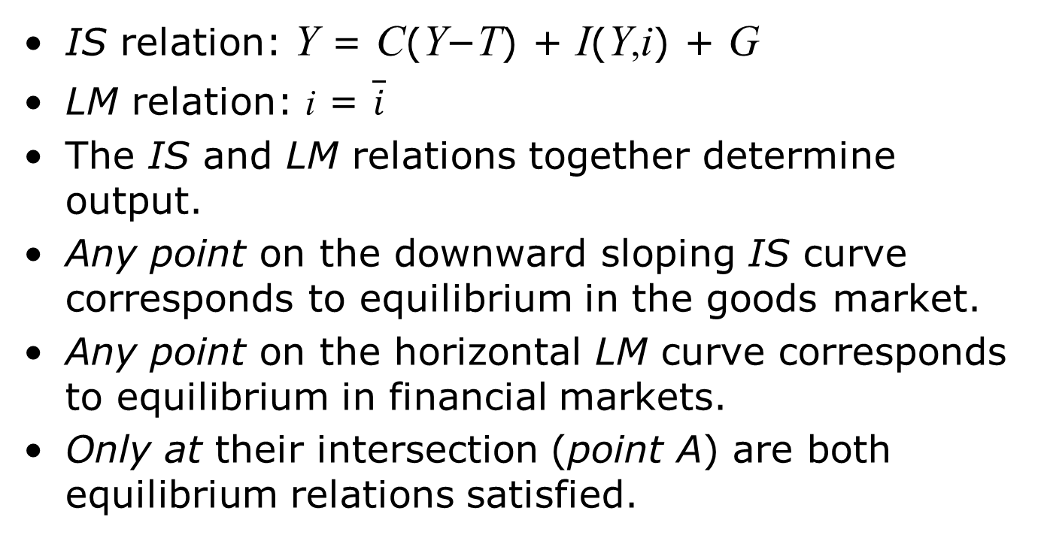
5-2 Financial Markets and the LM Relation
IS relation: Y = C(Y−T) + I(Y,i) + G
LM relation: i = $\overline{i}$
The IS and LM relations together determine output.
Any point on the downward sloping IS curve corresponds to equilibrium in the goods market.
Any point on the horizontal LM curve corresponds to equilibrium in financial markets.
Only at their intersection (point A) are both equilibrium relations satisfied.

Slide 13
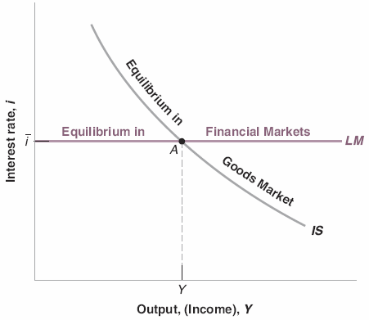
5-3 Putting the IS and the LM Relations Together
Figure 5-5 The IS–LM Model
Equilibrium in the goods market implies that an increase in the interest rate leads to a decrease in output.
This is represented by the IS curve.
Equilibrium in financial markets is represented by the horizontal LM curve. Only at point A, which is on both curves, are both goods and financial markets in equilibrium.

Slide 14
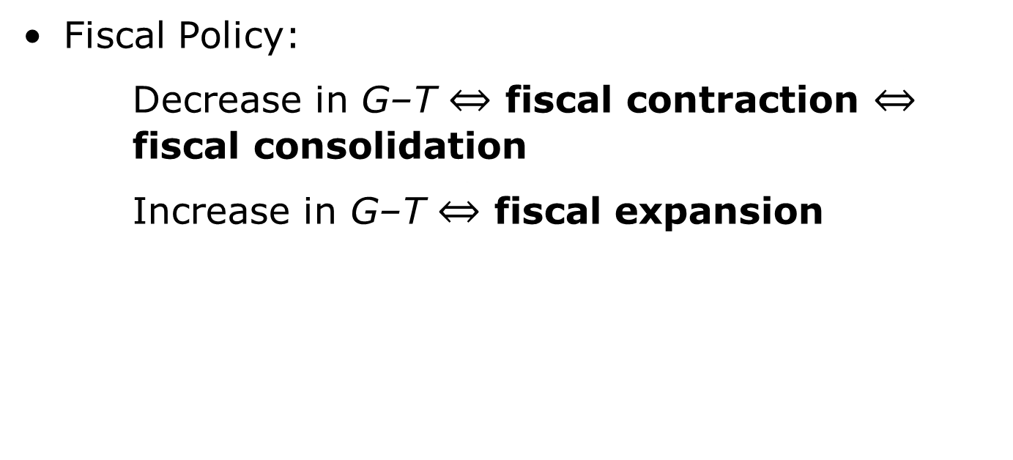
5-3 Putting the IS and the LM Relations Together
Fiscal Policy:
Decrease in G–T $\underset{⇔}{−}$ fiscal contraction $\underset{⇔}{−}$ fiscal consolidation
Increase in G–T $\underset{⇔}{−}$ fiscal expansion

Slide 15
5-3 Putting the IS and the LM Relations Together
Steps for analyzing the effects of changes in policy or exogenous variables:
  Does it shift the IS curve and/or the LM curve?
  What does this do to equilibrium output and the equilibrium interest rate?
  Describe the effects in words.

Slide 16
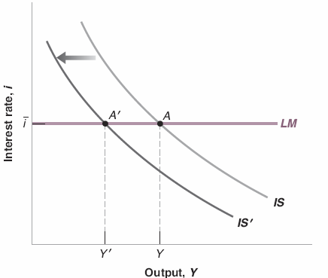
5-3 Putting the IS and the LM Relations Together
Figure 5-6 The Effects of an Increase in Taxes
An increase in taxes shifts the IS curve to the left.
This leads to a decrease in the equilibrium level of output.

Slide 17
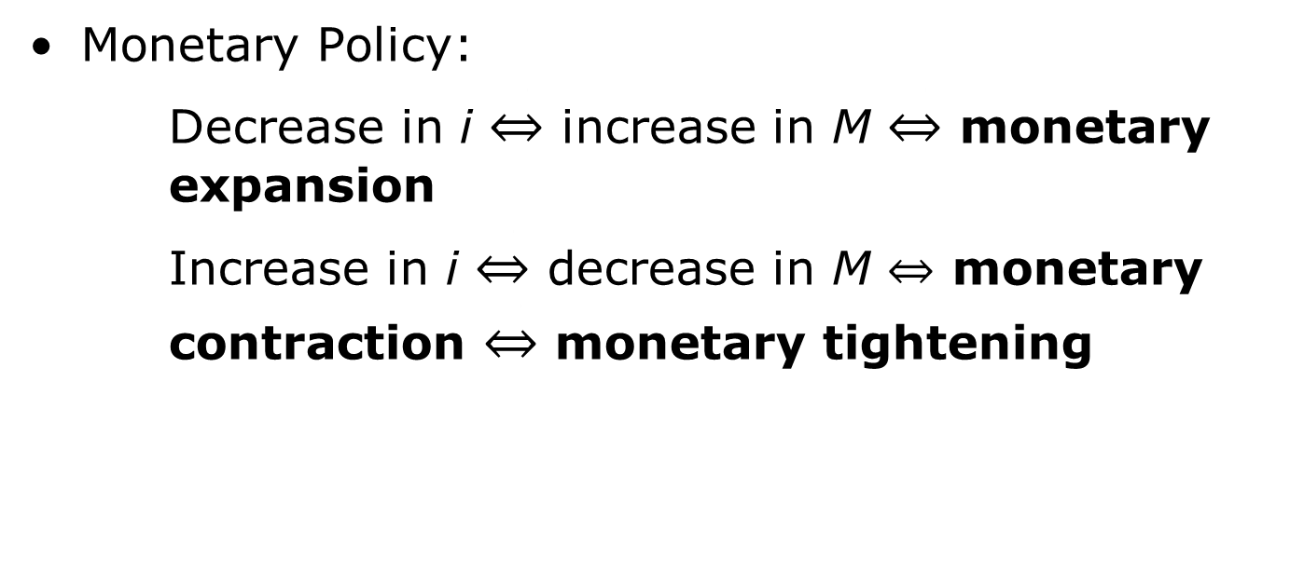
5-3 Putting the IS and the LM Relations Together
Monetary Policy:
Decrease in i $\underset{⇔}{−}$ increase in M $\underset{⇔}{−}$ monetary expansion
Increase in i $\underset{⇔}{−}$ decrease in M $\underset{⇔}{−}$ monetary contraction $\underset{⇔}{−}$ monetary tightening

Slide 18
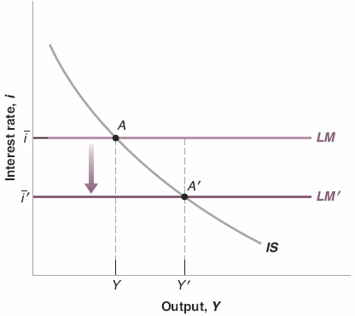
5-3 Putting the IS and the LM Relations Together
Figure 5-7 The Effects of a Decrease in the Interest Rate
A monetary expansion shifts the LM curve down, and leads to higher output.

Slide 19
5-4 Using a Policy Mix
Monetary-fiscal policy mix is the combination of monetary and fiscal policies.
Suppose that the economy is in a recession and output is too low.
Both fiscal and monetary policies can be used to increase output.

Slide 20
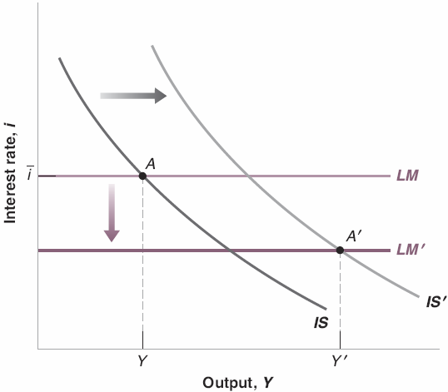
5-4 Using a Policy Mix
Figure 5-8 The Effects of a Combined Fiscal and Monetary Expansion
The fiscal expansion shifts the IS curve to the right.
A monetary expansion shifts the LM curve down.
Both lead to higher output.

Slide 21
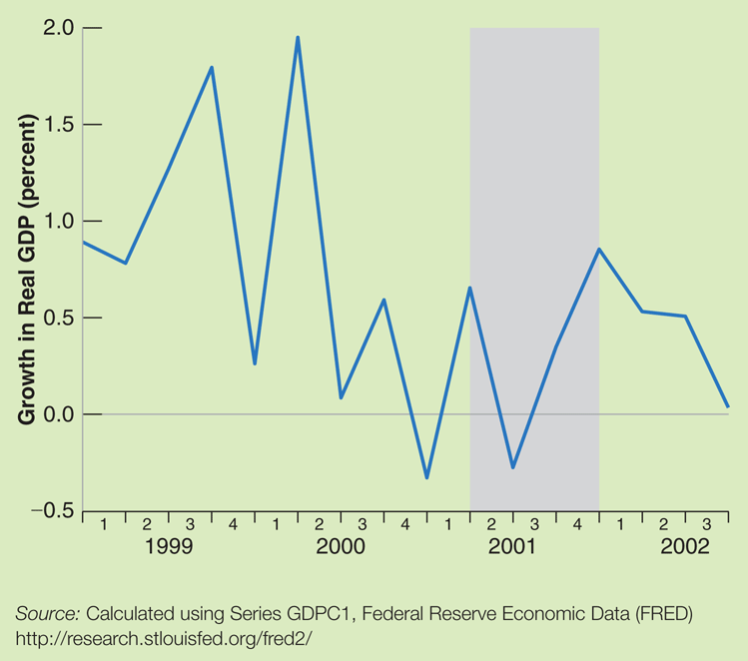
Focus: The U.S. Recession of 2001
Figure 1 The U.S. Growth Rate, 1999–1 to 2002–4
The National Bureau of Economic Research concluded that the U.S. economy was in a recession between March 2001 and December 2001, triggered by sharp declines in investment demand.

Slide 22
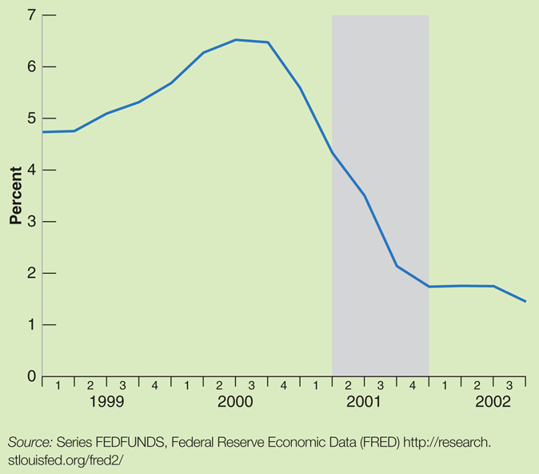
Focus: The U.S. Recession of 2001
Figure 2 The Federal Funds Rate, 1999–1 to 2002–4
The recession was met by strong macroeconomic policy response.
The Fed cut the federal funds rate from 6.5% in January to 2% at the end of 2001.

Slide 23
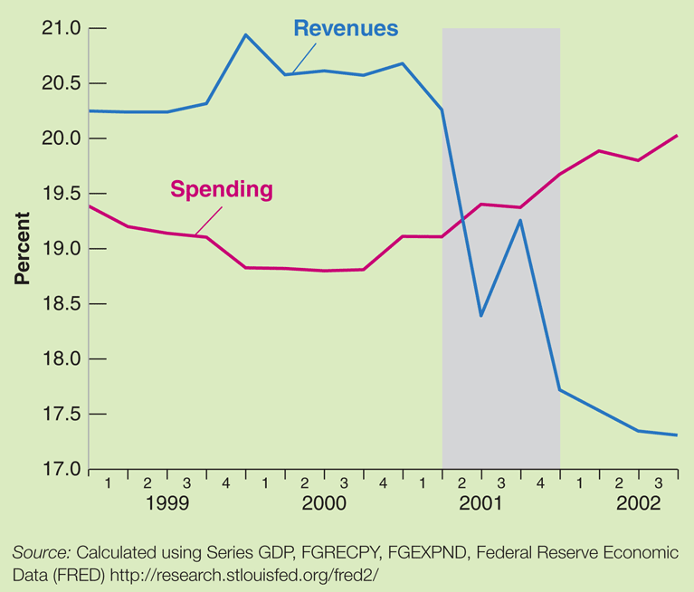
Focus: The U.S. Recession of 2001
Figure 3 U.S. Federal Government Revenues and Spending (as Ratios to GDP), 1999–1 to 2002–4
President George Bush also cut taxes in 2001 and 2002 budgets. The events of September 11, 2001 also lead to an increase in spending on defense and homeland security.

Slide 24
FOCUS: Deficit Reduction: Good or Bad for Investment?
Equilibrium in the goods market implies (recall Chapter 3):
I = S + (T − G)
Given private saving (S), a lower government deficit (higher T − G) means higher I.
However, a fiscal contraction lowers output and so S goes down by more than T − G increases, so I decreases.

Slide 25
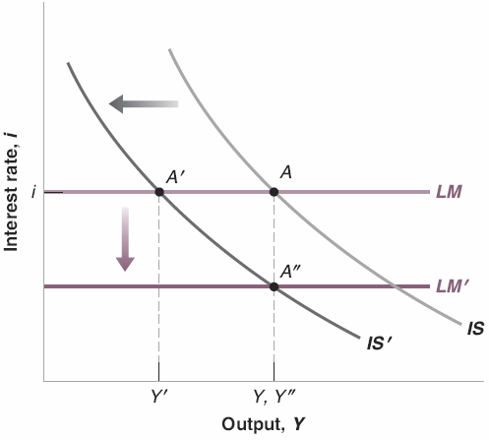
5-4 Using a Policy Mix
Figure 5-9 The Effects of a Combined Fiscal Consolidation and a Monetary Expansion
The fiscal consolidation shifts the IS curve to the left.
A monetary expansion shifts the LM curve down.
This allows for the reduction in the deficit without a recession.

Slide 26
5-5 How Does the IS-LM Model Fit the Facts?
Because the adjustment of output takes time, we need to reintroduce dynamics:
  Consumers are likely to take time to adjust their consumption following a change in disposable income.
  Firms are likely to take time to adjust investment spending following a change in their sales.
  Firms are likely to take time to adjust investment spending following a change in the interest rate.
  Firms are likely to take time to adjust production following a change in their sales.

Slide 27
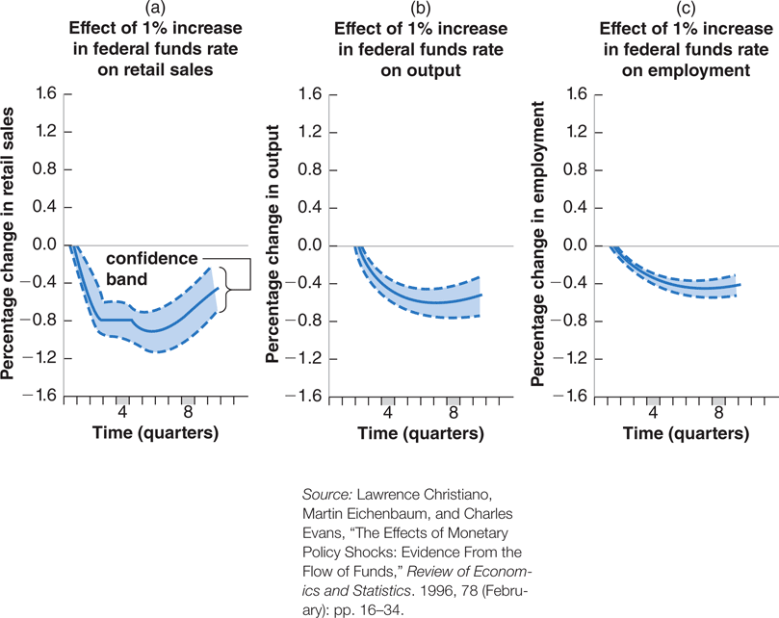
5-5 How Does the IS-LM Model Fit the Facts?
Figure 5-10 The Empirical Effects of an Increase in the Federal Funds Rate
In the short run, an increase in the federal funds rate leads to a decrease in output and to an increase in unemployment, but it has little effect on the price level.

Slide 28
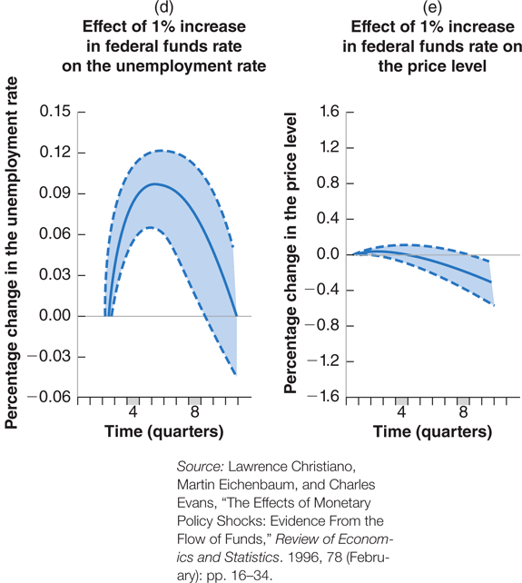
5-5 How Does the IS-LM Model Fit the Facts?
Figure 5-10 The Empirical Effects of an Increase in the Federal Funds Rate

