Slide 1
Output, the Interest Rate, and the Exchange Rate
Chapter 19

Slide 2
Chapter 19 Outline
Output, the Interest Rate, and the Exchange Rate
19-1 Equilibrium in the Goods Markets
19-2 Equilibrium in the Financial Markets
19-3 Putting Goods and Financial Markets Together
19-4 The Effects of Policy in an Open Economy
19-5 Fixed Exchange Rates
APPENDIX Fixed Exchange Rates, Interest Rates, and Capital Mobility

Slide 3
Output, the Interest Rate, and the Exchange Rate
In Chapter 18, we treated the exchange rate as one of the policy instruments available to the government.
The exchange rate is not a policy instrument, but instead it is determined in the foreign exchange market.
In this chapter, we examine the implications of equilibrium in both the goods market and financial markets, including the foreign exchange market.
The model is an extension to the open economy of the IS-LM model and it is known as the Mundell-Fleming model.

Slide 4


19-1 Equilibrium in the Goods Market
Recall the equilibrium condition in Chapter 18:
which can be rewritten as:
If ε = E, then goods market equilibrium implies that output depends negatively on both the nominal interest rate and the nominal exchange rate:

Slide 5


19-2 Equilibrium in Financial Markets
Recall the arbitrage relation or the interest parity condition in Chapter 17:
Assume the expected future exchange rate as given, so
which tells us that:
  An increase in the domestic interest rate leads to an increase in the exchange rate.
  An increase in the foreign interest rate leads to a decrease in the exchange rate.
  An increase in the expected future exchange rate leads to an increase in the current exchange rate.

Slide 6
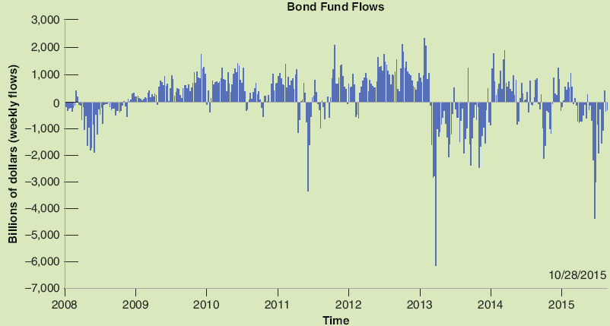
FOCUS: Sudden Stops, Safe Havens, and the Limits to the Interest Parity Condition
Sudden stops in emerging countries occurred when the interest parity failed and their exchange rates decreased a lot.
Figure 1 The Equity Flows to Emerging Countries since June 2008

Slide 7
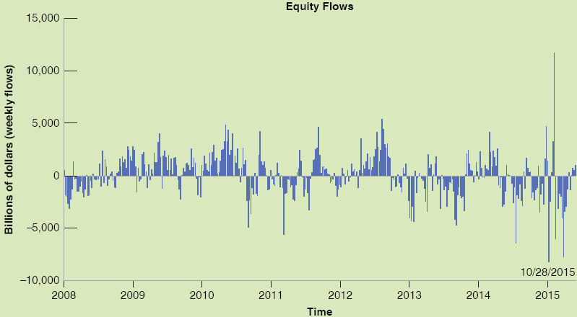
FOCUS: Sudden Stops, Safe Havens, and the Limits to the Interest Parity Condition
(cont’d)
In times of crisis, the United States is widely seen as a safe haven by investors.
Figure 1 The Equity Flows to Emerging Countries since June 2008 (cont’d)

Slide 8
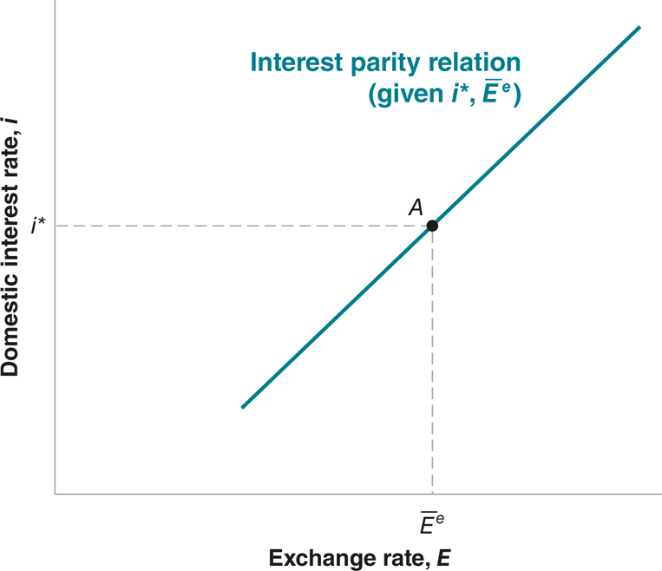
19-2 Equilibrium in Financial Markets
Figure 19-1 The Relation between the Interest Rate and the
Exchange Rate Implied by Interest Parity
A higher domestic interest rate leads to a higher exchange rate—an appreciation.

Slide 9
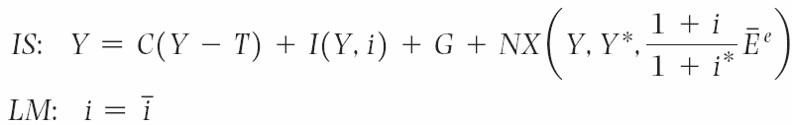
19-3 Putting Goods and Financial Markets Together
The open economy versions of the familiar IS and LM relations:
An increase in the interest rate now has two effects:
  The direct effect on investment
  The secondary effect through the exchange rate

Slide 10
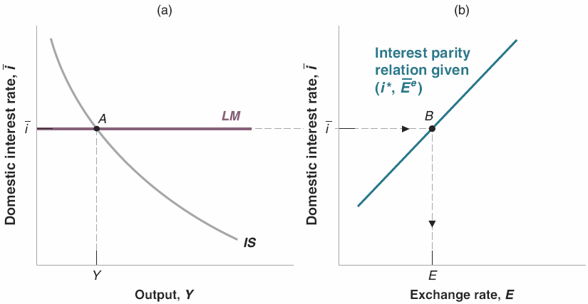
19-3 Putting Goods and Financial Markets Together
Figure 19-2 The IS–LM Model in the Open Economy
An increase in the interest rate reduces output both directly and indirectly (through the exchange rate). The IS curve is downward sloping. The LM curve is horizontal, as in Chapter 6.

Slide 11
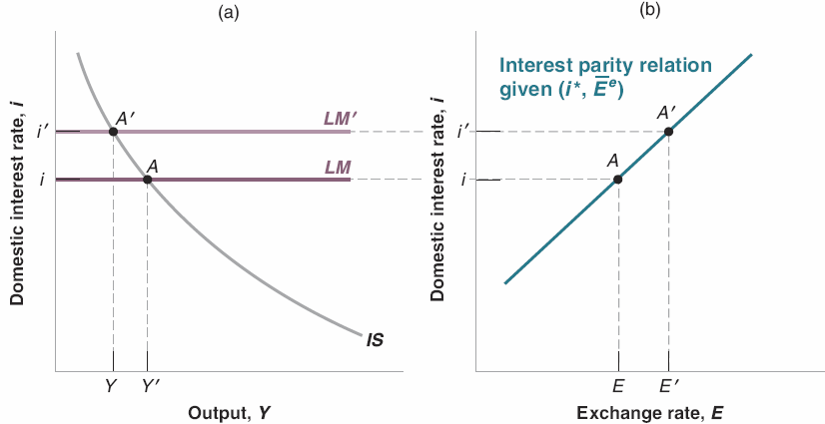
19-4 The Effects of Policy in an Open
Economy
Figure 19-3 The Effects of an Increase in the Interest Rate
An increase in the interest rate leads to a decrease in output and an appreciation.

Slide 12
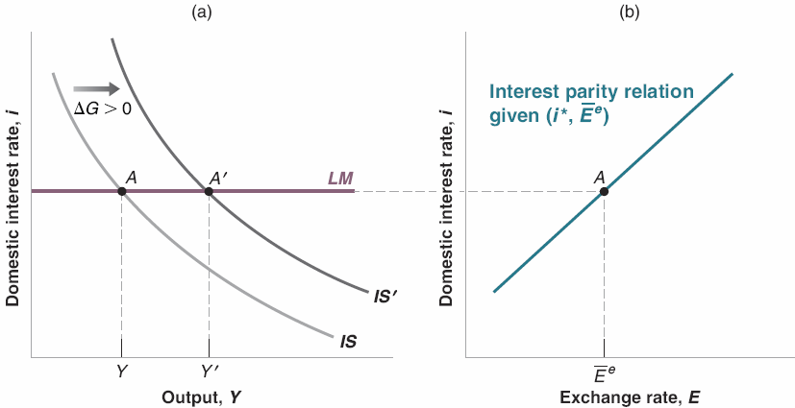
19-4 The Effects of Policy in an Open
Economy
Figure 19-4 The Effects of an Increase in Government Spending with an Unchanged Interest Rate
An increase in government spending leads to an increase in output. If the central bank keeps the interest rate unchanged, the exchange rate
also remains unchanged.

Slide 13
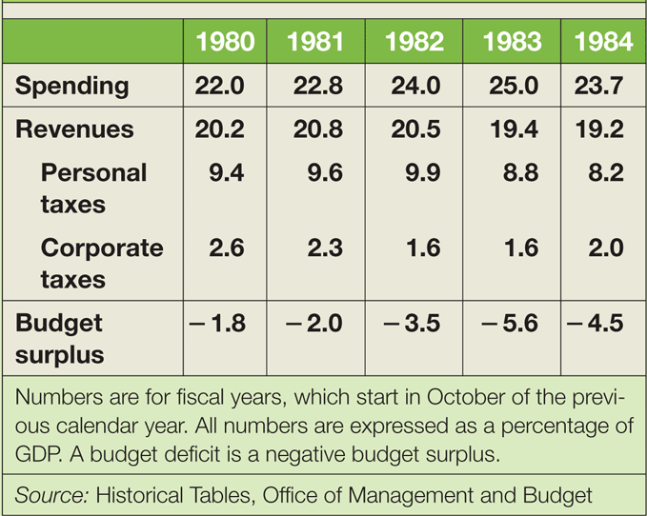
FOCUS: Monetary Contraction and Fiscal Expansion: The United States in the Early 1980s
The supply siders argued that a cut in tax rates would cause people and firms to work much harder and more productively, resulting in an increase, not a decrease in tax revenues.
Table 1 The Emergence of Large U.S. Budget Deficits, 1980–1984, (Percent of GDP)

Slide 14
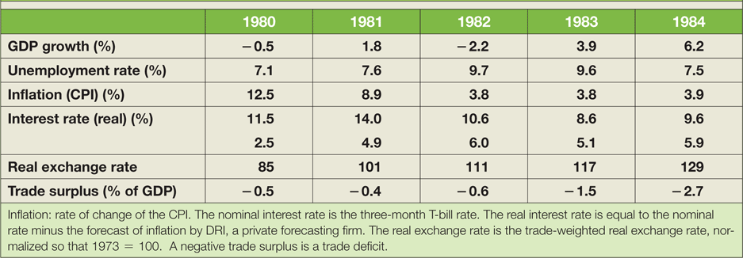
FOCUS: Monetary Contraction and Fiscal Expansion: The United States in the Early 1980s (cont’d)
The combined effects of higher interest rates and a fiscal expansion were very much in line with what the Mundell-Fleming model predicts.
By the mid-1980s, the twin-deficits (the budget deficit and the trade deficit) were the main macroeconomic policy issue.
Table 2 Major U.S. Macroeconomic Variables, 1980–1984

Slide 15
19-5 Fixed Exchange Rates
Some countries peg their currency to the dollar.
Some countries operate under a crawling peg by moving to an exchange rate target slowly.
The European Monetary System (EMS) determined the movements of exchange rates within the European Union from 1978 and 1998.
In the EMS, member countries agreed to maintain their exchange rate relative to the other currencies in the system within narrow limits or bands around a central parity—a given value for the exchange rate.
Beginning on January 1, 1999, a number of those European countries adopted a common currency, the euro.

Slide 16


19-5 Fixed Exchange Rates
Recall the interest rate parity condition:
If the country pegs the exchange rate so that , which also is the expectation of the future exchange rate, then the interest rate relation becomes:
Under a fixed exchange rate and perfect capital mobility, the domestic interest rate must be equal to the foreign interest rate.
Under fixed exchange rates, the central bank gives up monetary policy as a policy instrument.

Slide 17
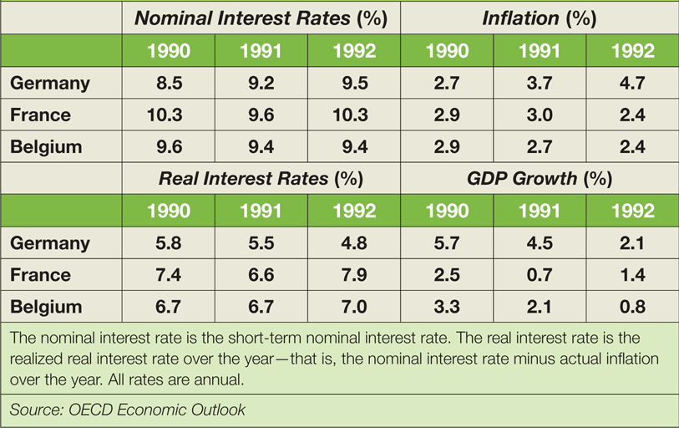
FOCUS: German Reunification, Interest Rates, and the EMS
German reunification in 1990 led to large increases in demand and interest rates in Germany.
To stay in the fixed exchange regime of the EMS, other European members had to match German interest rates, leading to decreases in their output.
Table 1 German Reunification, Interest Rates, and Output Growth: Germany, France, and Belgium, 1990–1992

Slide 18
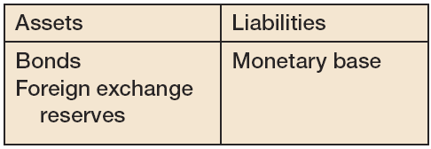
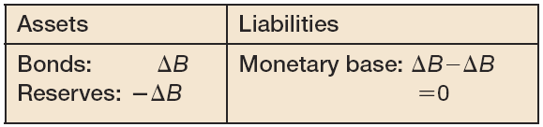
APPENDIX: Fixed Exchange Rates, Interest Rates, and Capital Mobility
Figure 1 Balance Sheet of the Central Bank
Figure 2 Balance Sheet of the Central Bank after an Open Market Operation, and the Induced Intervention in the Foreign Exchange Market

Slide 19
APPENDIX: Fixed Exchange Rates, Interest Rates, and Capital Mobility
Under fixed exchange rates and perfect capital mobility, the only effect of the open market operation is to change the composition of the central bank’s balance sheet but not the monetary base, nor the interest rate.
With imperfect capital mobility, the net effects of the initial open market operation and the following foreign exchange interventions are likely to be an increase in the monetary base; a decrease in the domestic interest rate; an increase in the central bank’s bond holdings; and some loss in reserves of foreign currency.

Slide 20
APPENDIX: Fixed Exchange Rates, Interest Rates, and Capital Mobility
With imperfect capital mobility, a country has some freedom to move the domestic interest rate while maintaining its exchange rate.
That freedom depends on:
the degree of development of its financial markets and the willingness of domestic and foreign investors to shift between domestic assets and foreign assets
the degree of capital controls
the amount of foreign exchange reserves it holds

