Slide 1


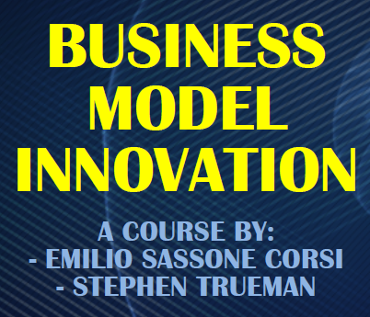
AIRBNB CASE STUDY
TEAM MEMBER:
Claudio Caprioli
Martina Di Carlo
Yali Men
Alexandra Suslova

Slide 2
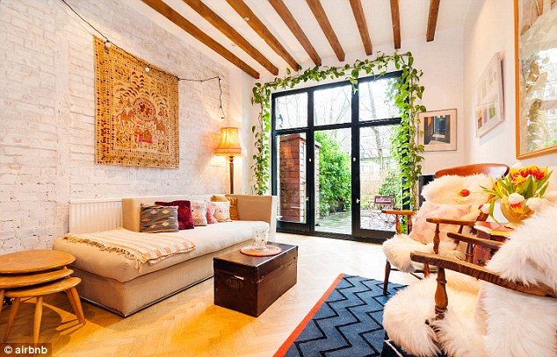

AGENDA
COMPANY
OVERVIEW
BUSINESS MODEL
UNDERSTAND THE BUSINESS
GROUPBNB

Slide 3
AGENDA
COMPANY
OVERVIEW
BUSINESS MODEL
UNDERSTAND THE BUSINESS
GROUPBNB

Slide 4
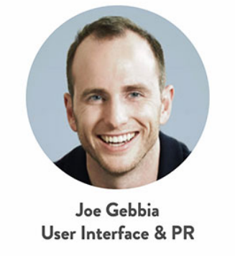

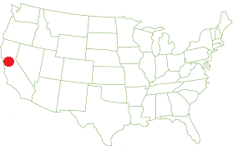


Airbnb
COMPANY OVERVIEW
Enable travelers to “feel at home anywhere you go in the world” by building connections with local hosts, gaining access to distinctive spaces and culture of their destinations.
AIRBNB MISSION
Airbnb was founded in August 2008 by:
Airbnb is a community-based online platform for listing and renting local homes. It operates as a transaction facilitator between hosts and travelers who are looking for comfortable accommodation at a cheap price.
HEADQUARTERS
San Francisco, California

Slide 5








Airbnb Timeline
COMPANY OVERVIEW
2009
2014
2019
2007
First funding received;
Change in the website;
10.000 users
A law named Airbnb Law was made in San Francisco.
Still growing…
Idea creation
Launch of AirBedandBreakfast.com
Sold cereal boxes and earned $30.000
2018
Other funds obtained and increase in number of users
Additional collections and types of accomodations;
Superguest programme;
Airbnb Plus;
Host an experience.
2010-2013
2008

Slide 6



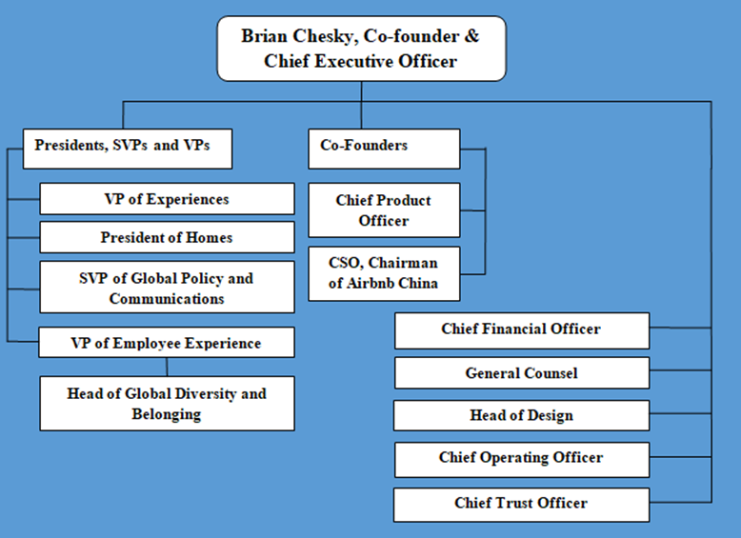


Key Numbers and Structure
COMPANY OVERVIEW
150M+
Total users Worldwide
Organizational Structure overview
2.9M+
Total hosts
$93M+
Profits
191
Countries
65000
Cities

Slide 7
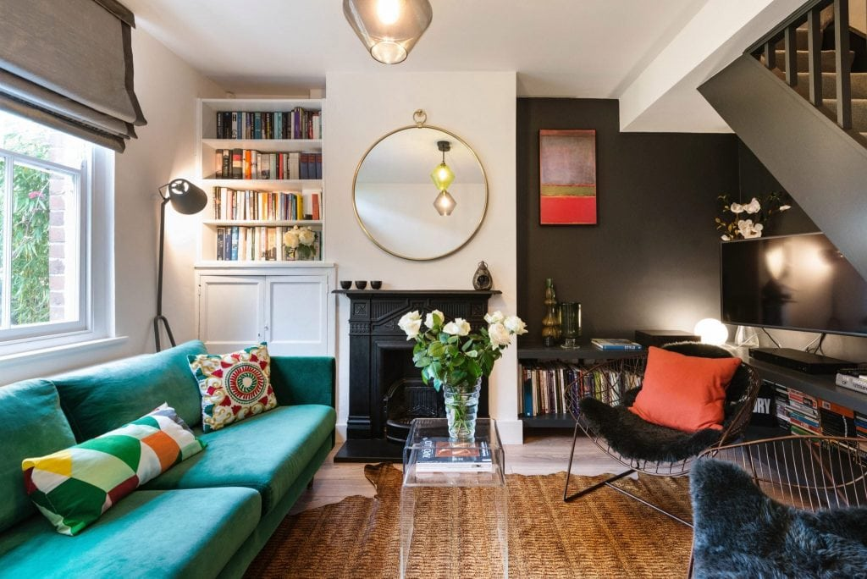
AGENDA
COMPANY
OVERVIEW
BUSINESS MODEL
UNDERSTAND THE BUSINESS
GROUPBNB

Slide 8
SWOT Analysis
BUSINESS MODEL
Strengths
Internal Analysis
Weaknesses
User-friendly platform
Global recognition
Price advantage
Personalization of the service
Law and Regulations
High cost structure
S
W
T
O
Threats
Opportunities
Uncertain regulatory environment
Competitors
External Analysis
Increase security
Expand and create specific services
7

Slide 9
Porter Five Forces Analysis
BUSINESS MODEL
Barriers to entry:
Bargaining power of suppliers
High
Low
Customer and supplier loyalty
Brand name
Supplier switching cost is high
(Big brand name &
Exclusive supply requirement)
Porter's five forces
Threat of substitutes
Bargaining power of customers
Low
High
Buyer switching cost is low
Buyer price sensitivity is high
Degree of differentiation is high
Competitive rivalry
High
Intense competition from hotels
8

Slide 10






AS IT IS
BUSINESS MODEL
New types of accommodationS
Additional coLLectionS
Boutique Hotel and typical residence
Not only «family», «work», but also «honey moon», «weddings», «social stay»
Airbnb plus
Super GUEST PROGRAM
The luxury side of AirBnb, which includes high-quality accomodations (in term of design, high speed connection, services’ functionality
Guest with the best feedback and reviews could obtain further discount
COOKING ON Airbnb Experience
Host an experience
The secret ingredient to local culture. Cook and eat meals with locals who treat you like family
It is possible to organize activies and tours in the host city
9

Slide 11






Product-Service/ Market Matrix
BUSINESS MODEL
 | SINGLE PERSON | Couples | WORKERS | FAMILIES | groups
SINGLE PRIVATE ROOM
SHARED ROOM
ENTIRE APARTMENT
RESTAURANT
EXPERIENCE
10

Slide 12
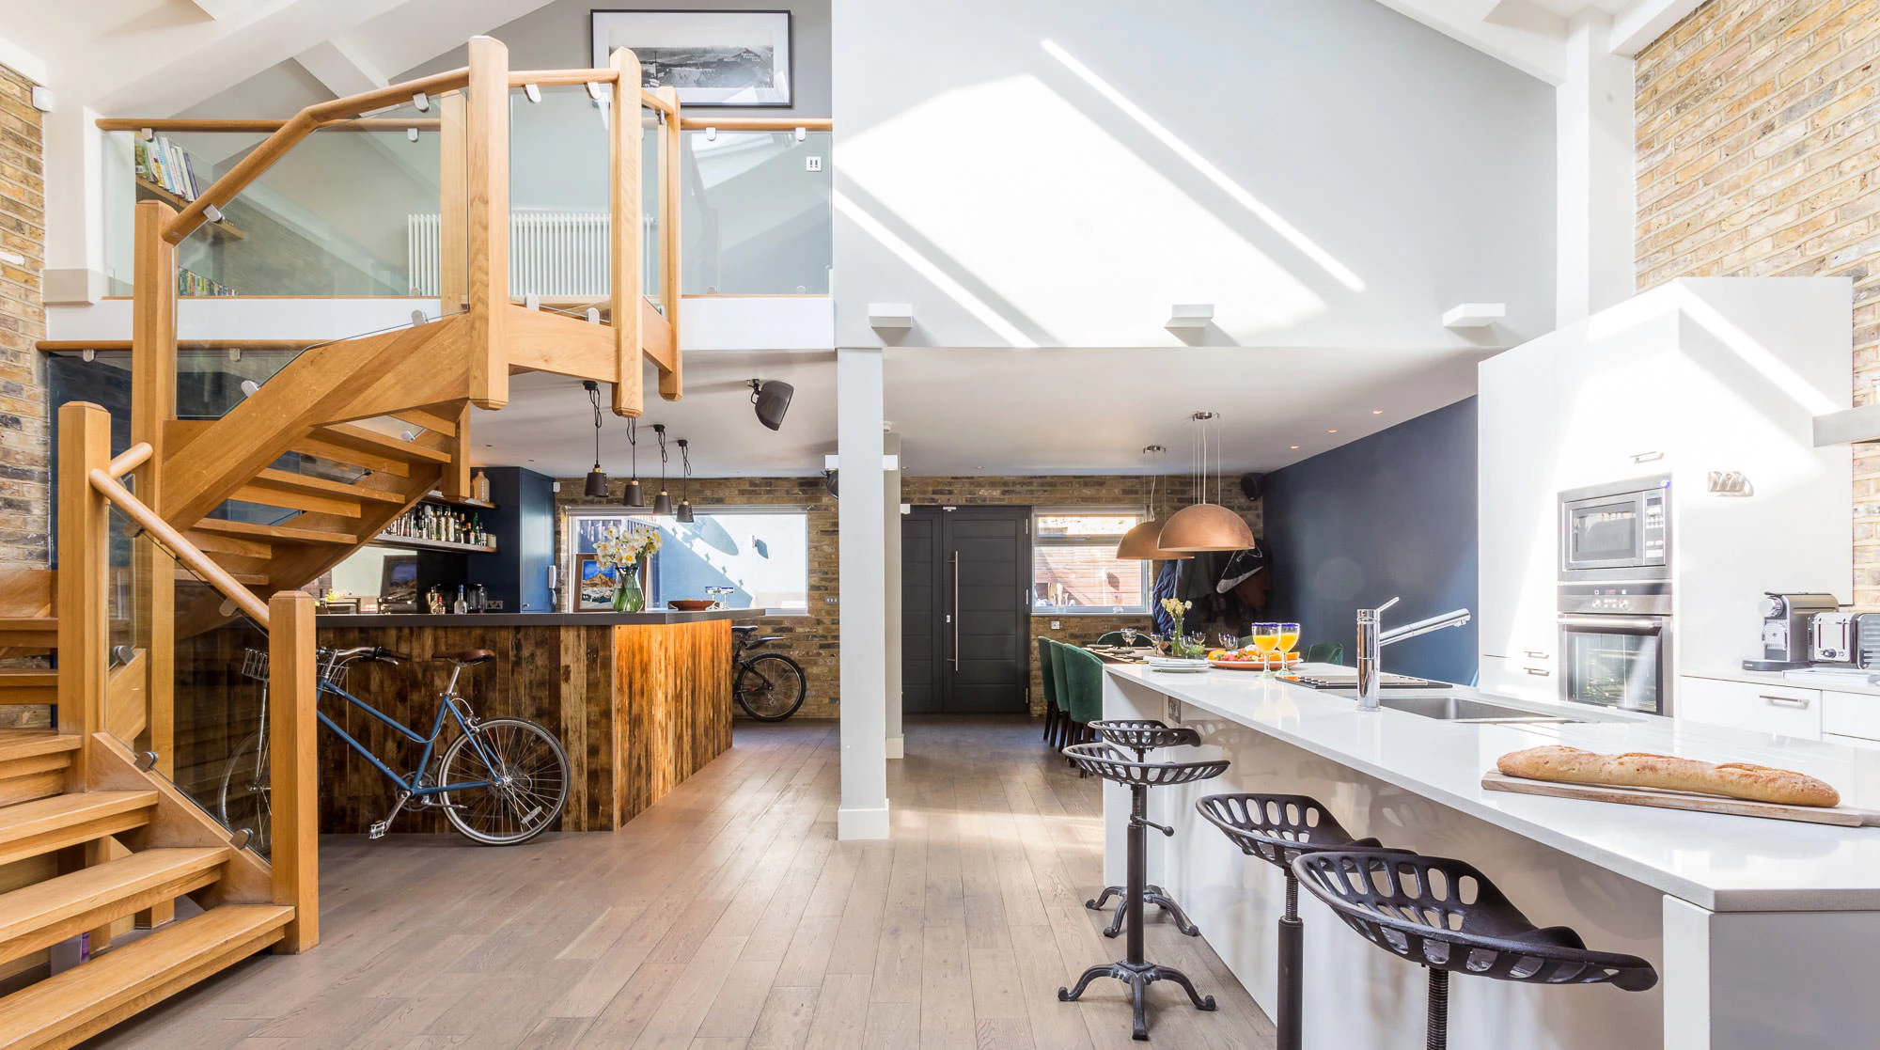
AGENDA
COMPANY
OVERVIEW
BUSINESS MODEL
UNDERSTAND THE BUSINESS
GROUPBNB

Slide 13





AirBnb Business Model Canvas
BUSINESS MODEL CANVAS
Key partners
Key activities
Value proposition
Customer relationships
Customer segments
Marketing;
Recruiting guests;
Platform R&D and maintenance;
Data analysis;
Participants engagement.
Hosts;
Experience providers and restaurants;
Guests.
Interaction between hosts and guests by messages;
Feedbacks and reviews;
Online relationships;
Promotional campaigns for loyal customers;
On-time customers support.
Guests:
Single person;
Workers;
Couples;
Families:
Groups.
Hosts;
Experience providers.
Investors;
IT developers;
Experience providers;
Payment processing channels;
Travel managers;
Business companies;
Car rentals.
Key resources
Brand itself;
People’s capabilities;
Analytics/algorithms;
Platform;
Feedbacks;
Website and App;
Channels
Website;
App;
Word of mouth; Social media.
Cost structure
Revenue streams
Personnel costs;
Online platform creation and maintenance costs.
Transaction fees;
Insurance costs;
Fees from hosts and guests;
Fees from partners.
12

Slide 14




Value Propositions
UNDERSTAND THE BUSINESS
One of a kind stay experience;
Easy and fast finding a place to stay;
Variety of accomodations;
Have fun with diverse types of trips;
Possibility to meet new people;
Easy travel;
Home insurance.
Income generation;
Easy transactions;
Possibility to meet people from all over the world;
Opportunity to select verified guests;
Calendar booking managements.
Profits;
New customers;
New potential feedbacks;
Word of mouth;
Increase of the visibility.
GUESTS
EXPERIENCE PROVIDERS/RESTAURANTS
HOSTS
Guests
Hosts
13

Slide 15
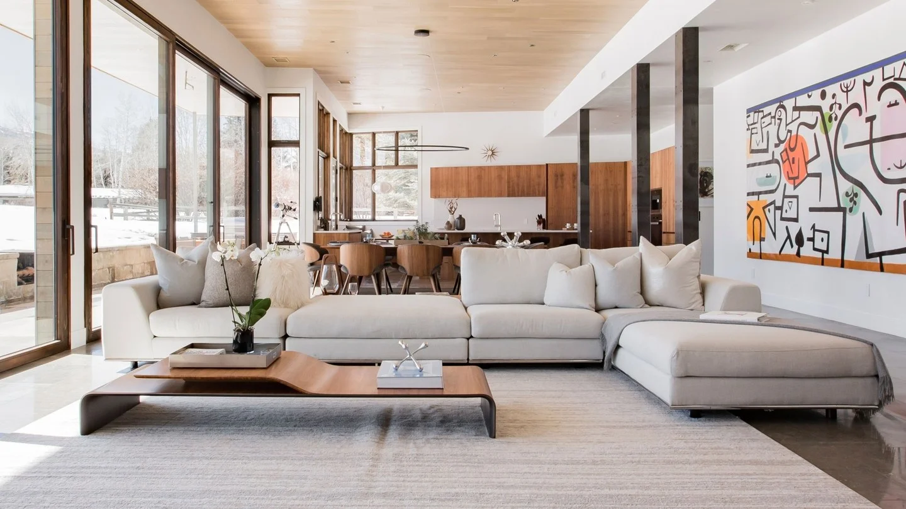
AGENDA
COMPANY
OVERVIEW
BUSINESS MODEL
UNDERSTAND THE BUSINESS
GROUPBNB

Slide 16
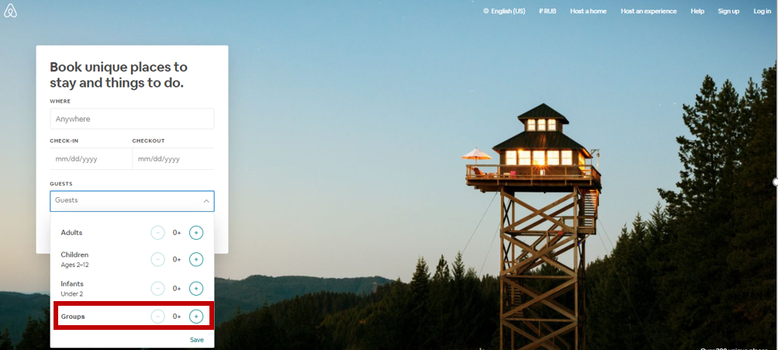





The first Version of GroupBnb
OUR PROTOTYPE
Airbnb for group - gROUPBNB
User-Friendly: Direct access to Group offer from the Home-Page
Social Support: Online support with a Chat-bot in order to select the Best trip for you
Book with 1-click: Create your desired trip, booking all what you need just with 1 click
16

Slide 17
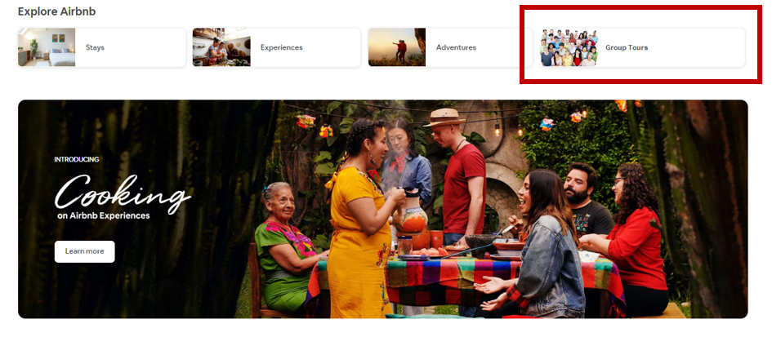



The first Version of GroupBnb
OUR PROTOTYPE
Make new Friends: Possibility to join group already created or create your group leaving the possibility to join it.
Airbnb+ for group.
New Interface that gives the possibility to select “Group” option,
Discount and dedicated offer: If you are a loyal customer you will have a dedicated section with all your dedicated offer
User Friendly: Direct access to specific offer
Travel ticket included: When you book your experience you do not to care about the ticket for the public transport, it is already included
17

Slide 18





Creating GroupBnb
ACTION PLAN – STRATEGY MAP
01
To create a user-friendly section on the website and apps
IT DEPARTMENT Research and employment of new talented resources
02
To have the opportunity to create the best experience at lowest price
Establish the right partnership
03
To reach the greatest number of client, it is essential to elaborate the right plan to promote the new possible solution
DEVELOP A MARKETING PLAN
Insert specific discounts and offers for loyal customers who have already booked an accommodation with Airbnb or have created a successful group experience
04
Improve customer loyalty
Give the possibility to customer to join already existing group or create their own to built the perfect experience
Launch Groupbnb
05
15

Slide 19



Testing the Business Idea: AirBnb Survey
OUR PROTOTYPE
92%
of our sample knows airbnb
53%
of the people are satisfied users of airbnb
89%
Of the Interviewed people would use our new section for group
35%
Of our sample would like that Airbnb will improve its services
18

Slide 20
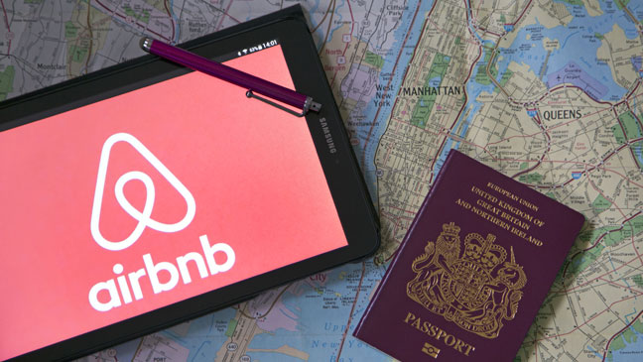
THANK YOU FOR THE ATTENTION!!
Q&A

