Slide 1
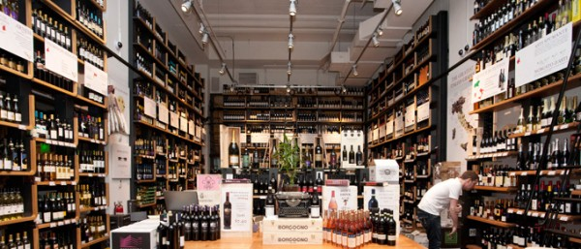

Business Model Innovation
Emmanuel, Sailaja, Gloria, Sandra, Niya

Slide 2
Agenda
About Eataly, Financials, and Organizational structure
Business Model of Eataly
Product-Service/Market matrix
Value proposition
Discover opportunities
Porter’s Five forces/SWOT Analysis
Innovation strategy
Business Model Canvas
Design solution
Strategy Map of Eataly
Final Remarks

Slide 3
OUR HISTORY, OUR FINANCIALS, OUR STRUCTURE

Slide 4
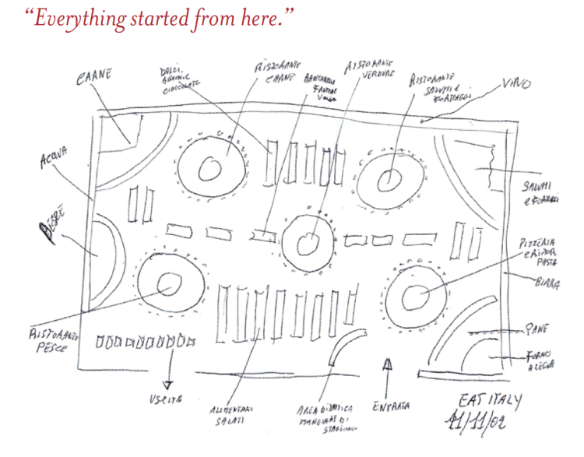
OUR HISTORY
In November 2002, the Eataly concept was born from Oscar Farinetti’s idea sketched on a piece of paper.
The idea was simple: to gather under one roof high-quality food at sustainable and reasonable prices for ALL, celebrate Italian biodiversity, and create an informal, natural, and simple place to eat, shop, and learn.
After five years of research and hard work, the first Eataly opened its doors in Torino on January 27, 2007

Slide 5





FINANCIALS 2018
Our unique business model has allowed us to bring excitement to one of the world’s most mature industries: food
Consolidated Turnover
Growth rate
+ €465 million
In Italy, growth is 12% approximately
In the USA it reached 48%
Rest of Europe: 10% growth rate
Japan and rest of Asia saw growth rate of 7%
Adjusted EBITDA
Total Cash Flow
25 million euros
25 million euros

Slide 6
ORGANIZATIONAL STRUCTURE
FUNCTIONAL STRUCTURE
CEO
Store Director
General Manager
Restaurant
General Manager
Quick Service
General Manager
Retail
Executive Chef
Assistant Manager
Grocery
Assistant Manager
Houseware
Assistant Manager
Grocery
Assistant Manager
Houseware
HR Department
Marketing Department
Facilities Department

Slide 7
BUSINESS MODEL

Slide 8
BUSINESS MODEL
Eataly Business Model Is Revolutionary
Evolving Customer Preference
Ripe High-End Culinary Market
Commitment to Traditional Italian Cuisine
Customer willingness to pay for customization, customer service, variety, and unique experiences has increased exponentially, and Eataly has capitalized on this trend by offering a multi-outlet concept where customers come to the marketplace for more reasons that just a meal.
An unyielding proof that there is a developed market for high-end gastronomy has prompted Eataly’s to develop incredibly high-quality food products and experiential components to fit the mold for these consumers.
Eataly has taken the Italian culinary experience to an entirely different level, differentiating itself from restaurants and markets by elevating the concept of food retail. Eataly has pledged to capture the essence of Italian culture not only through its restaurants, but also through its vivid displays, home-style product offerings, exceptional customer service and transfer of knowledge.
«LEARN AND BUY»

Slide 9
PRODUCT-SERVICE/MARKET MATRIX
Eataly is growing exponentially but has not yet fulfilled its cause in some markets
Product- Services/ Market | Italy | America | Asia-Pacific | Rest of Europe
Food | large | large | medium | Low
Wine & Beverages | large | medium | medium | Low
Restaurant Services | large | large | medium | Low
Retail Services | large | large | medium | Low
Culinary Services | large | large | medium | Low

Slide 10
VALUE PROPOSITION

Slide 11
VALUE PROPOSITION
Attractive value proposition that has proven to be innovative, successful, and scalable.
Customer Value Perception
Customer needs that Are Met
What are the Advantages
Experience (Newness)
Learning the Italian cuisine
Access to high Quality of food
What needs Could be Met
What would make Customer really happy
Price
Opening more stores in local towns

Slide 12
DISCOVER OPPORTUNITY
Customer
Market
Segment
Brand
Share
Recognition
Section 1
Section 2
Section 3
Introduction of events in form Students Fair where students can learn and have an exceptional experiences.
Market: USA
Introduced Digitization to create more Intriguing Customer Experience.
Expand to continents such as Africa, Australia

Slide 13
ANALYSE COMPETITION

Slide 14
PORTER’S FIVE FORCES
Barriers to entry
Threats of Substitution
Zero barrier to entry but we believe that Eataly is in no position to be threatened by the entrant of a new competitor because of its unique operation model and Innovativeness.
Very small threats of substitute because Eataly Concepts stands out from the Industry.
In fact no other company offers value the way Eataly does it
Bargaining power of suppliers
Bargaining power of buyers
Eataly has a strict set of suppliers and partners and we believe that because of Eataly high quality preference and principle they do not have a vast variety of supplier they can rely on.
Therefore, Suppliers have more bargaining power
Buyers we believe come to Eataly to have a unique experience that we can guarantee them. In the food industry, there are no identical product/service that our customer can switch to.
Eataly holds more power because of our powerful customer base
Competition/Rivalry
As of now, there are few players that are trying to disturb the Eataly’s Leadership.
In terms of grocery, there are big competitors such as Carreffour

Slide 15
SWOT ANALYSIS
HELPFUL | HARMFUL
INTERNAL | STRENGTHS Large variety of food selection Worldwide store locations and large workforce Collaboration with high skilled Italian chefs Cooking classes and events | WEAKNESSES No specific target market. Eataly target tourist and people living in the cities Due to quality, Price can be a problem for customers Only found in Large cities or remote areas
EXTERNAL | OPPORTUNITIES Use Paid marketing in addition to in store promotion Offer other services like catering services for events or corporate events Digitization can be the way forward | THREATS Business strategy easy to imitate No barriers to entry can allow market saturation

Slide 16

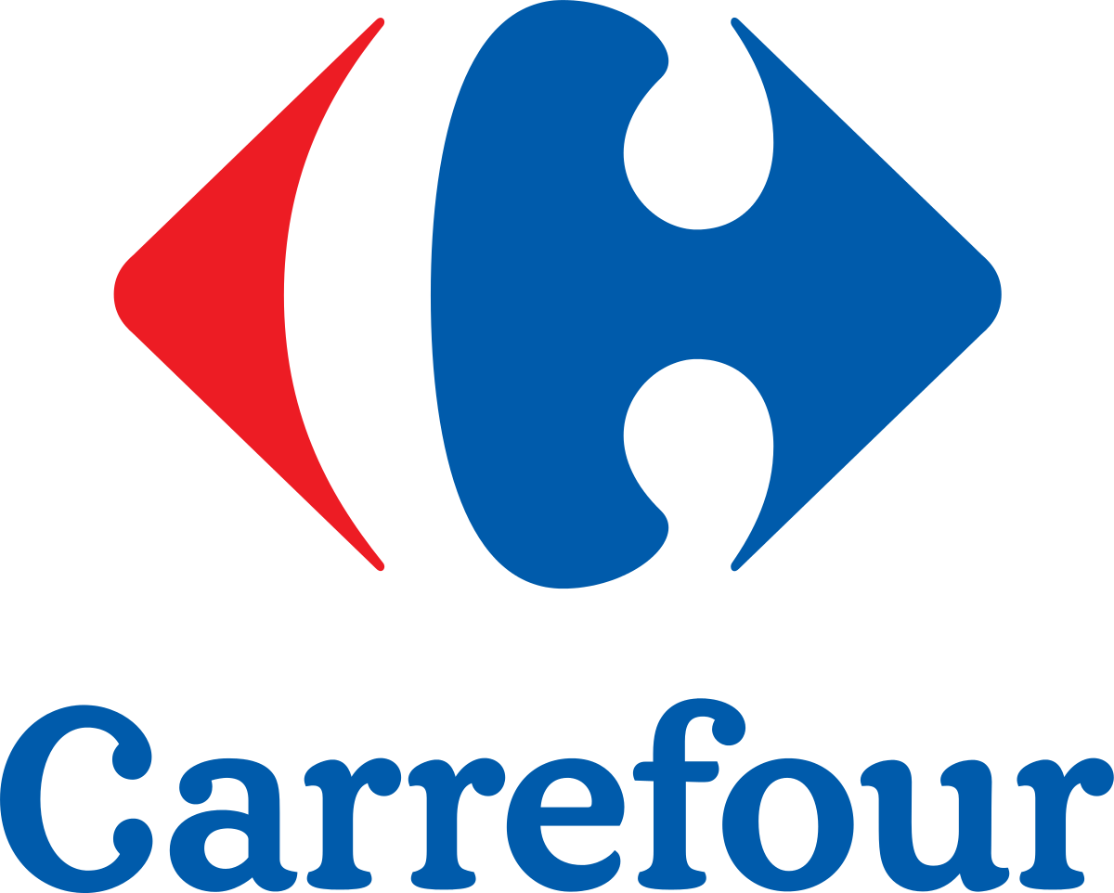





POSITIONING MAP
High Experience
More Expensive
Less Expensive
Low Experience

Slide 17
INNOVATION STRATEGY, BUSINESS MODEL CANVAS, AND DESIGN SOLUTION

Slide 18
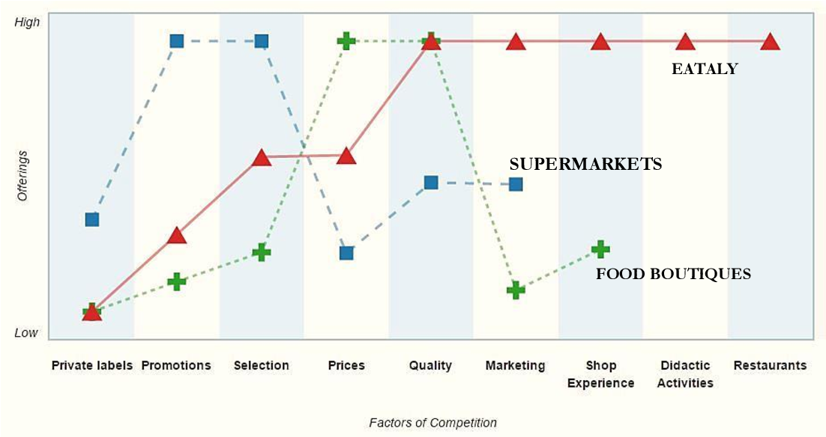
INNOVATION STRATEGY

Slide 19
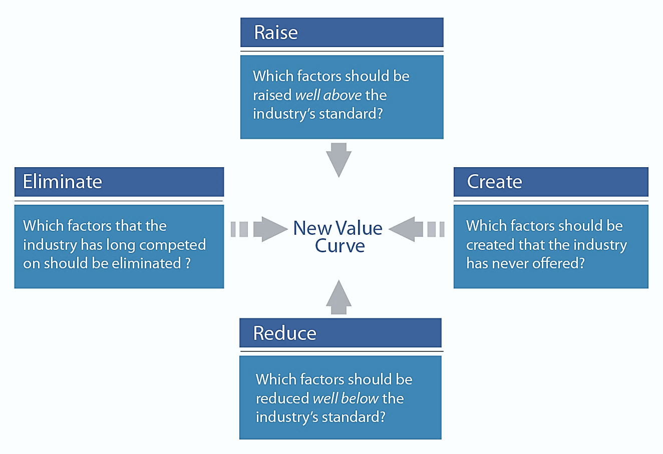

Slide 20
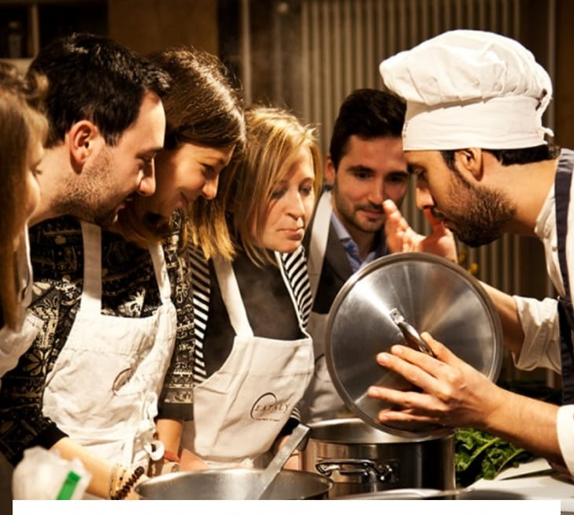
INNOVATION STRATEGY
The “Eat, Buy, Learn” soul of Eataly is present in the value curve seen previously, with the following three strategy moves:
Shop Experience : a slow, living, and dynamic store, full of culinary initiatives, highly skilled personnel, and overwhelming informative posters where customers get actively involved.
Didactic Activities : they are events meant to educate to educate grownups, kids and retired people at eating well and living better.
Restaurants : strategic areas where customers can taste the products offered in the grocery departments and finally decide to buy them or simply to spend time together enjoying the taste and the fragrances of high-end products.

Slide 21
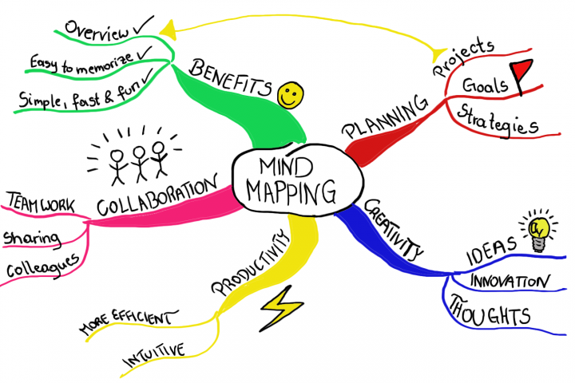
CREATIVE PROCESS

Slide 22
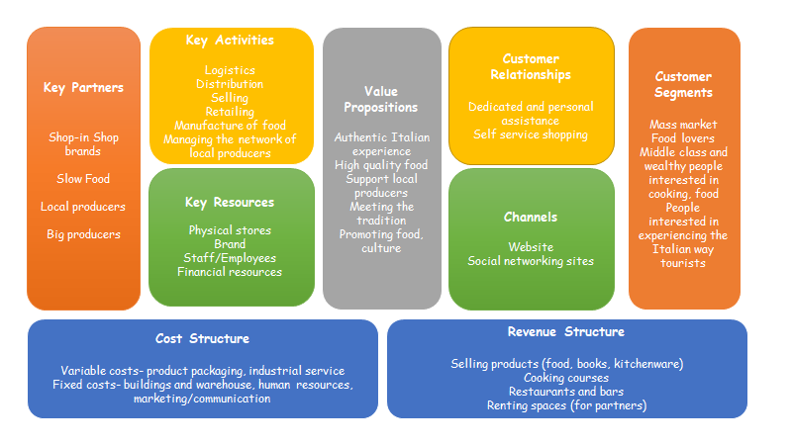
BUSINESS MODEL CANVAS

Slide 23
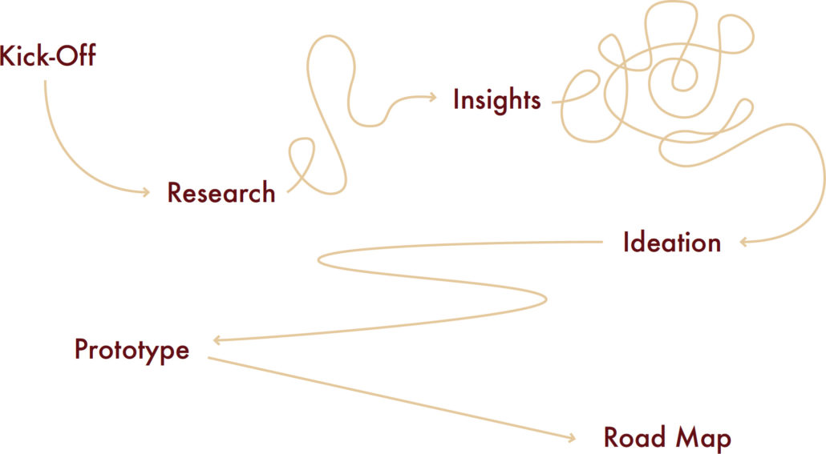
DESIGN SOLUTION
Customer research and observation revealed key retail experience issues for Eataly:
While the broad product offering was a virtue, the store shelves felt overwhelming and unfocused due to their arrangement and the store’s layout
The experience felt more “American” than authentically Italian
The Eataly brand took a backseat to the brands offered for sale
The team took these customer insights and began prototyping possible solutions to address the issues. These included concepts that employed printed collateral, concepts for displays and point of purchase, and wayfinding enhancements.

Slide 24
DESIGN SOLUTION
The in-store Beacon aims to help visitors with little knowledge of Italian dishes or customers in a hurry. A few Italian dishes digitally displayed direct people to ingredients or offers to have these waiting at the checkout counter.
Light Cube helps shoppers locate food sections from a distance and informs people about what is nearby with large-scale graphics and navigational signage projected on the floor.
Story Blocks inform customers about Italian ingredients through brief digital interactions. They are found in the shelves alongside the products. One version was called “Ask Nonna.” engaging visitors with stories of food and answering questions about Italian cuisine.

Slide 25
STRATEGY MAP OF EATALY AND FINAL CONCLUSION

Slide 26
Finance | Cost Reduction Reduce product/services cost per unit Reduce selling/administration cost | Revenue Growth Encourage private parties or special events Attract more customers Increase number of new products | Asset Utilization Increase asset utilization
Customers | Existing Market Increase Loyalty Increase Customer profitability Get involved in the local community | New Market Increase Market Share Organize events | Reputation Ask review from Customer Look at the Competition
Internal Business Process | Increase Customer Relationship Follow up with guests regularly Be authentic Increase service efficiency and quality | Increase Supplier Relationship Be opened about your plans and goals Increase long term relationship | Operations Decrease process cost Increase efficiency and quality
Learning and Growth | Employee Motivation Increase motivation in high level | Employee Satisfaction Increase satisfaction of employees and reduce turnover | Enhance Employee Capabilities Improve quality of training Attract quality employees 26

Slide 27
CONCLUSION
Eataly, the largest Italian food ambassador in the world. It is possible to remind the removal of intermediaries with suppliers, a tactic implemented to ensure a direct contact with the small producers and thus, to reduce the extremely high prices usually linked to superior products. The organization also created an atmosphere in which, through the sapient use of emotional and communicative marketing, the customer can breathe a remarkable shop experience characterized by a business model based on the “eat, buy, learn” soul.
To conclude, Eataly is a pioneer in the food industry, a business that radically overturned the previously accepted industry boundaries by matching together seemingly opposing concepts in a multidimensional shop experience

Slide 28
THANK YOU!
SAILAJA
SANDRA
EMMANUEL
GLORIA
NIYA

