Slide 1
Bagging and Random Forests
Chapter 08 (part 02)
Disclaimer:
This PPT is modified based on IOM 530: Intro. to Statistical Learning
"Some of the figures in this presentation are taken from "An Introduction to Statistical Learning, with applications in R" (Springer, 2013) with permission from the authors:
G. James, D. Witten, T. Hastie and R. Tibshirani "
http://speech.ee.ntu.edu.tw/~tlkagk/courses/ML_2016/Lecture/Ensemble%20(v6).pdf

Slide 2
Outline
Bagging
  Bootstrapping
  Bagging for Regression Trees
  Bagging for Classification Trees
  Out-of-Bag Error Estimation
  Variable Importance: Relative Influence Plots
Random Forests
Boosting

Slide 3
bagging

Slide 4
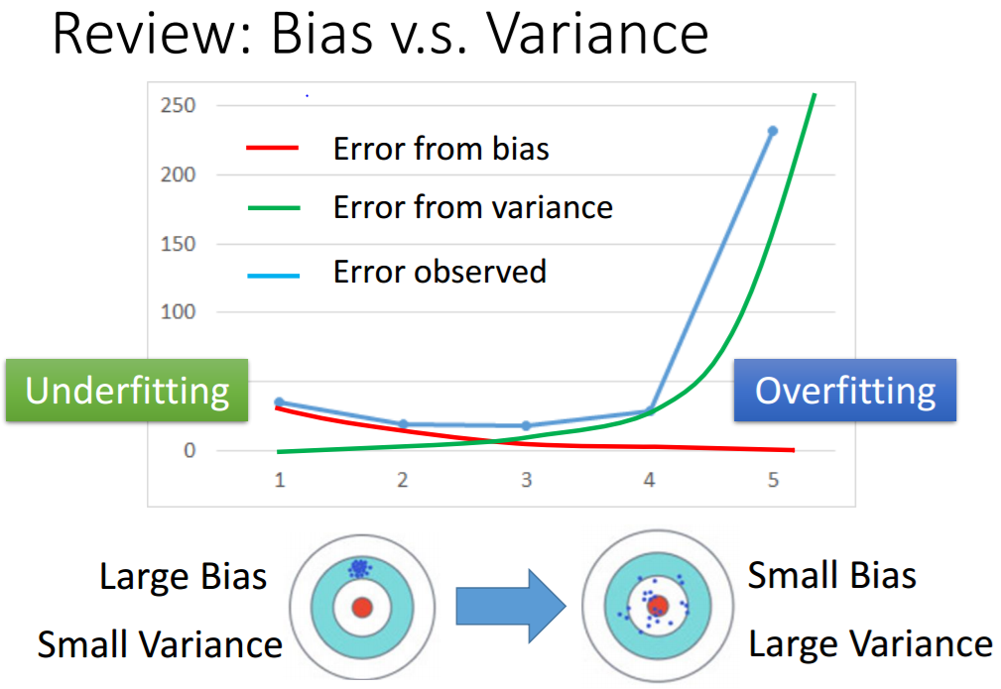
Problem!
http://speech.ee.ntu.edu.tw/~tlkagk/courses/ML_2016/Lecture/Ensemble%20(v6).pdf

Slide 5
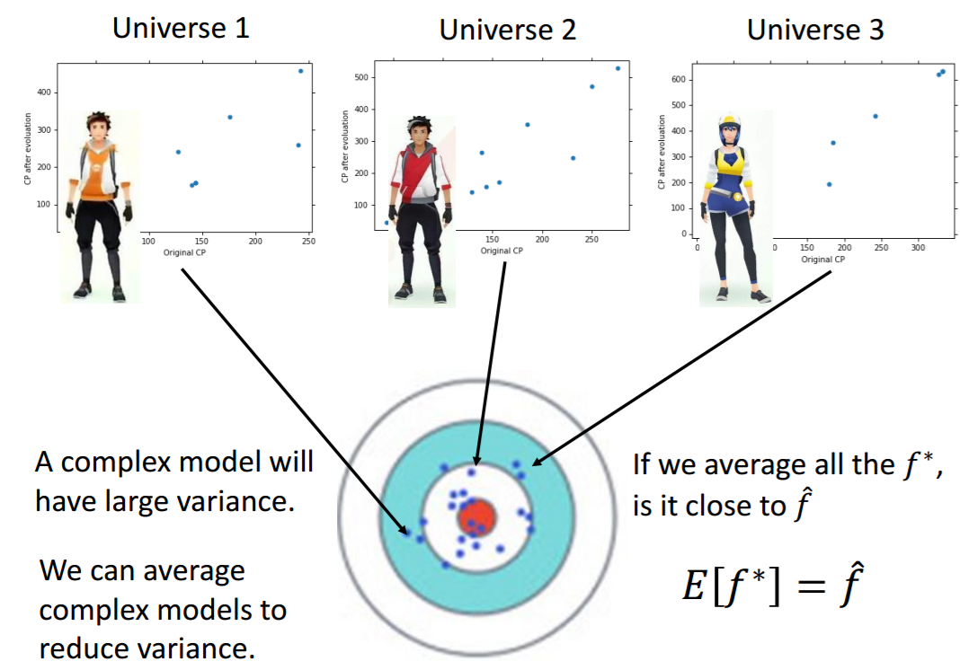
http://speech.ee.ntu.edu.tw/~tlkagk/courses/ML_2016/Lecture/Ensemble%20(v6).pdf

Slide 6
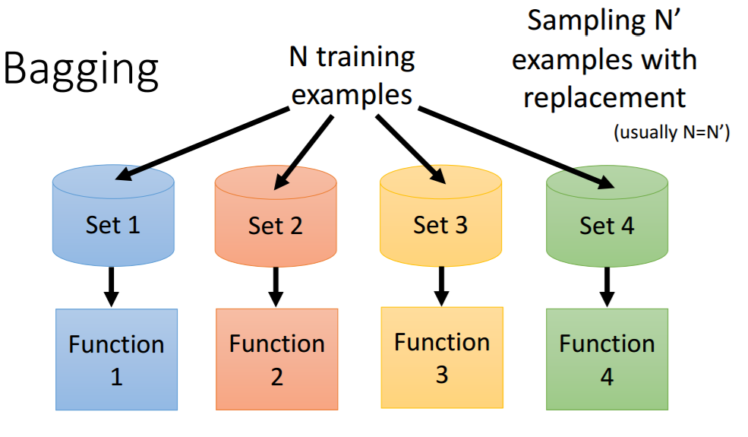
http://speech.ee.ntu.edu.tw/~tlkagk/courses/ML_2016/Lecture/Ensemble%20(v6).pdf

Slide 7
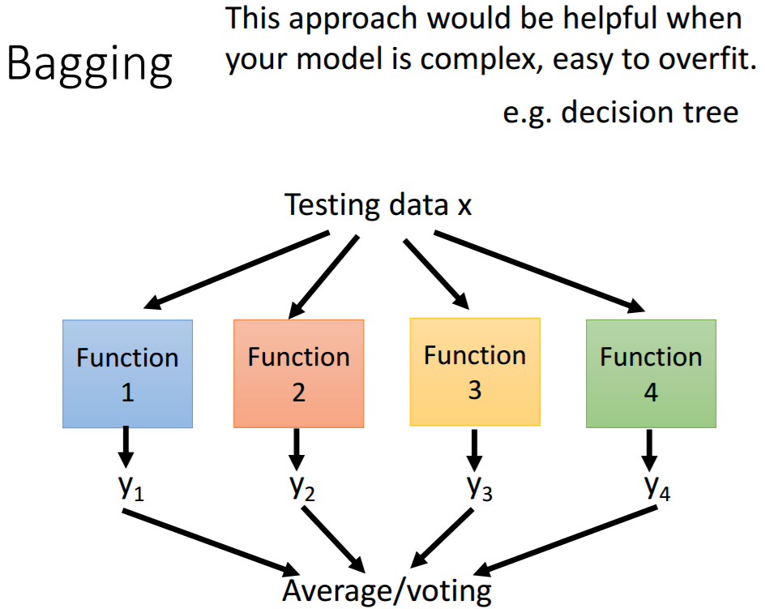
http://speech.ee.ntu.edu.tw/~tlkagk/courses/ML_2016/Lecture/Ensemble%20(v6).pdf

Slide 8
Problem!
Decision trees discussed earlier suffer from high variance!
  If we randomly split the training data into 2 parts, and fit decision trees on both parts, the results could be quite different
We would like to have models with low variance
To solve this problem, we can use bagging (bootstrap aggregating).

Slide 9
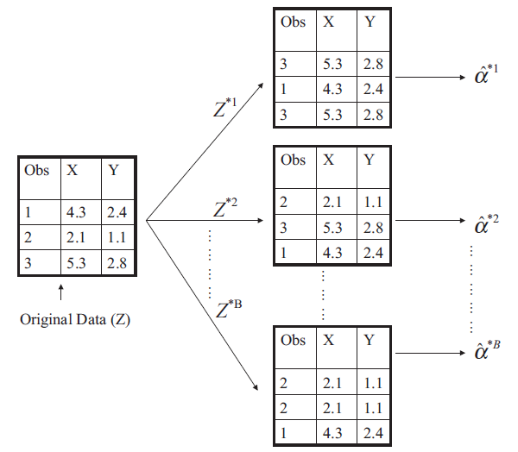
Chap5: Bootstrapping is simple!
Resampling of the observed dataset (and of equal size to the observed dataset), each of which is obtained by random sampling with replacement from the original dataset.

Slide 10
Toy examples
set.seed(100)
sample(1:3, 3, replace = T)
#
set.seed(15)
sample(1:3, 3, replace = T)
#
set.seed(594)
sample(1:3, 3, replace = T)
#
set.seed(500)
sample(1:3, 3, replace = T)
#
set.seed(200)
sample(1:3, 3, replace = T)

Slide 11
What is bagging?
Bagging is an extremely powerful idea based on two things:
  Averaging: reduces variance!
  Bootstrapping: plenty of training datasets!
Why does averaging reduces variance?
  Averaging a set of observations reduces variance. Recall that given a set of n independent observations Z₁, …, Z_{n}, each with variance , the variance of the mean of the observations is given by

Slide 12
How does bagging work?
Generate B different bootstrapped training datasets, by taking repeated sample from the (single) training data set.
Train the statistical learning method on each of the B bootstrapped training datasets, and obtain B predictions.
For prediction:
  Regression: average all B predictions from all B trees
  Classification: majority vote among all B trees

Slide 13
Bagging for Regression Trees
Construct B regression trees using B bootstrapped training datasets
Average the resulting predictions
Note: These trees are not pruned, so each individual tree has high variance but low bias.
Averaging these trees reduces variance, and thus we end up lowering both variance and bias ☺

Slide 14
Bagging for Classification Trees
Construct B regression trees using B bootstrapped training datasets
For prediction, there are two approaches:
  Record the class that each bootstrapped data set predicts and provide an overall prediction to the most commonly occurring one (majority vote).
  If our classifier produces probability estimates we can just average the probabilities and then predict to the class with the highest probability.
Both methods work well.

Slide 15
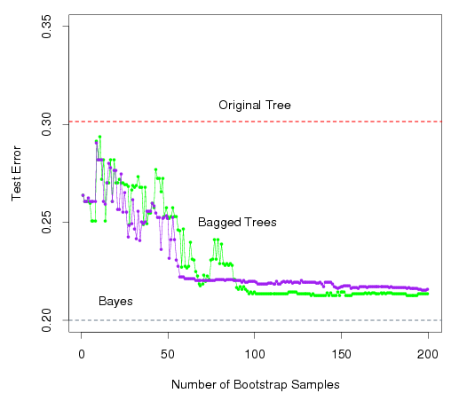
A Comparison of Error Rates
Here the green line represents a simple majority vote approach
The purple line corresponds to averaging the probability estimates.
Both do far better than a single tree (dashed red) and get close to the Bayes error rate (dashed grey).

Slide 16
Example 1: Housing Data
The red line represents the test mean sum of squares using a single tree.
The black line corresponds to the bagging error rate

Slide 17
Example 2: Car Seat Data
The red line represents the test error rate using a single tree.
The black line corresponds to the bagging error rate using majority vote while the blue line averages the probabilities.

Slide 18
Out-of-Bag Error Estimation
Since bootstrapping involves random selection of subsets of observations to build a training data set, then the remaining non-selected part could be the testing data.
On average, each bagged tree makes use of around 2/3 of the observations, so we end up having 1/3 of the observations (Out of Bag -- OOB) used for testing.
1-1/exp(1) ~ 0.632
1/exp(1) ~ 0.368

Slide 19
Variable Importance Measure
Bagging typically improves the accuracy over prediction using a single tree, but it is now hard to interpret the model!
We have hundreds of trees, and it is no longer clear which variables are most important to the procedure
Thus bagging improves prediction accuracy at the expense of interpretability
But, we can still get an overall summary of the importance of each predictor using Relative Influence Plots

Slide 20
Relative Influence Plots
How do we decide which variables are most useful in predicting the response?
  We can compute something called relative influence plots.
  These plots give a score for each variable.
  These scores represent the decrease in MSE when splitting on a particular variable
  A number close to zero indicates the variable is not important and could be dropped.
  The larger the score the more influence the variable has.

Slide 21
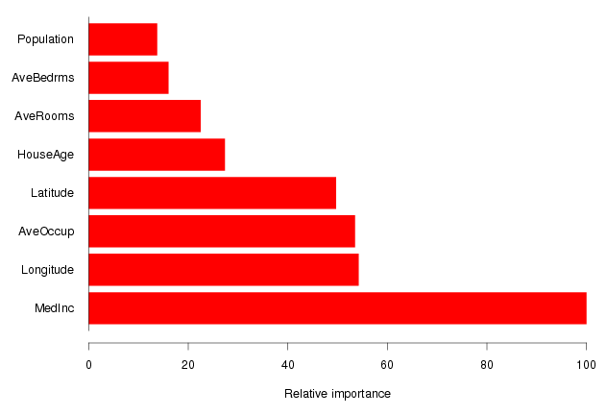
Example: Housing Data
Median Income is by far the most important variable.
Longitude, Latitude and Average occupancy are the next most important.

Slide 22
Random Forests

Slide 23
Random Forests for Classification
It is a very efficient statistical learning method
It builds on the idea of bagging, but it provides an improvement because it de-correlates the trees
Decision tree:
  Easy to achieve 0% error rate on training data
  If each training example has its own leaf ……
Random forest: Bagging of decision tree
  Resampling training data is not sufficient
  Randomly restrict the features/questions used in each split
How does it work?
  Build a number of decision trees on bootstrapped training sample, but when building these trees, each time a split in a tree is considered, a random sample of m predictors is chosen as split candidates from the full set of p predictors (Usually )

Slide 24
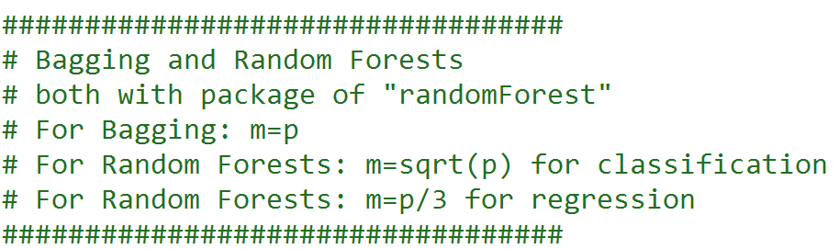
Random Forests for Regression

Slide 25
Why are we considering a random sample of m predictors instead of all p predictors for splitting?
Suppose that we have a very strong predictor in the data set along with a number of other moderately strong predictor, then in the collection of bagged trees, most or all of them will use the very strong predictor for the first split!
All bagged trees will look similar. Hence all the predictions from the bagged trees will be highly correlated
Averaging many highly correlated quantities does not lead to a large variance reduction, and thus random forests “de-correlates” the bagged trees leading to more reduction in variance

Slide 26
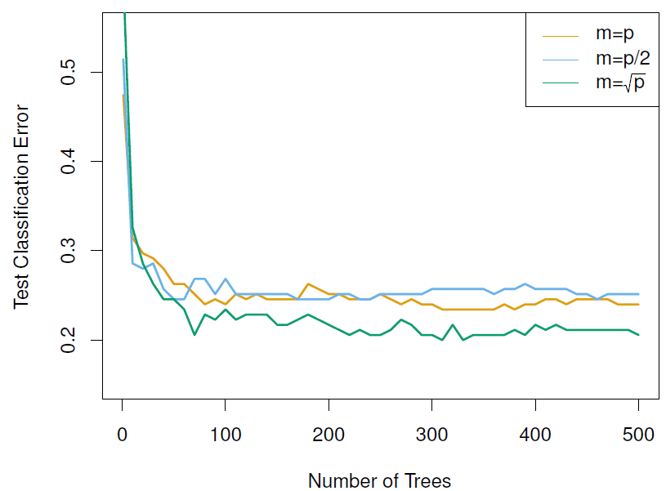
Random Forest with different values of “m”
Notice when random forests are built using
m = p, then this amounts simply to bagging.

Slide 27
Boosting

Slide 28
Boosting
Like bagging, boosting is a general approach that can be applied to many statistical learning methods for regression or classification. Consider boosting for decision trees.
Recall that bagging involves creating multiple copies of the original training data set using the bootstrap, fitting a separate decision tree to each copy, and then combining all of the trees in order to create a single predictive model.
Notably, each tree is built on a bootstrap data set, independent of the other trees.
Boosting works in a similar way, except that the trees are grown sequentially: each tree is grown using information from previously grown trees.

Slide 29
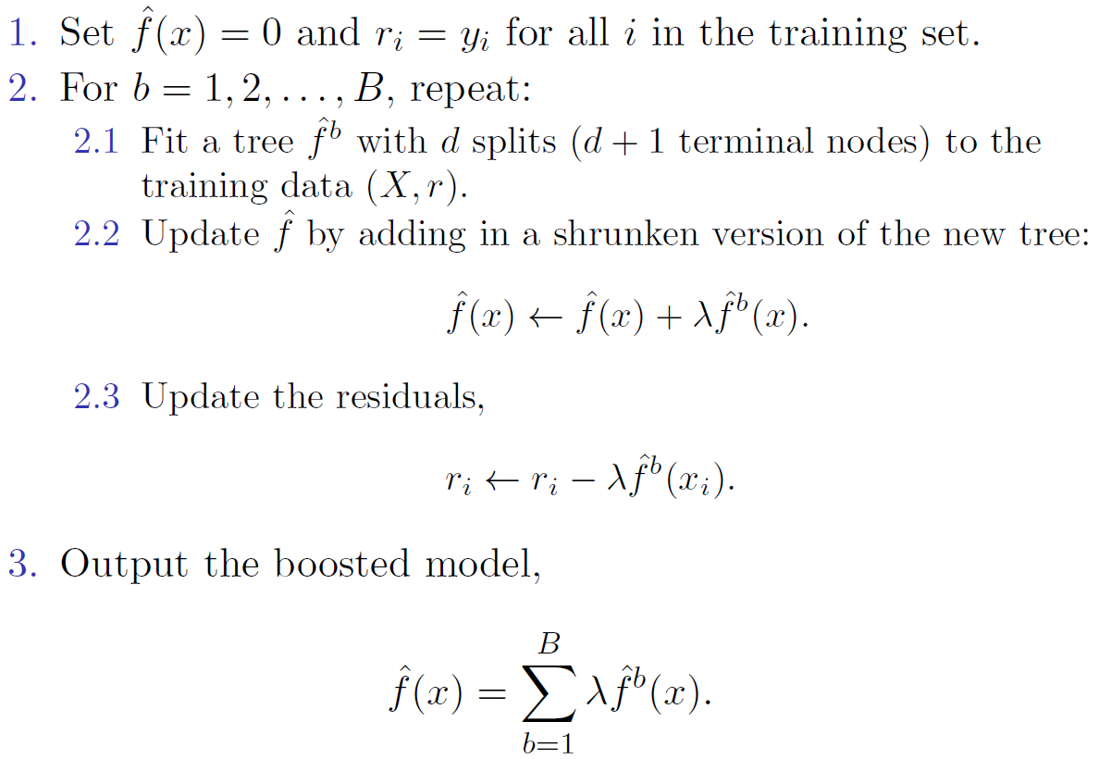
Boosting algorithm for regression trees
See more details from the this PPT:
http://speech.ee.ntu.edu.tw/~tlkagk/courses/ML_2016/Lecture/Ensemble%20(v6).pdf

Slide 30
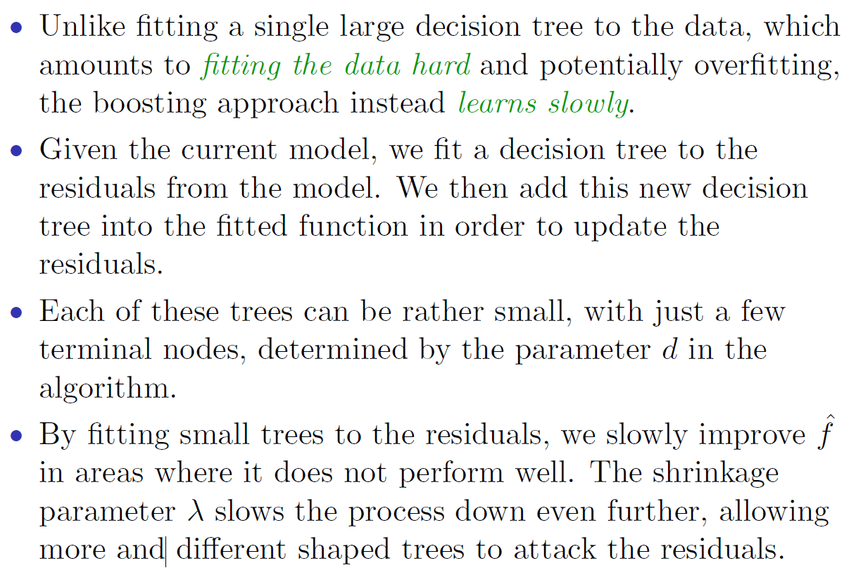
What is the idea behind this procedure?

Slide 31
Ensemble: Boosting
Improving Weak Classifiers
Declaimer: All PPTs below are from:
http://speech.ee.ntu.edu.tw/~tlkagk/courses/ML_2016/Lecture/Ensemble%20(v6).pdf

Slide 32
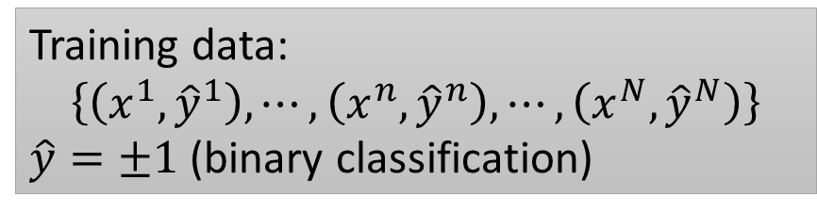
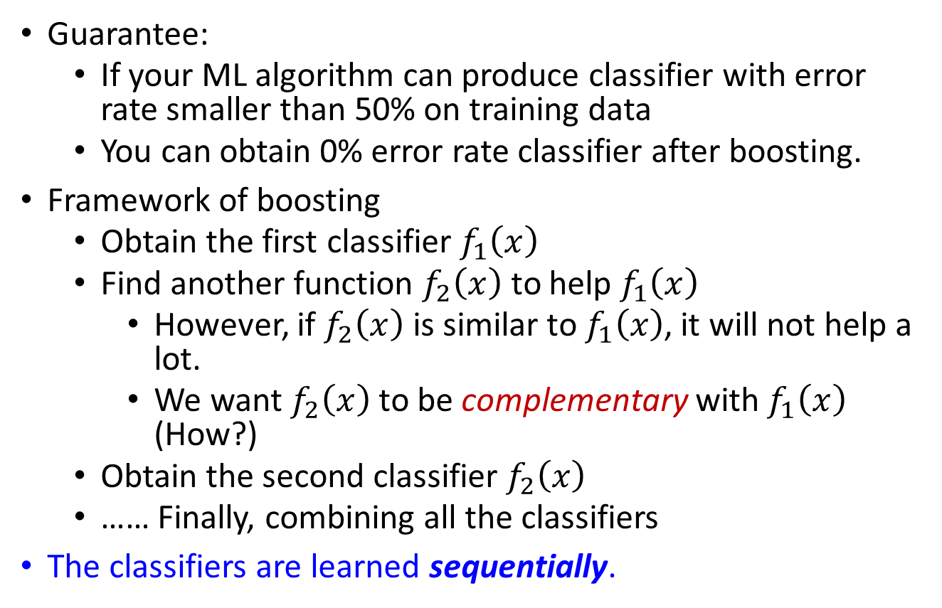
Boosting
http://speech.ee.ntu.edu.tw/~tlkagk/courses/ML_2016/Lecture/Ensemble%20(v6).pdf
Notes:
We use an ML algorithm to obtain a function 𝑓_1 (𝑥)
If 𝑓_1 (𝑥) is weak, i.e. bad performance on training data, what can we do?

Slide 33
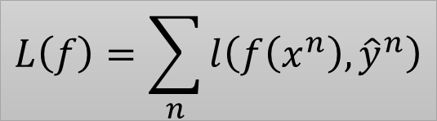




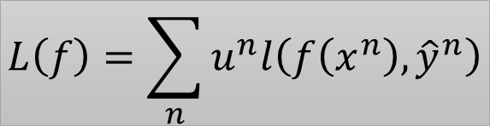


How to obtain different classifiers?
Training on different training data sets
How to have different training data sets
  Re-sampling your training data to form a new set
  Re-weighting your training data to form a new set
  In real implementation, you only have to change the cost/objective function
0.4
2.1
0.7
http://speech.ee.ntu.edu.tw/~tlkagk/courses/ML_2016/Lecture/Ensemble%20(v6).pdf

Slide 34
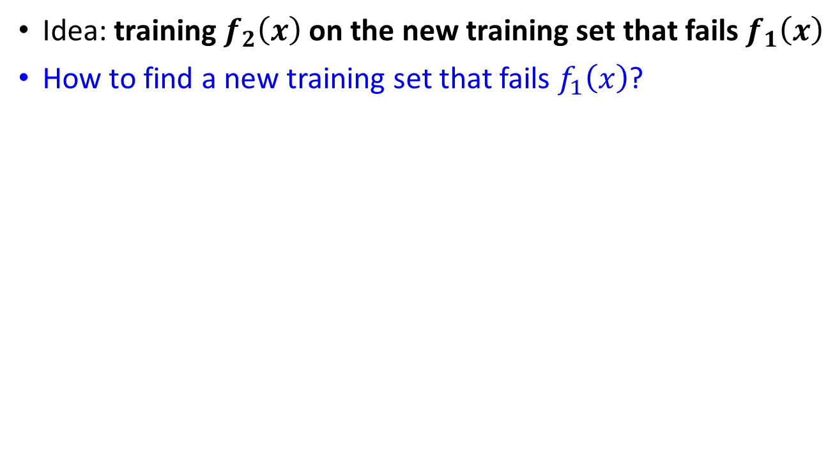















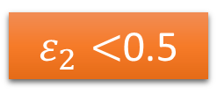
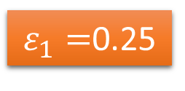


Re-weighting Training Data
0.5
http://speech.ee.ntu.edu.tw/~tlkagk/courses/ML_2016/Lecture/Ensemble%20(v6).pdf

Slide 35
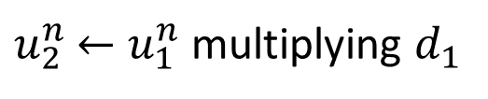
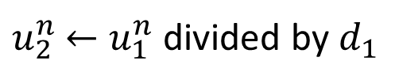
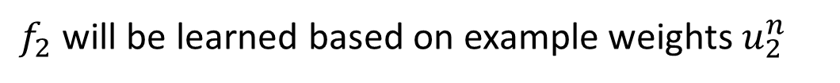
Re-weighting Training Data
increase
decrease
http://speech.ee.ntu.edu.tw/~tlkagk/courses/ML_2016/Lecture/Ensemble%20(v6).pdf
Notes:
Intuitive reason:

Slide 36
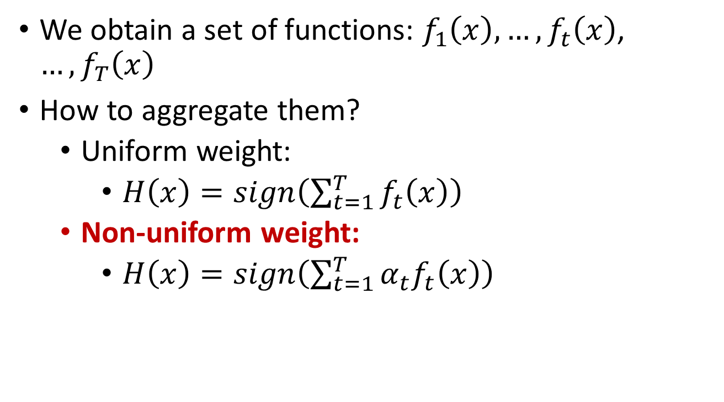
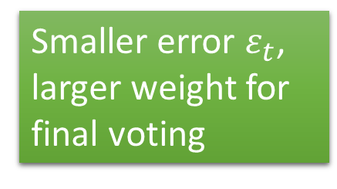




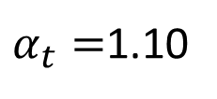
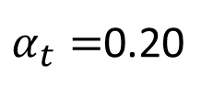
Algorithm for AdaBoost
http://speech.ee.ntu.edu.tw/~tlkagk/courses/ML_2016/Lecture/Ensemble%20(v6).pdf

Slide 37




Toy Example
T=3, weak classifier = decision stump
t=1
+
+
1.0
1.53
1.0
+
0.65
+
-
-
1.0
1.53
+
+
1.0
1.53
+
-
-
-
1.0
0.65
+
-
1.0
1.0
0.65
0.65
+
-
1.0
1.0
0.65
0.65
+
-
-
1.0
0.65
-
http://speech.ee.ntu.edu.tw/~tlkagk/courses/ML_2016/Lecture/Ensemble%20(v6).pdf

Slide 38
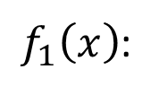
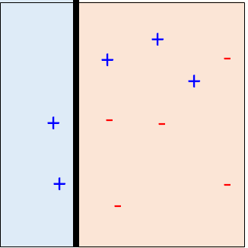





Toy Example
T=3, weak classifier = decision stump
t=2
+
+
1.53
0.78
+
0.65
0.33
-
+
-
1.53
+
0.78
+
1.53
0.78
0.33
-
-
0.65
+
-
-
+
0.65
0.65
1.26
1.26
0.65
0.33
0.33
0.65
-
+
-
+
-
0.65
1.26
-
http://speech.ee.ntu.edu.tw/~tlkagk/courses/ML_2016/Lecture/Ensemble%20(v6).pdf

Slide 39
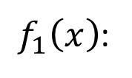
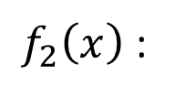
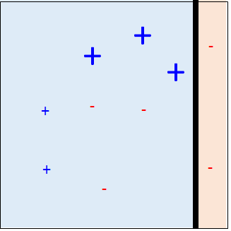


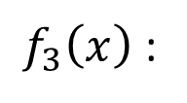
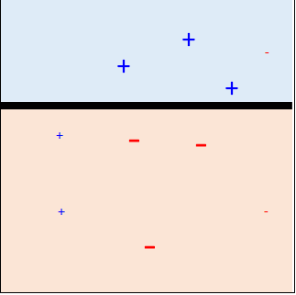





Toy Example
T=3, weak classifier = decision stump
t=3
+
0.78
0.33
+
-
0.78
+
0.78
0.33
-
-
+
1.26
1.26
0.33
0.33
+
-
1.26
-
http://speech.ee.ntu.edu.tw/~tlkagk/courses/ML_2016/Lecture/Ensemble%20(v6).pdf

Slide 40
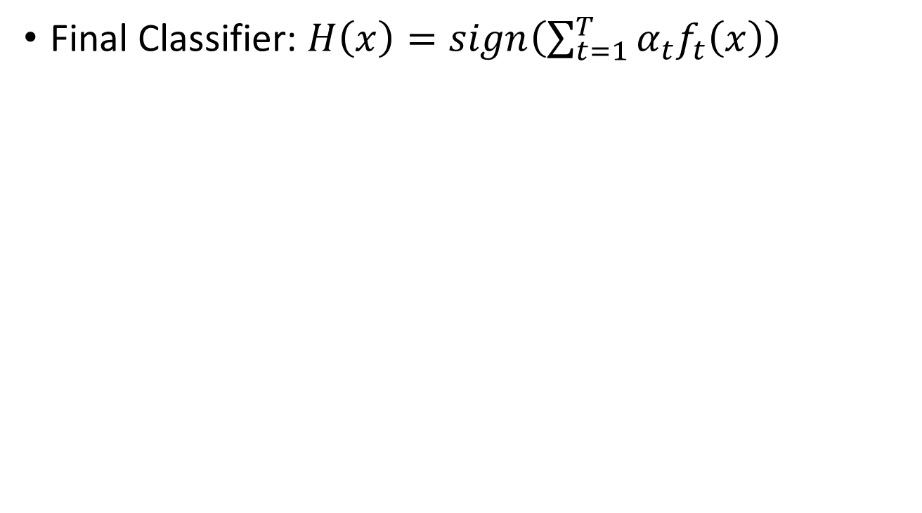





Toy Example
+
+
+
Assume:
For Orange region: f(x) = 1
For Blue region: f(x) = -1
For red circle:
0.42(1)+0.66(-1)+(0.95)(-1)<0
➔classified into Blue
For green circle:
0.42(1)+0.66(-1)+0.95(1)>0
➔classified into Orange
+
-
+
+
-
-
+
-
-
http://speech.ee.ntu.edu.tw/~tlkagk/courses/ML_2016/Lecture/Ensemble%20(v6).pdf

Slide 41
R Lab in Chap 8

Slide 42
Boosting
The R package gbm (gradient boosted models) handles a
variety of regression and classification problems.

Slide 43
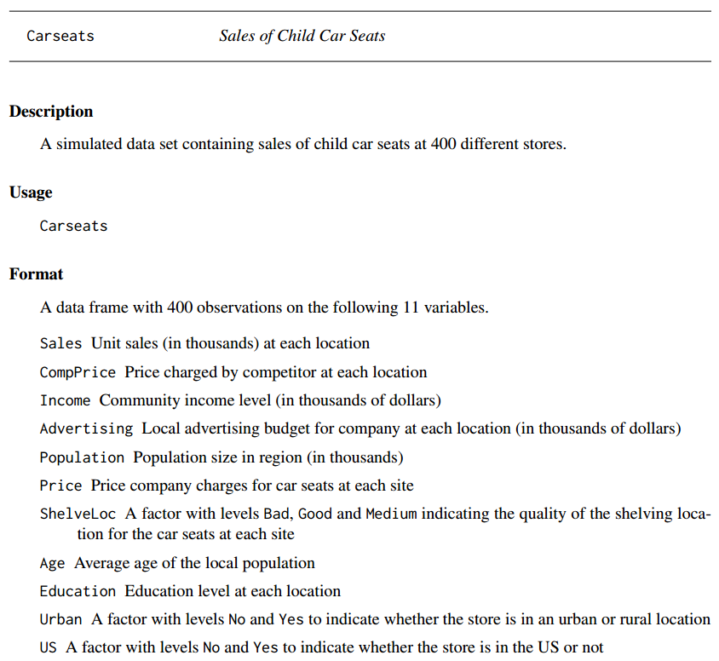

Slide 44
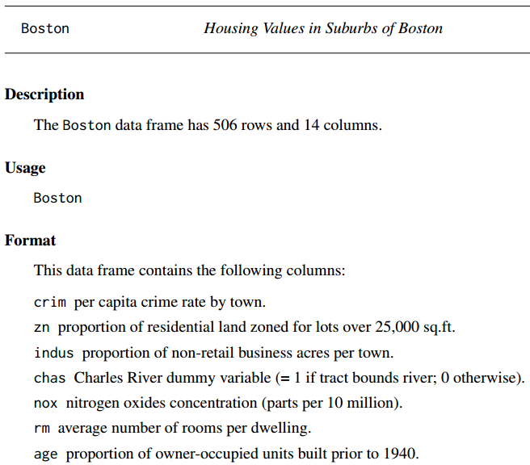
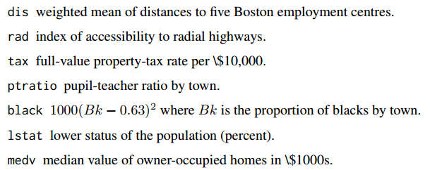

Slide 45
Deviance, page 206
Deviance is a measure deviance that plays the role of RSS for a broader class of models.
The deviance is negative two times the maximized log-likelihood;
The smaller the deviance, the better the fit.

