Slide 1
CHAPTER 1
INTRODUCTION
Prem Mann, Introductory Statistics, 8/E Copyright © 2013 John Wiley & Sons. All rights reserved.

Slide 2
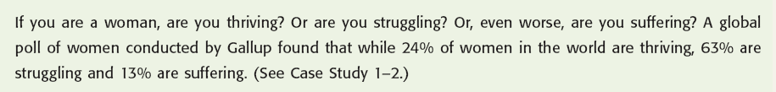
Opening Example
Prem Mann, Introductory Statistics, 8/E Copyright © 2013 John Wiley & Sons. All rights reserved.

Slide 3
WHAT IS STATISTICS?
Definition
Statistics is the science of collecting, analyzing, presenting, and interpreting data, as well as of making decisions based on such analyses.
Prem Mann, Introductory Statistics, 8/E Copyright © 2013 John Wiley & Sons. All rights reserved.

Slide 4
TYPES OF STATISTICS
Definition
Descriptive Statistics consists of methods for organizing, displaying, and describing data by using tables, graphs, and summary measures.
Prem Mann, Introductory Statistics, 8/E Copyright © 2013 John Wiley & Sons. All rights reserved.

Slide 5
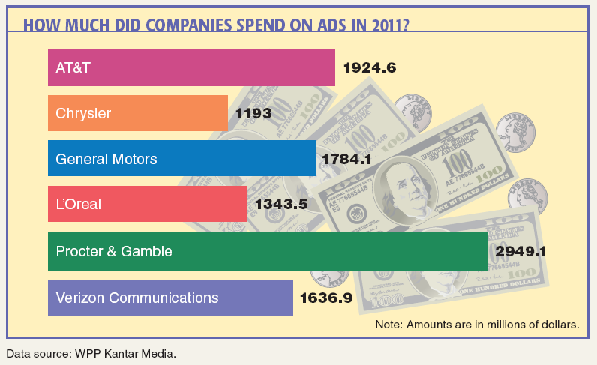
Case Study 1-1 How Much Did Companies Spend on Ads in 2011?
Prem Mann, Introductory Statistics, 8/E Copyright © 2013 John Wiley & Sons. All rights reserved.

Slide 6
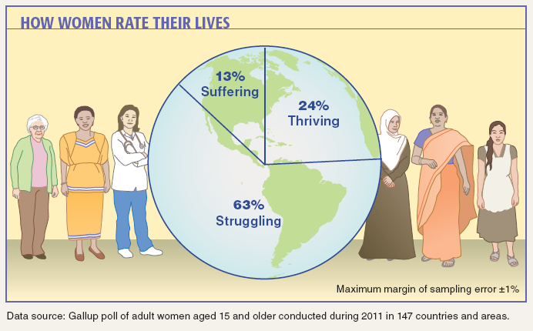
Case Study 1-2 How Women Rate Their Lives
Prem Mann, Introductory Statistics, 8/E Copyright © 2013 John Wiley & Sons. All rights reserved.

Slide 7
TYPES OF STATISTICS
Definition
Inferential Statistics consists of methods that use sample results to help make decisions or predictions about a population.
Prem Mann, Introductory Statistics, 8/E Copyright © 2013 John Wiley & Sons. All rights reserved.

Slide 8
POPULATION VERSUS SAMPLE
Definition
A population consists of all elements – individuals, items, or objects – whose characteristics are being studied. The population that is being studied is also called the target population.
A portion of the population selected for study is referred to as a sample.
Prem Mann, Introductory Statistics, 8/E Copyright © 2013 John Wiley & Sons. All rights reserved.

Slide 9
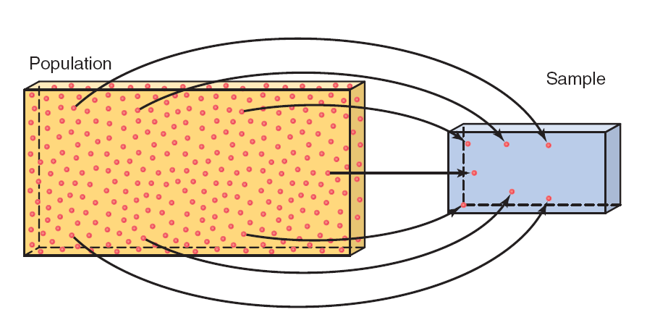
Figure 1.1 Population and Sample
Prem Mann, Introductory Statistics, 8/E Copyright © 2013 John Wiley & Sons. All rights reserved.

Slide 10
POPULATION VERSUS SAMPLE
Definition
A survey that includes every member of the population is called a census. The technique of collecting information from a portion of the population is called a sample survey.
Prem Mann, Introductory Statistics, 8/E Copyright © 2013 John Wiley & Sons. All rights reserved.

Slide 11
POPULATION VERSUS SAMPLE
Definition
A sample that represents the characteristics of the population as closely as possible is called a representative sample.
Prem Mann, Introductory Statistics, 8/E Copyright © 2013 John Wiley & Sons. All rights reserved.

Slide 12
POPULATION VERSUS SAMPLE
Definition
A sample drawn in such a way that each element of the population has a chance of being selected is called a random sample. If all samples of the same size selected from a population have the same chance of being selected, we call it simple random sampling. Such a sample is called a simple random sample.
Prem Mann, Introductory Statistics, 8/E Copyright © 2013 John Wiley & Sons. All rights reserved.

Slide 13
POPULATION VERSUS SAMPLE
A sample may be selected with or without replacement.
In sampling with replacement, each time we select an element from the population, we put it back in the population before we select the next element.
Sampling without replacement occurs when the selected element is not replaced in the population.
Prem Mann, Introductory Statistics, 8/E Copyright © 2013 John Wiley & Sons. All rights reserved.

Slide 14
BASIC TERMS
Definition
An element or member of a sample or population is a specific subject or object (for example, a person, firm, item, state, or country) about which the information is collected.
Prem Mann, Introductory Statistics, 8/E Copyright © 2013 John Wiley & Sons. All rights reserved.

Slide 15
BASIC TERMS
Definition
A variable is a characteristic under study that assumes different values for different elements. In contrast to a variable, the value of a constant is fixed.
Prem Mann, Introductory Statistics, 8/E Copyright © 2013 John Wiley & Sons. All rights reserved.

Slide 16
BASIC TERMS
Definition
The value of a variable for an element is called an observation or measurement.
A data set is a collection of observations on one or more variables.
Prem Mann, Introductory Statistics, 8/E Copyright © 2013 John Wiley & Sons. All rights reserved.

Slide 17
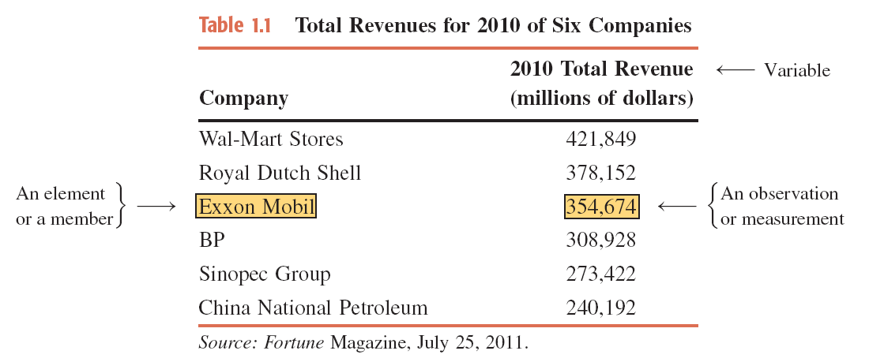
Table 1.1 Total Revenues for 2010 of Six Companies
Prem Mann, Introductory Statistics, 8/E Copyright © 2013 John Wiley & Sons. All rights reserved.

Slide 18
TYPES OF VARIABLES
Quantitative Variables
  Discrete Variables
  Continuous Variables
Qualitative or Categorical Variables
Prem Mann, Introductory Statistics, 8/E Copyright © 2013 John Wiley & Sons. All rights reserved.

Slide 19
Quantitative Variables
Definition
A variable that can be measured numerically is called a quantitative variable. The data collected on a quantitative variable are called quantitative data.
Prem Mann, Introductory Statistics, 8/E Copyright © 2013 John Wiley & Sons. All rights reserved.

Slide 20
Quantitative Variables: Discrete
Definition
A variable whose values are countable is called a discrete variable. In other words, a discrete variable can assume only certain values with no intermediate values.
Prem Mann, Introductory Statistics, 8/E Copyright © 2013 John Wiley & Sons. All rights reserved.

Slide 21
Quantitative Variables: Continuous
Definition
A variable that can assume any numerical value over a certain interval or intervals is called a continuous variable.
Prem Mann, Introductory Statistics, 8/E Copyright © 2013 John Wiley & Sons. All rights reserved.

Slide 22
Qualitative or Categorical Variables
Definition
A variable that cannot assume a numerical value but can be classified into two or more nonnumeric categories is called a qualitative or categorical variable. The data collected on such a variable are called qualitative data.
Prem Mann, Introductory Statistics, 8/E Copyright © 2013 John Wiley & Sons. All rights reserved.

Slide 23
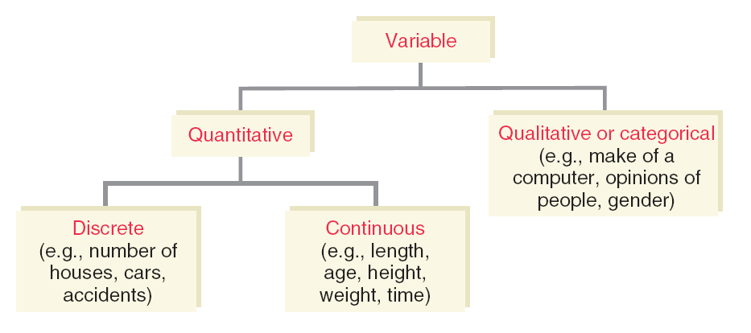
Figure 1.2 Types of Variables
Prem Mann, Introductory Statistics, 8/E Copyright © 2013 John Wiley & Sons. All rights reserved.

Slide 24
CROSS-SECTION VS. TIME-SERIES DATA
Cross-Section Data
Time-Series Data
Prem Mann, Introductory Statistics, 8/E Copyright © 2013 John Wiley & Sons. All rights reserved.

Slide 25
Cross-Section Data
Definition
Data collected on different elements at the same point in time or for the same period of time are called cross-section data.
Prem Mann, Introductory Statistics, 8/E Copyright © 2013 John Wiley & Sons. All rights reserved.

Slide 26
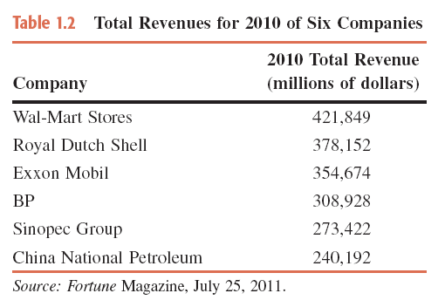
Table 1.2 Total Revenues for 2010 of Six Companies
Prem Mann, Introductory Statistics, 8/E Copyright © 2013 John Wiley & Sons. All rights reserved.

Slide 27
Time-Series Data
Definition
Data collected on the same element for the same variable at different points in time or for different periods of time are called time-series data.
Prem Mann, Introductory Statistics, 8/E Copyright © 2013 John Wiley & Sons. All rights reserved.

Slide 28
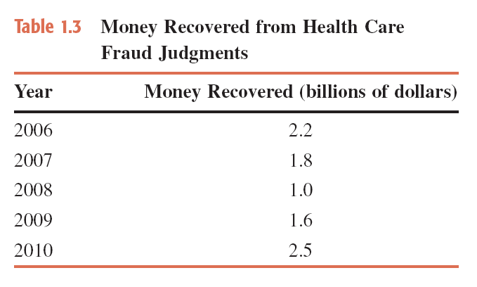
Table 1.3 Money Recovered from Health Care Fraud Judgments
Prem Mann, Introductory Statistics, 8/E Copyright © 2013 John Wiley & Sons. All rights reserved.

Slide 29
SOURCES OF DATA
Data may be obtained from
  Internal Sources
  External Sources
  Surveys and Experiments
Prem Mann, Introductory Statistics, 8/E Copyright © 2013 John Wiley & Sons. All rights reserved.

Slide 30
SUMMATION NOTATION
Suppose a sample consists of five books, and the prices of these five books are
$175, $80, $165, $97, and $88
The variable price of a book: x
Price of the first book = x₁ = $175
Price of the second book = x₂ = $80
Price of the third book = x₃ = $165
Price of the fourth book = x₄ = $97
Price of the fifth book = x₅ = $88
Prem Mann, Introductory Statistics, 8/E Copyright © 2013 John Wiley & Sons. All rights reserved.

Slide 31
SUMMATION NOTATION
Adding the prices of all five books gives
x₁+x₂+x₃+x₄+x₅ = 175+80+165+97+88 = 605
Σx = x₁+x₂+x₃+x₄+x₅ = 605
Prem Mann, Introductory Statistics, 8/E Copyright © 2013 John Wiley & Sons. All rights reserved.

Slide 32
Example 1-1
Annual salaries (in thousands of dollars) of four workers are 75, 90, 125, and 61, respectively. Find
    (a) ∑x (b) (∑x)² (c) ∑x²
Prem Mann, Introductory Statistics, 8/E Copyright © 2013 John Wiley & Sons. All rights reserved.

Slide 33
Example 1-1: Solution
(a) ∑x = x₁ + x₂ + x₃ + x₄
= 75 + 90 + 125 + 61
= 351 = $351,000
(b) Note that (∑x)² is the square of the sum of all x values.
Thus,
(∑x)² = (351)² = 123,201
Prem Mann, Introductory Statistics, 8/E Copyright © 2013 John Wiley & Sons. All rights reserved.

Slide 34
Example 1-1: Solution
(c) The expression ∑x² is the sum of the squares of x values.
To calculate ∑x² , we first square each of the x values and
then sum these squared values. Thus,
∑x² = (75)² + (90)² + (125)² + (61)²
= 5,625 + 8,100 + 15,625 + 3,721
= 33,071
Prem Mann, Introductory Statistics, 8/E Copyright © 2013 John Wiley & Sons. All rights reserved.

Slide 35

Example 1-2
The following table lists four pairs of m and f values:
Compute the following:
(a) Σm (b) Σf² (c) Σmf (d) Σm²f
Prem Mann, Introductory Statistics, 8/E Copyright © 2013 John Wiley & Sons. All rights reserved.

Slide 36
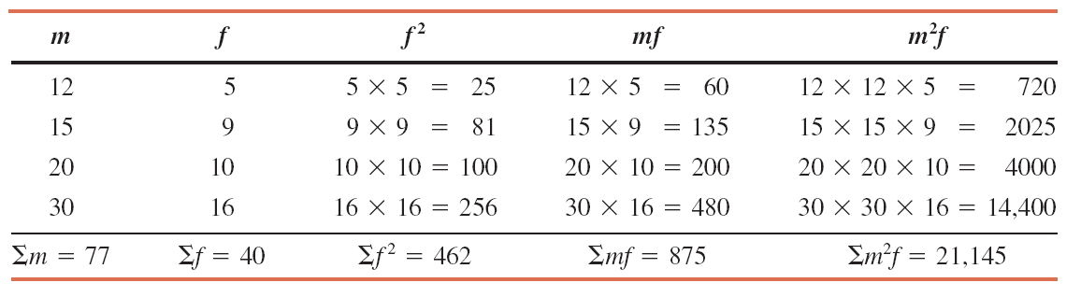
Example 1-2: Solution
We can write
m₁ = 12 m₂ = 15 m₃ = 20 m₄ = 30
f₁ = 5 f₂ = 9 f₃ = 10 f₄ = 16
(a) (b) (c) (d)
Prem Mann, Introductory Statistics, 8/E Copyright © 2013 John Wiley & Sons. All rights reserved.

Slide 37

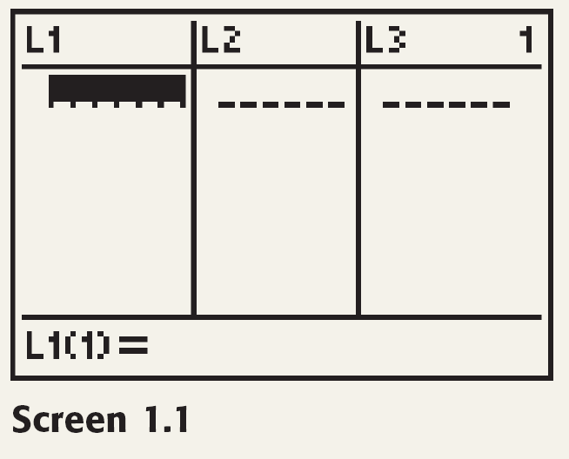
TI-84
Prem Mann, Introductory Statistics, 8/E Copyright © 2013 John Wiley & Sons. All rights reserved.

Slide 38
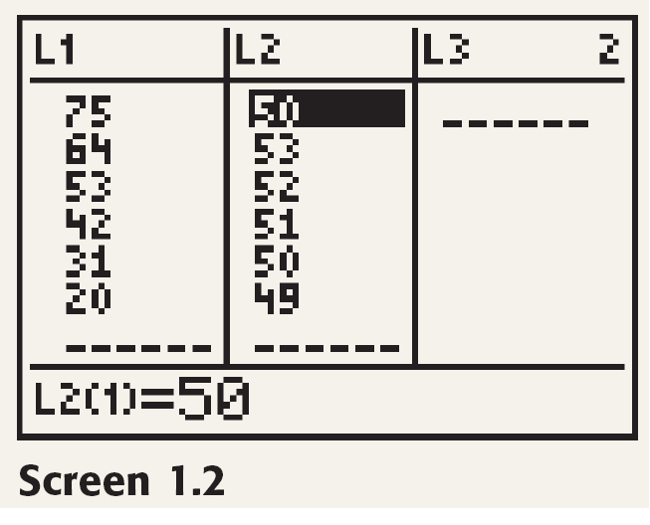
TI-84
Prem Mann, Introductory Statistics, 8/E Copyright © 2013 John Wiley & Sons. All rights reserved.

Slide 39
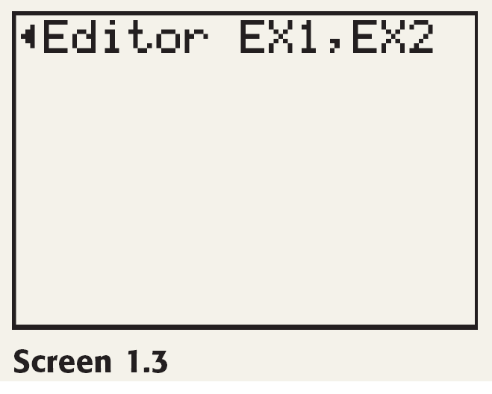
TI-84
Prem Mann, Introductory Statistics, 8/E Copyright © 2013 John Wiley & Sons. All rights reserved.

Slide 40
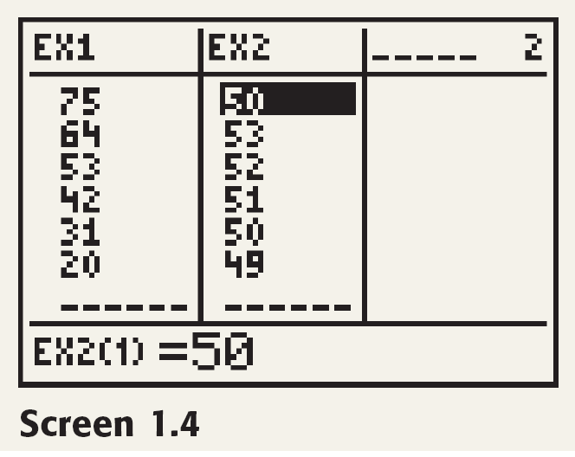
TI-84
Prem Mann, Introductory Statistics, 8/E Copyright © 2013 John Wiley & Sons. All rights reserved.

Slide 41
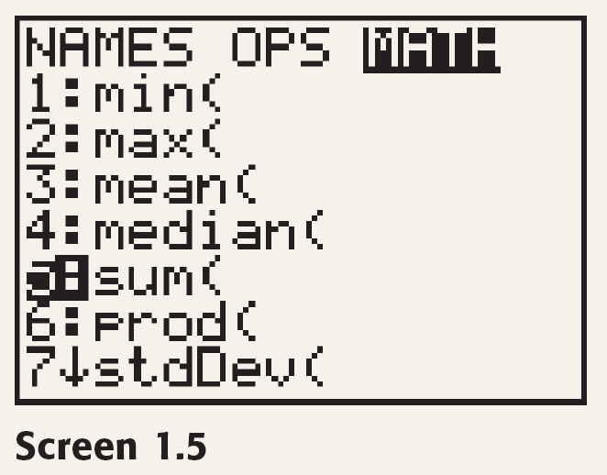
TI-84
Prem Mann, Introductory Statistics, 8/E Copyright © 2013 John Wiley & Sons. All rights reserved.

Slide 42
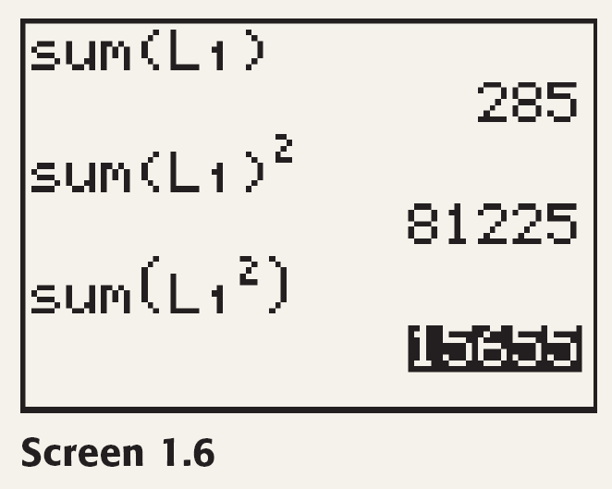
TI-84
Prem Mann, Introductory Statistics, 8/E Copyright © 2013 John Wiley & Sons. All rights reserved.

Slide 43

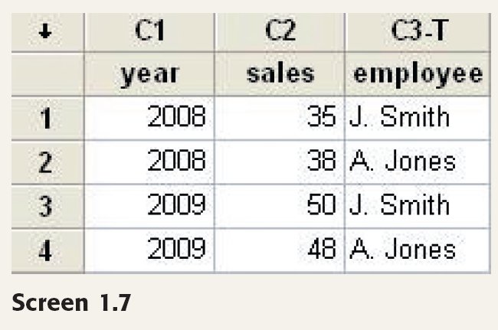
Minitab
Prem Mann, Introductory Statistics, 8/E Copyright © 2013 John Wiley & Sons. All rights reserved.

Slide 44
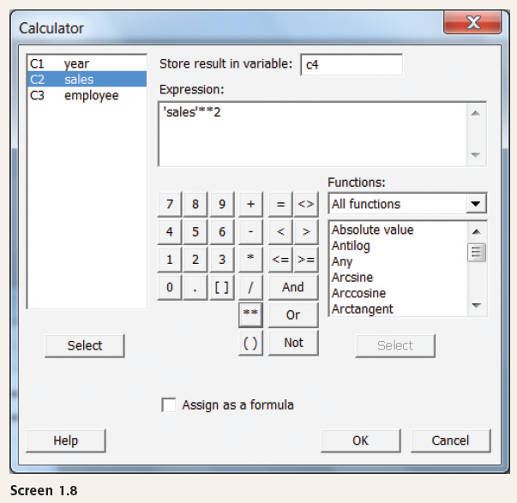
Minitab
Prem Mann, Introductory Statistics, 8/E Copyright © 2013 John Wiley & Sons. All rights reserved.

Slide 45
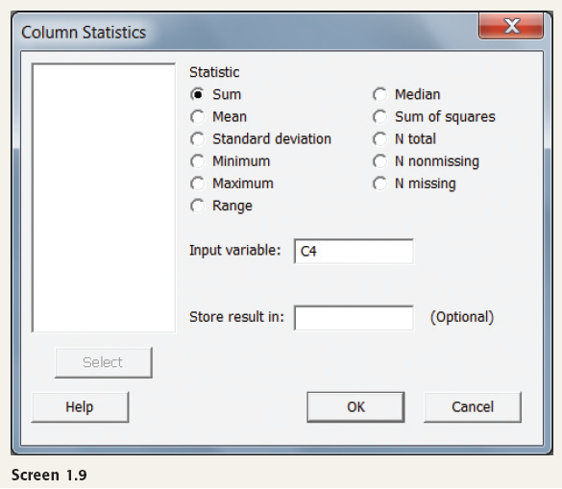
Minitab
Prem Mann, Introductory Statistics, 8/E Copyright © 2013 John Wiley & Sons. All rights reserved.

Slide 46
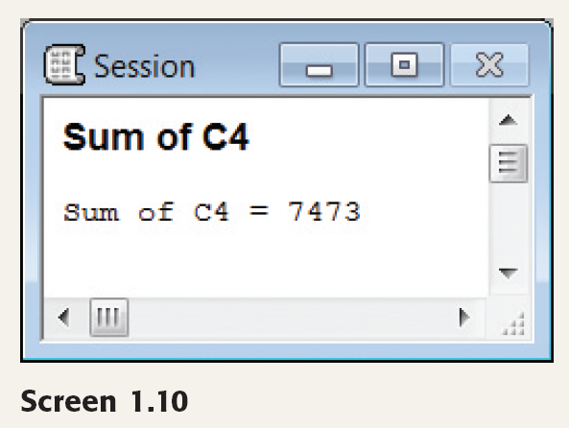
Minitab
Prem Mann, Introductory Statistics, 8/E Copyright © 2013 John Wiley & Sons. All rights reserved.

Slide 47

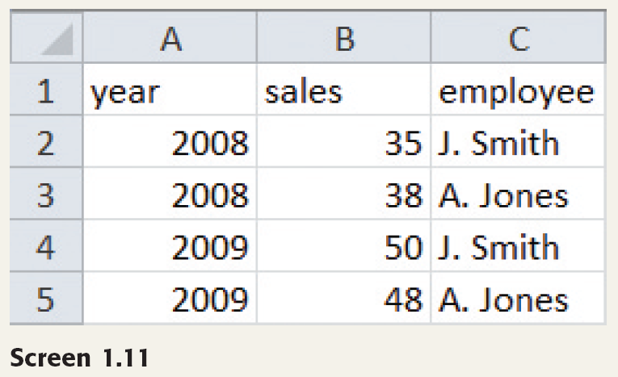
Excel
Prem Mann, Introductory Statistics, 8/E Copyright © 2013 John Wiley & Sons. All rights reserved.

Slide 48
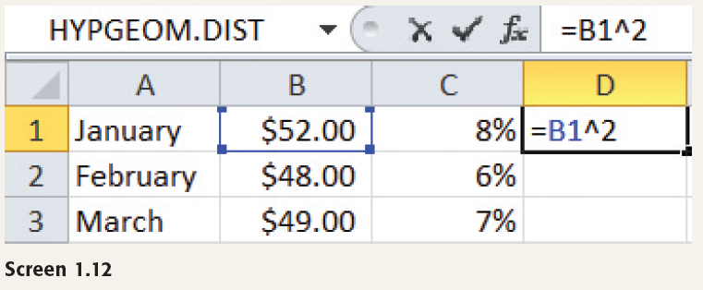
Excel
Prem Mann, Introductory Statistics, 8/E Copyright © 2013 John Wiley & Sons. All rights reserved.

Slide 49
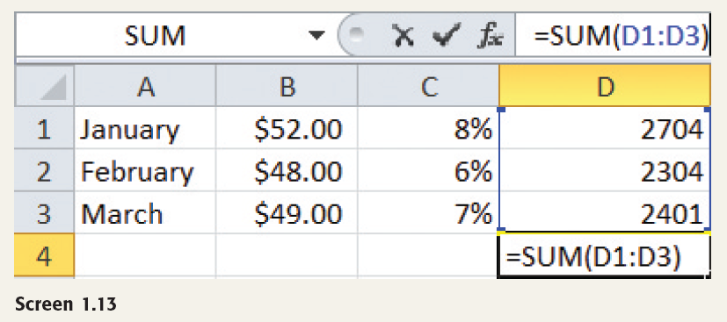
Excel
Prem Mann, Introductory Statistics, 8/E Copyright © 2013 John Wiley & Sons. All rights reserved.

