Slide 1


Neural Networks
School of Computer Science
10-601B Introduction to Machine Learning
Readings:
Bishop Ch. 5
Murphy Ch. 16.5, Ch. 28
Mitchell Ch. 4
Matt Gormley
Lecture 15
October 19, 2016

Slide 2
Outline
Logistic Regression (Recap)
Neural Networks
Backpropagation

Slide 3
Recall: Logistic Regression

Slide 4
Using gradient ascent for linear classifiers
Recall…
Key idea behind today’s lecture:
  Define a linear classifier (logistic regression)
  Define an objective function (likelihood)
  Optimize it with gradient descent to learn parameters
  Predict the class with highest probability under the model

Slide 5
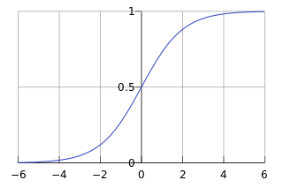
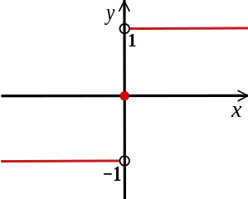
Using gradient ascent for linear classifiers
Recall…
This decision function isn’t differentiable:
Use a differentiable function instead:
sign(x)

Slide 6
Using gradient ascent for linear classifiers
Recall…
This decision function isn’t differentiable:
Use a differentiable function instead:
sign(x)

Slide 7
Logistic Regression
Recall…
Data: Inputs are continuous vectors of length K. Outputs are discrete.
Model: Logistic function applied to dot product of parameters with input vector.
Learning: finds the parameters that minimize some objective function.
Prediction: Output is the most probable class.

Slide 8
Neural Networks

Slide 9
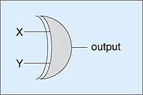
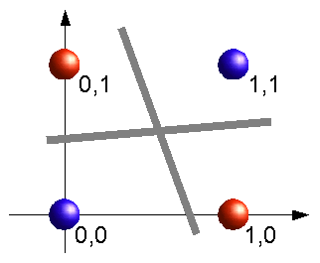
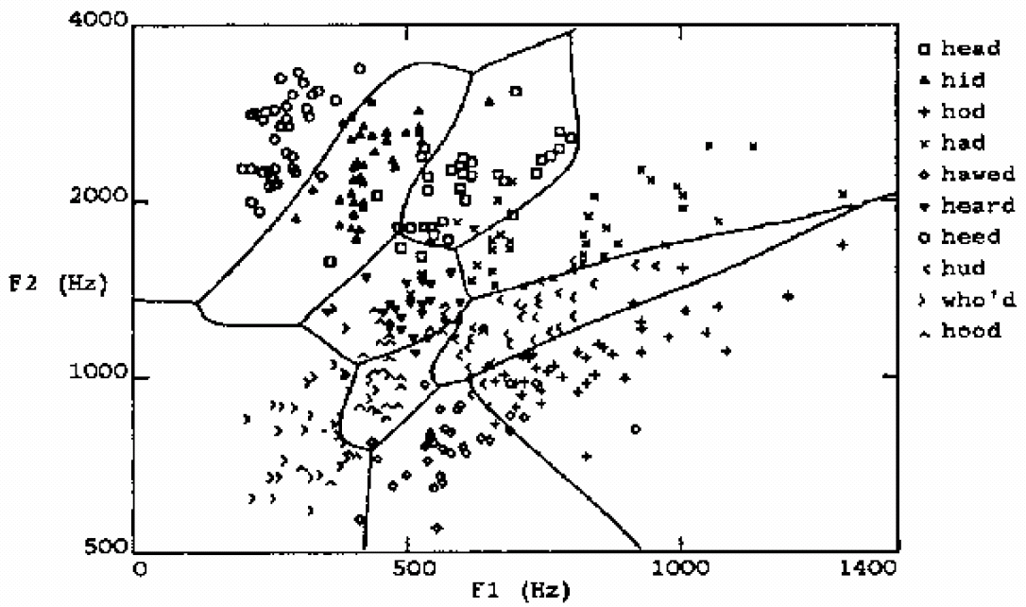
Learning highly non-linear functions
f: X → Y
f might be non-linear function
X (vector of) continuous and/or discrete vars
Y (vector of) continuous and/or discrete vars
The XOR gate
Speech recognition

Slide 10
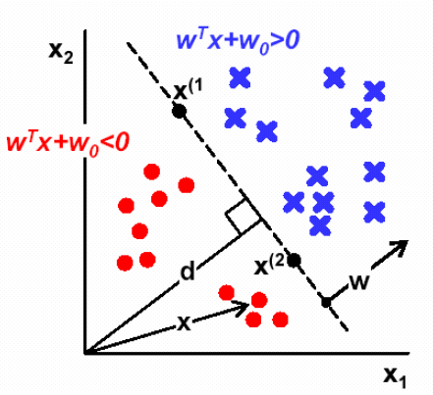
Perceptron and Neural Nets
From biological neuron to artificial neuron (perceptron)
Activation function
Artificial neuron networks
  supervised learning
  gradient descent

Slide 11
Connectionist Models
Consider humans:
  Neuron switching time
  ~ 0.001 second
  Number of neurons
  ~ 10¹⁰
  Connections per neuron
  ~ 10⁴⁻⁵
  Scene recognition time
  ~ 0.1 second
  100 inference steps doesn't seem like enough
  → much parallel computation
Properties of artificial neural nets (ANN)
  Many neuron-like threshold switching units
  Many weighted interconnections among units
  Highly parallel, distributed processes

Slide 12

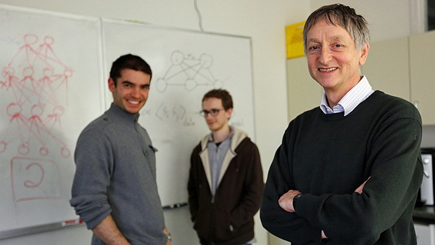


Why is everyone talking about Deep Learning?
Motivation
Because a lot of money is invested in it…
  DeepMind: Acquired by Google for $400 million
  DNNResearch: Three person startup (including Geoff Hinton) acquired by Google for unknown price tag
  Enlitic, Ersatz, MetaMind, Nervana, Skylab:
  Deep Learning startups commanding millions of VC dollars
Because it made the front page of the New York Times

Slide 13
Why is everyone talking about Deep Learning?
Motivation
1960s
Deep learning:
  Has won numerous pattern recognition competitions
  Does so with minimal feature engineering
1980s
1990s
This wasn’t always the case!
  Since 1980s: Form of models hasn’t changed much,
  but lots of new tricks…
  More hidden units
  Better (online) optimization
  New nonlinear functions (ReLUs)
  Faster computers (CPUs and GPUs)
2006
2016
Notes:
TODO: Cut this.

Slide 14


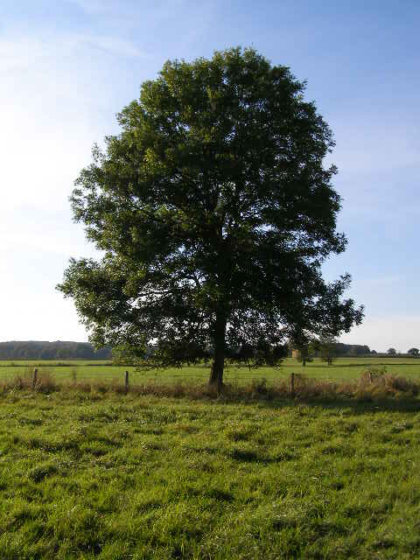
A Recipe for
Machine Learning
Background
1. Given training data:
Face
Face
Not a face
2. Choose each of these:
  Decision function
  Loss function
Examples: Linear regression, Logistic regression, Neural Network
Examples: Mean-squared error, Cross Entropy

Slide 15
A Recipe for
Machine Learning
Background
1. Given training data:
3. Define goal:
2. Choose each of these:
  Decision function
  Loss function
4. Train with SGD:
(take small steps opposite the gradient)

Slide 16
A Recipe for
Machine Learning
Background
Gradients
1. Given training data:
3. Define goal:
Backpropagation can compute this gradient!
And it’s a special case of a more general algorithm called reverse-mode automatic differentiation that can compute the gradient of any differentiable function efficiently!
2. Choose each of these:
  Decision function
  Loss function
4. Train with SGD:
(take small steps opposite the gradient)

Slide 17
A Recipe for
Machine Learning
LET’S GO INTO IT
Background
1. Given training data:
3. Define goal:
2. Choose each of these:
  Decision function
  Loss function
4. Train with SGD:
(take small steps opposite the gradient)

Slide 18
Linear Regression
Decision Functions
y
Output
θ₁
θ₂
θ₃
θ_{M}
x₁
x₂
x₃
…
x_{M}
Input

Slide 19
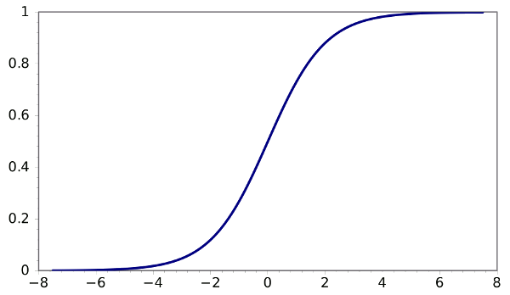
Logistic Regression
Decision Functions
y
Output
θ₁
θ₂
θ₃
θ_{M}
x₁
x₂
x₃
…
x_{M}
Input

Slide 20
Logistic Regression
Decision Functions
y
Output
Face
Face
Not a face
θ₁
θ₂
θ₃
θ_{M}
x₁
x₂
x₃
…
x_{M}
Input

Slide 21
Logistic Regression
Decision Functions
y
Output
θ₁
θ₂
θ₃
θ_{M}
x₁
x₂
x₃
…
x_{M}
Input

Slide 22
Neural Network Model
Inputs
Output
Age
34
.6
.4
.2
Σ
0.6
.1
.5
Gender
2
Σ
.3
.2
.8
.7
Σ
“Probability of beingAlive”
Stage
4
.2
Dependent variable
Prediction
Independent variables
Weights
HiddenLayer
Weights

Slide 23
“Combined logistic models”
Inputs
Output
Age
34
.6
.5
0.6
.1
Gender
2
Σ
.7
.8
“Probability of beingAlive”
Stage
4
Dependent variable
Prediction
Independent variables
Weights
HiddenLayer
Weights

Slide 24
Inputs
Output
Age
34
.2
.5
0.6
Gender
2
Σ
.3
.8
“Probability of beingAlive”
Stage
4
.2
Dependent variable
Prediction
Independent variables
Weights
HiddenLayer
Weights

Slide 25
Inputs
Output
Age
34
.6
.2
.5
0.6
.1
Gender
1
Σ
.3
.7
.8
“Probability of beingAlive”
Stage
4
.2
Dependent variable
Prediction
Independent variables
Weights
Hidden
Layer
Weights

Slide 26
no target for hidden units...
Age
34
.6
.4
.2
Σ
0.6
.1
.5
Gender
2
Σ
.3
.2
.8
.7
Σ
“Probability of beingAlive”
Stage
4
.2
Dependent variable
Prediction
Independent variables
Weights
Hidden
Layer
Weights

Slide 27
Jargon Pseudo-Correspondence
Independent variable = input variable
Dependent variable = output variable
Coefficients = “weights”
Estimates = “targets”
Logistic Regression Model (the sigmoid unit)
Inputs
Output
Age
34
5
0.6
Gender
1
4
Σ
“Probability of beingAlive”
Stage
4
8
Independent variables
x1, x2, x3
Coefficients
a, b, c
Dependent variable
p Prediction

Slide 28
Neural Network
Decision Functions
y
Output
a₁
a₂
…
a_{D}
Hidden Layer
x₁
x₂
x₃
…
x_{M}
Input
Notes:
TODO: Include the math on the right.
TODO: Show the parameters.

Slide 29
Neural Network
Decision Functions
Output
y
Hidden Layer
z₁
z₂
…
z_{D}
Input
x₁
x₂
x₃
…
x_{M}

Slide 30
Building a Neural Net
y
Output
x₁
x₂
…
x_{M}
Features
Notes:
This is regular perceptron

Slide 31
Building a Neural Net
y
Output
a₁
a₂
…
a_{D}
Hidden Layer
D = M
1
1
1
x₁
x₂
…
x_{M}
Input
Notes:
What if we connect all the X to all the Z?

Slide 32
Building a Neural Net
y
Output
a₁
a₂
…
a_{D}
Hidden Layer
D = M
x₁
x₂
…
x_{M}
Input
Notes:
What if we connect all the X to all the Z?

Slide 33
Building a Neural Net
y
Output
a₁
a₂
…
a_{D}
Hidden Layer
D = M
x₁
x₂
…
x_{M}
Input
Notes:
What if we connect all the X to all the Z?

Slide 34
Building a Neural Net
y
Output
a₁
a₂
…
a_{D}
Hidden Layer
D < M
x₁
x₂
x₃
…
x_{M}
Input
Notes:
What if we connect all the X to all the Z?

Slide 35
Decision Boundary
0 hidden layers: linear classifier
  Hyperplanes
Example from to Eric Postma via Jason Eisner

Slide 36
Decision Boundary
1 hidden layer
  Boundary of convex region (open or closed)
Example from to Eric Postma via Jason Eisner
Notes:
We saw with XOR

Slide 37
Decision Boundary
2 hidden layers
  Combinations of convex regions
Example from to Eric Postma via Jason Eisner

Slide 38
Multi-Class Output
Decision Functions
y₁
…
y_{K}
Output
a₁
a₂
…
a_{D}
Hidden Layer
x₁
x₂
x₃
…
x_{M}
Input
Notes:
Why called feed forward?

Slide 39
Deeper Networks
Decision Functions
Output
y
Hidden Layer 1
a₁
a₂
…
a_{D}
Input
x₁
x₂
x₃
…
x_{M}

Slide 40
Deeper Networks
Decision Functions
Next lecture:
Output
y
Hidden Layer 2
b₁
b₂
…
b_{E}
Hidden Layer 1
a₁
a₂
…
a_{D}
Input
x₁
x₂
x₃
…
x_{M}

Slide 41
Deeper Networks
Decision Functions
Next lecture: Making the neural networks deeper
Output
y
Hidden Layer 3
c₁
c₂
…
c_{F}
Hidden Layer 2
b₁
b₂
…
b_{E}
Hidden Layer 1
a₁
a₂
…
a_{D}
Input
x₁
x₂
x₃
…
x_{M}

Slide 42
Different Levels of Abstraction
Decision Functions
We don’t know the “right” levels of abstraction
So let the model figure it out!
Example from Honglak Lee (NIPS 2010)
Notes:
TODO: Make pixels greyscle
TODO: Increase size of 1st hidden layer

Slide 43
Different Levels of Abstraction
Decision Functions
Face Recognition:
  Deep Network can build up increasingly higher levels of abstraction
  Lines, parts, regions
Example from Honglak Lee (NIPS 2010)
Notes:
TODO: Make pixels greyscle
TODO: Increase size of 1st hidden layer

Slide 44
Different Levels of Abstraction
Decision Functions
Output
y
Hidden Layer 3
c₁
c₂
…
c_{F}
Hidden Layer 2
b₁
b₂
…
b_{E}
Hidden Layer 1
a₁
a₂
…
a_{D}
Input
x₁
x₂
x₃
…
x_{M}
Example from Honglak Lee (NIPS 2010)

Slide 45
Architectures

Slide 46
Neural Network Architectures
Even for a basic Neural Network, there are many design decisions to make:
  # of hidden layers (depth)
  # of units per hidden layer (width)
  Type of activation function (nonlinearity)
  Form of objective function

Slide 47
Activation Functions
Neural Network with sigmoid activation functions
Output
y
Hidden Layer
z₁
z₂
…
z_{D}
Input
x₁
x₂
x₃
…
x_{M}

Slide 48
Activation Functions
Neural Network with arbitrary nonlinear activation functions
Output
y
Hidden Layer
z₁
z₂
…
z_{D}
Input
x₁
x₂
x₃
…
x_{M}

Slide 49
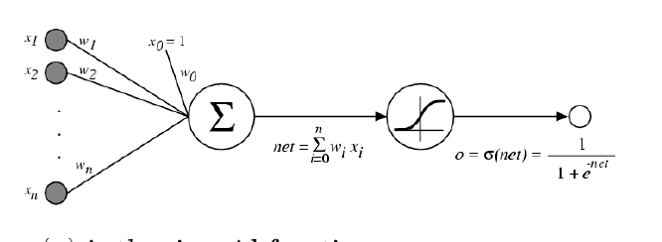
Activation Functions
Sigmoid / Logistic Function
So far, we’ve assumed that the activation function (nonlinearity) is always the sigmoid function…

Slide 50
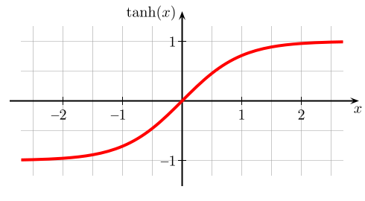
Activation Functions
A new change: modifying the nonlinearity
  The logistic is not widely used in modern ANNs
Alternate 1: tanh
Like logistic function but shifted to range [-1, +1]
Slide from William Cohen

Slide 51
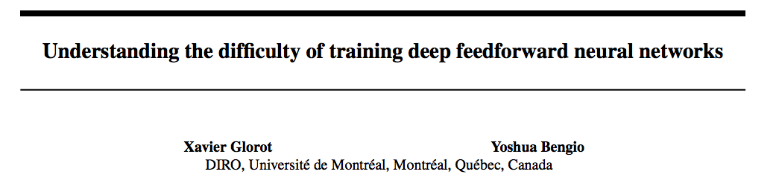
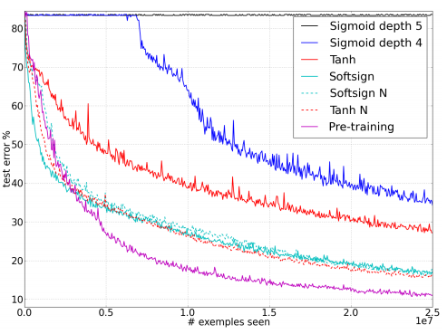
AI Stats 2010
depth 4?
sigmoid
vs.
tanh
Figure from Glorot & Bentio (2010)

Slide 52
Multi-Class Output
y₁
…
y_{K}
Output
a₁
a₂
…
a_{D}
Hidden Layer
x₁
x₂
x₃
…
x_{M}
Input
Notes:
Why called feed forward?

Slide 53
Multi-Class Output
Softmax:
y₁
…
y_{K}
Output
Hidden Layer
a₁
a₂
…
a_{D}
Input
x₁
x₂
x₃
…
x_{M}
Notes:
Why called feed forward?

Slide 54
A Recipe for
Machine Learning
Background
1. Given training data:
3. Define goal:
2. Choose each of these:
  Decision function
  Loss function
4. Train with SGD:
(take small steps opposite the gradient)

Slide 55
Backpropagation

Slide 56
Chain Rule
Training
Given:
Chain Rule:
y₁
u₁
u₂
…
u_{J}
x₂

Slide 57
Chain Rule
Training
Given:
Chain Rule:
y₁
u₁
u₂
…
u_{J}
x₂

Slide 58
Chain Rule
Training
y₁
Given:
Chain Rule:
u₁
u₂
…
u_{J}
x₂
Backpropagation:
Instantiate the computation as a directed acyclic graph, where each intermediate quantity is a node
At each node, store (a) the quantity computed in the forward pass and (b) the partial derivative of the goal with respect to that node’s intermediate quantity.
Initialize all partial derivatives to 0.
Visit each node in reverse topological order. At each node, add its contribution to the partial derivatives of its parents
This algorithm is also called automatic differentiation in the reverse-mode

Slide 59
Backpropagation
Training
Output
y
Hidden Layer
z₁
z₂
…
z_{D}
Input
x₁
x₂
x₃
…
x_{M}

Slide 60
Backpropagation
Training
Output
y
Hidden Layer
z₁
z₂
…
z_{D}
Input
x₁
x₂
x₃
…
x_{M}

