Slide 1
Decision Trees

Slide 2
Data Mining Techniques
Supervised learning
  Classification and regression
Unsupervised learning
  Clustering and association rules
Dependency modeling
Outlier and deviation detection
Trend analysis and change detection

Slide 3
Supervised Learning
F(x): true function (usually not known)
D: training sample drawn from F(x)
57,M,195,0,125,95,39,25,0,1,0,0,0,1,0,0,0,0,0,0,1,1,0,0,0,0,0,0,0,0
78,M,160,1,130,100,37,40,1,0,0,0,1,0,1,1,1,0,0,0,0,0,0,0,0,0,0,0,0,0
69,F,180,0,115,85,40,22,0,0,0,0,0,1,0,0,0,0,1,0,0,0,0,0,0,0,0,0,0,0,0
18,M,165,0,110,80,41,30,0,0,0,0,1,0,0,0,0,0,0,0,0,0,0,0,0,0,0,0,0,0
54,F,135,0,115,95,39,35,1,1,0,0,0,1,0,0,0,1,0,0,0,0,1,0,0,0,1,0,0,0,0
84,F,210,1,135,105,39,24,0,0,0,0,0,0,0,0,1,0,0,0,0,0,0,0,0,0,0,0,0,0
89,F,135,0,120,95,36,28,0,0,0,0,0,0,0,0,0,0,0,0,1,1,0,0,0,0,0,0,1,0,0
49,M,195,0,115,85,39,32,0,0,0,1,1,0,0,0,0,0,0,1,0,0,0,0,0,1,0,0,0,0
40,M,205,0,115,90,37,18,0,0,0,0,0,0,0,0,0,0,0,0,0,0,0,0,0,0,0,0,0,0
74,M,250,1,130,100,38,26,1,1,0,0,0,1,1,0,0,0,0,0,0,0,0,0,0,0,0,0,0
77,F,140,0,125,100,40,30,1,1,0,0,0,0,0,0,0,0,1,0,0,0,0,0,0,0,0,0,1,1
0
1
0
1
1
0
1
0
0
1
0

Slide 4
Supervised Learning
F(x): true function (usually not known)
D: training sample (x,F(x))
57,M,195,0,125,95,39,25,0,1,0,0,0,1,0,0,0,0,0,0,1,1,0,0,0,0,0,0,0,0 0
78,M,160,1,130,100,37,40,1,0,0,0,1,0,1,1,1,0,0,0,0,0,0,0,0,0,0,0,0,0 1
69,F,180,0,115,85,40,22,0,0,0,0,0,1,0,0,0,0,1,0,0,0,0,0,0,0,0,0,0,0,0 0
18,M,165,0,110,80,41,30,0,0,0,0,1,0,0,0,0,0,0,0,0,0,0,0,0,0,0,0,0,0 0
54,F,135,0,115,95,39,35,1,1,0,0,0,1,0,0,0,1,0,0,0,0,1,0,0,0,1,0,0,0,0 1
G(x): model learned from D 71,M,160,1,130,105,38,20,1,0,0,0,0,0,0,0,0,0,1,0,0,0,0,0,0,0,0,0,0 ?
Goal: E[(F(x)-G(x))²] is small (near zero) for future samples

Slide 5
Supervised Learning
Well-defined goal:
Learn G(x) that is a good approximation
to F(x) from training sample D
Well-defined error metrics:
Accuracy, RMSE, ROC, …

Slide 6
Supervised vs. Unsupervised Learning
Supervised
y=F(x): true function
D: labeled training set
D: {x_{i},F(x_{i})}
Learn:
G(x): model trained to predict labels D
Goal:
E[(F(x)-G(x))²] ¡Ö 0
Well defined criteria: Accuracy, RMSE, ...
Unsupervised
Generator: true model
D: unlabeled data sample
D: {x_{i}}
Learn
??????????
Goal:
??????????
Well defined criteria:
??????????

Slide 7
Goals and Requirements
Goals:
  To produce an accurate classifier/regression function
  To understand the structure of the problem
Requirements on the model:
  High accuracy
  Understandable by humans, interpretable
  Fast construction for very large training databases

Slide 8
Different Types of Classifiers
Decision Trees
Simple Bayesian models
Nearest neighbor methods
Logistic regression
Neural networks
Linear discriminant analysis (LDA)
Quadratic discriminant analysis (QDA)
Density estimation methods

Slide 9
Decision Trees
A decision tree T encodes d (a classifier or regression function) in form of a tree.
A node t in T without children is called a leaf node. Otherwise t is called an internal node.

Slide 10
Simple
Structure
But
Understandable
To human
To a certain degree only
Decision trees learn from data to approximate a set of if-then-else decision rules.
The deeper the tree, the more complex the decision rules and the fitter the model.
Ocham razor

Slide 11
A DECISION TREE breaks down a data set into smaller and smaller subsets while at the same time an associated decision tree is incrementally developed. The final result is a tree with decision nodes and leaf nodes.
A decision node has two or more branches. Leaf node represents a classification or decision.
The topmost decision node in a tree which corresponds to the best predictor called root node. Decision trees can handle both categorical and numerical data.

Slide 12
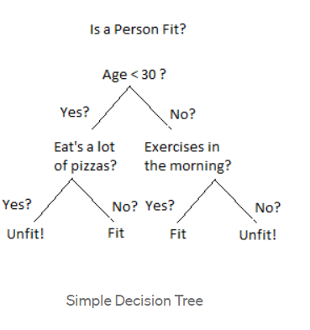
These are similar to flowcharts.

Slide 13
How Do Decision Trees Work?
There are several steps involved in the building of a decision tree.

Slide 14
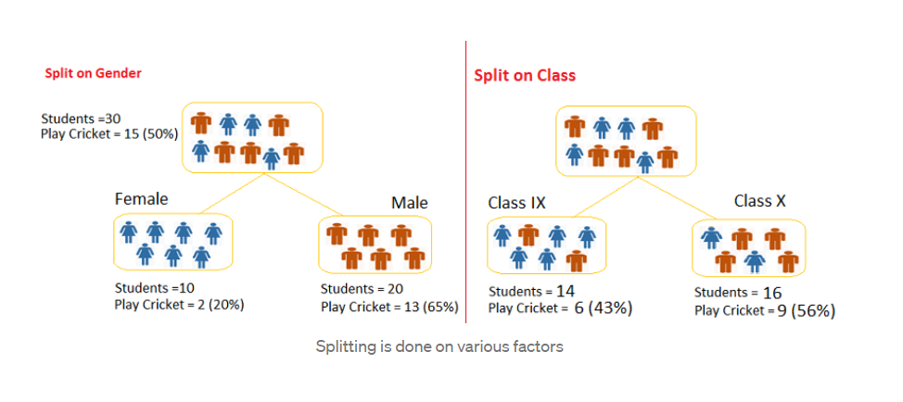
Splitting
The process of partitioning the data set into subsets. Splits are formed on a particular variable

Slide 15
Pruning
The shortening of branches of the tree. Pruning is the process of reducing the size of the tree by turning some branch nodes into leaf nodes, and removing the leaf nodes under the original branch. Pruning is useful because classification trees may fit the training data well, but may do a poor job of classifying new values. A simpler tree often avoids over-fitting.
overfitting

Slide 16
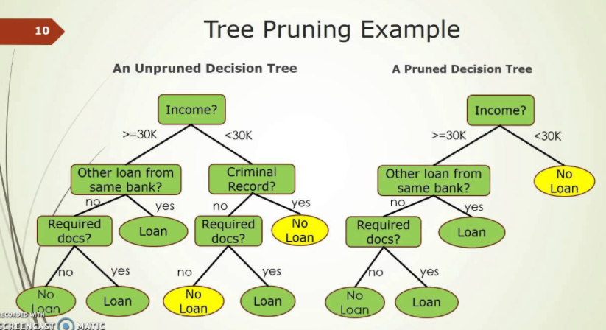

Slide 17
Tree Selection
The process of finding the smallest tree that fits the data with the smallest error

Slide 18
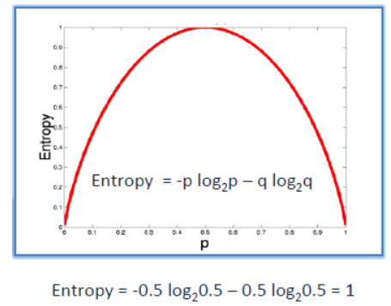
Key Factors :
A decision tree is built top-down from a root node and involves partitioning the data into subsets that contain instances with similar values (homogeneous). Dec tree uses entropy to calculate the homogeneity of a sample. If the sample is completely homogeneous the entropy is zero and if the sample is an equally divided it has entropy of one.

Slide 19
2. Information Gain
The information gain is based on the decrease in entropy after a dataset is split on an attribute. Constructing a decision tree is all about finding feature that returns the highest information gain (i.e., the most homogeneous branches).

Slide 20
Computing the Information Gain Steps 1 and 3
1) Calculate entropy of the target
The dataset is then split on the different attributes.
The entropy for each branch is calculated.
Then it is added proportionally, to get total entropy for the split.
The resulting entropy is subtracted from the entropy before the split.
The result is the Information Gain, or decrease in entropy.

Slide 21
Step 3:
Choose attribute with the largest information gain as the decision node, divide the dataset by its branches and repeat the same process on every branch.

Slide 22
Pros and Cons
GOOD! Computionally cheap to use, easy for humans to understand results and it can deal with irrelevant feaures also
NOT SO GOOD! Prone to Overfitting.(It refers to the process when models is trained on training data too well that any noise in testing data can bring negative impacts to performance of model.)

Slide 23
In Nutshell
A decision tree classifier is just like a flowchart diagram with the terminal nodes representing classification outputs/decisions. Starting with a dataset, you can measure the entropy to find a way to split the set until all the data belongs to the same class.

Slide 24
Decision Trees in R using rpart
2 DIFFERENT APPLICATIONS (Motivating Problems)
there’s a common scam amongst motorists whereby a person will slam on his breaks in heavy traffic with the intention of being rear-ended. The person will then file an insurance claim for personal injury and damage to his vehicle, alleging that the other driver was at fault. Suppose we want to predict which of an insurance company’s claims are fraudulent using a decision tree.
use the current loan application data (for Germany) to predict whether or not an applicant will be able to repay a loan according to the set of attributes.

Slide 25
Make sure all the categorical variables are converted into factors.
The function rpart will run a regression tree if the response variable is numeric, and a classification tree if it is a factor.
rpart parameter - Method - "class" for a classification tree ; "anova" for a regression tree
minsplit : minimum number of observations in a node before splitting. Default value - 20
minbucket : minimum number of observations in terminal node (leaf). Default value - 7 (i.e. minsplit/3)
xval : Number of cross validations (to be explained)

Slide 26
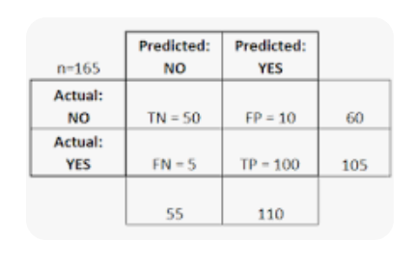
A confusion matrix is a table that is often used to describe the performance of a classification model (or "classifier") on a set of test data for which the true values are known. The classifier made a total of 165 predictions (e.g., 165 patients were being tested for the presence of that disease).

