Slide 1
Two cases
Pierre Fabre Dermo-Cosmétique SAS
Coty Germany GmbH

Slide 2
Market power (quality) and consumer welfare
p
Consumer welfare loss
Market power as
“quality” reduction
(Remember: the demand function indicates how much consumers are willing to pay)
p₁
MC₁
D₂
D₁
Q₁
Q

Slide 3
A more complex situation
How do we deal with conducts that lead to a price increase
and
to a quality improvement?

Slide 4
Balancing opposite effects-1
p
Market power
Price increase and “quality” improvement
p₂
p₁
MC₁
D₁
D₂
Q₁
Q₂
Q

Slide 5
Balancing opposite effects-2
p
Case 1
Price increase and “quality” improvement
such that the overall
quantity does not change
Q₁ = Q₂
p₂
p₁
MC₁
D₁
D₂
Q₁
= Q₂
Q

Slide 6
Balancing opposite effects-3
p
Welfare loss
Case 2
Price increase and “quality” improvement
such that the overall
quantity decreases
Q₁ > Q₂
p₂
p₁
MC₁
D₁
D₂
Q₂ <
Q₁
Q

Slide 7
Balancing opposite effects-4
p
Welfare gain
Case 3
Price increase and “quality” improvement
such that the overall
quantity increases
Q₁ < Q₂
p₂
p₁
MC₁
D₁
D₂
Q₁
< Q₂
Q

Slide 8
Balancing opposite effects-5
Rule of thumb:
If Q increases, consumer welfare increases as well

Slide 9
Selective distribution
Manufacturer’s profits:
Π = (w – c) x Q(p, s)
w = wholesale price; c = manufacturer’s marginal cost; Q(p, s) = downstream demand, which depends on p = retail price and s = retail demand enhancing factors
If a selective distribution system is “efficient” this means that it implies a combination of p and s (say (p*, s*)) such that consumer welfare is higher, even though it entails a higher p
Notes:
there are legitimate requirements, such as the maintenance of a specialist trade capable of providing specific services as regards high-quality and high-technology products, which may justify a reduction of price competition in favour of competition relating to factors other than price (par. 40)

Slide 10
E-commerce enters the picture
Is e-commerce a strong competitive force?
What type of competition is strengthened by the e-commerce?
Why?
Notes:
there are legitimate requirements, such as the maintenance of a specialist trade capable of providing specific services as regards high-quality and high-technology products, which may justify a reduction of price competition in favour of competition relating to factors other than price (par. 40)

Slide 11
E-commerce and selective distribution
Suppose that e-commerce, if unrestrained, shifts the combination of p and s from (p*,s*) to (p’,s’) (e.g. p’ < p* and s’ < s*)
When is the new combination good (or bad) for consumers?
According to the “rule of thumb”
Q(p’,s’) > Q(p*,s*) Good
Q(p’,s’) < Q(p*,s*) Bad
Under what conditions does the manufacturer want to restraint e-commerce?

Slide 12
The manufacturer’s incentive
Manufacturer’s profit:
Π = (w – c) x Q(p, s)
All else equal, profit is:
higher if Q(p’,s’) > Q(p*,s*)
lower if Q(p’,s’) < Q(p*,s*)
The manufacturer wants the restraint only if it improves consumer welfare
Unless…
it alters w (this is an essential element of a theory of harm in a vertical restraint case and it is never discussed by the ECJ)

Slide 13
Theory: Events and probability
Consider an unknown event called “infringement” (I) (for instance a cartel) and a known (observed) event called “evidence” (E) (for instance parallel pricing)
We need to establish whether E contributes to prove I
In probability theory there is a concept called “conditional probability” that is the probability, i.e. the probability of an event (A) given another (known, observed) event (B)
P(A│B)

Slide 14
Theory: Prior and posterior
Let P(I) the unconditional probability of an infringement (i.e. the probability that I occurred before collecting any evidence) – it is the “prior”
Suppose E is observed and we can compute the conditional probability P(I│E) – the “posterior” ; 3 cases are possible:
1) P(I│E) = P(I) → E is irrelevant
2) P(I│E) > P(I) → E is inculpatory (contributes to prove that the infringement occurred)
3) P(I│E) < P(I) → E is exculpatory (contributes to disprove that the infringement occurred)

Slide 15
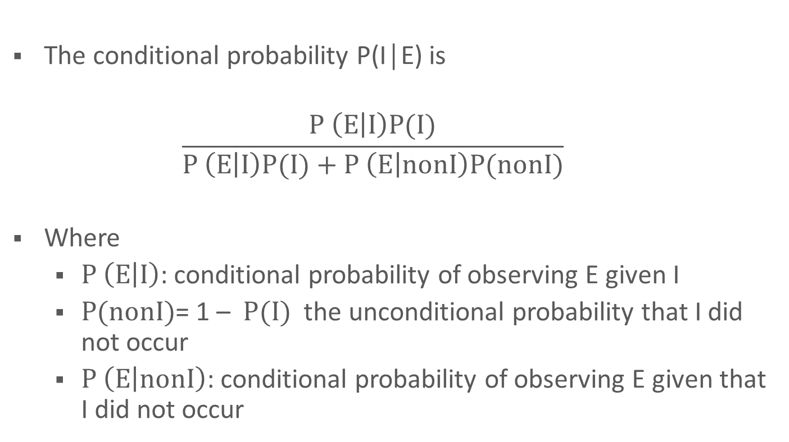
Theory: The Bayes Theorem
The conditional probability P(I│E) is
$$\frac{P \left(E | I\right)P(I)}{P \left(E | I\right)P(I)+P \left(E | nonI\right)P(nonI)}$$
Where
  $P \left(E | I\right)$: conditional probability of observing E given I
  $P(nonI)$= 1 – $P(I)$ the unconditional probability that I did not occur
  $P \left(E | nonI\right)$: conditional probability of observing E given that I did not occur

Slide 16
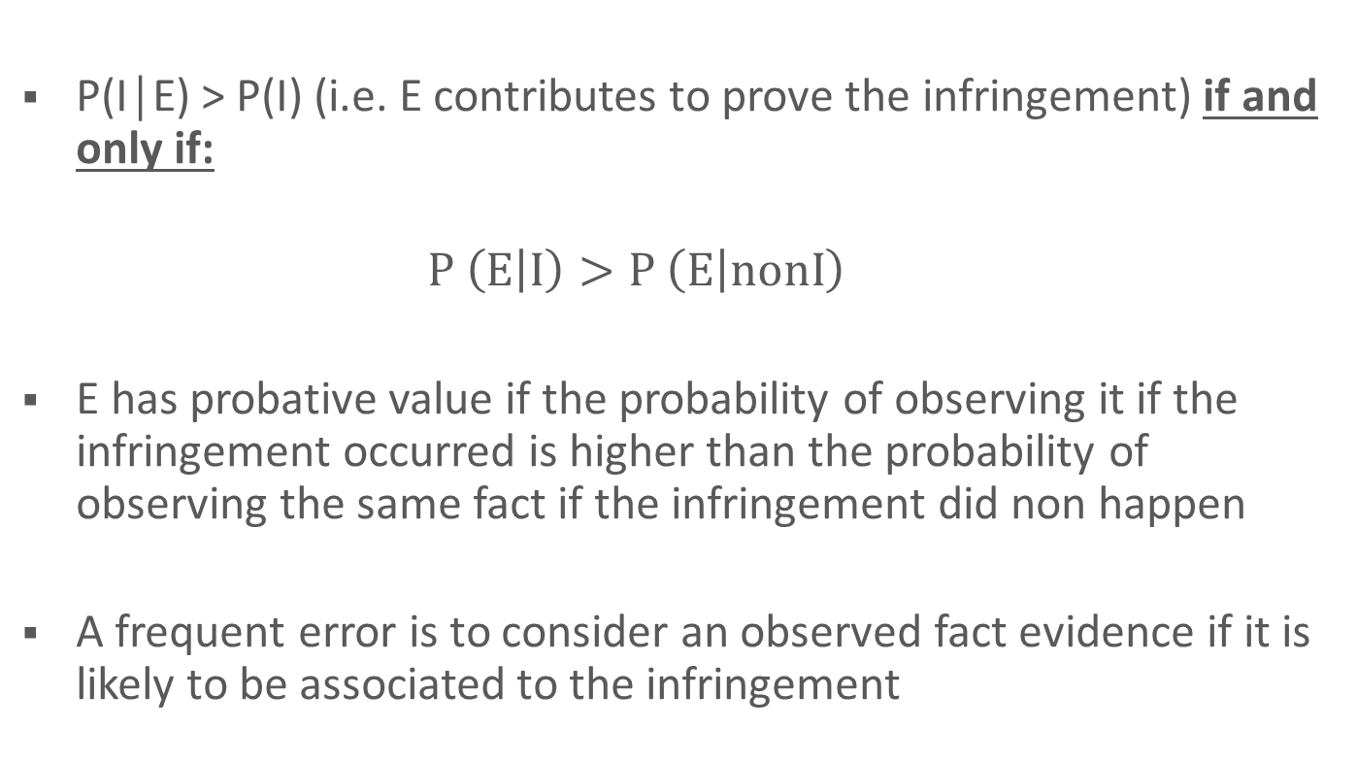
Theory: Applying the Bayes Theorem
P(I│E) > P(I) (i.e. E contributes to prove the infringement) if and only if:
  $$P \left(E | I\right)>P \left(E | nonI\right)$$
  E has probative value if the probability of observing it if the infringement occurred is higher than the probability of observing the same fact if the infringement did non happen
  A frequent error is to consider an observed fact evidence if it is likely to be associated to the infringement

Slide 17
A case: Istituti di Vigilanza Sardegna
Market: Security Services (Guards) in the province of Cagliari
Market structure
Company | Market Share
Vigilanza Sardegna (VS) | 51.4%
Sicurezza Notturna (SN) | 25.0%
Sicurvis | 8,6%
Cannas | 9.2%
S. Elena | 4.4%
Gerrei | 1.4%
Total | 100.0%

Slide 18
Pricing behavior
 | 1990
Pres. | S.N. | V. S.
A | 22.184 | 22.477
B | 22.358 | 22.177
C | 22.358 | 22.177
D | 22.358 | 22.177
E | 22.358 | 22.177
F | 22.358 | n.o.
G | 22.184 | 22.477
H | 22.184 | 22.477
I | n.o. | 22.477
L | 22.184 | 22.477
M | 22.184 | 22.477
1991
S. N | V.S | Cannas
25.200 | 25.477 | 26.000
25.800 | 25.477 | 26.000
25.800 | 25.477 | 26.000
25.800 | 25.477 | 26.000
25.800 | 25.477 | 26.000
25.200 | 25.477 | 26.000
25.200 | 25.477 | 26.000
25.200 | 25.477 | 26.000
25.800 | 25.477 | 26.000
25.200 | 25.477 | 26.000
25.200 | 25.477 | 26.000
 | 1992
S.N.. | V. S.. | S. El.
26.500 | n.o. | n.o.
n.o. | 26.350 | n.o.
n.o. | 26.350 | n.o.
n.o. | 26.350 | n.o.
n.o. | 26.350 | n.o.
26.500 | n.o. | n.o.
26.500 | n.o. | n.o.
26.500 | n.o. | n.o.
n.o. | 26.350 | 16.950
26.500 | n.o. | 16.950
26.500 | n.o. | n.o.
 | 1993
S.N. | V. S . | S. El. | Gerrei
8.900 | 8.950 | n.o. | n.o.
9.000 | 8.950 | 16.000 | n.o.
9.000 | 8.950 | 15.500 | n.o.
9.000 | 8.950 | 14.700 | n.o.
9.000 | 8.950 | n.o. | n.o.
8.900 | 8.950 | n.o. | n.o.
8.900 | 8.950 | n.o. | 17.945
8.900 | 8.950 | n.o. | 17.945
9.000 | 8.950 | 12.200 | 17.945
8.900 | 8.950 | 12.200 | 17.945
8.900 | 8.950 | n.o. | 17.945

Slide 19
IVS: evidence
Suppliers bids are higher for a particular lot than the same supplier's bid for another similar lot
Significant reductions from past price levels after a bid from a new or infrequent supplier, e.g. the new supplier may have disrupted an existing bidding cartel
There is a clear allocation of winning tenders. Firms submitted tenders that always win the same lots
Regular suppliers fail to bid on a lot they would normally be expected to bid for, but have continued to bid for other lots

Slide 20
IVS: decision
On the basis of the evidence described above the Italian Competition Authority issued an infringement decision
The decision was upheld by the administrative courts in the subsequent appeals!

