Slide 1
Introduction to competition law

Slide 2
Outline
A quick introduction to the the substantive rules
The objectives of competition law

Slide 3
A quick intro to competition law
Two main rules that regulate firms’ conducts
Prohibition of agreements and concerted practices that restrict competition (e.g. cartels) (Art. 101 TFEU)
Prohibition of abuses of dominant position (Art. 102 TFEU)
Merger control regulation

Slide 4
Art. 101 (1) TFEU
The following shall be prohibited as incompatible with the internal market all agreements between undertakings, decisions by associations of undertakings and concerted practices which may affect trade between Member States and which have as their object or effect the prevention, restriction or distortion of competition within the internal market, and in particular those which:
(a) directly or indirectly fix purchase or selling prices or any other trading conditions;
(b) limit or control production, markets, technical development, or investment;
(c) share markets or sources of supply;
(d) apply dissimilar conditions to equivalent transactions with other trading parties, thereby placing them at a competitive disadvantage;
(e) make the conclusion of contracts subject to acceptance by the other parties of supplementary obligations which, by their nature or according to commercial usage, have no connection with the subject of such contracts.

Slide 5
Art. 101 (3) TFEU
The provisions of paragraph 1 may, however, be declared inapplicable in the case of: any agreement or category of agreements between undertakings, any decision or category of decisions by associations of undertakings, any concerted practice or category of concerted practices, which contributes to improving the production or distribution of goods or to promoting technical or economic progress, while allowing consumers a fair share of the resulting benefit, and which does not:
(a) impose on the undertakings concerned restrictions which are not indispensable to the attainment of these objectives;
(b) afford such undertakings the possibility of eliminating competition in respect of a substantial part of the products in question.

Slide 6
Notion of undertaking
For the purpose of EU competition law, any entity engaged in an economic activity, that is an activity consisting in offering goods or services on a given market, regardless of its legal status and the way in which it is financed, is considered an undertaking
No intention to earn profits is required (but they have to bear the financial risk of the economic activity)
Public bodies are not excluded (but bodies that perform only a market regulation function are excluded)
Non-trivial examples:
  Individual professionals (lawyers, accountants, etc.)
  Sport associations

Slide 7
Agreement and concerted practice
Agreement has a wide meaning and covers agreements whether legally enforceable or not, written or oral; it includes so-called gentlemen’s agreements:
  There does not have to be a physical meeting of the parties for an agreement to be reached
  An exchange of letters or telephone calls may suffice
  In the US the jurisprudence talks of a “meeting of the minds”
Concerted practice: co-ordination between undertakings which, without having reached the stage of concluding a formal agreement, have knowingly substituted practical co-operation for the risks of competition
Some form of direct or indirect communications is involved in both definition

Slide 8
Conducts caught by Art. 101.1 TFEU
Horizontal agreements
  Cartels
  Information sharing agreements
  Purchasing agreements
  Commercialization agreements
  Other horizontal agreements (e.g. R&D)
Vertical Agreements
  Distribution agreements
  Franchising
  Input supply, etc.

Slide 9
Art. 102 TFEU
Any abuse by one or more undertakings of a dominant position within the internal market or in a substantial part of it shall be prohibited as incompatible with the internal market in so far as it may affect trade between Member States.
Such abuse may, in particular, consist in:
(a) directly or indirectly imposing unfair purchase or selling prices or other unfair trading conditions;
(b) limiting production, markets or technical development to the prejudice of consumers;
(c) applying dissimilar conditions to equivalent transactions with other trading parties, thereby placing them at a competitive disadvantage;
(d) making the conclusion of contracts subject to acceptance by the other parties of supplementary obligations which, by their nature or according to commercial usage, have no connection with the subject of such contracts.

Slide 10
Conducts covered by Art. 102 TFEU
Exploitative abuses: e.g. excessive pricing (Art. 102; a)
Exclusionary abuses
  Predatory pricing
  Refusal to supply an essential input
  Exclusive contracts (with customers)
  Fidelity rebates
  Tying and bundling, etc.

Slide 11
Merger control/1
Mergers that satisfy some predefined conditions must be notified to the competent competition authority
Article 2
1. Concentrations within the scope of this Regulation shall be appraised in accordance with the objectives of this Regulation…
In making this appraisal, the Commission shall take into account: …
(b) the market position of the undertakings concerned and their economic and financial power, the alternatives available to suppliers and users, their access to supplies or markets, any legal or other barriers to entry, supply and demand trends for the relevant goods and services, the interests of the intermediate and ultimate consumers, and the development of technical and economic progress provided that it is to consumers' advantage and does not form an obstacle to competition.

Slide 12
Merger control/2
Article 2 (ctd)
2. A concentration which would not significantly impede effective competition in the common market or in a substantial part of it, in particular as a result of the creation or strengthening of a dominant position, shall be declared compatible with the common market.
3. A concentration which would significantly impede effective competition, in the common market or in a substantial part of it, in particular as a result of the creation or strengthening of a dominant position, shall be declared incompatible with the common market

Slide 13
Types of merger
Horizontal mergers: between firms that operate at the same level of the supply chain (substitutes)
Vertical mergers: between firms that operate at different levels of the supply chain (complements)
Conglomerate mergers: between firms that supply products that are neither substitutes nor complements

Slide 14
Formal approach – Define the “conducts”
"Conducts" that are subject to antitrust scrutiny
Agreements
Unilateral conducts of dominant companies
Mergers
Notes:
Discuss what a counterfactual is
Maybe discuss as a side note the link between theory of harm, counterfactual, and private enformcement / actions for damages

Slide 15
Formal approach – Identify the “form” of prohibited conducts
Some examples:
  Agreements
    Cartels: e.g. an explicit agreement aimed at fixing the price
    Vertical agreements: e.g. an agreement imposing exclusivity
  Abuses of dominance
    Setting a price below cost
    Tying two independent products (including one sold in a market in which the firm is dominant)
  Mergers
    Horizontal mergers that reduces the number of competitors below 4
    A vertical merger that includes a company that enjoys a dominant position in one of the two markets

Slide 16
Economic approach
Identify conducts that limit competition and are harmful
We do not have a clear-cut notion of competition
  Perfect competition
  Imperfect competition
  Workable competition
  Competition on the merit
  …
Let us consider a more stable notion: market power
Notes:
Discuss what a counterfactual is
Maybe discuss as a side note the link between theory of harm, counterfactual, and private enformcement / actions for damages

Slide 17
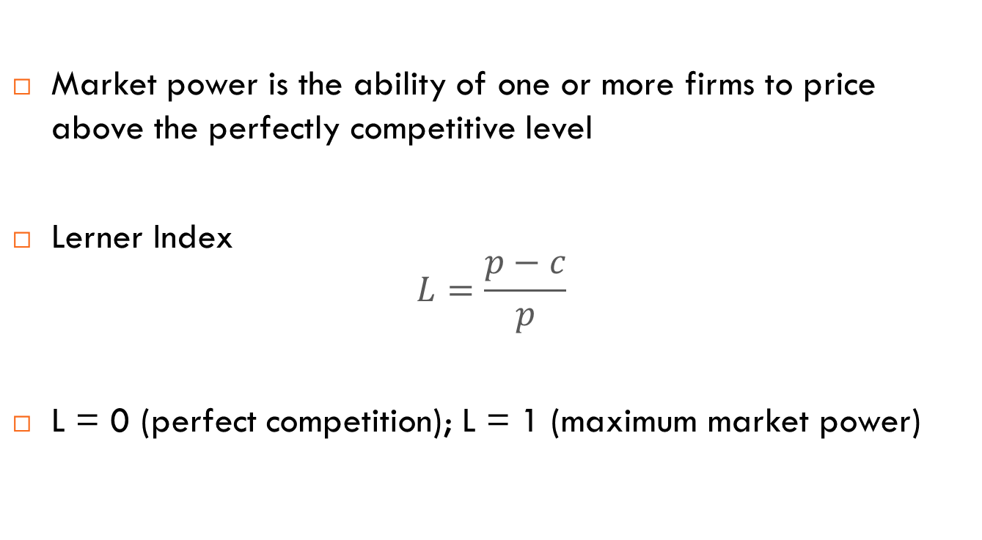
Market power
Market power is the ability of one or more firms to price above the perfectly competitive level
Lerner Index
$$L=\frac{p−c}{p}$$
L = 0 (perfect competition); L = 1 (maximum market power)
Notes:
Discuss what a counterfactual is
Maybe discuss as a side note the link between theory of harm, counterfactual, and private enformcement / actions for damages

Slide 18
Efficiency and the objectives of competition law
Consumer surplus, producer surplus and social welfare
Allocative efficiency
Productive efficiency
Dynamic efficiency
Distributive goals (?)

Slide 19
Consumer welfare (surplus)
p
The demand function indicates how much consumers are willing to pay to buy a certain amount of product
Consumer welfare (surplus) is the difference between what they are willing to pay and what they actually pay
p₁
MC₁
D
Q₁
Q

Slide 20
Producer surplus
p
The marginal cost function indicates how much a producer is willing to accept sell a certain amount of product
Producer (surplus) is the difference between what the producer gets and what she is willing to accept
p₁
MC₁
D
Q₁
Q

Slide 21
Notions of efficiency
Allocative efficiency: a (static) property of a market (the system through which the exchange of products occurs)
Productive efficiency: a (static) property of the production process (i.e. the system through which goods and services are produced and distributed)
Dynamic efficiency: a property of the system of production and exchange to be assessed over time

Slide 22
Allocative efficiency
Consumers that derive from the consumption of a product a benefit larger than the social cost of producing the same good are able to buy the product
Consumers that derive a benefit lower than the social cost of producing the same good are excluded from the consumption of the product
Produces whose costs are lower than consumers’ willingness to pay are able to sell the product
Produces whose costs are higher than consumers’ willingness to pay are prevented from selling the product

Slide 23
Productive efficiency
Output is produced with the minimum amount of input (technical efficiency), and
Output is produced at the minimum cost (economic efficiency)

Slide 24
Dynamic efficiency
Improvement of economic activities over time, i.e. innovation
  New (more efficient) production processes
  New products (better quality, more differentiated)
  New distribution systems (e.g. ecommerce)

Slide 25
Distrubutive goals
Consumer welfare vs total welfare, i.e. should we give more weight to consumer rather than producer surplus?
  Consumers must get a “fair” share of any efficiency
  Political economy explanation
Fighting inequality
  Is this a competition policy goal or its “byproduct”?
  Are we sure that “consumers” are less affluent than producers?
  Do competition agencies have a legitimate mandate to pursue this goal?
  Is this a political decision?
  Are other public policies more appropriate?

Slide 26
My preferred definition
The purpose of competition law is to prevent the creation, strengthening (or exercise) of market power if market power leads to a (significant) reduction of social/consumer welfare (over a foreseeable period of time)

