Slide 1
Assessment of market power: structural analysis and theories of harm

Slide 2
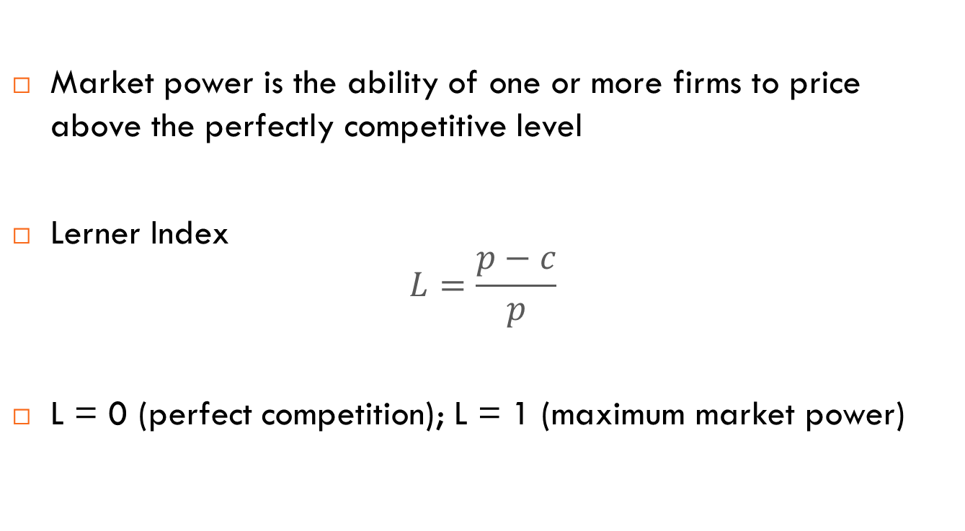
Market power
Market power is the ability of one or more firms to price above the perfectly competitive level
Lerner Index
$$L=\frac{p−c}{p}$$
L = 0 (perfect competition); L = 1 (maximum market power)
Notes:
Discuss what a counterfactual is
Maybe discuss as a side note the link between theory of harm, counterfactual, and private enformcement / actions for damages

Slide 3
Market power and allocative efficiency
p
A is a “transfer” of surplus
B is a deadweight loss
p₂
A
B
p₁
MC₁
D
Q₂
Q₁
Q

Slide 4
Market power and productive efficiency
p
Market power may be a necessary evil to achieve productive efficiency
Example: economies of scale
More efficient to concentrate production within “few” firms, possibly one (natural monopoly)
p₂
B
p₁
MC₁
A
MC₂
D
Q₂
Q₁
Q

Slide 5
Market power and dynamic efficiency
Competition and dynamic efficiency
Two effects of competition
  Escape competition effect
  Schumpeterian effect
Innovation depends on incentives
Inverted-U relationship
high
Innovation
low
low
high
Competition

Slide 6
A framework for assessing market power
Market power can exist in a variety of contexts:
  in some markets, a single undertaking may possess market power (unilateral effects)
  in other markets, a number of undertakings may collectively possess market power (coordinated effects)
It is necessary to have a conceptual framework to assess whether and to what extent market power exists, may be created, or strengthened
Notes:
Discuss what a counterfactual is
Maybe discuss as a side note the link between theory of harm, counterfactual, and private enformcement / actions for damages

Slide 7
The “old” economic approach
The traditional approach for assessing market power relied on the causal link between structure–conduct–performance
Main focus on structural factors
Notes:
Discuss what a counterfactual is
Maybe discuss as a side note the link between theory of harm, counterfactual, and private enformcement / actions for damages

Slide 8
Structural analysis: steps
Step 1: Define a relevant market (product and geographic)
Step 2: Analyse the supply-side structure of the market
  Number of competitors
  Market shares and concentration indexes
  Vertical integration; etc.
Step 3: Assess barriers to entry (potential competition)
Step 4: Assess countervailing buyer power (if any)
Notes:
Discuss what a counterfactual is
Maybe discuss as a side note the link between theory of harm, counterfactual, and private enformcement / actions for damages

Slide 9
Modern economic approach: developing a theory of harm
In the latest years, antitrust authorities focused on articulating a “theory of harm” behind a competition concern
The theory of harm is a story that explains why an agreement between two or more firms or a practice engaged by a firm or a merger may create or increase market power and adversely affect consumers
It does not only take into account the structural features of the market but also the incentives and the ability of the firms involved

Slide 10
Theory of harm: elements
A well-developed theory of harm:
should articulate how competition and, ultimately, consumers will be harmed by the practice under exam relative to an appropriately defined counterfactual
should be consistent with the incentives and the ability of the parties involved
should be consistent with the available economic theory
should be consistent with the available empirical evidence
Notes:
Discuss what a counterfactual is
Maybe discuss as a side note the link between theory of harm, counterfactual, and private enformcement / actions for damages

Slide 11
Theory of harm: broad categories
Individual theories of harm are numerous and specific to the case at stake
However, most draw on a limited number of common potential sources of competitive harm:
  Softening competition/unilateral market power
  One or more firms have a lower incentive to compete aggressively and can unilaterally exercises market power
  Collusion
  Two or more firms coordinate to jointly exercise market power
  Foreclosure
  A firm reinforces or protects its market power by excluding equally efficient competitors from the market

Slide 12
Softening competition
One or more firms undertake a practice such that lowers their incentives to compete aggressively
Examples
  Merger between two close competitors: unilateral effects
  Best pricing policies
    Price Matching Guarantee
    Parity clause
  Softening competition theory of harm is based on an alteration of a static game

Slide 13
Collusion
Coordination of market strategies (prices, output etc.) such as to raise profits and harm consumers
Coordination occurs through a dynamic interaction (repeated game)
3 Problems:
  Coordination problem: finding the terms of coordination
  Enforcement problem: curbing firms’ incentive to deviate through a punishment mechanism
  External stability: impeding disruptive actions by fringe competitors and/or buyers

Slide 14
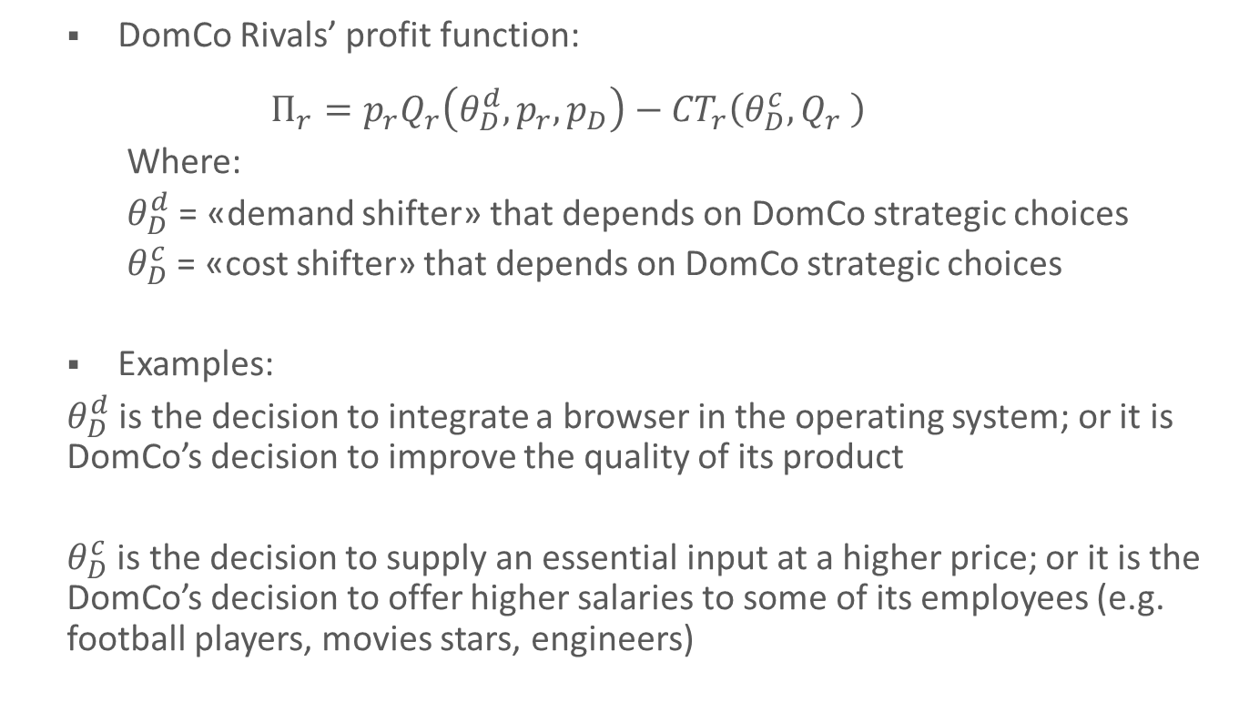
Foreclosure: general representation
DomCo Rivals’ profit function:
  $$Π_{r}=p_{r}Q_{r}\left(θ_{D}^{d},p_{r},p_{D}\right)−{CT}_{r}\left(θ_{D}^{c},Q_{r} \right)$$
  Where:
  $θ_{D}^{d}$ = «demand shifter» that depends on DomCo strategic choices
  $θ_{D}^{c}$ = «cost shifter» that depends on DomCo strategic choices
Examples:
$θ_{D}^{d}$ is the decision to integrate a browser in the operating system; or it is DomCo’s decision to improve the quality of its product
$θ_{D}^{c}$ is the decision to supply an essential input at a higher price; or it is the DomCo’s decision to offer higher salaries to some of its employees (e.g. football players, movies stars, engineers)

Slide 15
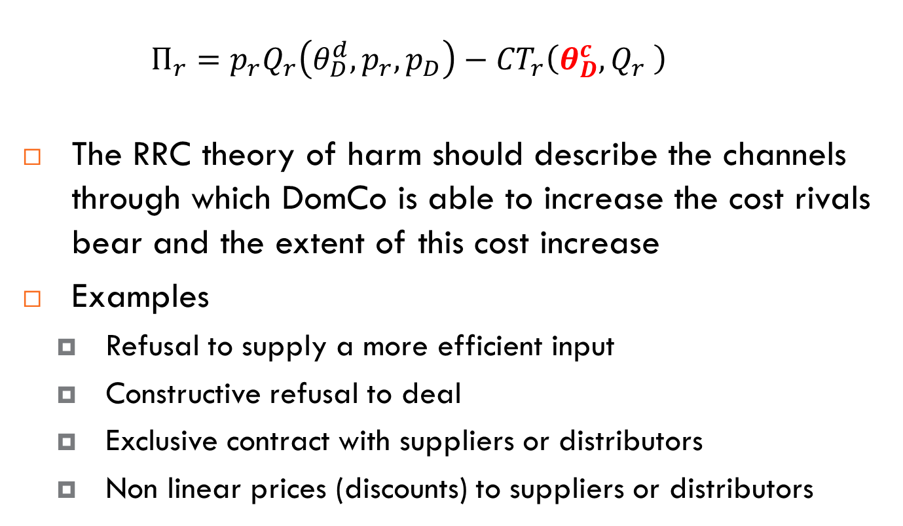
Raising Rivals’ Costs
  $$Π_{r}=p_{r}Q_{r}\left(θ_{D}^{d},p_{r},p_{D}\right)−{CT}_{r}\left(θ_{D}^{c},Q_{r} \right)$$
The RRC theory of harm should describe the channels through which DomCo is able to increase the cost rivals bear and the extent of this cost increase
Examples
  Refusal to supply a more efficient input
  Constructive refusal to deal
  Exclusive contract with suppliers or distributors
  Non linear prices (discounts) to suppliers or distributors

Slide 16
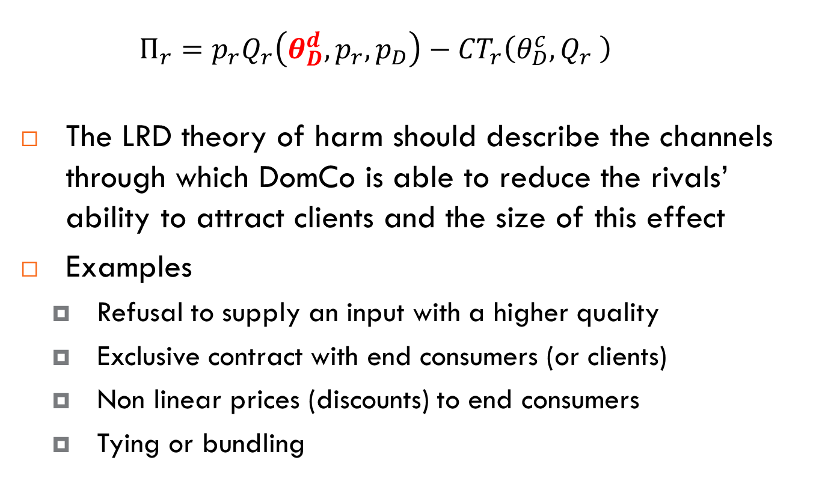
Lowering Rivals’ Demand
  $$Π_{r}=p_{r}Q_{r}\left(θ_{D}^{d},p_{r},p_{D}\right)−{CT}_{r}\left(θ_{D}^{c},Q_{r} \right)$$
The LRD theory of harm should describe the channels through which DomCo is able to reduce the rivals’ ability to attract clients and the size of this effect
Examples
  Refusal to supply an input with a higher quality
  Exclusive contract with end consumers (or clients)
  Non linear prices (discounts) to end consumers
  Tying or bundling

Slide 17
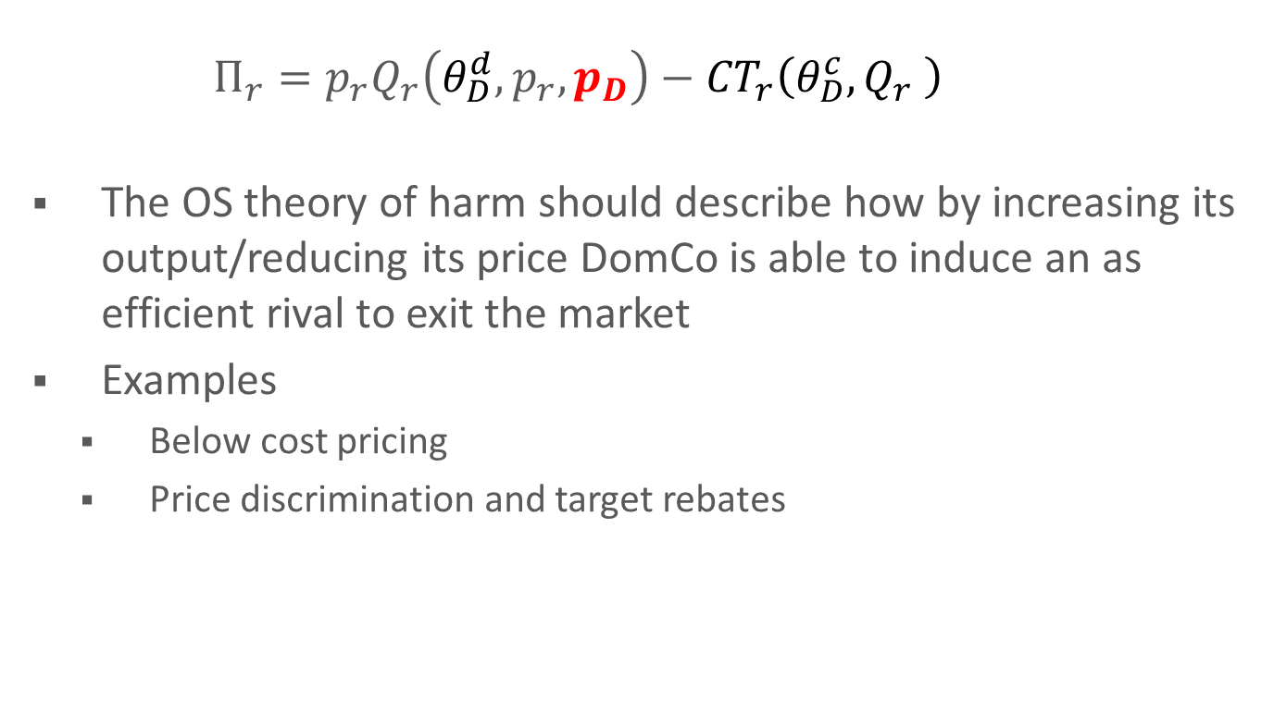
Output strategies
  $$Π_{r}=p_{r}Q_{r}\left(θ_{D}^{d},p_{r},p_{D}\right)−{CT}_{r}\left(θ_{D}^{c},Q_{r} \right)$$
The OS theory of harm should describe how by increasing its output/reducing its price DomCo is able to induce an as efficient rival to exit the market
Examples
  Below cost pricing
  Price discrimination and target rebates

Slide 18
Categories of efficiency justification
Allocative efficiency: a lower price is generally socially efficient
Productive efficiency
  Economies of scale and scope
  Vertical coordination (provide the right incentives to suppliers or distributors)
Dynamic efficiency
  Protecting investments in tangible and/or intangible assets

Slide 19
Summary (with examples)
 | Softening competition | Collusion | Foreclosure
Agreements | Parity clause | Bid rigging | Boycot
Abuses of dominance | Tying | Predatory pricing | Predatory pricing
Mergers | Horizontal mergers between close competitors | Horizontal merger without single dominance | Vertical or conglomerate merger
Some conducts (e.g. cartels) are so clearly harmful that do not require a full economic analysis → the ToH can be “truncated” (only factual assertions – see next slides)
However, an economic analysis can provide useful evidence

Slide 20
Rule vs. Standard
Legal commands can have two forms
Rules prescribe or prohibit specific and well-defined behavior;
  To enforce a rule the enforcer needs only to ascertain if the triggering facts defined by the rule hold
Standards prohibit behavior that are against a certain objective or prescribe conducts that pursue a certain objective
  To enforce a standard the enforcer needs to understand if the observed behavior is compatible or incompatible with the objective that is pursued

Slide 21


Rule vs Standard
This is a Rule
This is a Standard

Slide 22
Rules, Standards and ToH
The enforcement of a standard requires the definition of a Theory of Harm (ToH)
The enforcement of a rule requires only to ascertain some relevant facts (the triggering conditions) that are already identified by the rule, however…
The design of the rule is (or should be) based on a ToH

Slide 23
Does competition law contain rules or standards?
The language of the main provisions (e.g. 101 and 102 TFEU, Sections 1 and 2 of the Sherman Act) defines standards
Do enforcers need to identify a specific ToH anytime they investigate a possible infringement of competition law?
No, courts and enforcers have developed rules that can be applied
They may be simple or complex rule

Slide 24
A simple rule and absolute presumptions
A price-fixing agreement among competitors is prohibited per se (or it is an infringement per object)
A competition authority has “only” to ascertain that some competitors met and coordinated their pricing decision
This finding creates a presumption
  The observed behavior is against the objective of competition law
  If the presumption is absolute, we have a per se rule

Slide 25
A complex rule and relative presumptions
Predatory pricing
  If the undertaking is dominant
    Price below average avoidable cost is illegal
    Price above long run incremental cost is legal
    Price between AAC and LRIC is illegal if we can prove exclusionary intent, is legal otherwise
This is a complex rule (we have to ascertain many facts)
Moreover, it only creates a relative presumption
  The dominant undertaking can rebut the presumption and show that the pricing decision is justified by efficiency reasons

Slide 26
Court-made rules: implicit or truncated ToH
Court-made rules hinge on implicit ToHs
  Why is price-fixing illegal?
  Because we have a ToH that a price-fixing agreement is against the objective pursued by competition law
Court-made rules may use truncated ToHs
  If a dominant undertaking prices below average avoidable cost we do not need to prove recoupment

Slide 27
Proving a theory of harm: statements
A theory of harm and the justifications of the various nodes of the story will make emerge two categories of statements:
Factual assertions: description – and possibly quantification – of an economic phenomenon
  e.g. X and Y are the closest competitors; consumers face high switching costs; demand price elasticity is 1.6
Logical propositions: a reasoning that, on the basis of a set of premises, (i.e. some factual assertions), derives a conclusion
  e.g. switching costs would prevent a new entrant from reaching an efficient scale and would impede entry

Slide 28
Proving a theory of harm: testing the statements
In general, a factual assertion can be either true or false
  When a factual assertion contains estimates it is impossible to express such a clear-cut opinion and the judgement it can only concern the reliability or robustness of the estimates
A logical proposition is valid or invalid
  internal consistency: conclusions must logically follow from the premises
  economic theory: conclusion are related to the premises by an established or sound economic theory

