Slide 1
Introducing Alpha
The SCOR Business Case
Case study for the MScBA Students
Sergio Vacca
APICS SCOR Master Instructor
Academic year 2019-2020

Slide 2
ENGAGEMENT RULES
The case study refers to the Alpha company, a virtual company for learning purpose
The objective is to get familiar with the SCOR tools.
The benchmark data and figures are only for simulation purposes
You will be required to work out in teams some exercises to consolidate and practice your learning
Sometimes the solution is the outcome of a group decision or a good guess as in management it often happens
When you believe the description of the business is not unique and straight forward, make your own assumptions and go ahead
Different solutions and approaches will generate productive professional exchanges among groups of students, thus simulating real life situations.
E
For «EDUCATION» purpose
S
Exercises for «STUDENTS» practice

Slide 3
Alpha Background
Company Background
  Alpha Company is a $1 Billion US based company who designs and manufactures two products (EVERGREEN LINE and NEW LINE) for the consumer market. Alpha employs 6000 people.
Strategic Objectives
  Grow Profitably as the Preferred Supplier of Customers in our Targeted Markets
    Overall revenue growth for current year targeted at 10%
  Driven by VALUE defined by customer
  Align processes to deliver this value
  Leverage strengths to deliver value

Slide 4
Alpha Critical Success Factors
  Maintain revenue contribution by increasing share of EVERGREEN Product Line in existing markets (distributor) preserving OI (Operating Income) return.
  Drive revenue growth by introducing NEW product Line in new market (direct to consumer) and capturing targeted share.
  Maintain image as technical leader in NEW and MATURE product lines while minimizing investments in MATURE product line manufacture.
  Add capacity through OEM supplier in MATURE Product Line

Slide 5
Background: Alpha Financials
(assumes cost structure be the same for Evergreen and New Prod.s)
AP:Account Payable
AR: Account Receivables
REVENUE forecast to grow to $1100M (57,200 orders); actual projection after 6 months is $1000M (52,000 orders) OR a $100M (5200 order) shortfall.
COGS improved 10%, due primarily to the unit prices achieved in the OEM supplier bid.
SGA went up 70% due primarily to: → (see case study)
Material acquisition, Administration and Capital Charge → (see case study)
Notes:
Capital charge: the cost to a company of borrowing money to buy or improve the buildings, equipment, etc. that it uses to produce products or provide services

Slide 6
Alpha Critical Business Issues
  NEW Products introduced to new market (direct to consumer) are selling slower than anticipated while market continues to grow at forecasted rate.
  Not one NEW line order has been processed without some customer complaint
  Profits are disappearing from the EVERGREEN Products in spite of achieving unit manufacturing costs targets (unit purchase price from outsource). Sales forecast is on track.

Slide 7
Using SCOR to build the Alpha Framework

Slide 8
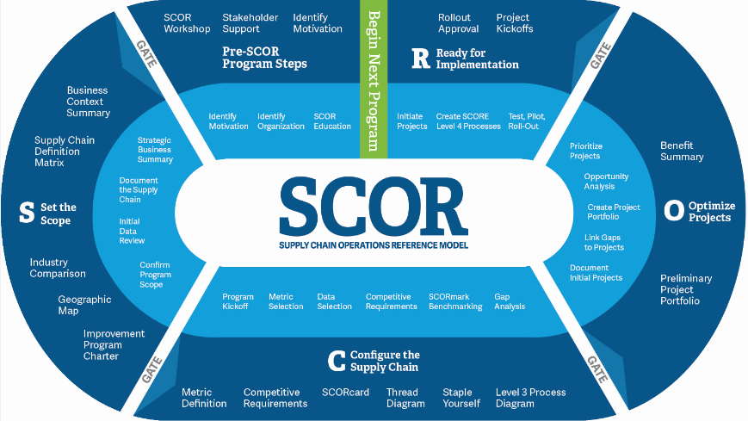
SCOR Improvement Program Racetrack

Slide 9
Pre-SCOR Program Steps:
Overview
E
Objective: Prepare the organization for the mission critical SCOR improvement program.
Program Phase Activities
Key Tasks
Identify improvement motivation
Identify internal SCOR program champion
Identify SCOR team executive sponsor
Identify SCOR executive team
Select the SCOR improvement program team
Conduct SCOR training
Gain organizational approval
Deliverables
Identify motivation
SCOR program organization
SCOR-professional training course
Plan for phase 2—S: Set the Scope
Notes:
THIS PHASE IS ESSENTIAL IN TERMS OF ORGANIZATIONAL SET UP, MOTIVATION, SPONSORSHIP, TEAMS, TRAINING/EDUCATION AND APPROVAL FROM THE BOARD
THIS IS ONE OF THE LONGEST PHASES - GOOD PRE-REQUISITES ENSURE A GOOD EXECUTION
EDUCATION BRINGS TO SCOR P AND EVENTUALLY TO THE ENDORSEMENT
ALIGNMENT AMONG LEADERS IS IMPORTANT
IT’S IMPORTANT TO HAVE A GO/NO GO ACCORDING TO THE PRESENCE OF THE REQUIREMENTS

Slide 10
Exercise 1: What are the Motivations of the Team?
S
Identify 2 / 3 statements which describe what is motivating the SCOR Alpha Team to start an improvement project.
Motivation | SCOR Level 1 Attribute

Slide 11
SCOR Improvement Program Organization
E
Program stakeholders
Executive team
Customers
Executive
sponsor
Channel
partners
Operations
management
Technology
team
Program champion
Program team
Other
stakeholders
Financial
team
Team
leader
Other teams
Functional
managers
Improvement team
Supply chain
team
Detail Project
Subprojects

Slide 12
Organization Chart
Alpha Company

Slide 13
SCOR improvement Program Organization - Deliverables
E
Objective:
Formal definition of the composition, duties, and structure of the SCOR improvement program organization.
Detail role definition:
For each role:
Role definition: Definition of each of the major roles in the program
Identification of roles: Assignment of company individuals to various program roles
Meeting schedule: Generic description of the activities normally performed by team members during the course of the SCOR improvement program
Responsibilities: Detail statement of the responsibilities of each SCOR team member for each of the remaining four project phases

Slide 14
Exercise 2:
SCOR Program Organization
S
From the Case Study description and the Alpha organisation chart, who do you believe could take the following roles:
Executive sponsor
Project Champion
Team leader
and why (provide some explanations).
Ps. The Team Leader can also be a member of a Function and not described directly in the organisation chart (dept.mgr, shift leader)

Slide 15
S: Set the Scope Overview
E
Objective: Understand the business environment and define the scope of the supply chain for a SCOR improvement program
Program Phase Activities
Key Tasks
Perform a business context summary
Document current supply chain
Collect performance data
Define the scope of supply chain involvement
Draft an improvement program charter
Deliverables
Business Context Summary
Supply Chain Definition Matrix
Industry Comparison
Geographic Map
Improvement Program Charter
Plan for Phase 3

Slide 16
Business Context Summary
E
Identify and document the enterprise, its businesses, and a high level view of the competitive landscape.
Objective:
Sources:
Key stakeholders
Financial statements
Business plans
Competitive analysis
Independent financial reviews
Activities:
Detail the environment of the business.
Chart the financial performance of the business.
Detail the internal business structure, functions, and performance.
Detail the value delivery network (customers) and the process value chain (suppliers and partners).
Chart risks to the organization and supply chain.

Slide 17
Business Context Summary Deliverables
E
Component | Description
Business description | High level description of the company’s products, customer base, internal organizational structure, and supply chains
Challenges and opportunities | A summary of company competitive strengths and weaknesses, opportunities, and threats from competitors
Value proposition | How the business and supply chain are providing competitive value to each major customer or customer segment
Critical issues | The performance gaps in reliability, responsiveness, agility, costs, and asset management
Risks | Key organizational and supply chain risks
Financial performance | Current state of company income, assets, liabilities, and profitability expectations
Internal profile | Internal business structure, functions, and performance
External profile | Supply chain and business partners and the customer delivery channel

Slide 18
Exercise 3:
Business Context Summary Deliverable
S
Prepare a Context Summary document which provides a simple and effective one page summary of the Alpha business, opportunities, risks and major features describing internal/external profile.
→ Please just fill the following empty doc. or make a separate one as you prefer.

Slide 19
Exercise 3 cont.ed: fill the chart
E
Component | Description
Business description
Challenges and opportunities
Value proposition
Critical issues
Risks
Financial performance
Internal profile
External profile

Slide 20
Defining the supply chain
E
The scope of the supply chain model will be determined by a number of conditions
  Product grouping
  Geography
  Profit Center / Cost Center
  Organizational
  Customer
  Supplier
Always try to avoid the “one fits all” approach, by differentiating each supply chain.
We will focus only on a high level definition of the individual Alpha Supply Chains (SIPOC)

Slide 21
Creating the Supply Chain Definition SIPOC (Supplier Input/Process/Customer Output) (*)
E
Suppliers | mp3 Inc. | Customers
Flash Inc.
Supplier of hard drives located in Seoul, South Korea
Battery ltd.
Supplier of NiMH batteries near ZhengZhou, China
Components
Supplier of all plastics and main PCB located near Tokyo, Japan
mp3, Inc. Head Quarters
mp3 Inc. is a California based company that designs and markets mp3 players, phones, and PCs in the US and sells them in Europe
mp3, Inc. Factory
mp3 Inc. produces MP3 players in its joint venture located in Shenzhen, China
Customers GE
The main market in Europe is Germany, customers in Belgium and Netherlands fall within this group
Customers GB
The second market is Great Britain and Ireland
Customers SEU
Customers located in France, Italy and Spain (South Europe)
Channel partners
mp3 Inc. Warehouse
mp3 Inc. has outsourced its European warehouse operations to a 3PL services provider in Rotterdam, Netherlands
(*) this above is a general example
Notes:
SI - Supplier Input
P - Process
OC - Outside Customer

Slide 22
Exercise 4: Supply Chain Definition
S
Create a SI-P-OC for the Evergreen and for the New product lines.
Include the few important Suppliers, Alpha processes and Customers for the two product lines.
SI: Supplier In
P: Process
OC: Outside Customer
Is a simple but comprehensive methodology to describe an End to End process. To make it effective:
Define the boundaries (from where to where in the supply chain)
Select one supply chain, ex. in our case study one specific SC as the Evergreen or New.

Slide 23
Exercise 4 cont.ed: Creating the Supply Chain Definition SIPOC - EVERGREEN PRODUCTS
S
Suppliers | ALPHA | Customers
Notes:
SIPOC

Slide 24
Exercise 4 cont.ed: Creating the Supply Chain Definition SIPOC - NEW PRODUCTS
S
Suppliers | ALPHA | Customers
Notes:
SIPOC

Slide 25
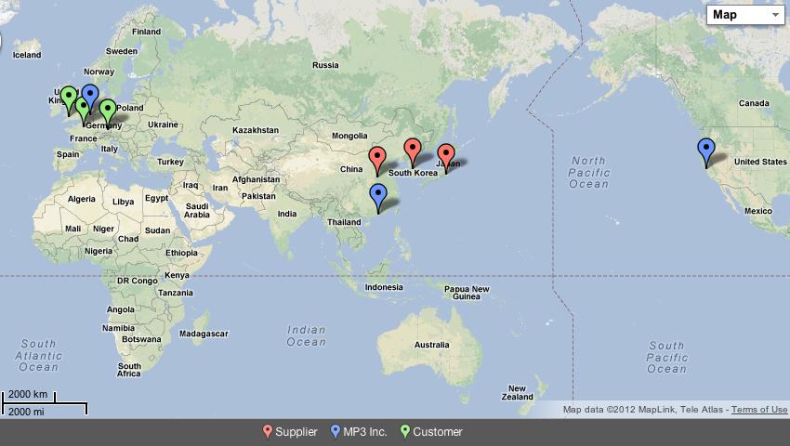
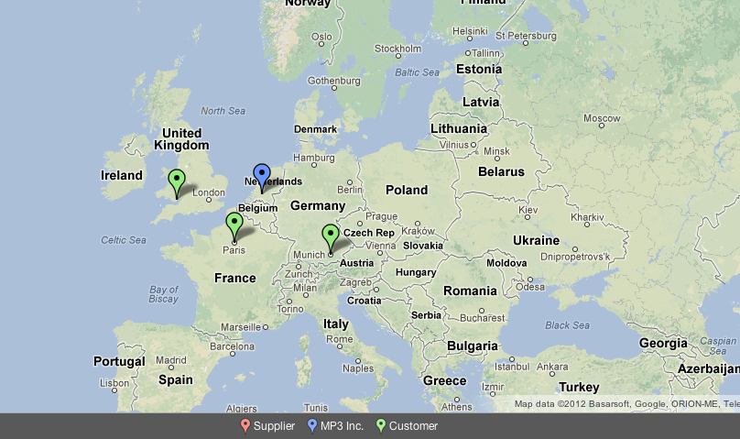
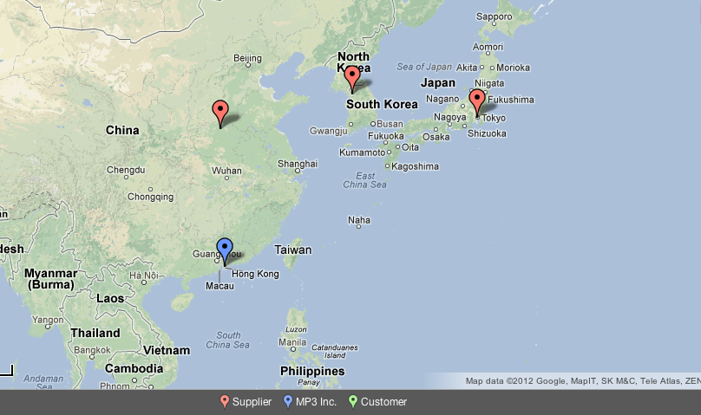
Geographical Mapping of the Supply Chain
E
Steps to create the Geographic Map:
Create geographic context (a.k.a. the map)
Draw and name your customers on the map
  Identify the level-2 processes
  List the level-2 processes in the customer node
Starting with your customers, repeat for each node:
  Identify all supplying nodes
  Draw and name these supplying nodes
  Identify the level-2 processes
  List the level-2 processes in each node
  Draw the material flows (connecting arrows)
Repeat until you have included all your suppliers
1
3b³
Flash, Inc.
[sP1, sD1]
3b²
2
3b¹
Battery Ltd
[sP1, sD1]
Components
[sP1, sD1]
2
Warehouse
[sP4, sS1, sD1]
3e¹
Customers GB
[sP1, sS1]
2b
Customers GE
[sP1, sS1]
China
3e²
2b
Factory
[sP3, sS1, sM1, sD1]
Customers SEU
[sP1, sS1]
2b
India

Slide 26

Exercise 5: Alpha Process Mapping
S
  Draw a simplified geographic map for the EVERGREEN only Product line
    Identify geographic locations
    Identify material flow
    Identify Level 2 processes for each node (Whse, Plant, etc)
WHSE / DC
DISTRIBUTOR
MANUFACTURING
CUSTOMER
Use the above symbols.

Slide 27
AS IS Geographic Map
EVERGREEN Product Line
S
Notes:
43
26

Slide 28
Improvement Program Charter: Overview
E
Provides the SCOR improvement organization and all stakeholders with a full understanding of the scope and objectives of the SCOR improvement program
Details the background and business need for the improvement program
Helps to align assumptions and expectations among the executive team, executive sponsor, SCOR design team, and associated shareholders
Provides a formal contract detailing the involvement of executive teams, SCOR design teams, and shareholders
Details the improvement program scope, performance metrics, project schedule, activities and deliverables, resources, and expected benefits

Slide 29
Improvement Program Charter Deliverable
E
Section | Subsection | Discussion
Introduction | Purpose, table of contents, control/maintenance | Improvement program charter overview
Program Definition | Scope | Which supply chains selected
 | Business objectives | Performance metrics
 | Improvement program objectives | Supply chain performance targets
 | Program organization | Definition of program team and shareholders
Program Contents | Methodology | Five-phased SCOR racetrack
 | Schedule | Timeline, detailed activities, meetings
 | Roles | Program activity responsibles
 | Deliverables and milestones | Detailed deliverables and milestones
 | Risks and dependencies | Critical risks and avoidance strategies
 | Benefits | Measures of success, analysis
The Improvement Program Charter is a summary document incorporating the decisions and the main activities developed during the S-Set The Scope SCOR phase.
Nb. You are not requested to produce a Program Charter, it is just for educational completeness
Notes:
The Improvement Program Charter is a summary document incorporating the decisions and the main activities developed during the S-Set The Scope SCOR phase.
THE FORMAT CAN DIFFER BASED UPON NEEDS OF THE PROJECT
TYPICAL SECTIONS ARE:
- INTRODUCTION: STATEMENT OF PURPOSE
- IMPROVEMENT PROGRAM DEFINITION
- IMPROV.PROGRAM CONTENTS
→ must be signed (means aligned also through emailing to part.s)
ADDITIONAL CONSIDERATIONS:
- VIBRANT BUSINESS CASE
- PROBLEM STATEMENT
- PROJECT SCOPE
- REALISTIC MILESTONES
- CLEARLY DEFINED ROLES AND RESPONISIBILITIES
PROJECT CHARTER CAN BE THE REASON FOR FAILURES; FOR SCOPE CREEP (ITEMS OF SCOPE GOING OUT AND IN) → STAY FOCUSED

Slide 30
C: Configure the Supply Chain Overview
Objective: Determine the performance metrics and processes of the SCOR improvement program
Key Tasks
Program Kickoff
Select SCOR metrics
Metric data collection
Perform competitive analysis
Benchmark the supply chain
Perform gap analysis
Deliverables
Metric Definition
Competitive Requirements
Final SCORcard
Thread Diagram
Staple Yourself
Level 3 Process Diagrams
Plan for Phase 4
Program Phase
Activities
Notes:
THIS IS THE QUANTITATIVE PHASE
SUMMARY OF KEY ACTIVITIES AND DELIVERABLES
3 KEY OBJECTIVES (DELIVERABLES):
1. SELECT THE SCOR METRICS
2. PERFORM BENCHMARKING AND COMPETITIVE ANALYSIS
3. DETAIL THE SC PERFORMANCE GAP (GAP ANALYSIS – THE ENGINE!)
KEY ACTIVITIES:
- IMPROVEMENT PROGRAM KICK OFF
- SELECTION OF THE SCOR PA’S TO MEASURE THE SC
- DATA COLLECTION
- COMPETITIVE ANALYSIS (SCORMARK OR OTHER)
- “GAP ANALYSIS”

Slide 31
Applying Metrics to Alpha

Slide 32
Supply Chain Modeling - Measuring Performance (Metrics)
E
Measuring how well the supply chain performs is as essential as understanding how it operates.
Just remember that:
  Measurements must link to business objectives
  Measurements must be repeatable
  Measurements must provide insights into how to manage the supply chain more effectively
  Measurements must be appropriate for the process activity they are measuring

Slide 33
SCOR Level 1 Performance Metric Selection
E
 | Attribute | Level 1 Strategic Metrics
Customer | Reliability | RL.1.1 Perfect order fulfilment
 | Responsiveness | RS.1.1 Order fulfillment cycle time
 | Agility | AG.1.1 Upside supply chain adaptability
 |  | AG.1.2 Downside supply chain adaptability
 |  | AG.1.3 Overall value at risk (VAR)
Internal | Cost | CO.1.1 Total supply chain management costs (TSCMC)
 |  | CO.1.2 Cost of goods sold
 | Asset management efficiency | AM.1.1 Cash-to-cash cycle time
 |  | AM.1.2 Return on supply chain fixed assets
 |  | AM.1.3 Return on working capital
Customer
Internal
Notes:
In the C phase we need to QUANTIFY the expected SC performances

Slide 34
Background: assumptions for the SCORcard definition
Notes:
Pay attention to the Unit of Measure of Cash to Cash components. Some in Days and some in Value, so need to bring all of them into Days (recall the class exercise you have done)

Slide 35
Background: Alpha Service - summary
Ps) Should you eaborate different figures, make assumptions and decide how to progress

Slide 36
Exercise 6: NEW Product Line
Level 1 Metric Calculation
S
Fill the actuals based on the data available
Arrange a «combined» actual for the overall business. You can estimate.

Slide 37
Alpha Competitive Analysis

Slide 38
Linking Business Strategy to Supply Chain Performance
E
Identify your business strategy in the context of your competitive environment. Sources:
  SWOT Analysis
    Strengths, Weaknesses, Opportunities, Threats
  Company profile (Int./Ext.)
  Critical Success Factors (CSF)
  Business issues / Value proposition
  …overall Alpha case study description
Determine what you believe is critical to improve the Alpha performance (Ex. Reliability, Responsiveness, Cost etc)
Go through the next slide, competitive benchmark data, and compare the Alpha actual performance with the industry results.
Be ready to decide where to give priority in Alpha business (competitive Matrix) to accelerate its business results

Slide 39
Competitive analysis: industry benchmark
Use the below benchmark data to define the Competitive Matrix for ALPHA
E
Responsiveness is mainly based on the delivery cycle time. Out of this matrix, you may evaluate other lev.2 metrics components, if relevant.

Slide 40
Exercise 7: Competitive Matrix definition
S
Now that you have established what is important for Alpha to succeed
Select for the Total ALPHA company:
  1 Superior
  2 Advantage
  2 Parity
  So to define your Competitive Matrix and identify the gaps to fill to achieve the expected performance, starting form the actual results.

Slide 41
Exercise 7: just an example (not your final solution)
E
P
A
S
A
P
Legend
●

○
Superior
Advantage
Parity
Notes:
The arrows are put only as an example: you choose your own.
Insert actuals
Decide 1 S, 2 A and 2 P

Slide 42
Exercise 7 cont.ed: Fill in one S, two A, two P
S
Legend
●

○
Superior
Advantage
Parity
Notes:
Insert actuals
Decide 1 S, 2 A and 2 P on the 5 Performance Attributes
If you want you can position some more targets also on individual KPI (example you place an S on overall Agility but you do some evaluations on the individual Lev.1 KPI’s)

Slide 43
Exercise 7 cont.ed: Competitive analysis: industry benchmark
S
Indicate the GAP between the Goal (from S, A, P) and the Actual; define the key improvement projects.
Notes:
Actuals are already in the chart
Calculate the Gap between your selection and actual. Ex. if you have selected SC Reliability as Advantage (85%) and your Actual is 59%, the Gap is (85%-59%=26%)
Based on the Gap value, identify which important projects you would like to implement and test.
→ You can fill the above slide or prepare a separate one with the projects list and expected benefits

Slide 44
Exercise 8: Mapping the AS IS execution processes
S
EVERGREEN PRODUCTS: Complete the Thread Diagram using the appropriate SCOR processes, following the Alpha case description and Geo Map (pick pictograms from the following slide). You may want to include the sP-Plan and sR-Return, but feel free to skip them
ALPHA
Americas
Distributors
European RM Supplier
Raw Material
POE
OEM
Japan
POE
Los Angeles
Alpha MFG
NA
Alpha Regional W/H
Key Other RM Suppliers
Regional POE
Alpha Regional W/H
S1
M1
D1
S1
S1
S1
The AS IS represents a current situation of the business. Now that you have decided where to improve, you can identify the areas of improvement.

Slide 45
Exercise 8 cont.ed: pick and choose the pictograms to complete the Thread diagram
S1
M1
D1
SR1
DR1
P1
E1
S2
M2
D2
SR2
DR2
P2
E2
S3
M3
D3
SR3
DR3
P3
E3
D4
P4
E4
E5
E6
E7
E8
E9

Slide 46
Exercise 8 cont.ed: arrange here your Thread diagram

Slide 47
Exercise 8 cont.ed: IMPROVEMENT PROJECTS
S
FOCUSING ON WHAT DESCRIBED SO FAR, ON THE COMPETITIVE MATRIX, ON THE THREAD/ PROCESS DIAGRAM, DISCUSS AND REPORT THOSE PROJECTS AND ACTIONS WHICH WILL HELP IN COVERING THE COMPETITIVE GAPS. EXPAND AS MUCH AS YOU WANT AND CAN.
METRIC IMPACTED | ACTION REQUIRED | EXPECTED BENEFIT | DATE/RESP.

Slide 48
NEXT PHASES:
In real business you can then make additional evaluations, ground test your selected projects, take decisions with other stakeholders to finalize the project portfolio and produce action plans. In our exercise we stop at this C-Configure the Supply Chain phase, which already reflects your choise and plans.
You don’t need to progress with the O-Optimize projects and R-Ready for implementation.

Slide 49
IMPROVEMENT PROJECTS and the “TO BE”
E
The ALPHA company will start to improve its performances when the selected projects will start to generate postive results.
Starting from the AS IS model, you will be able to identify those projects aiming to add value to processes, simplify and improve.
There are several tools imported from Lean, Six Sigma and Continous Improvement methodologies which come in support.
Some of them, among the most used are:
Workflows, Value Stream Mapping, Makigami
By this exercise (the Thread diagram) it is possible to go into more details and analyse lev 3 (and 4), with the specific metrics (Lev.2 and 3)
Interviews: asking in a structured way to other employees information will help in solving issues (expert panel interview, customers and suppliers, etc)
«Staple to an order» helps in floowing the actual flow and steps. It is recommended to do it physically
Develop alternatives: brainstorming, analyse data with additional tools as Ishikawa Root Cause Analysis, 5 Why’s technique, Affinity diagrams, etc.
Notes:
This is to remind the main tools used during the process mapping, evaluation, defect analysis and definition of the «To Be» configuration.

Slide 50
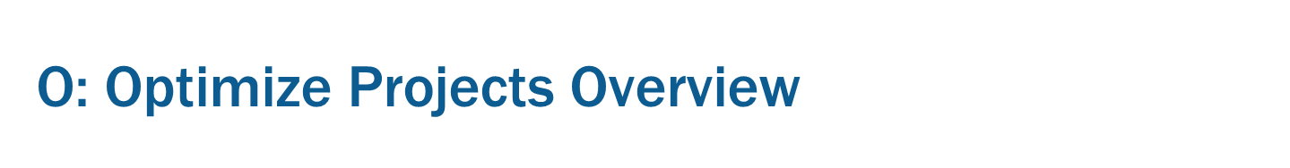
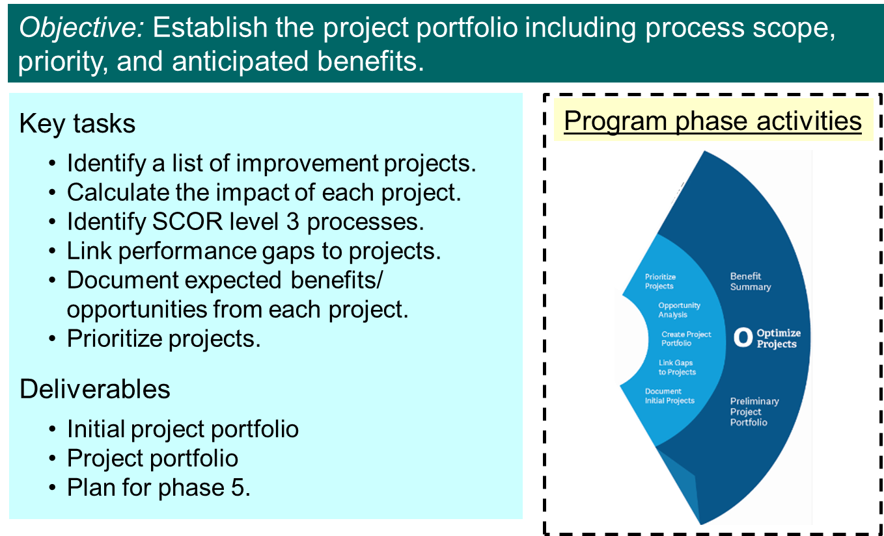

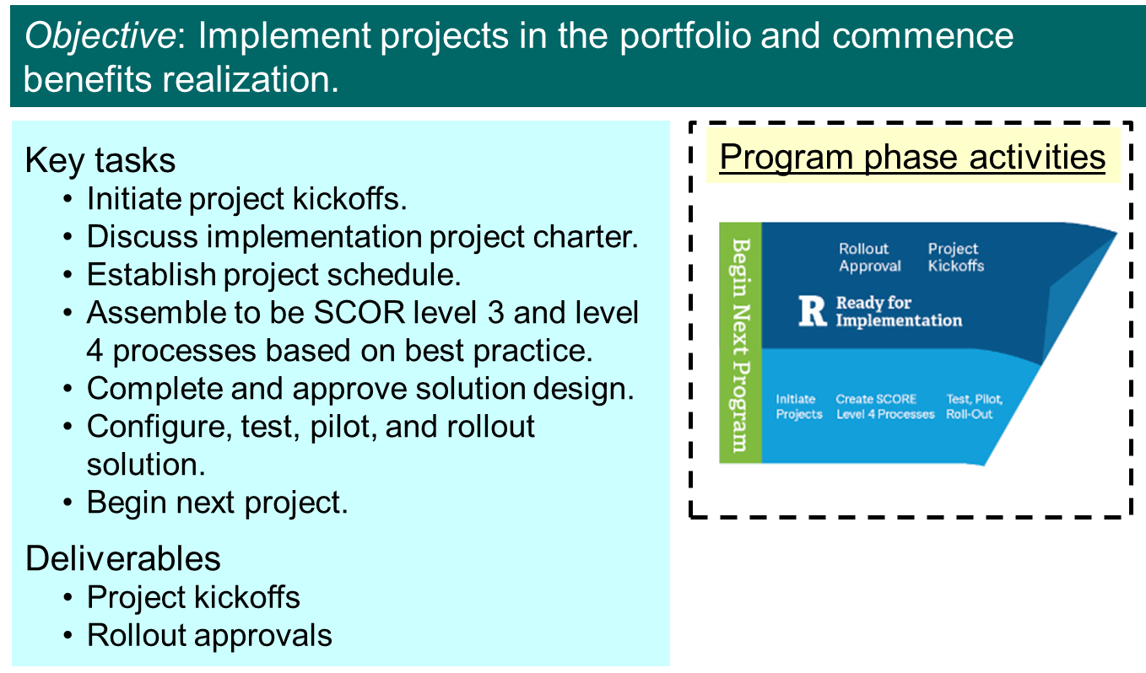
Objective:
Streamline projects portfolio you have identified before to the priority ones and most effective actions
Objective:
Approve, test, implement projects and be ready to begin a next phase of SCOR improvement
Notes:
These modules are not developed in our case study.

Slide 51
You have completed your team work.
Please be ready to share your project with the extended Students’ Group

