Slide 1
EUROPEAN INSTITUTIONS, LAW AND MARKETS
1
Biancamaria Raganelli
Università degli Studi di Roma Tor Vergata
biancamaria.raganelli@uniroma2.it

Slide 2
Rules of the game
Introduction and presentation.
Content of the course.
Interaction. Case laws presentation.
Syllabus, Exercise, final, exam.
Where should I study?

Slide 3
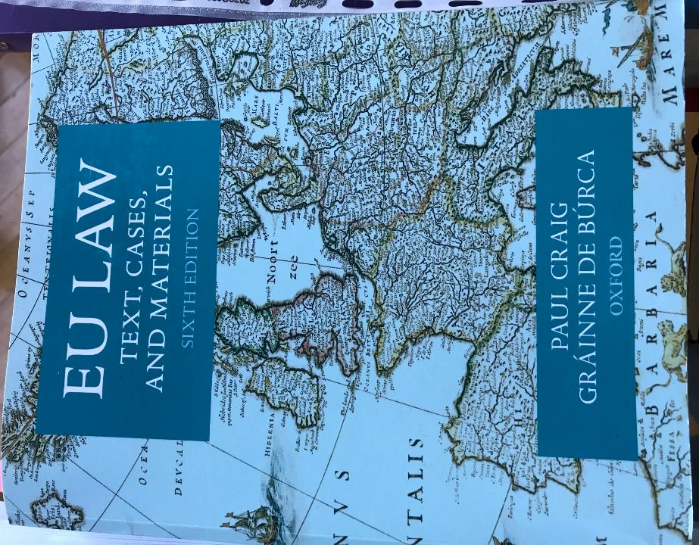

Slide 4
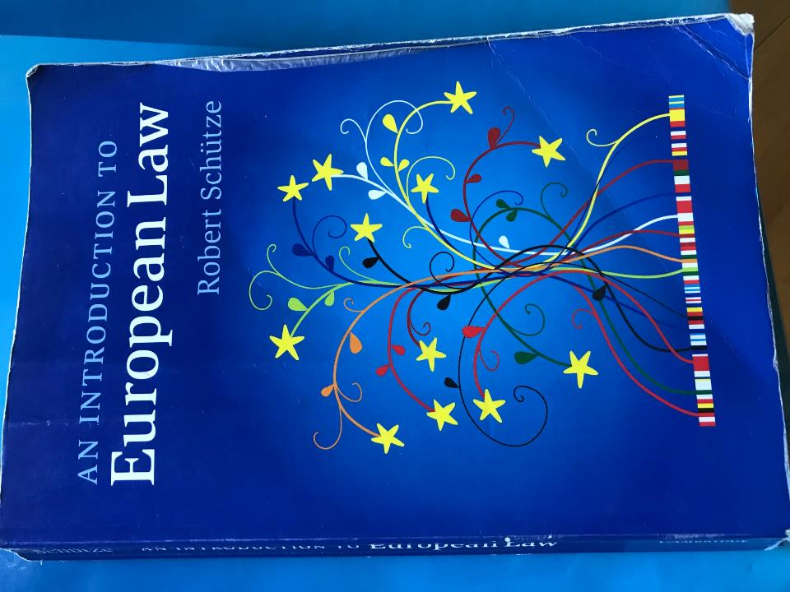

Slide 5
COURSE REQUIREMENTS FOR ATTENDING STUDENTS
(% OF FINAL GRADE)
This class is designed to be significantly involved in-class discussion and working groups
A) Attendance and Participation in the debate including workshops: 60 %
Students are expected to attend every class meeting and come prepared to discuss the assigned readings. Every student is required to bring a notebook or tablet to download teaching materials and work on them
Participation includes discussion in class of teaching materias and ECJ cases law provided on the web page and constructive feedback on each presentation done by other students
Workshop: each student is expected to read and give comments to a ECJ judgment highlighting the main issues
B) Final term/ 35 %: Each student will be required to answer to 3 out of 4 open questions.
C) Oral exam/clarification on final 5 %: meeting with the Professor during the formal exam section.
EVALUATION FOR ATTENDING STUDENTS-PRE-EXAM: A+B+C

Slide 6
Main concepts
European Union
Sovreign State
Globalization
Coexistence
Cooperation

Slide 7
EUROPEAN UNION: what and why
EU IN A GLANCE
SOME DISTINCTIONS

Slide 8
THE IDEA OF EU
Idea if EU
Idea of Sovereign State

Slide 9
IDEA OF EU
Idea of EU is old as the idea of sovereign State.
The last has been discredited by world war in XXth century and by social forces of globalization.
The decline of monadic State found expression in the spread of inter-State cooperation
This process is also part of a general transition from an international law of COEXISTENCE to an international law of COOPERATION
Notes:
Globalization is the process of international integration arising from the interchange of world views, products, ideas, and other aspects of culture.
In 2000, the International Monetary Fund (IMF) identified four basic aspects of globalization:
trade and transactions,
capital and investment movements,
migration and movement of people and
the dissemination of knowledge.

Slide 10
WHAT DO WE MEAN FOR SOVREIGN STATE?

Slide 11
Sovereign state
A sovereign state is a non-physical juridical entity of the international legal system that is represented by a centralized government that has supreme independent authority over a geographic area.
International law defines sovereign States as having a permanent population, a Government and the capacity to enter into relations with other Sovereign States.
It is also normally understood to be a State which is neither dependent on nor subject to any other power or State.

Slide 12
Cooperation among different countries in europe
European Union
has its roots in the transition from coexistence between States pre-second World War
to co-operation among Countries

Slide 13
WHAT DO WE MEAT FOR COEXISTENCE ?
AND FOR COOPERATION?
WHAT’S THE DIFFERENCE?

Slide 14
Coexistence - cooperation
coexistence
1. To exist together, at the same time, or in the same place.
2. To live in peace with another or others despite differences, especially as a matter of policy
cooperation
1. a situation in which people work together to do something.
2. The actions of someone who is being helpful by doing what is wanted or asked for.

Slide 15
The First result of cooperation
Community
“people living in one particular area or people who are considered as a unit because of their common interests, social group, or nationality”
Cambridge English Dictionary

Slide 16
COMMUNITY
A social group of any size whose members reside in a specific locality, share government, and often have a common cultural and historical heritage.
A social, religious, occupational or other group sharing common characteristics or interests and perceived or perceiving itself as distinct in some respect from the larger society within which it exists.

Slide 17
EUROPEAN COMMUNITIES
1951: ECSC (Treaty of Paris)
1957: EEC (Treaty of Rome)
1957: EURATOM (Treaty of Rome)

Slide 18
The EUROPEAN COMUNITIES
The European Communities (EC) were three international organisations that were governed by the same set of institutions:
European Coal and Steel Community (ECSC)
European Economic Community (EEC)
the European Atomic Energy Community (EAEC or Euratom)

Slide 19
EUROPEAN UNION origins and evolution
2007 LISBON TREATY (2009 in to force)
The II World War
1952 TREATY OF PARIS: ECSC
1957 TREATY OF ROME: EEC-EURATOM
1967 THE MERGER TREATY
1992 MAASTRICT TREATY
2001 DRAFT OF CONSTITUTIONAL TREATY

Slide 20
1952
CECA: A COMMUNITY TO INTEGRATE ONE INDUSTRIAL SECTOR
1957
CEE, EURATOM: ADDITIONAL COMMUNITIES
NO REAL INTEGRATION ALSO IN MERGER TREATY 1967
1992
INTEGRATED COMMUNITIES INTO THE EUROPEAN UNION
2001
DRAFT CONSTITUTIONAL TREATY FAILED
2009 NEW EUROPEAN UNION based on LISBON TREATY

Slide 21
EUROPEAN UNION
IS
An economic and political union of 27 MS located primarily in Europe
An international legal person
Created via Treaties signed on behalf of Member States
Governed by Institutions

Slide 22
The economic Union
Single market
EMU: single cuRrency and single MONETARY POLICY
Banking Union: SSM, SSm, EDIS

Slide 23
The political issue
The Politics of the European Union are different from other organisations and States due to the unique nature of the European Union (EU).
The EU is similar to a confederation, where many policy areas are federalised into common institutions capable of making law.
However the EU does not, unlike most States, control foreign policy, defence policy or the majority of direct taxation policies.

Slide 24
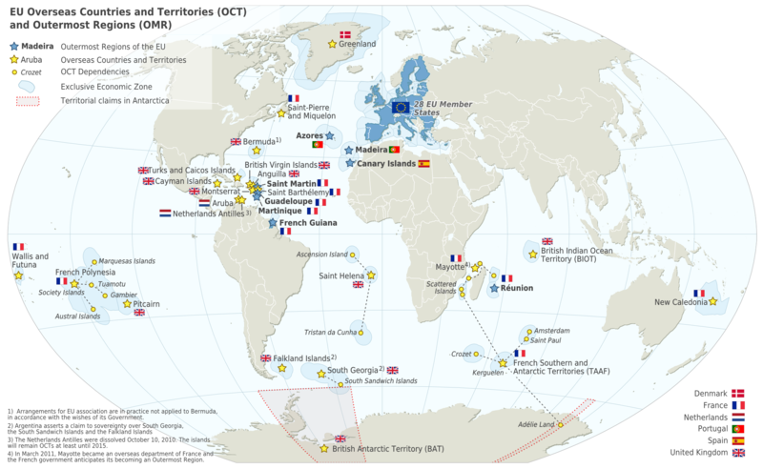
LOCATED PRIMARLY IN EUROPE

Slide 25
What is the European Union?
27
Shared values: liberty, democracy, respect for human rights and fundamental freedoms, and the rule of law.
Largest economic body in the world.
World’s most successful model for advancing peace and democracy.
A unique institution – Member States voluntarily cede national sovereignty in many areas to carry out common policies and governance.
Not a super-State to replace existing States, nor just an organization for international cooperation.
World’s most open market for goods and commodities from developing countries.
Member States
Combined population of
EU Member States
490
million
7
Percent of world’s
population
Percent of
global GDP
30
55
Percent of combined
worldwide Official
Development Assistance
Notes:
RULE OF LAW primarily refers to the influence and authority of law within society, especially as a constraint upon behavior, including behavior of government officials.

Slide 26
HOW EU WORKS AND OPERATEs?
OPERATES THROUGH
a system of supranational independent institutions
intergovernmental negotiated decisions by the Member States
attributed Powers
a standardised system of laws that apply in all Member States enacted by European Institutions.

Slide 27
Candidate countries
Albania
Moldova
Montenegro
Serbia
Turkey
The Republic of North Macedonia
Ukraine
Potential condidates
Bosnia-Erzegovina, Kossovo

Slide 28
The european union first aim
Was to develop a SINGLE MARKET thought:
the establishment of 4 freedoms;
the principle of free COMPETITION and politics on competition;
the prohibition of State aids.
EU POLICIES aim to ensure the free movement of people, goods, services, and capital, enact legislation in justice and home affairs, and maintain common policies on trade, agriculture, fisheries, and regional development.

Slide 29
WHAT IS COMPETION IN ECONOMICS?
WHAT’S IN LAW?

Slide 30
Competition principle
In ECONOMICS: competition is the rivalry among sellers trying to achieve such goals as increasing profits, market share, and sales volume by varying the elements of the marketing mix: price, product, distribution, and promotion.
Adam Smith,The Wealth of Nations (1776)

Slide 31
COMPETITION PRINCIPLE
IN LAW
The pivot of the European structure.
The law that promotes and maintains market competition by regulating anti-competitive conduct by companies.
Since the 20th century, competition law has become global.

Slide 32
How to achieve the principle of competition in Europe?
No discrimination on the base of nationality
Equal treatment (same rules of game for a fair competition field)
Process of harmonization in Europe

Slide 33
Program and Structure
CREATION
ENFORCEMENT
SUBSTANCE
Institutions
Procedures
Competences
Human rights
Direct effect
Legal supremacy
National actions
European actions
Internal market
4 freedoms
Competition law

Slide 34
WHY a european union?
EU MISSION
TEN STEPS

Slide 35
EU MISSION
The EU’s mission in the 21st century is to:
maintain and build on the PEACE established between its member States;
bring European countries TOGHETER in practical cooperation;
ensure that European citizens can live in SECURITY;
promote economic and social SOLIDARITY;
preserve European IDENTITY and DIVERSITY in a globalised world;
promulgate the VALUES that Europeans share.

Slide 36
I. Peace
During the II World war:
A DREAM
- Before becoming a real political objective, the idea of one Europe was just a dream in the minds of philosophers and visionaries.
Victor Hugo: a peaceful ‘United States of Europe’
After the II World war:
A NEED
- The need to create the conditions for lasting peace.

Slide 37
The idea of a new era
Between 1945 and 1950, a group of statesmen including Robert Schuman (Jean Monnet), Konrad Adenauer, Alcide de Gasperi and Winston Churchill set about persueding their peoples to enter a new era.
NEW STRUCTURE would be created in western Europe, based on SHARED INTERESTS and founded upon TREATIES guaranteeing the RULE OF LAW and EQUALITY between all Countries.

Slide 38
RULE OF LAW
Primarily refers to the influence and authority of law within society, especially as a constraint upon behavior, including behavior of government officials.
System of rules regulating the public power in general on private interests (connection with principle of state reason and contracdictory)

Slide 39
INNER AND OUTER COUNTRIES in the beginning
INNER SIX
Belgium
France
West Germany
Italy
Luxembourg
Netherlands
OUTER SEVEN
Austria
Denmark
Norway
Portugal
Sweden
Switzerland
United Kingdom

Slide 40
II. BrIngIng euroPe together
1989: Fall fo Berlin Wall
Unification of Germany
EU: 8 members
Following enlargment (still in progress)

Slide 41
III. SecurIty
The mean to build peace.
Developing a genuine EUROPEAN SECURITY and DEFENCE POLICY
INTERNAL and EXTERNAL SECURITY
EU as an ‘AREA OF FREEDOM, SECURITY AND JUSTICE’ where everyone has equal access to justice and is equally protected by the law: a new challenge that requires close cooperation between governments.
Europol, the European Police Office

Slide 42
IV. economIc and SocIal SolIdarIty
The European Union was created to achieve POLITICAL GOALS, through ECONOMIC COOPERATION.
Europe-wide free competition must be counterbalanced by Europe-wide SOLIDARITY.

Slide 43
V. EU IdentIty and dIVerSIty In a gloBalISed world
TWO EFFORTS:
REDUCE SIGNIFICANT GAPS BETWEEN RICH AND POOR;
MANTAIN CULTURAL AND LINGUISTIC IDENTITY OF INDIVIDUAL COUNTRIES.
Many EU activities help to promote regional specialities and the diversity of Europe’s traditions and cultures.

Slide 44
VI. ValueS
EU wishes to promote:
HUMANITARIAN AND PROGRESSIVE VALUE.
CHARTER OF FOUNDAMENTAL RIGHTS of the EU (different by ECHR) proclaimed in Nice in December 2000: sets out all the rights recognised today by the EU’s Member States and their citizen.
Now legally binding thanks to the Treaty of Lisbon (which came into force on 1 December 2009).

Slide 45
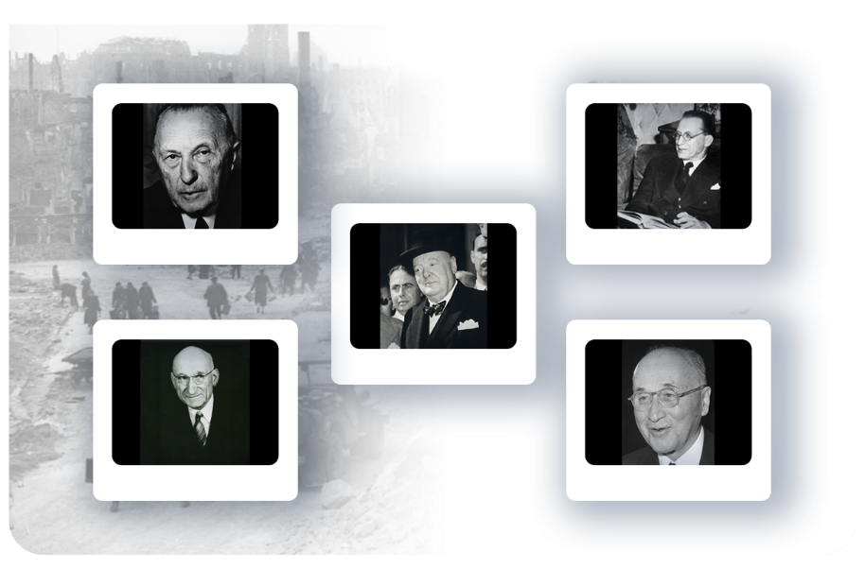
Founders
New ideas for lasting peace and prosperity…
Konrad Adenauer
Alcide De Gasperi
Winston Churchill
Robert Schuman
Jean Monnet

Slide 46
FIRST STEP
1951:
Treaty of Paris of (18 April 1951)
The European Coal and Steel Community (ECSC) was set up by the six founding members:
ITALY, GERMANY, FRANCE, BELGIUM, NEDERLANDS, LUXEMBOURG
The aim: to secure peace between European nations and bring them together as equals, cooperating within shared institutions.

Slide 47
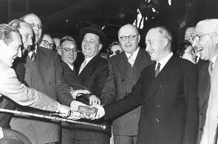
1951
European Coal and
Steel Community
After the World War II the aim was to secure peace among Europe’s victorious and bring European States together as equals, cooperating within shared institutions.
Based on a plan by French Foreign Minister
Robert Schuman.
Six founding countries – Belgium, the Federal Republic of Germany, France, Italy, Luxembourg and the Netherlands – signed a treaty to run heavy industries (coal and steel) under common management.
Jean Monnet and other leaders with
the first “European” ingot of steel

Slide 48
SECOND STEP
1957:
The same six countries sign the Treaty of Rome (25 March 1957), setting up:
the European Economic Community (EEC)
EEC would involve building a wider common market covering a whole range of goods and services.
the European Atomic Energy Community (Euratom).
Notes:
EEC would involve building a wider common market covering a whole range of goods and services.
Customs duties between the six countries were abolished on 1 July 1968 and common policies, notably on trade and agriculture, were also put in place during the 1960s.

Slide 49
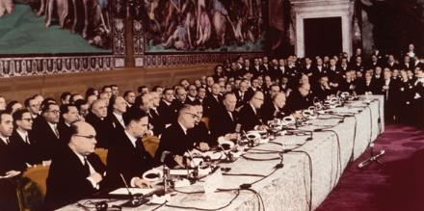

1957
Treaty of Rome
The six founding countries expanded cooperation to other economic sectors, creating the European Economic Community (EEC) – or “common market.”
As a result, people, goods, services, and capital today move freely across the Union.
Signing of the Treaty of Rome

Slide 50
EURATOM
The principal aims of the Euratom Treaty include:
the promotion of investment in the nuclear energy industry;
the establishment of uniform safety standards for the protection of workers and the general public from atomic hazards;
ensuring that nuclear materials are not diverted for aims other than peaceful purposes.

Slide 51
Third, forth, fifth steps
1973: The Communities expand to 9 member states and introduce more common policies (Denmark, Ireland, the United Kingdom)
1979: The first direct elections to the European Parliament.
1981: The first Mediterranean enlargement
(1981: GREECE, 1986: SPAIN, PORTUGAL)
Notes:
New social and environmental policies were introduced, and the European Regional Development Fund (ERDF) was set up in 1975.

Slide 52
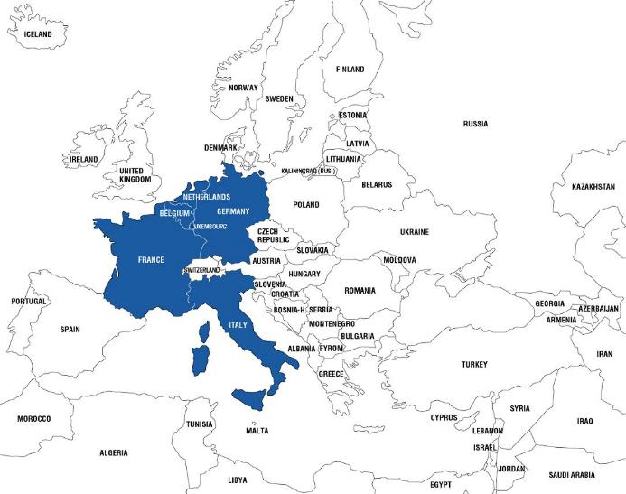
1951
Founding Members
Belgium
France
Germany
Italy
Luxembourg
Netherlands

Slide 53
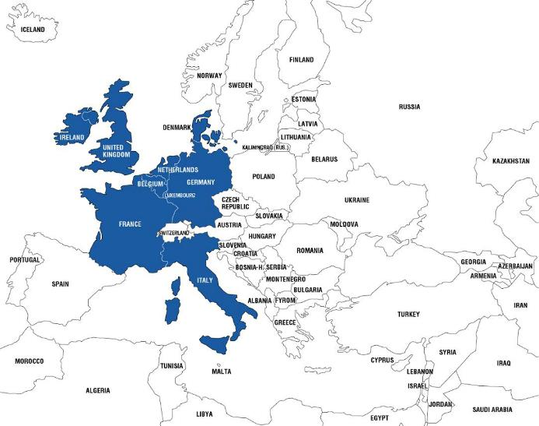
1973
Denmark
Ireland
United Kingdom

Slide 54
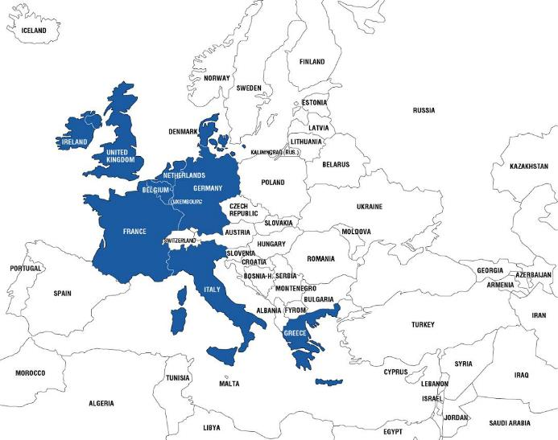
1981
Greece

Slide 55
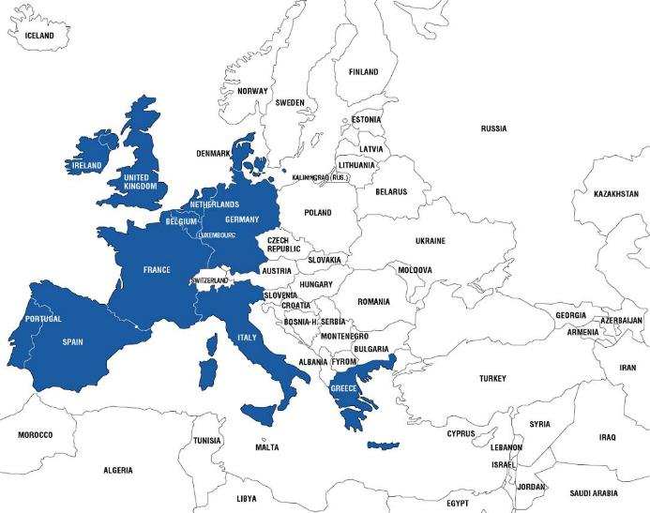
1986
Portugal
Spain

Slide 56
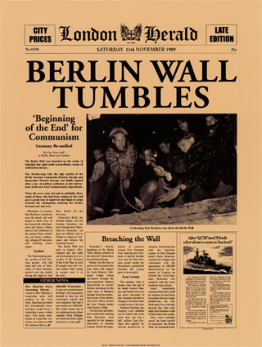
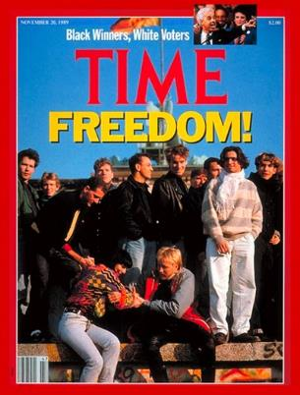
November 1989
Fall of the
Berlin Wall
sets the
stage for
unifying
Europe and
EU enlargement

Slide 57
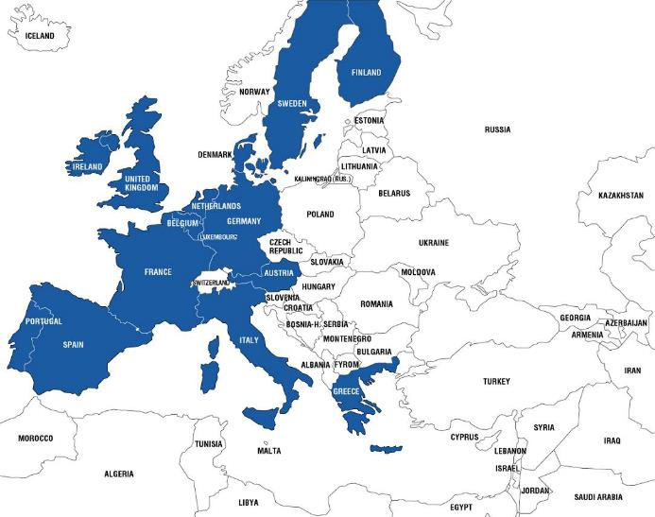
1995
Austria
Finland
Sweden

Slide 58
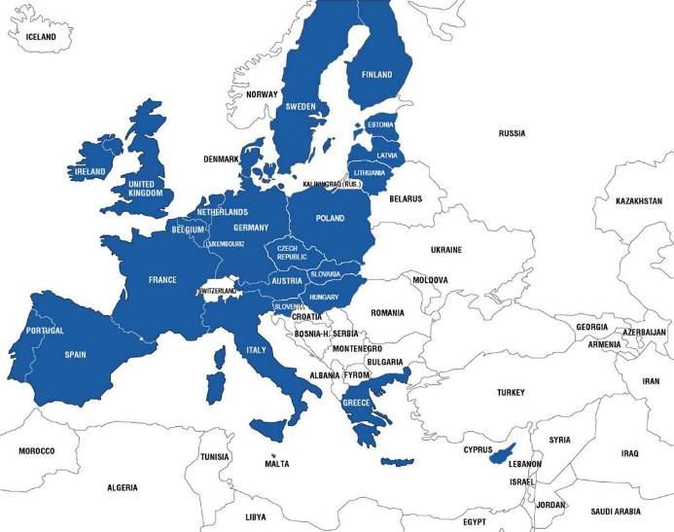
2004
Cyprus
Czech Republic
Estonia
Hungary
Latvia
Lithuania
Malta
Poland
Slovakia
Slovenia

Slide 59
ENLARGEMENT
Enlargement has:
Inspired reforms and consolidated common principles of liberty, democracy, respect for human rights, fundamental freedoms, the rule of law, and market economy.
“Enlargement has been a success story for the European Union and Europe as a whole. It has helped to overcome the division of Europe and contributed to peace and stability throughout the continent.”
European Council Declaration
Dec. 15, 2006

Slide 60
enlargment
Each Treaty admitting a new member requires the UNANIMOUS APPROVAL of all member states.
In addition, in advance of each new enlargement, the EU must assess its capacity to absorb the new member(s) and the ability of its institutions to continue to function properly.

Slide 61
Sixth step
1986: SINGLE EUROPEAN ACT
The European single market has been completed in 1992
A new hope after the 1980 economic recession. In 1985 (Delors) was published the White Paper setting out a timetable for completing the European single market by 1 January 1993.
Notes:
The worldwide economic recession in the early 1980s brought with it a wave of ‘euro-pessimism’. However, hope sprang a new in 1985 when the European Commission, under its President Jacques Delors, published a White Paper setting out a timetable for completing the European single market by 1 January 1993. This ambitious goal was enshrined in the Single European Act, which was signed in February 1986 and came into force on 1 July 1987.

Slide 62
Seventh STEP
1993:
The Treaty of Maastricht establishes the
European Union (EU)
THREE PILLARS SYSTEM

Slide 63
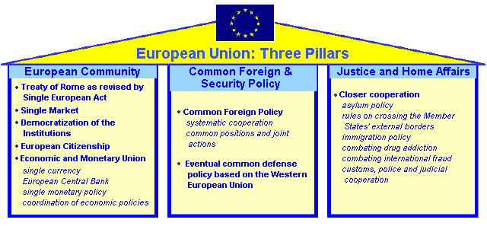

Slide 64
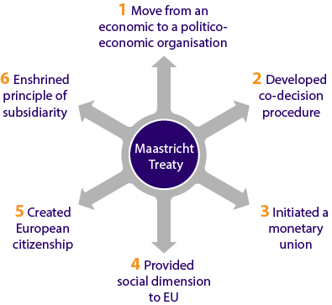

Slide 65
FOCUS - REadings
SCHUMAN SPEECH
ECSC PREAMBLE
TREATY ON EUROPEAN UNION PREAMBLE
TREATY ON EUROPEAN UNION - ART. 1-5

Slide 66
EC vs EU
They shared the same governing institutions (those of the EEC) from 1967 until those institutions became those of the EU (1992).
The EC operated as the largest of the EU's three pillars until was absorbed and the EU was designated as its legal successor.
The ECSC expired in 2002.
Euratom remains until 2009.

Slide 67
EU Law Principles
EC – EU : own system of law special because:
Direct sources of rights and obligations for States and citizens (van Gend & Loos, 1962)
Priority (previous and later national legislation) (Costa-ENEL, 1964)
Autonomous character of the law system of the EU

Slide 68
EIGHTH and NINTH STEPS
2002:
The euro comes into circulation (12 Countries)
(EMU completed)
2007:
The EU has 27 member states
Notes:
CHALLANGES OD GLOBALIZATION
unemployment and the rising cost of pensions were putting pressure on national economies,

Slide 69
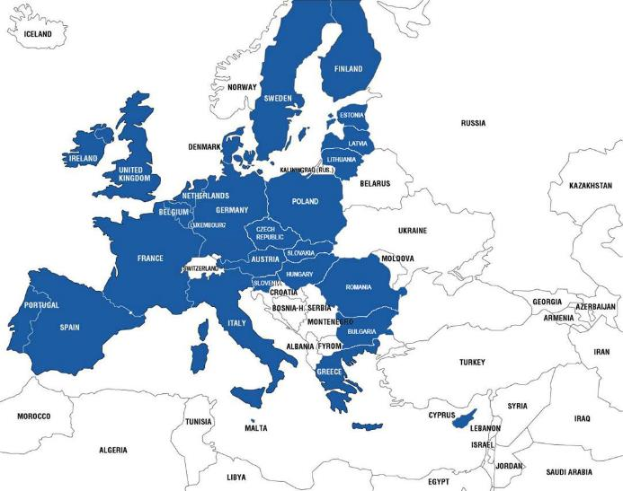
2007
Bulgaria
Romania
2020
UK left the EU

Slide 70
FROM 1957 TO 2007
1957 2007
Member States 6 27
Population 174 million 493 million
Languages 4 23

Slide 71
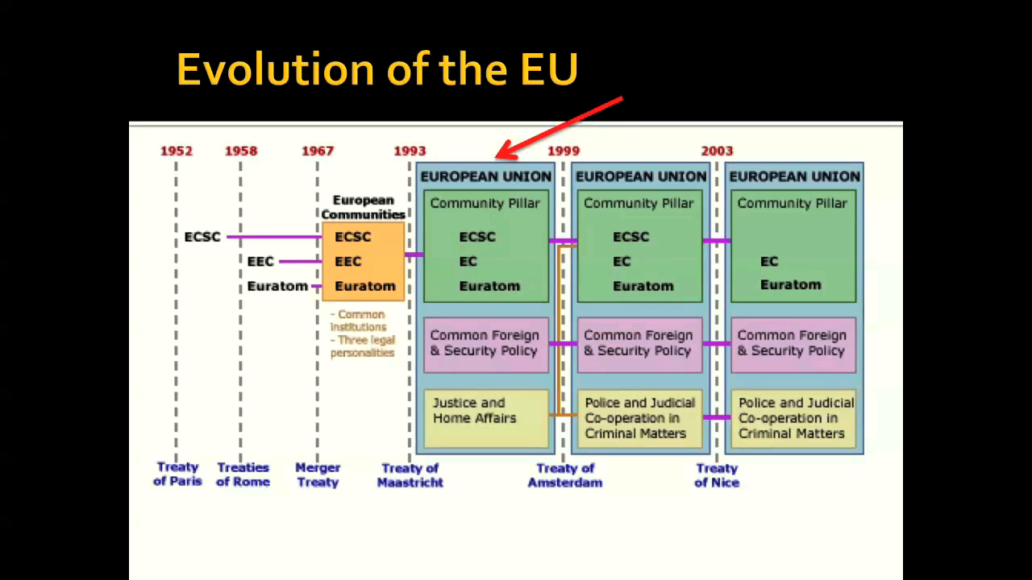

Slide 72
The PROJECT OF A EUROPEAN CONSTITUTION
October 2004: a draft EU Constitution
To face complex challenges of the 21st century, the enlarged EU needed a simpler and more efficient method for taking its joint decisions.
Rejected by two national referendums in 2005.
The project has been replaced by the Treaty of Lisbon.
It amends, but does not replace the previous Treaties
It introduces most of the changes that featured in the Constitution

Slide 73
Tenth step
2009:
The LISBON TREATY comes into force, changing the way the EU works (1 December 2009)
In March 2000 EU leaders adopted the ‘Lisbon strategy’. It was designed to enable the European Union to compete on the World market with other major players such as the United States and other industrialised countries.
The aim was to encourage innovation and business investment and to ensure that Europe’s education systems met the needs of the information society.

Slide 74
Prominent changes
From unanimity to qualified majority
more powerful European Parliament
consolidated legal personality for the EU
long-term President of the European Council and a High Representative of the Union for Foreign Affairs and Security Policy
Charter of Fundamental Rights legally binding

