Slide 1
EUROPEAN UNION LAW AND INSTITUTIONS
Biancamaria Raganelli
Università degli Studi di Roma Tor Vergata
biancamaria.raganelli@uniroma2.it

Slide 2
European union INSTITUTIONS

Slide 3
Main concepts
The EU acts through a standardised system of laws that apply in all member states enacted by European Institutions.
What is the European Union Law?
EU SOURCES: Types of EU law. Supplementary sources.
The enforcement of EU law: Domestic courts -ECJ

Slide 4
three sources of European Union law
Primary law
Secondary law
Supplementary law

Slide 5
MAIN SOURCES
Primary law:
Secondary law:
the Treaties establishing the European Union: TUE - TFUE.
include regulations, directives, decisions which are based on the Treaties.
Supplementary sources of European Union law
case law ECJ,
international law
general principles of European Union law

Slide 6
WHO IS RESPONSIBLE FOR THE PRODUCTION OF EU SECONDARY LAW?

Slide 7
institutional framework for Legislative power
European Parliament
Council of Ministers
European Commission
under the Treaties may establish secondary law to pursue the objective set out in the Treaties.

Slide 8
^{PROVISIONS ON THe} ^{INSTITUTIONS}
Art. 13 TEU
1. The Union shall have an institutional framework which shall aim to promote its values, advance its objectives, serve its interests, those of its citizens and those of the Member States, and ensure the consistency, effectiveness and continuity of its policies and actions.
The Union's institutions shall be:
— the European Parliament,
— the European Council,
— the Council,
— the European Commission (hereinafter referred to as ‘the Commission’), — the Court of Justice of the European Union,
— the European Central Bank,
— the Court of Auditors.
2. Each institution shall act within the limits of the powers conferred on it in the Treaties and in conformity with the procedures, conditions and objectives set out in them. The institutions shall practice mutual sincere cooperation.

Slide 9
THE EU INSTITUTIONS
European Council (summit)
European Parliament
Council of Ministers
(The Council)
European Commission
Court of Justice
Court of Auditors
Economic and Social Committee
Committee of the Regions
European Investment Bank
Agencies
European Central Bank

Slide 10
DISTINCTIONS
COUNCIL OF EUROPE
EUROPEAN COUNCIL
COUNCIL OF EUROPEAN UNION OR OF MINISTERS

Slide 11
Council of Europe
Is an international organisation promoting co-operation between all Countries of Europe in the areas of legal standards, human rights, democratic development, the rule of law and cultural co-operation.
It was founded in 1949 and has 46 member states.
Is an entirely separate body from EU, which has 27 member states.
Unlike the EU, the Council of Europe cannot make binding laws.
The two do however share certain symbols such as the flag and the anthem.

Slide 12
RAPRESENTATION
COMMISSION: represents the EU interests
COUNCIL: represents governments
PARLAMENT: represents citizens
ECONOMIC AND SOCIAL COMMITTEE: represents organised civil society
EUROPEAN COUNCIL: brings together national and EU-level leaders and sets the EU's broad priorities

Slide 13
EUROPEAN COUNCIL

Slide 14
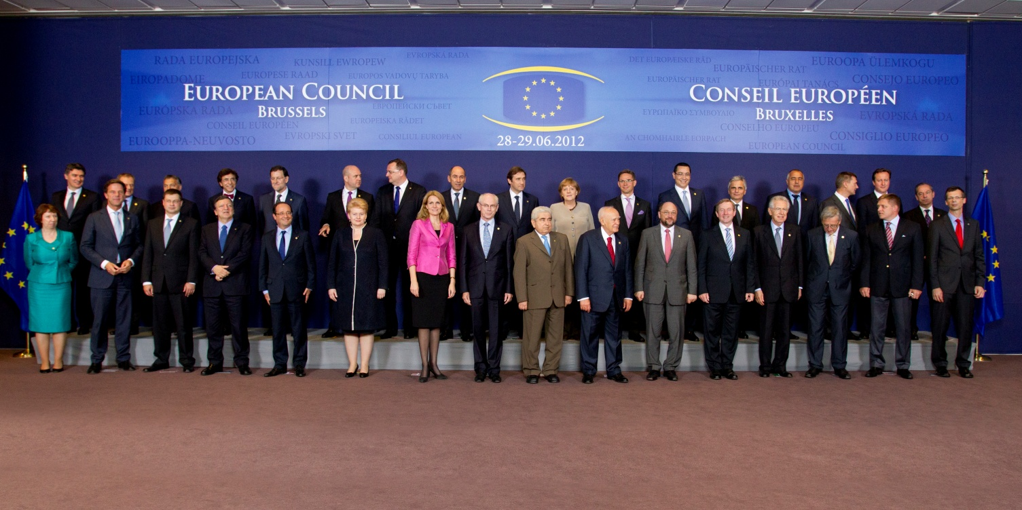
Summit at the European Council
Summit of heads of State and Government of all 27 EU MS.
Held twice every six months
Decides on foreign policy issues.
Notes:
The European Council defines the general political direction and priorities of the European Union. With the entry into force of the Treaty of Lisbon on 1 December 2009, it became an institution. Its President is Herman Van Rompuy.
Article 15 of the Treaty on European Union.

Slide 15
WHAT IS THAT?
What does IT do ?
The European Council is an institution of the European Union.
The European Council provides the Union with the necessary impetus for its development and defines the general political directions and priorities thereof.
It does not exercise legislative functions.
Under the Treaty of Lisbon it is empoweed to defining "the general political directions and priorities" of the Union.
So it is the Union's strategic body.

Slide 16
Art. 15 TEU
1. The European Council shall provide the Union with the necessary impetus for its development and shall define the general political directions and priorities thereof. It shall not exercise legislative functions.
2. The European Council shall consist of the Heads of State or Government of the Member States, together with its President and the President of the Commission. The High Representative of the Union for Foreign Affairs and Security Policy shall take part in its work.
3. The European Council shall meet twice every six months, convened by its President. When the agenda so requires, the members of the European Council may decide each to be assisted by a minister and, in the case of the President of the Commission, by a member of the Commission. When the situation so requires, the President shall convene a special meeting of the European Council.
4. Except where the Treaties provide otherwise, decisions of the European Council shall be taken by consensus.
5. The President of the European Council shall not hold a national office.

Slide 17
roles
Setting the EU's general political direction and priorities: sets up THE EU AGENDA, but has NON POWER TO PASS LAW
Dealing with complex or sensitive issues that cannot be resolved at a lower level of intergovernmental cooperation.

Slide 18
POWERS
EXERCISES POWERS OF APPONTMENT, such as appointment of its own President, the President of the European Commission, the High Representative of the Union for Foreign Affairs and Security Policy, and the President of the European Central Bank.

Slide 19
INFLUENCES
European Council INFLUENCES:
police and justice planning,
the composition of the Commission,
matters relating to the organisation of the rotating Council presidency,
the suspension of membership rights, and
changing the voting systems.

Slide 20
Who are its members?
The European Council consists of the Heads of State or Government of the Member States, together with its President and the President of the Commission. The High Representative of the Union for Foreign Affairs and Security Policy takes part in its work.
When the agenda so requires, the members of the European Council may decide each to be assisted by a minister and, in the case of the President of the Commission, by a member of the Commission.
Meetings in Bruxelles

Slide 21
How does it take its decisions?
Except where the Treaties provide otherwise, decisions of the European Council are taken by consensus: by unanimity or by qualified majority, depending on what the Treaty provides for.

Slide 22
EUROPEAN PARLAMENT

Slide 23
European Parliament
Voice of European citizens
passes EU laws with the Council
ADOPTS the EU budgets
Approves EU Commissioners

Slide 24
European parliament art. 14
1. The European Parliament shall, jointly with the Council, exercise legislative and budgetary functions. It shall exercise functions of political control and consultation as laid down in the Treaties. It shall elect the President of the Commission.
2. The European Parliament shall be composed of representatives of the Union's citizens. They shall not exceed seven hundred and fifty in number, plus the President. Representation of citizens shall be degressively proportional, with a minimum threshold of six members per Member State. No Member State shall be allocated more than ninety-six seats.

Slide 25
European parliament art. 14
2. The European Council shall adopt by unanimity, on the initiative of the European Parliament and with its consent, a decision establishing the composition of the European Parliament, respecting the principles referred to in the first subparagraph.
3. The members of the European Parliament shall be elected for a term of five years by direct universal suffrage in a free and secret ballot.
4. The European Parliament shall elect its President and its officers from among its members.

Slide 26
WHAT IS THAT?
How does it works?
The EP is the directly elected institution of the EU.
It has been directly elected every five years by universal suffrage since 1979.
However, turnout at EP elections has fallen consecutively at each election since that date, and has been under 50% since 1999.
At the beginning of the 2019–2024 term, there were 751 members of parliament divided among the 28 member states, which changed after the UK left the European Union.
After the withdrawal of the UK from the European Union, the numbers have changed. Now the European Parliament is made up of 705 Members elected in the 27 Member States of the enlarged European Union.

Slide 27
THE PRESIDENT
The President of the EP presides over the debates and activities of the European Parliament.
He or she also represents the Parliament within the EU and internationally. The President's signature is required for enacting most EU laws and the EU budget.
Presidents serve 2 and ½ year terms, normally divided between the two major political parties.

Slide 28
POWERS AND FUNCTIONS
LEGISLATIVE PROCEDURE
BUDGET
CONTROL OF THE EXECUTIVE
SUPERVISORY POWERS

Slide 29
1. LEGISLATIVE FUNCTION
It exercises the LEGISLATIVE FUNCTION of the EU (with EC and C of M).
NO LEGISLATIVE INITIATIVE: it does not formally possess legislative initiative, as most national parliaments of European Union Member States do.

Slide 30
2. Budgetary power
Shares equal BUDGETARY POWERS with the Council (except in a few areas where the special legislative procedures apply).
It has EQUAL CONTROL over the EU budget.

Slide 31
3. Control of the executive
APPOINTMENT OF THE E.C. and EC President.
Every five years, the newly elected EP can – by a simple majority vote – approve or reject the European Council’s nominee for the post of Commission President. Clearly, this vote will reflect the results of the recent EP elections.
The EP also interviews each proposed member of the Commission before voting on whether to approve the new Commission as a whole.

Slide 32
3. Control of the executive
MOTION OF CENSURE
At any time, Parliament can dismiss the whole Commission by adopting a motion of censure
(CAN FORCE EC TO RESIGN)
This requires a (2/3) two thirds majority.

Slide 33
4. Democratic supervision over the union
E.P. exercises democratic supervision over the Union, and in particular over the activity of European Commission.
Supervises the day- to-day management of EU policies by putting oral and written questions to the Commission and the Council.

Slide 34
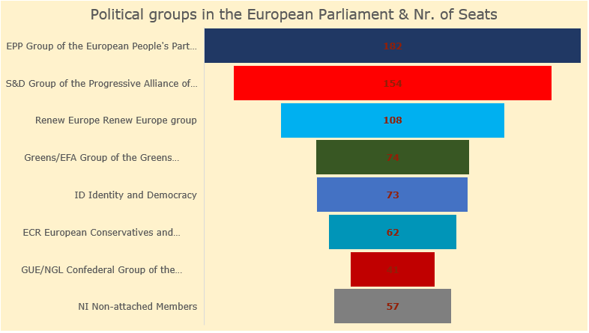
The EU Political Parties
European Parliament: 2019 – 2024 (Constitutive session)

Slide 35
DECISION MAKING PROCESS

Slide 36
BICAMERAL LEGISLATIVE BRANCH
In the ordinary legislative procedure: the Parliament and Council can be regarded as two chambers in a bicameral legislative branch of the European Union, with law-making power being officially distributed equally between both parliamentary chambers.

Slide 37
The basis in the treaty
Every European law is based on a specific treaty article, referred to as the ‘legal basis’ of the legislation.
This determines which legislative procedure must be followed. The treaty sets out the decision-making process, including Commission proposals, successive readings by the Council and Parliament and the opinions of the advisory bodies.
It also lays down when unanimity is required, and when a qualified majority is sufficient for the Council to adopt legislation.

Slide 38
Two legislative procedures
Ordinary legislative procedure
Special legislative procedures
Notes:
A. EP and C act like co-legislator with symmetric procedural rights. Institutional equality of two institutions.
B. First variant: EP has a dominant position and the C a mere partecipation in teh for of CONSENT. The procedure for the adoption of the union budget.
C. Second variant: C has the dominant position and EP partecipates with its CONSENT or CONSULTATION

Slide 39
Before the treaty of amsterdam and lisbon
CONSULTATION (EP can advise)
CO-OPERATION (EP can amend, art. 251 EC)
CO-DECISION (EP can amend,reject, art. 252)

Slide 40
The treaty of lisbon
The rule: the co-decision procedure renamed ordinary legislative procedure
The legislative power of the European Parliament increases, as the co-decision procedure with the Council of the EU is extended to almost all areas of policy.
Exception: CONSULTATION PROCEDURES within the special legislative procedures.
The Commission will have to submit each proposed budget of the European Union directly to Parliament, which must approve the budget in its entirety.

Slide 41
Ordinary legislative procedure
Set out by artt. 294, 297 TFEU
The great majority of EU legislation is adopted using the Ordinary Legislative Procedure.
In this procedure, the Parliament and the Council share legislative power.

Slide 42
Art. 289 TFEU
1. The ordinary legislative procedure shall consist in the joint adoption by the European Parliament and the Council of a regulation, directive or decision on a proposal from the Commission. This procedure is defined in Art. 294.
2. In the specific cases provided for by the Treaties, the adoption of a regulation, directive or decision by the European Parliament with the participation of the Council, or by the latter with the participation of the European Parliament, shall constitute a special legislative procedure.

Slide 43
SEVEN STAGES
PROPOSAL STAGE
FIRST READING
SECOND READING
CONCILIATION STAGE
THIRD READING
SIGNING
PUBLICATION

Slide 44
Involved institutions
Council of Ministers
European Parliament
European Commission

Slide 45
1. PROPOSAL STAGE
The procedure begins with the Commission.
When considering launching a proposal for action,
the Commission often invites views on the topic from governments, business, civil society organisations and individuals.
The opinions collected feed into a Commission proposal that is presented to the Council and Parliament.
The proposal may have been made at the invitation of the Council, the European Council, the Parliament or European citizens, or it may have been made on the Commission’s own initiative.

Slide 46
MONOPOLY IN
LEGISLATIVE INITIATIVE
Only the Commission can make formal proposals for legislation. AGENDA-SETTING POWER. Any Council amendment that the Commission dislikes will require unanimity (art. 293).
This monopoly is designed to ensure coordinated and coherent drafting of EU law.
Exception in the field of POLICE AND JUDICIAL COOPERATION (ART 76 TFEU)
No legislative act is allowed in the field of the Common Foreign and Security Policy.

Slide 47
COMPLAIN
COMMISSION VERSUS PARLAMENT
This monopoly has been challenged by some who claim the Parliament should also have the right, with most national parliaments holding the right in some respects.
DEMOCRATIC DEFICIT?

Slide 48
REQUEST LEGISLATION TO THE COMMISSION
PARLAMENT AND COUNCIL. EC can refuse the request as it did in 2008 over transnational collective conventions.
CITIZENS. Under the Lisbon Treaty, EU citizens are also able to request the Commission to legislate in an area via a petition carrying one million signatures, but this is not binding.
The Commission's powers in proposing law have usually centred on economic regulation.

Slide 49
HOW THE EU LAWS ARE MADE
Citizens, interest groups, experts or EP/Council: discuss, consult
Commission: makes formal proposal
Parliament and Council of Ministers: decide jointly
National or local authorities: implement
Commission and Court of Justice: monitor implementation

Slide 50
2. DISCUSSING THE PROPOSAL: FIRST READING
THE PROPOSAL GOES TO EP: acts by a majority of votes cast (majority of parliamentarians phisically present). Can reject, approve, amend.
THE BILL GOES TO C: act by a qualified majority of its members.
The Council and the Parliament each read and discuss the proposal.

Slide 51
VOTING
In most cases, the Parliament votes on proposals by simple majority and the Council by qualified majority voting, whereby each Member State has a certain number of votes in line with its size and population.
In some cases, unanimous voting is required in the Council.

Slide 52
Qualified majority
With the Treaty of Lisbon a new system known as “double majority” was introduced.
Into force on 1 November 2014. The Nice system shall remain applicable during the transition period up to 31 October 2014.
The new qualified majority corresponds to at least 55% of the members of the Council and representing at least 65% of the European population. A blocking minority may be formed comprising at least four members of the Council.

Slide 53
3. SECOND READING
THE BILL GOES BACK TO THE EP tha can:
APPROVE the C.’s position by a majority of votes cast
REJECT it: by a majority of its component members
AMEND it and SEND to the C. and to the COMMISSION (must deliver ad OPINION)
THE COUNCIL can by a qualified majority:
APPROVE ALL AMENDMENTS: THE LEGISLATION ACT IS ADOPTED
DO NOT APPROVE ALL.

Slide 54
AGREED TEXT
Once the committee has reached an AGREEMENT, the agreed text is then sent to Parliament and the Council for a
THIRD READING, so that it can finally be adopted as law.

Slide 55
4. SERCH FOR AN AGREEMENT: THE CONCILIATION STAGE
If no agreement is reached at the second reading,
the proposal is put before a
‘CONCILIATION COMMITTEE’
comprising equal numbers of Council and Parliament representatives. Commission representatives also attend the committee meetings and contribute to the discussions.
ACTS BY A QUALIFIED MAJORITY OF COUNCIL RAPRESENTATIVES AND A MAJORITY OF PALIAMENT RAPRESENTATIVE.

Slide 56
5. Third reading
The proposal made by the conciliation commitee has to be approved without amendments by:
The EP: by a majority of votes cast
The C: by a qualified majority
2 possibilities:
ADOPTION OR
THE BIL FLOUDER

Slide 57
6-7. SIGNING AND PUBLICATION
Signing by EP and the COUNCIL (art. 297)
Published on the Official Journal of the EU
Publication is a foundamental element of modern societies governed by the rule of law.
Only public legislative act have the FORCE OF LAW.
DUTY OF REASON (art. 296)

Slide 58
The agreed text is adopted as LAW

Slide 59
SPECIAL PROCEDURES
First variant: PARLIAMENTARY LEGISLATION
Second variant: COUNCIL LEGISLATION
EP has a dominant position
C has the dominant position
CONSENT (veto power)
Es. the procedure for the adoption of the union budget.
or CONSULTATION
CM has mere partecipation in the form of CONSENT (take it or leave it: veto power).
EP partecipates with its

Slide 60
CONSULTATION PROCEDURE
the Council is required to consult Parliament on a proposal from the Commission, but is not required to accept Parliament’s advice.
This procedure is only applicable in a few areas,
such as internal market exemptions and competition law

Slide 61
CONSENT PROCEDURE
Parliament may accept or reject a proposal (VETO POWER), but may not propose amendments.
This procedure can be used when the proposal concerns the approval of an international Treaty that has been negotiated.

Slide 62
COUNCIL OF MINISTERS
OR COUNCIL

Slide 63
The council of ministers art. 16 TUE
1. The Council shall, jointly with the European Parliament, exercise legislative and budgetary functions. It shall carry out policy-making and coordinating functions as laid down in the Treaties.
2. The Council shall consist of a representative of each Member State at ministerial level, who may commit the government of the Member State in question and cast its vote.

Slide 64
WHAT IS THAT ?
Who are the members?
It is made up of MINISTERS from the EU’s national Governments.
The Member States take it in turns to HOLD the Council Presidency for a six-month period.
Every Council meeting is ATTENDED by one minister from each EU country.
Which ministers attend a meeting depends on which topic is on the agenda: foreign affairs, agriculture, industry, transport, the environment, etc.

Slide 65

Council of Ministers voice of the member states
4One minister from each EU country
4PRESIDENCY: rotates every six months
4 DECIDES EU laws and budget together
with Parliament
4MANAGES the common foreign and
security policy

Slide 66
WHAT DOES IT DO?
PASS LAWS. The Council’s main job is to pass EU laws. Normally it shares this responsibility with the European Parliament.
ADOPTING EU BUDJECT. The Council and the Parliament also share equal responsibility for adopting the EU budget.
SIGNS INTERNATIONAL AGREEMENTS. In addition, the Council signs international agreements that have been negotiated by the Commission.
Develops the EU's foreign and defence policies and coordinates cooperation between courts and police forces of member countries.

Slide 67
Majorities
The Council shall act by a qualified majority except where the Treaties provide otherwise.
As from 1 November 2014, a qualified majority shall be defined as at least 55 % of the members of the Council, comprising at least fifteen of them and representing Member States comprising at least 65 % of the population of the Union.
A blocking minority must include at least four Council members, failing which the qualified majority shall be deemed attained.
The other arrangements governing the qualified majority are laid down in Article 238(2) of the Treaty on the Functioning of the European Union.

Slide 68
MAJIORITIES
According to the Lisbon TREATY, the Council depending on the subject to be decided, has to take its decisions either by:
SIMPLE MAJORITY
QUALIFIED MAJORITY
UNINIMOUSLY

Slide 69
VOTES
The Council has to agree UNANIMOUSLY on important questions such as taxation, amending the Treaties, launching a new common policy or allowing a new country to join the Union.
In most other cases, QUALIFIED MAJORITY voting is used. This means that a Council decision is adopted if a specified minimum number of votes are cast in its favour.
The NUMBER OF VOTES allocated to each EU country reflects the size of its population.

Slide 70
EUROPEAN COMMISSION

Slide 71

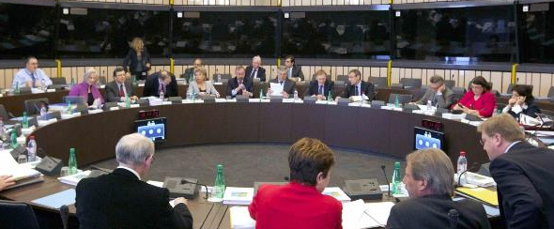
The European Commission promoting the common interest
27 independent members,
one from each EU country
4Proposes new legislation
4Executive organ
4Guardian of the treaties
4Represents the EU on the international stage

Slide 72
Commission art. 17 TEU
1. The Commission shall promote the general interest of the Union and take appropriate initiatives to that end. It shall ensure the application of the Treaties and of measures adopted by the institutions pursuant to them. It shall oversee the application of Union law under the control of the Court of Justice of the European Union. It shall execute the budget and manage programmes. It shall exercise coordinating, executive and management functions, as laid down in the Treaties. With the exception of the common foreign and security policy, and other cases provided for in the Treaties, it shall ensure the Union's external representation. It shall initiate the Union's annual and multiannual programming with a view to achieving interinstitutional agreements.
2. Union legislative acts may only be adopted on the basis of a Commission proposal, except where the Treaties provide otherwise. Other acts shall be adopted on the basis of a Commission proposal where the Treaties so provide.

Slide 73
independence
3. The Commission's term of office shall be five years.
The members of the Commission shall be chosen on the ground of their general competence and European commitment from persons whose independence is beyond doubt.
In carrying out its responsibilities, the Commission shall be completely independent. Without prejudice to Article 18(2), the members of the Commission shall neither seek nor take instructions from any Government or other institution, body, office or entity. They shall refrain from any action incompatible with their duties or the performance of their tasks.

Slide 74
Members of the commission
5. As from 1 November 2014, the Commission shall consist of a number of members, including its President and the High Representative of the Union for Foreign Affairs and Security Policy, corresponding to two thirds of the number of Member States, unless the European Council, acting unanimously, decides to alter this number.
The members of the Commission shall be chosen from among the nationals of the Member States on the basis of a system of strictly equal rotation between the Member States, reflecting the demographic and geographical range of all the Member States. This system shall be established unanimously by the European Council in accordance with Article 244 of the Treaty on the Functioning of the European Union.

Slide 75
President of the commissione
6. The President of the Commission shall:
(a) lay down guidelines within which the Commission is to work;
(b) decide on the internal organisation of the Commission, ensuring that it acts consistently, efficiently and as a collegiate body;
(c) appoint Vice-Presidents, other than the High Representative of the Union for Foreign Affairs and Security Policy, from among the members of the Commission.
A member of the Commission shall resign if the President so requests. The High Representative of the Union for Foreign Affairs and Security Policy shall resign, in accordance with the procedure set out in Article 18(1), if the President so requests.

Slide 76
7. Taking into account the elections to the European Parliament and after having held the appropriate consultations, the European Council, acting by a qualified majority, shall propose to the European Parliament a candidate for President of the Commission. This candidate shall be elected by the European Parliament by a majority of its component members. If he does not obtain the required majority, the European Council, acting by a qualified majority, shall within one month propose a new candidate who shall be elected by the European Parliament following the same procedure.
8. The Commission, as a body, shall be responsible to the European Parliament. The European Parliament may vote on a motion of censure of the Commission. If such a motion is carried, the members of the Commission shall resign as a body and the High Representative of the Union for Foreign Affairs and Security Policy shall resign from the duties that he carries out in the Commission.

Slide 77
WHAT IS THAT?
Is a key EU institution.
Enjoys a substantial degree of independence in exercising its powers.
Uphold the common interest, which means that it must not take instructions from any national government.

Slide 78
Link to the parlament
The Commission is answerable to the Parliament, and
the entire Commission has to resign if the Parliament passes a motion of censure against it.

Slide 79
TRASPARENCY
In 2009 the European Ombudsman published statistics of citizens' complaints against EU institutions, with most of them filed against the Commission (66%) and concerning LACK OF TRASPARENCY (36%).
In 2010 the Commission was sued for blocking access to documents on EU biofuel policy
Lack of transparency, unclear lobbyist relations, conflicts of interests and excessive spending of the Commission was highlighted in a number of reports by internal and independent auditing organisations.

Slide 80
WHAT DOES IT DO ?
LEGISLATIVE INITIATIVE
It alone has the right to draw up proposals for new EU legislation, which it sends to the Council and Parliament for discussion and adoption.

Slide 81
WHAT DOES IT DO ?
ENFORCEMENT - LEGISLATION
Once legislation is passed by the Council and Parliament, it is the Commission's responsibility to ensure it is implemented.
It does this through the MS or through its AGENCIES.
In adopting the necessary technical measures, the Commission is assisted by COMMETTEES made up of representatives of member states and of the public and private lobbies (a process known in jargon as "COMITOLOGY").

Slide 82
WHAT DOES IT DO ?
ENFORCEMENT - EU BUDJECT
EC is responsible for the implementation of the EU budget;
ensuring, along with the Court of Auditors, that EU funds are correctly spent.

Slide 83
What does it do ?
‘GUARDIAN OF THE TREATIES’,
It has to ensure that the regulations and directives adopted by the Council and Parliament are being implemented in the member states.
If they are not, the Commission can take the offending party to the Court of Justice to oblige it to comply with EU law.

Slide 84
WHAT DOES IT DO ?
The EU’S EXECUTIVE ARM,
The Commission implements the decisions taken by the Council in areas such as the common agricultural policy.
It has wide powers to manage the EU’s common policies, such as research and technology, overseas aid and regional development. It also manages the budget for these policies.

Slide 85
WHAT DOES IT DO ?
EXTERNAT REPRESENTATION FOR THE EU
The Commission provides some external representation for the Union, alongside the member states and the Common Foreign and Security Policy, representing the Union in bodies such as the World Trade Organisation.
It is also usual for the President to attend meetings of the G8.

Slide 86
article 17 TEU
The Commission has several responsibilities:
develop medium-term strategies;
draft legislation and arbitrate in the legislative process;
represent the EU in trade negotiations;
make rules and regulations, for example in competition policy;
draw up the budget of the European Union;
and to scrutinise the implementation of the treaties and legislation.

Slide 87
THE STRUCTURE
The Commissioners are assisted by a CIVIL SERVICES, based mainly in Brussels and Luxembourg,
Divided into 43 DEPARTMENTS and SERVICES.
There are also a number of AGENCIES, set up to carry out specific tasks for the Commission and mostly located in other European cities.

