Slide 1
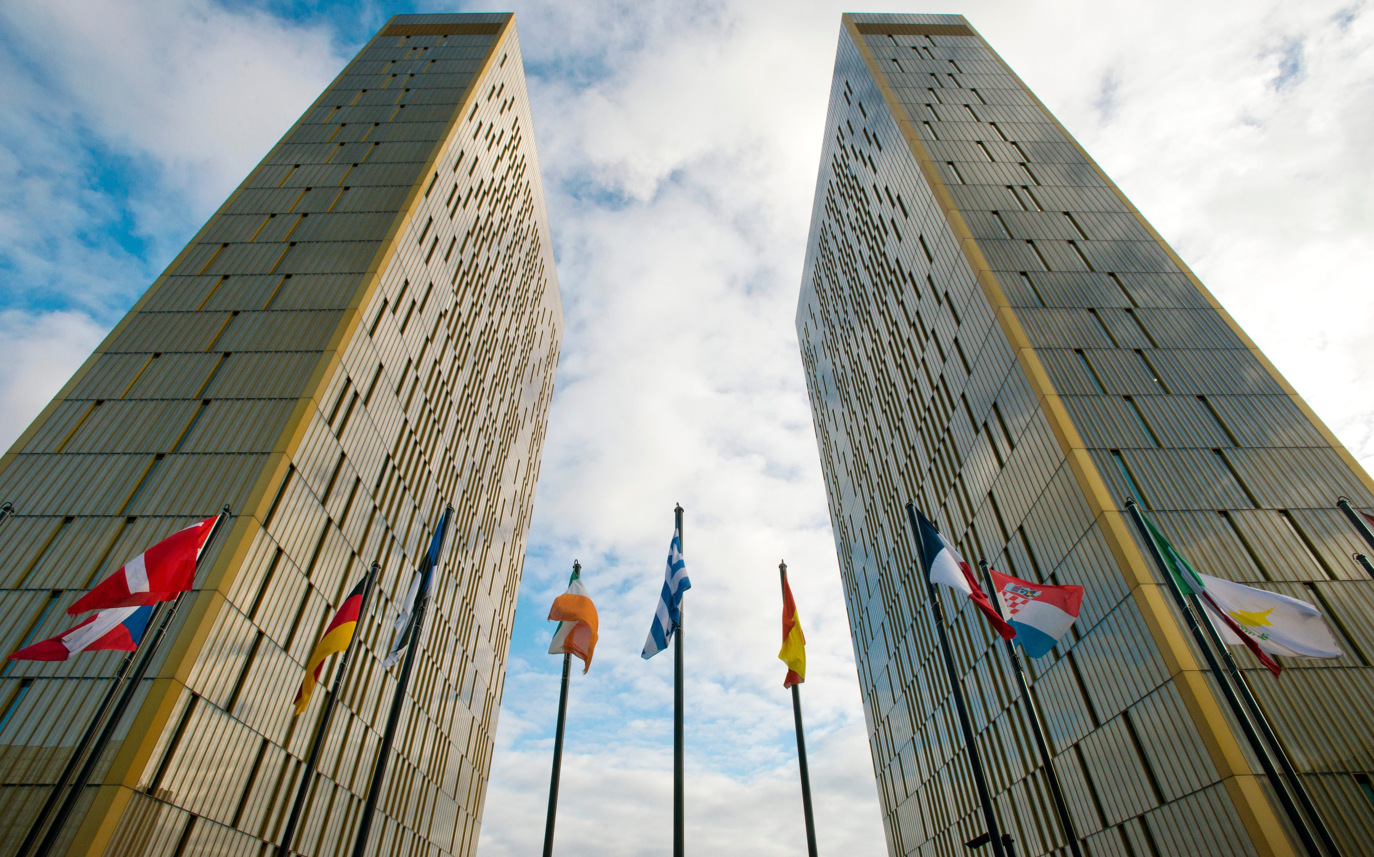
EUROPEAN COURT OF JUSTICE

Slide 2
overview
-

Slide 3
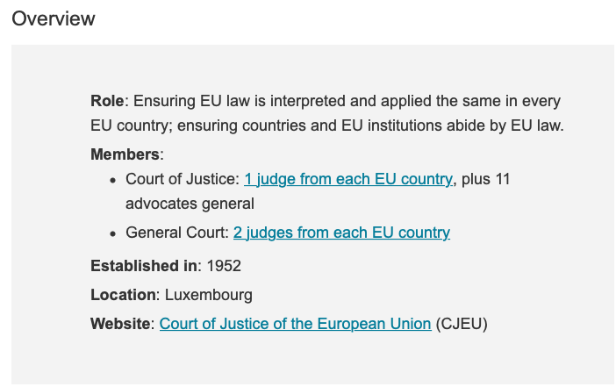

Slide 4
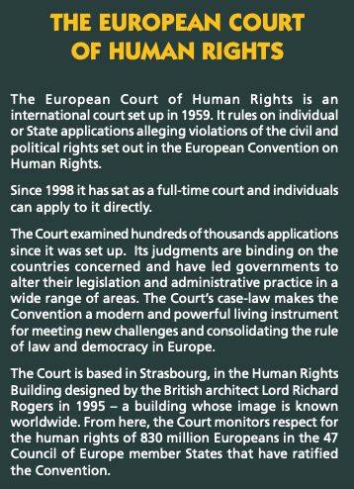
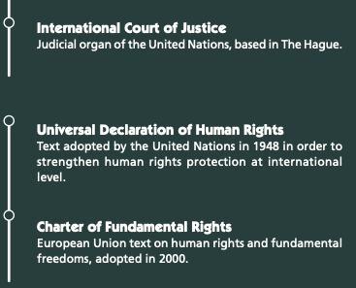
Not to be confused with…

Slide 5

ROLE
The Court of Justice of the European Union (CJEU) interprets EU law to make sure it is applied in the same way in all EU countries, and settles legal disputes between national governments and EU institutions.
It can also, in certain circumstances, be used by individuals, companies or organizations to take action against an EU institution, if they feel it has somehow infringed their rights.
The Court thus constitutes the judicial authority of the European Union and, in cooperation with the courts and tribunals of the Member States, it ensures the uniform application and interpretation of EU law.

Slide 6
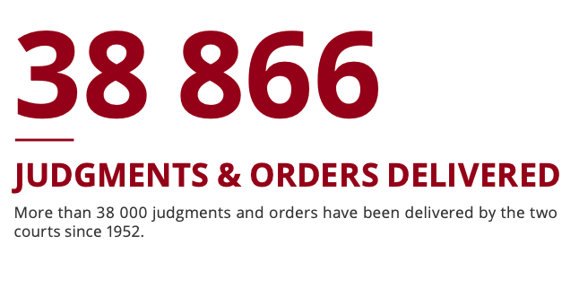
As part of that mission, the Court of Justice of the European Union:
reviews the legality of the acts of the institutions of the European Union;
ensures that the Member States comply with obligations under the Treaties;
interprets European Union law at the request of the national courts and tribunals through preliminary rulings.
Since the establishment of the Court of Justice of the European Union in 1952, its mission has been to ensure that “the law is observed” “in the interpretation and application” of the Treaties.

Slide 7
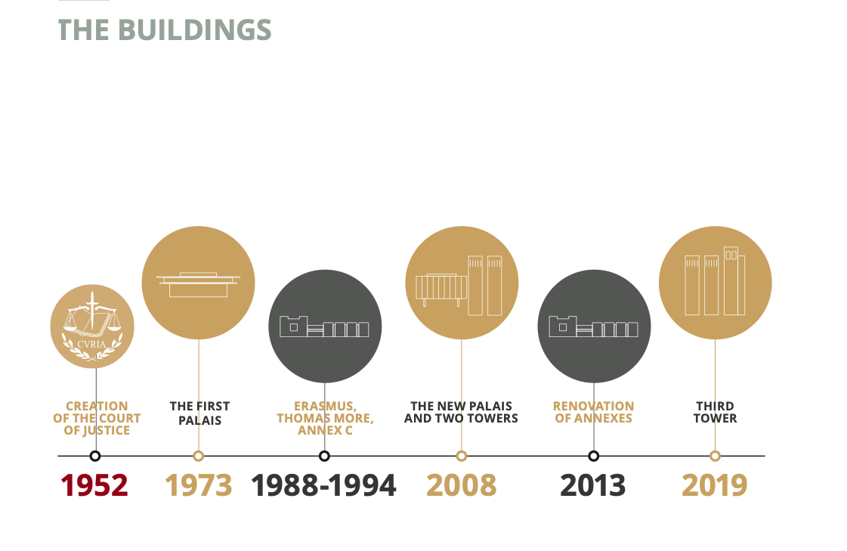
The seat of the Court of Justice of the European Union has been in Luxembourg since its creation in 1952. The first Palais (courthouse) of the Court was opened in 1973 on the Kirchberg Plateau and various extensions have since been added.

Slide 8
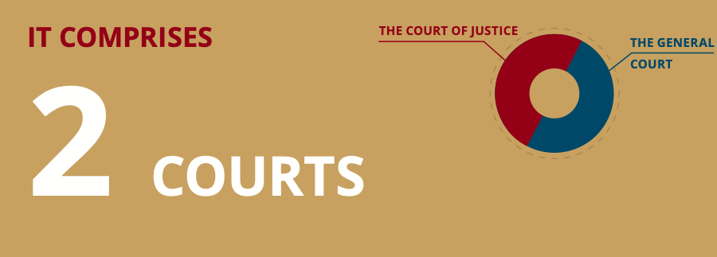
MEMBERS
The Court of Justice of the European Union consists of two courts:
the Court of Justice;
General Court (created in 1988)
(the Civil Service Tribunal, established in 2004, ceased to operate on 1 September 2016 after its jurisdiction was transferred to the General Court in the context of the reform of the European Union’s judicial structure).

Slide 9
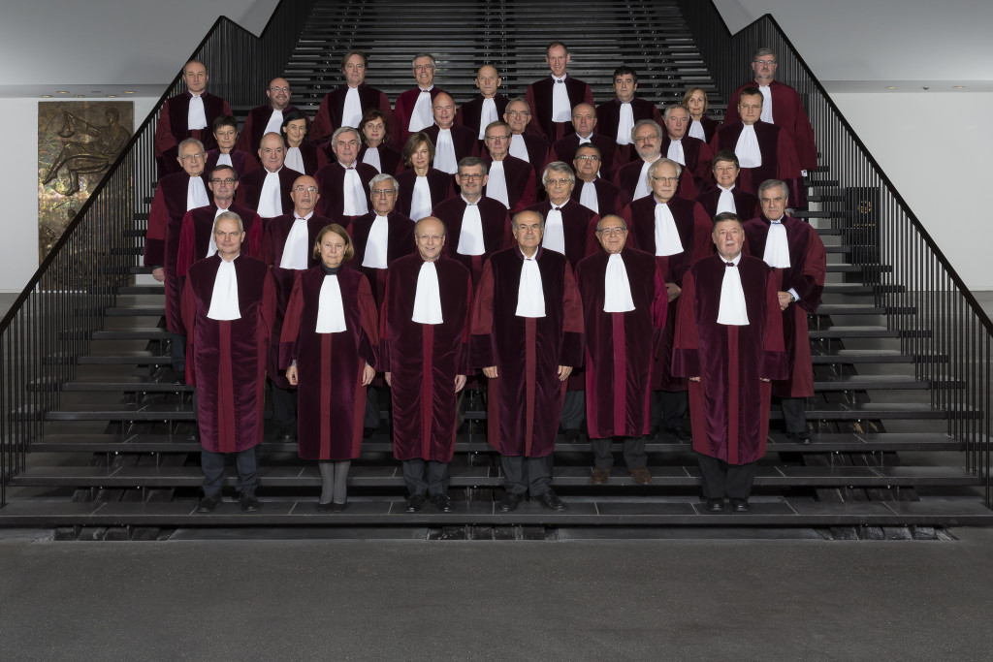
Composition
1. Court of Justice
The Court deals with requests for preliminary rulings from national courts, certain actions for annulment and appeals.
It is composed of 27 Judges and 11 Advocates General.
The Judges and Advocates General are appointed by common accord of the governments of the Member States after consultation of a panel responsible for giving an opinion on prospective candidates’ suitability to perform the duties concerned.
They are appointed for a term of office of six years, which is renewable.
They are chosen from among individuals whose independence is beyond doubt and who possess the qualifications required for appointment, in their respective countries, to the highest judicial offices, or who are of recognized competence.

Slide 10


The Judges of the Court of Justice elect from amongst themselves a President and a Vice-President for a renewable term of three years.
The President directs the work of the Court and presides at hearings and deliberations of the full Court or the Grand Chamber.
The Vice-President assists the President in the exercise of his duties and takes his place when necessary.
The Advocates General assist the Court. They are responsible for presenting, with complete impartiality and independence, an ‘opinion' in the cases assigned to them.
The Registrar is the institution’s secretary general and manages its departments under the authority of the President of the Court.

Slide 11

Composition
2. General Court
The General Court rules on actions for annulment brought by individuals, companies and, in some cases, EU governments.
In practice, this means that this court deals mainly with competition law, State aid, trade, agriculture, trade marks.
As of 1 September 2019, the General Court has 2 Judges per Member State.
The Judges are appointed by common accord of the Member States for a renewable term of six years.
The Judges elect the President and Vice-President from among their number for a renewable term of three years.
They carry out their tasks with complete impartiality.

Slide 12
Over time, the General Court has become competent to hear cases at first instance brought by natural or legal persons and some cases brought by EU institutions (with the exception of those specifically reserved for the Court of Justice) in more than 40 subject area:
competition, intellectual property, environment, health, agriculture, external relations, EU staff cases, public procurement, access to documents, institutional law, and banking and finance
The judgments of the General Court can be appealed, on points of law only, before the Court of Justice.

Slide 13
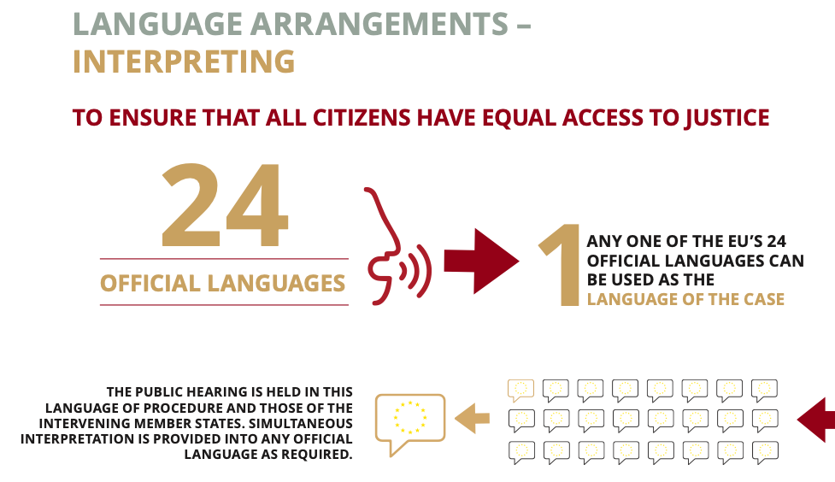
As each Member State has its own language and specific legal system, the Court of Justice of the European Union is a multilingual institution. Its language arrangements have no equivalent in any other court in the world, since each of the official languages of the European Union can be the language of a case. The Court is required to observe the principle of multilingualism in full, because of the need to communicate with the parties in the language of the proceedings and to ensure that its case-law is disseminated throughout the Member States.

Slide 14
Eu system OF LEGAL PROTECTION
To enable it properly to fulfil its task, the Court has been given clearly defined jurisdiction, which it exercises on references for preliminary rulings and in various categories of proceedings.

Slide 15
The EU system of legal protection
A Union which aspires to be a community governed by law must provide its citizens with a complete and effective system of legal protection. The European Union’s system of legal protection meets this requirement.
It recognizes the right of the individual to effective judicial protection of the rights derived from EU law. This protection, which is codified in Article 47 of the Charter of Fundamental Rights, is one of the fundamental legal principles resulting from the constitutional traditions common to the Member States and the ECHR (Articles 6 and 13).
It is guaranteed by the EU’s legal system (the Court of Justice and the General Court) (Article 19(1) TEU)

Slide 16
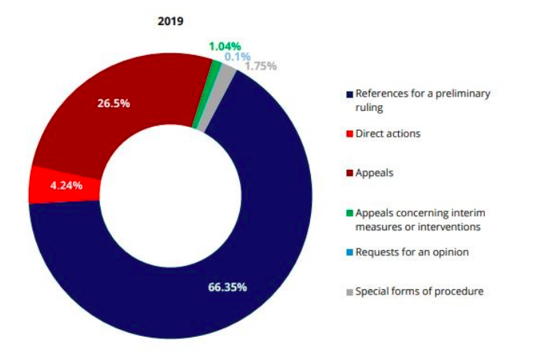
THE VARIOUS TYPES OF PROCEEDINGS:
References for preliminary ruling;
Action for failure to fulfil obligations;
Actions for annulment;
Actions for failure to act;
Appeals.

Slide 17
1. References for preliminary rulings
(art. 267 TFEU)
The Court of Justice cooperates with all the courts of the Member States, which are the ordinary courts in matters of European Union law. A reference for a preliminary ruling may also seek the review of the validity of an act of EU law.
To ensure the effective and uniform application of European Union legislation and to prevent divergent interpretations, the national courts may, and sometimes must (if the validity of an EU instrument is at issue), refer to the Court of Justice and ask it to clarify a point concerning the interpretation of EU law, so that they may ascertain, for example, whether their national legislation complies with that law.

Slide 18
The Court of Justice's reply is not merely an opinion, but takes the form of a judgment or reasoned order. The national court to which it is addressed is, in deciding the dispute before it, bound by the interpretation given.
The Court's judgment likewise binds other national courts before which the same problem is raised.
It is thus through references for preliminary rulings that any European citizen can seek clarification of the European Union rules which affect him.
Although such a reference can be made only by a national court, all the parties to the proceedings before that court, the Member States and the institutions of the European Union may take part in the proceedings before the Court of Justice.
In that way, several important principles of EU law have been laid down by preliminary rulings, sometimes in reply to questions referred by national courts of first instance.

Slide 19
2. Actions for failure to fulfil obligations (art. 258 TFEU)
These actions enable the Court of Justice to determine whether a Member State has fulfilled its obligations under European Union law
PRELIMINARY PROCEDURE:
If the dispute is not settled at that stage, either the Commission (Article 258 TFEU) or another Member State (Article 259 TFEU) may institute an action in the Court.
Before bringing the case before the Court of Justice, the Commission conducts a preliminary procedure in which the Member State concerned is given the opportunity to reply to the complaints addressed to it.

Slide 20
The Court investigates the complaint and decides whether a treaty has been infringed.
If the Court finds that an obligation has not been fulfilled, the State must bring the failure to an end without delay.
If a Member State fails to comply with a judgment given against it, the Commission has the possibility of a second court ruling ordering that state to pay a lump-sum fine and/or a penalty (Article 260 TFEU).
In practice the initiative is usually taken by the Commission.
There are therefore serious financial implications for a Member State which continues to disregard a Court judgment against it for treaty infringement.

Slide 21

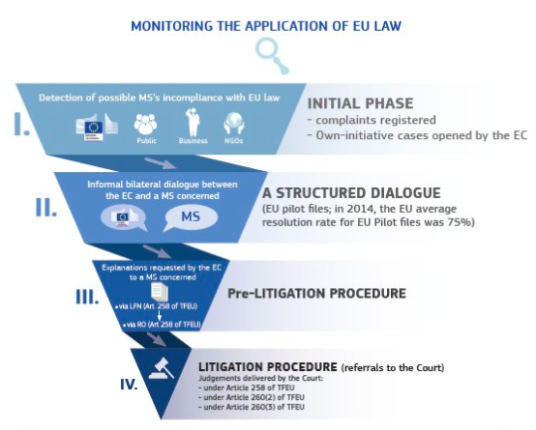

Slide 22
3. Actions for annulment
(art. 263 TFEU)
By an action for annulment, the applicant seeks the annulment of a measure (in particular a regulation, directive or decision) adopted by an institution, body, office or agency of the European Union
The Court of Justice has exclusive jurisdiction over actions brought by a Member State against the European Parliament and/or against the Council (apart from Council measures in respect of State aid, dumping and implementing powers) or brought by one European Union institution against another.
The General Court has jurisdiction, at first instance, in all other actions of this type and particularly in actions brought by individuals.

Slide 23
4. Actions for failure to act
(art. 265 TFEU)
These actions enable the lawfulness of the failure of the institutions, bodies, offices or agencies of the European Union to act to be reviewed
There is a preliminary procedure whereby the complainant puts the institution on notice to fulfil its duty.
The order sought in an action by the institutions is a declaration that the body concerned has infringed the treaty by neglecting to take a decision required of it.
Where the action is brought by a Union citizen or an undertaking, it is for a declaration that the Union institution has infringed the treaty by neglecting to address an individual decision to them.

Slide 24
Jurisdiction to hear actions for failure to act is shared between the Court of Justice and the General Court according to the same criteria as for actions for annulment.
The judgment simply finds that the neglect was unlawful.
The Court of Justice/General Court has no jurisdiction to order that a decision be taken: the party against whom judgment is given is merely required to take measures to comply with the judgment (Article 266 TFEU).

Slide 25
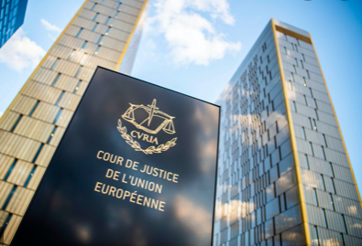
5. Appeal
(art. 256 TFEU)
Appeals on points of law only may be brought before the Court of Justice against judgments and orders of the General Court.
If the appeal is admissible and well founded, the Court of Justice sets aside the judgment of the General Court.
Where the state of the proceedings so permits, the Court of Justice may itself decide the case.
Otherwise, it refers the case back to the General Court, which is bound by the CJEU’s legal assessment.

Slide 26
PROCEDURES
Whatever the type of case, there is always a written stage and, if appropriate, an oral stage, which is public. However, a distinction must be drawn between, first, references for preliminary rulings and, second, other actions (direct actions and appeals)

Slide 27
How does the CJEU work?
Whatever the type of case, there is always a written stage and, if appropriate, an oral stage, which is public. However, a distinction must be drawn between, first, references for preliminary rulings and, second, other actions (direct actions and appeals).
In the Court of Justice, each case is assigned 1 judge (the "judge-rapporteur”) and 1 advocate general. Cases are processed in 2 stages:
General Court procedure is similar, except that most cases are heard by 3 judges and there are no advocates general.
Written stage
Oral stage – a public hearing

Slide 28
In references for preliminary rulings
The national court submits questions to the Court of Justice about the interpretation or validity of a provision of European Union law, generally in the form of a judicial decision in accordance with national procedural rules.
When that request has been translated into all the European Union languages by the Court's translation service, the Registry notifies it to the parties to the national proceedings, and also to all the Member States and the institutions of the European Union.
A notice is published in the Official Journal of the European Union stating, inter alia, the names of the parties to the proceedings and the content of the questions.
The parties, the Member States and the institutions have two months within which to submit written observations to the Court of Justice.

Slide 29
In direct actions and appeals
An action before the Court must be brought by application addressed to the Registry.
The Registrar publishes a notice of the action in the Official Journal, setting out the applicant's claims and arguments.
The application is served on the other parties, who have two months within which to lodge a defense or a response. If appropriate, the applicant may lodge a reply and the defendant a rejoinder.
The time limits for lodging these documents must be complied with.
In both types of action, a Judge-Rapporteur and an Advocate General, responsible for monitoring the progress of the case, are appointed by the President and the First Advocate General respectively.

Slide 30
1) Written stage:
The parties give written statements to the Court - and observations can also be submitted by national authorities, EU institutions and sometimes private individuals.
  How many judges will deal with the case: 3, 5 or 15 judges (the whole Court), depending on the importance and complexity of the case. Most cases are dealt with by 5 judges, and it is very rare for the whole Court to hear the case.
All of this is summarized by the judge-rapporteur and then discussed at the Court's general meeting, which decides:
  Whether a hearing (oral stage) needs to be held and whether an official opinion from the advocate general is necessary.

Slide 31
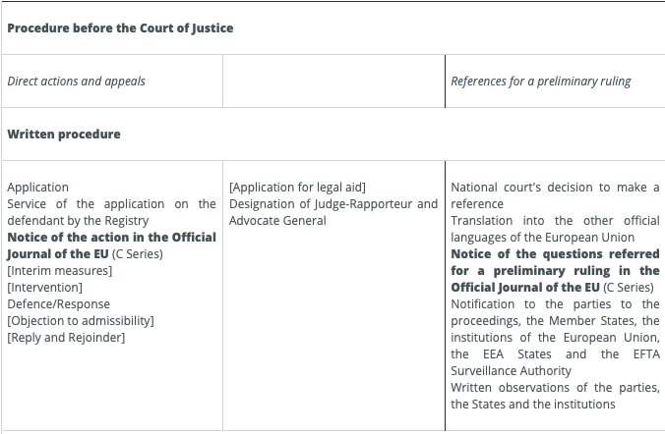

Slide 32

2. Oral stage – a public hearing
In all proceedings, once the written procedure is closed, the parties may state, within three weeks, whether and why they wish a hearing to be held.
The Court decides, after reading the proposal of the Judge-Rapporteur and hearing the views of the Advocate General, whether any preparatory inquiries are needed, what type of formation the case should be assigned to, and whether a hearing should be held for oral argument, for which the President will fix the date.

Slide 33
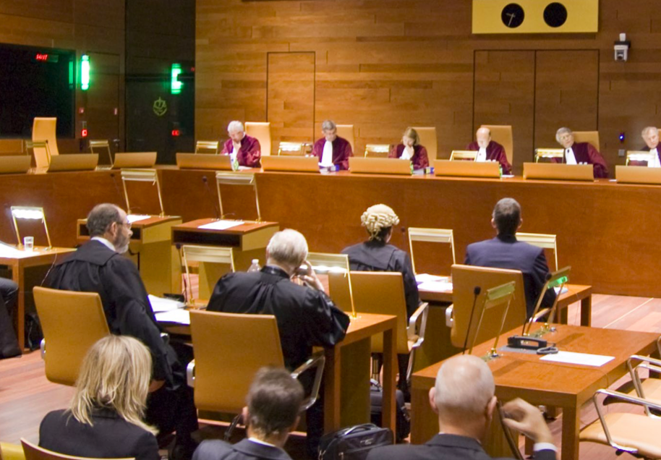
When it has been decided that an oral hearing will be held, the case is argued at a public hearing, before the bench and the Advocate General. The Judges and the Advocate General may put to the parties any questions they consider appropriate.
Some weeks later, the Advocate General delivers his or her Opinion before the Court of Justice, again in open court. He or she analyses in detail the legal aspects of the case and suggests completely independently to the Court of Justice the response which he or she considers should be given to the problem raised.
This marks the end of the oral stage of the proceedings. If it is decided that the case raises no new question of law, the Court may decide, after hearing the Advocate General, to give judgment without an Opinion.

Slide 34
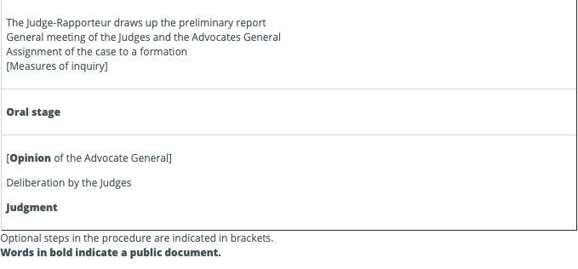

Slide 35
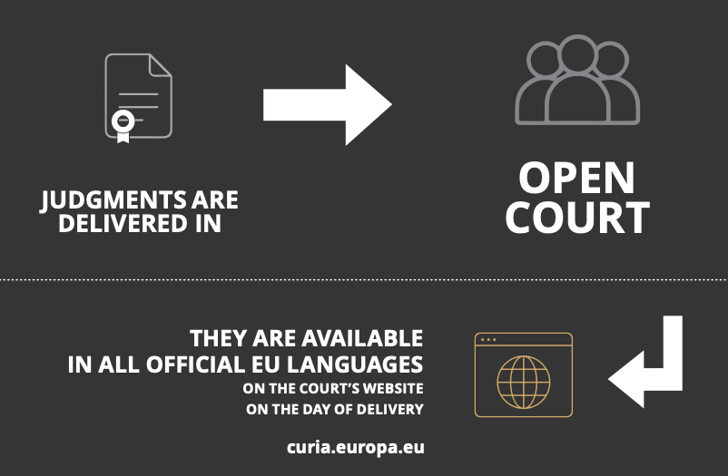
Judgements
The Judges deliberate on the basis of a draft judgment drawn up by the Judge-Rapporteur. Each Judge of the formation concerned may propose changes.
Decisions of the Court of Justice are taken by majority and no record is made public of any dissenting opinions. Only the Judges present during the oral deliberations in the course of which the judgment is adopted sign the judgment.
Judgments are pronounced in open court.
Judgments and the Opinions of the Advocate General are available on the CURIA internet site on the day they are delivered. They are, in most cases, subsequently published in the European Court Reports.

Slide 36
Special forms of procedure
The simplified procedure
The expedited procedure
The urgent preliminary ruling procedure
Applications for interim measures

Slide 37
1. The simplified procedure
a question referred for a preliminary ruling is identical to a question on which the Court has already been called on to rule,
after hearing the Advocate General
OR
the Court may give its decision by reasoned order, citing in particular a previous judgment relating to that question or the relevant case-law
the answer to the question admits of no reasonable doubt or may be clearly deduced from existing case-law,

Slide 38
2. The expedited procedure
The expedited procedure enables the Court to give its rulings quickly in very urgent cases by reducing the time-limits as far as possible and giving such cases absolute priority.
On application by one of the parties, the President of the Court may decide, on a proposal from the Judge-Rapporteur, and after hearing the Advocate General and the other parties, whether the particular urgency of the case requires the use of the expedited procedure.
Such a procedure can also be used for references for preliminary rulings. In that case, the application is made by the national court seeking the preliminary ruling and must set out in the application the circumstances establishing that a ruling on the question put to the Court is a matter of exceptional urgency.

Slide 39
Reasons for the application of the expedited procedure
Examples:
Nature and sensitivity of the area of interpretation covered by the reference for a preliminary ruling;
Particular severity of the legal uncertainty to which the reference for a preliminary ruling relates;
Risk of interference with fundamental rights;
Risk of serious environmental damage;
…

Slide 40
3. The urgent preliminary ruling procedure
This procedure enables the Court of Justice to deal in a much shorter timeframe with the most sensitive issues relating to the area of freedom, security and justice (police and judicial cooperation in civil and criminal matters, as well as visas, asylum, immigration and other policies related to free movement of persons).
Cases are referred to a Chamber of five specially designated Judges and the written part of the procedure is, in practice, essentially conducted electronically and is very much curtailed, both in terms of duration and in the number of those authorized to submit written observations, the majority of them intervening in the oral part of the procedure, which is mandatory.

Slide 41
Reasons for the application of the urgent preliminary ruling procedure
Example 1: Risk of deterioration of the parent/child relationship
Judgment of 22 December 2010, Aguirre Zarraga (C-491/10 PPU, EU:C:2010:828)
In this case, a Spanish national and a German national who were the parents of a young daughter had initiated divorce proceedings in Spain, the family’s habitual place of residence. In that context, sole rights of custody in respect of their daughter had been provisionally awarded to the father, who appeared best placed to ensure that the child’s family environment was maintained, the mother having expressed her wish to settle in Germany with her new partner. However, after having spent the summer at her mother’s new residence in Germany, the child did not return to Spain. Several sets of proceedings were then initiated by the parents, in Spain and in Germany, seeking, respectively, the child’s return to Spain, the recognition and enforcement of Spanish decisions in Germany and the definitive award of rights of custody.
In that context, the Oberlandesgericht Celle (Higher Regional Court, Celle, Germany) referred a number of questions to the Court of Justice concerning the interpretation of Article 42, headed
The Court decided of its own motion that the reference for a preliminary ruling should be dealt with under the PPU. In that regard, it observed that it recognised the urgency of ruling in cases of child removal, in particular where the separation of a child from the parent to whom custody had previously been awarded, even if only provisionally, would be likely to bring about a deterioration of their relationship, or harm that relationship, and to cause psychological damage (paragraph 39). Applying that case-law to this particular case, the Court of Justice noted that the child had been separated from her father for more than 2 years and that, given the distance between the parents and their strained relationship, there was a real and serious risk that the child and her father would have absolutely no contact for the duration of the proceedings before the referring court. According to the Court of Justice, in those circumstances, the use of the ordinary procedure might cause serious, and perhaps irreparable, harm to the relationship between father and daughter and also further jeopardise the daughter’s integration into the father’s family and social environment in the event of any return to Spain (paragraph 40).

Slide 42
Example 2: Risk of interference with fundamental rights
Judgment of 17 October 2018, UD (C-393/18 PPU, EU:C:2018:835)
Following her marriage to a British national, a Bangladeshi national had been granted a visa enabling her to live in the United Kingdom. The couple had subsequently travelled to Bangladesh during the Bangladeshi national’s pregnancy. Their daughter was born there and had never been to the United Kingdom, the father having returned there alone. According to the mother’s claims, which were disputed by the father, the father had tricked her into giving birth in a third country and coerced her into remaining in that country with the child, without access to gas, electricity or clean water, without income and in a community that stigmatised her. Accordingly, the mother commenced proceedings in the High Court of Justice (England & Wales), Family Division (United Kingdom) for an order that the child be made a ward of that court and that she and the child return to the United Kingdom.
First of all, the High Court of Justice (England & Wales), Family Division, considered it necessary to resolve the issue of its jurisdiction to make a decision concerning the child, which involved determining whether the child’s habitual residence, for the purposes of Article8(1) of Regulation No 2201/2003, could be considered to be in the United Kingdom, even though she had never been to that Member State. Further, the High Court of Justice (England & Wales), Family Division, queried whether the circumstances of the case, notably the father’s behaviour and the breach of the fundamental rights of the mother or of the child, had an effect on that concept of ‘habitual residence’.
The referring court also requested that the reference for a preliminary ruling be dealt with under the PPU, a request that was granted by the Court of Justice. In that regard, the Court stated at the outset that, in the event that the father’s coercion of the mother is established, the child’s current welfare would be seriously compromised. Any delay in taking judicial decisions relating to the child would prolong the situation and would thereby risk causing serious, possibly irreparable, harm to that child’s development. Next, the Court noted that, in the event of a possible return to the United Kingdom, such a delay would also risk being detrimental to the child’s integration in her new family and social environment. Last, the Court pointed out that the very young age of the child (1 year and 2 months at the date of the order for reference) made her stimulation and development particularly delicate (paragraphs 26 and 27).

Slide 43
4. Applications for interim measures
Applications for interim measures seek suspension of the operation of measures which an institution has adopted and which form the subject-matter of an action, or any other interim order necessary to prevent serious and irreparable damage to a party.

Slide 44
Thank you!

