Slide 1
Europe from Obscurity to Economic Recovery
An Economic History of Europe: Knowledge, Institutions and Welfare, Prehistory to the Present (3rd edition)
Karl Gunnar Persson, Markus Lampe, Paul Sharp

Slide 2
Light in the ‘Dark Ages’
Post-Roman period often seen as a time of decline
Recent research shows nuanced recovery after initial collapse
Population fell, trade routes disrupted, infrastructure decayed
Gradual revival from 8th–9th centuries CE onward
New power centres emerged in Western & Central Europe
Spread of coinage and institutions paved the way for growth
Muslim world and Byzantine empire often more advanced at this time

Slide 3
Gains from Division of Labour (Adam Smith Revisited)
Subdividing production tasks raises efficiency
Specialisation increases skill via repetition (‘economies of practice’)
Households shift from self-sufficiency to partial/full specialisation
Surplus production exchanged in markets
Stimulates urban growth and crafts specialisation
Requires trust, contract enforcement, property rights
Sets stage for sustained, though slow, growth in pre-industrial Europe

Slide 4
Division of Labour is Constrained by Demand
Smith’s insight: ‘extent of the market’ limits specialisation
Insufficient demand → fewer incentives to specialise
Population decline after Roman Empire broke links, shrank markets
Restoring social/political order fosters larger markets
Transport infrastructure crucial for extending reach of trade
Monetary systems facilitate exchange beyond barter
Growth stalls when division of labour regresses or is reversed

Slide 5
Division of Labour Promotes Technological Change
Repetition and scale encourage incremental innovation
Artisans improve skills, develop specialised tools
Knowledge passes across generations, can be lost if demand falls
Large-scale workshops arise only if markets can absorb output
Tech progress raises output per worker, can offset resource limits
But war, epidemics, or fractured markets can cause setbacks
Economic revival often hinged on re-establishing secure trade routes

Slide 6
Gains from Division of Labour

Slide 7
Virtuous and Vicious Processes in Technological Progress/Regress

Slide 8
The Economic Renaissance (9th to 15th Centuries)
Population began rising again, spurring market growth
Political consolidation improved security for trade
Long-distance networks formed (e.g. Champagne fairs)
Monetary systems regained stability, silver coinage spread
Medieval revival: re-urbanisation, growing demand for non-food goods
Regions with stable institutions, e.g. northern Italy, led commerce
Eventually set the stage for the later commercial revolution

Slide 9
Restoration of Monetary Systems and Trade Routes
Post-Roman collapse saw limited coinage, reliance on barter
Lead-silver mining revived from ~8th century, boosting silver currency
‘Carolingian’ standard briefly unified coinage, then fragmented
Italian cities became major nodes for finance and maritime trade
Overland routes linked Mediterranean with northern Europe
Markets required uniform measures, stable coin weights
Fairs offered legal services to handle contracts & disputes

Slide 10
Lead deposition in Greenland ice

Slide 11
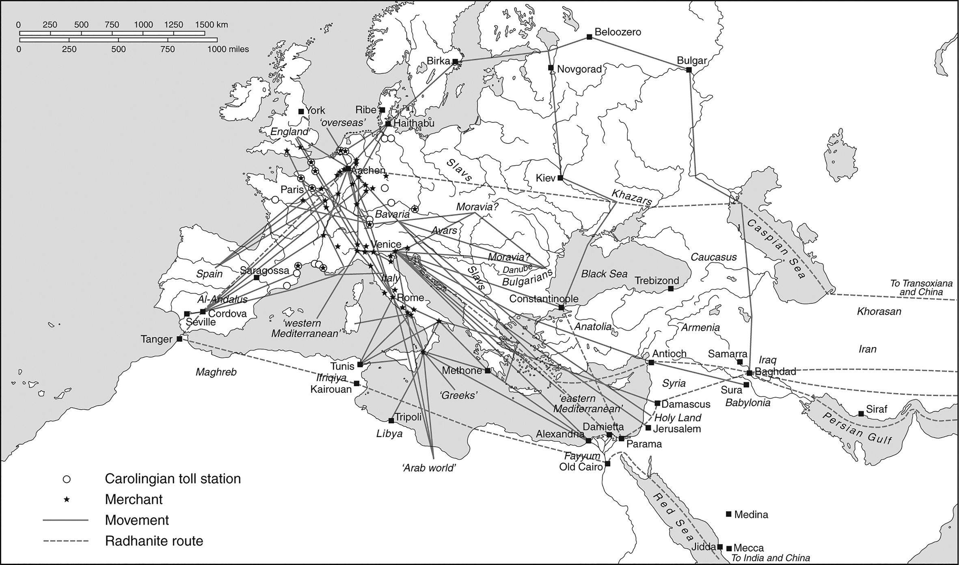
Merchant Communications in the Early Centuries of European Revival

Slide 12
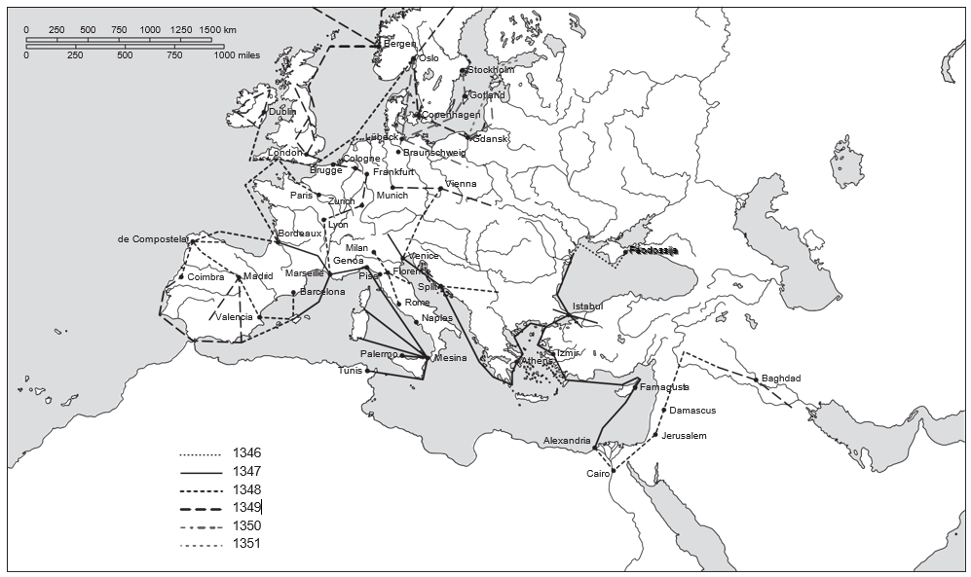
The Spread of Plague Within Europe
(1347–1350)

Slide 13
Urbanisation as a Measure of Progress
Roman urban heritage declined, then partial recovery
Cities grow again from 10th century: hubs for trade & crafts
Non-food producers signal higher per capita income
Growing demand for textiles, metal goods, luxuries
Northern Italy and Flanders become especially urbanised
Large cities formed: Paris, London, Venice, Florence
Urban share correlates with broader economic development

Slide 14
Increasing Division of Labour as Measured by Number of Occupations

Slide 15
Urbanisation in Europe and China

Slide 16
Production and Technology in the Revival
Gradual adoption of water and windmills as labour-saving tech
Mechanised tasks: milling grain, sawing wood, metal forging
Paper-making mechanised with water wheels → cheaper paper
Printing with movable type (mid-15th c.) spurred literacy & record-keeping
Innovations spread slowly but had lasting impacts
Urban workshops became centres for crafts & inventions
By 14th–15th centuries, foundation for later industrial breakthroughs

Slide 17
The Cost Effectiveness of Hand-powered vs. Water-powered Mills
Unit cost
A
Handmill
Watermill
Aggregate demand

Slide 18
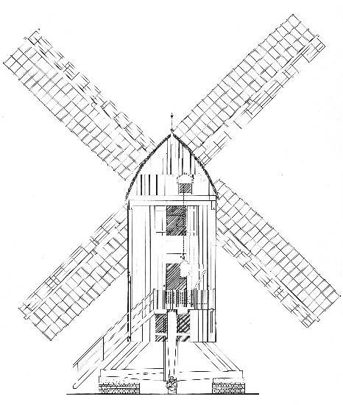
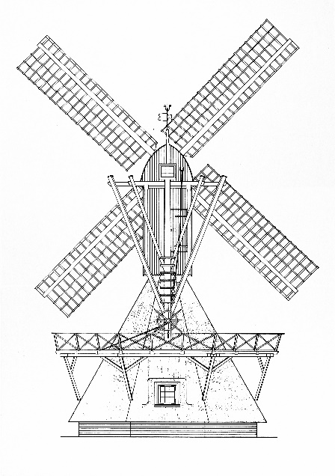
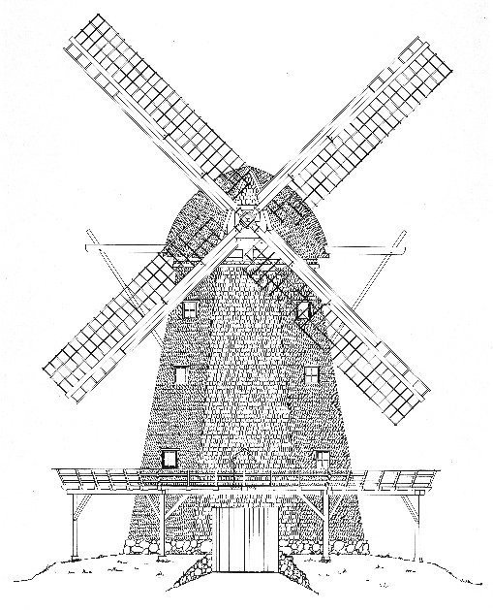
Progress in Dutch and Northern German Windmill Technology
(a) Post mill, ca. 12th Century
(b) Hollow mill, ca. 1400
(c) Smock mill, ca. 1600

Slide 19
Chapter 2 Summary
From Roman decline to a modest revival: population recovered, trade routes slowly reopened
Division of labour & markets: key to improvements in productivity
Technological progress was incremental, relying on stable demand and institutions
Monetary revival: silver coinage, fairs, cross-regional trade
Urban growth signalled expansion beyond basic subsistence
Paved way for further transformations in subsequent centuries
Next chapter explores how population resources affect pre-industrial growth

