Slide 1
Theories of migration

Slide 2
Questions to be answered
Smith (1776) : “…the wages of labour vary more from place to place than the price of provisions… It appears evidently from experience that a man is of all sorts of luggage the most difficult to be transported”
Why some people migrate but others do not?
How migration changes the receiving and sending countries?

Slide 3
Literature
Massey D. S. et al. Theories of international migration: A review and appraisal //Population and development review. – 1993. – С. 431-466.
Borjas G. J. The economic analysis of immigration //Handbook of labor economics. – 1999. – Т. 3. – С. 1697-1760.
Handbook of the Economics of Migration

Slide 4
Preview of main ideas
There is no a single “general” theory of migration
Wage differential is at the core of economics of migration but many other theoretical contributions showed importance of other factors
Basic theories do not contradict each other, rather they complement each other

Slide 5
Map of theories
Macro
  Demand side
    Dual labor market theory(Piore (1979) )
    World systems theory (Wallerstein (1974),
  Supply side
    Neoclassical theory [Lewis, 1954; Ranis and Fei, 1961; Harris and Todaro, 1970; Todaro, 1976]
Micro
  Individual level
    Neoclassical theory [(Sjaastad, 1962; Todaro, 1969, 1976, 1989; Todaro and Maruszko, 1987)]
  Household level
    New economics of migration [Stark and Levhari, 1982; Stark, 1984; Katz and Stark, 1986; Lauby and Stark, 1988; Taylor, 1986; Stark, 1991]

Slide 6
World Systems Theory
[Wallerstein, Immanuel. 1974. The modern World System I: Capitalist Agriculture and the Origins of the European World-Economy in the Sixteenth Century. New York: Academic Press]
Main idea: causes of migration lie in the structure of world economy
The penetration of capitalist economic relations into peripheral, non-capitalist societies creates a mobile population that is ready to migrate abroad.
Migration is a natural outgrowth of disruptions and dislocations that occur in the process of capitalist development in developing countries. World system theory argues that international migration follows the expanding global markets.

Slide 7
World Systems Theory
International migration is a natural consequence of capitalist market formation in the developing world; the penetration of the global economy into peripheral regions is the catalyst for international movement.
The international flow of labor follows the international flow of goods and capital, but in the opposite direction. Capitalist investment foments changes that create an uprooted, mobile population in peripheral countries while simultaneously forging strong material and cultural links with core countries, leading to transnational movement.
International migration is especially likely between past colonial powers and their former colonies, because cultural, linguistic, administrative, etc. links were established early
International migration ultimately has little to do with wage rates or employment differentials between countries; it follows from the dynamics of market creation and the structure of the global economy

Slide 8
April 9, 1870, Karl Marx letter to Sigfrid Meyer and August Vogt
And most important of all! Every industrial and commercial centre in England now possesses a working class divided into two hostile camps, English proletarians and Irish proletarians. The ordinary English worker hates the Irish worker as a competitor who lowers his standard of life. In relation to the Irish worker he regards himself as a member of the ruling nation and consequently he becomes a tool of the English aristocrats and capitalists against Ireland, thus strengthening their domination over himself. He cherishes religious, social, and national prejudices against the Irish worker. His attitude towards him is much the same as that of the“poor whites” to the Negroes in the former slave states of the U.S.A. The Irishman pays himback with interest in his own money. He sees in the English worker both the accomplice and thestupid tool of the English rulers in Ireland.
This antagonism is artificially kept alive and intensified by the press, the pulpit, the comic papers, in short, by all the means at the disposal of the ruling classes. This antagonism is the secret of the impotence of the English working class , despite its organization. It is the secret by which the capitalist class maintains its power. And the latter is quite aware of this.

Slide 9
Neoclassical theories
Hicks (1932): “. . .differences in net economic advantages, chiefly differences in wages, are the main causes of migration”

Slide 10
Neoclassical macro
(Lewis, 1954; Ranis and Fei, 1961; Harris and Todaro, 1970;Todaro, 1976)
The international migration of workers is due to wage rates differences between countries.
The elimination of wage differentials will end the movement of labor, and migration will not occur in the absence of such differentials.
International flows of human capital-that is, highly skilled workers respond to differences in the rate of return to human capital, which may be different from the overall wage rate, yielding a distinct pattern of migration that may be opposite that of unskilled workers.
Labor markets are the primary mechanisms by which international flows of labor are induced; other kinds of markets do not have important effects on international migration.
The way for governments to control migration flows is to regulate or influence labor markets in sending and/or receiving countries.

Slide 11
Neoclassical micro I
Sjaastad, 1962; Todaro, 1969, 1976, 1989; Todaro and Maruszko, 1987
International movement stems from international differentials in both earnings and employment rates, whose product determines expected earnings
Individual human capital characteristics that increase the likely rate of remuneration or the probability of employment in the destination relative to the sending country (e.g., education, experience, training, language skills) will increase the likelihood of international movement, other things being equal.
Individual characteristics, social conditions, or technologies that lower migration costs increase the net returns to migration and, hence, raise the probability of international movement.
For these reasons, individuals within the same country can display very different proclivities to migrate.

Slide 12
Neoclassical micro II
Aggregate migration flows between countries are simple sums of individual moves undertaken on the basis of individual cost-benefit calculations.
International movement does not occur in the absence of differences in earnings and/or employment rates between countries. Migration occurs until expected earnings (the product of earnings and employment rates) have been equalized internationally (net of the costs of movement), and movement does not stop until this product has been equalized.
The size of the differential in expected returns determines the size of the international flow of migrants between countries.
Migration decisions stem from disequilibria or discontinuities between labor markets; other markets do not directly influence the decision to migrate.
If conditions in receiving countries are psychologically attractive to prospective migrants, migration costs may be negative. In this case, a negative earnings differential may be necessary to halt migration between countries

Slide 13
Dual Labour Market Theory
[Piore, M (1979) Birds of passage: migrant labor and industrial societies. Cambridge: Cambridge University Press]
Main idea: International migration stems from the intrinsic labour demands of modern industrial societies.
People in developed societies faced motivational problems to enter at the bottom of the job hierarchy because there is no status in society and few channels for upward mobility.
Such a job vacancy creates the demand for foreign workers who do not have the motivational problems because they do not expect anything than the means to earn money.
Migration is usually initiated by recruitment on the part of the employers in the developed countries, or by the governments acting as agents of the employers.

Slide 14
Dual Labour Market Theory
International labor migration is largely demand-based and is initiated by recruitment on the part of employers in developed societies, or by governments acting on their behalf.
Since the demand for immigrant workers grows out of the structural needs of the economy and is expressed through recruitment practices rather than wage offers, international wage differentials are neither a necessary nor a sufficient condition for labor migration to occur. Indeed, employers have incentives to recruit workers while holding wages constant.
Low-level wages in immigrant-receiving societies do not rise in response to a decrease in the supply of immigrant workers; they are held down by social and institutional mechanisms and are not free to respond to shifts in supply and demand.
Low-level wages may fall, however, as a result of an increase in the supply of immigrant workers, since the social and institutional checks that keep low-level wages from rising do not prevent them from falling.
Governments are unlikely to influence international migration through policies that produce small changes in wages or employment rates; immigrants fill a demand for labor that is structurally built into modern, post-industrial economies, and influencing this demand requires major changes in economic organization.

Slide 15
New Economics of Migration
Object of analysis – migration from LDC
LDC often lack proper financial and insurance institutions
Thus migration takes upon it functions of the absent institutions:
  Insure hh income from risks
  Smooth consumption
  Acquire funds for investments
  Invest spare money

Slide 16
New Economics of Migration
[Stark and Bloom1985]
Costs and benefits of migration are shared between migrant and a group of non-migrants (household, extended family)
Migration decision is a mutually beneficial contractual arrangement between migrant and family
Remittances could be viewed as a part of such contract

Slide 17
New Economics of Migration
[Stark 1991]
Households vulnerable to idiosyncratic shocks that are region or sector-specific
Migration → household members exposed to different regional shocks
Risk diversification through pooling of household members’ income → remittances
Migration optimal even without income differentials if individuals risk averse → consumption smoothing through risk sharing

Slide 18
Munshi and Rosenzweig (AER, 2016)
Puzzle: The low male migration rates in India and the seemingly large gains from migrating: large rural-urban wage gap.
The basic idea for the low mobility of men:
Combination of well-functioning rural insurance networks and the absence of formal insurance (Banerjee and Newman 1998).
In rural India, insurance networks are organized along caste lines.
Commitment and information problems are greater for households with male migrants.
If the resulting loss in network insurance is sufficiently large, and alternative sources of insurance are unavailable, then large wage gaps could persist without generating a flow of workers to higher wage areas.

Slide 19
New Economics of Migration
Families, households, or other culturally defined units of production and consumption are the appropriate units of analysis for migration research, not the single individual.
A wage differential is not a necessary condition for international migration to occur; households may have strong incentives to diversify risks through transnational movement even in the absence of wage differentials.
International migration and local employment or local production are not mutually exclusive possibilities. Indeed, there are strong incentives for households to engage in both migration and local activities. In fact, an increase in the returns to local economic activities may heighten the attractiveness of migration as a means of overcoming capital and risk constraints on investing in those activities. Thus, economic development within sending regions need not reduce the pressures for international migration.

Slide 20
New Economics of Migration
International movement does not necessarily stop when wage differentials have been eliminated across national boundaries. Incentives for migration may continue to exist if other markets within sending countries are absent, imperfect, or in disequilibria.
The same expected gain in income will not have the same effect on the probability of migration for households located at different points in the income distribution, or among those located in communities with different income distributions.
Governments can influence migration rates not only through policies that influence labor markets, but also through those that shape insurance markets, capital markets, and futures markets. Government insurance programs, particularly unemployment insurance, can significantly affect the incentives for international movement.
Government policies and economic changes that shape income distributions will change the relative deprivation of some households and thus alter their incentives to migrate.
.

Slide 21
Neoclassical approach
Assumption:
Free flow of labour and capital
Predictions:
Migration exists when there is geographic imbalance of labour demand and supply
Migration should lead to equalization of wages

Slide 22
Harris-Todaro Model: Basic Ideas
Original focus: rural-urban migration in LDC
Observation: rural residents move to urban regions despite already high unemployment there
Puzzle: migration continues although it makes (some) rural migrants worse off
HT model: migrants motivated by expected returns
  Expected returns may be different from actually realized returns

Slide 23
Harris-Todaro Model: Assumptions
Two regions: urban and rural
  Rural wage: w_{R} (farming)
  Urban wage: w_{U}>w_{R}
Full employment in rural region
Involuntary urban unemployment
  Fraction q of urban workers hold jobs
  1-q are unemployed and have zero earnings
Urban wages downward rigid
  Minimum-wage rules, unionization, or b/c workers must acquire residence/work permits
Workers are risk neutral

Slide 24
Harris-Todaro Model: Outcomes
Migration continues as long as: w_{U}*q>w_{R}
  That is: migration occurs only in disequilibrium and is an adjustment mechanism
Migration is optimal despite unemployment
Migration from LDC to DC is similar case

Slide 25
Harris-Todaro Model: Implications
Todaro paradox: Government spending aimed at urban job creation may increase urban unemployment
Explanation model: Urban job creation (government spending) raises q → migration more attractive
Improving education in rural areas may increase migration if educated rural worker face higher q
Rising rural wages reduce incentive to migrate to urban region

Slide 26
Harris-Todaro Model: Limitations
  Does not account for migration costs
    If migration is costly, rising rural incomes may relieve liquidity constraints on migration
    In this case the main implication of the model (the higher is expected wage gap – the larger is migration stream) is incorrect
  Very primitive model of labor market
    Rural residents can find job before moving even if with less probability
    Different groups of workers face different unemployment rate

Slide 27
Harris-Todaro Model: Conclusions
The model has introduced the idea that migration is a response to spatial differences in the expected returns to labor supply
It gives a rich framework for theoretical analysis but its empirical predictions are unrealistic
Thus multiple extensions of the model that fit actual data better have been made

Slide 28
Sjaastad Model: Basic Ideas
Individual is maximizing utility by maximizing her lifetime net earnings
Migration is a form of human capital investment – a way to increase returns to human capital
Making a decision, potential migrant compares costs and benefits of migration to particular destination

Slide 29
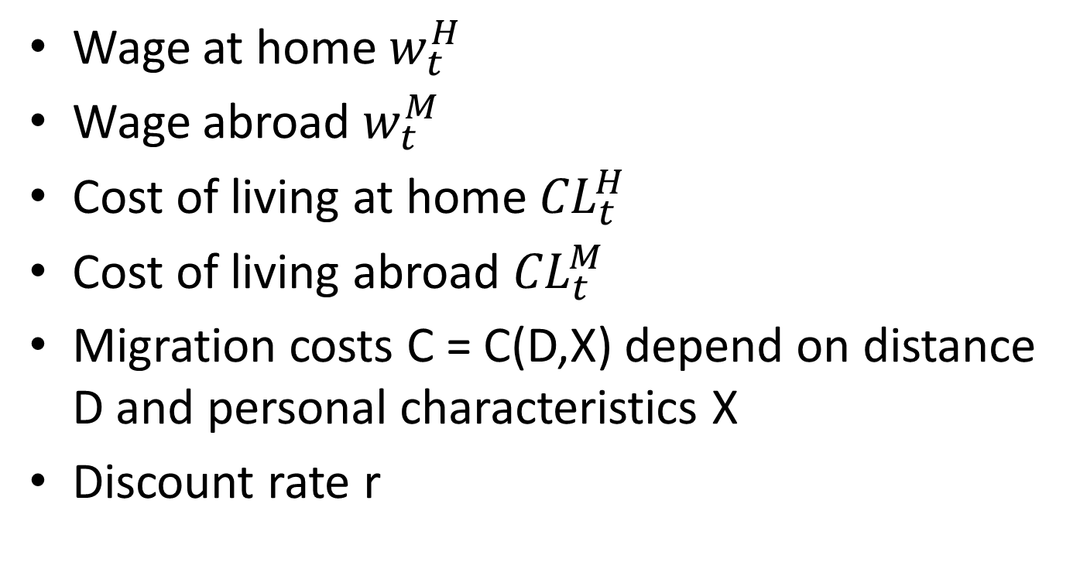
Sjaastad Model: Notations
Wage at home $w_{t}^{H}$
Wage abroad $w_{t}^{M}$
Cost of living at home ${CL}_{t}^{H}$
Cost of living abroad ${CL}_{t}^{M}$
Migration costs C = С(D,X) depend on distance D and personal characteristics X
Discount rate r

Slide 30
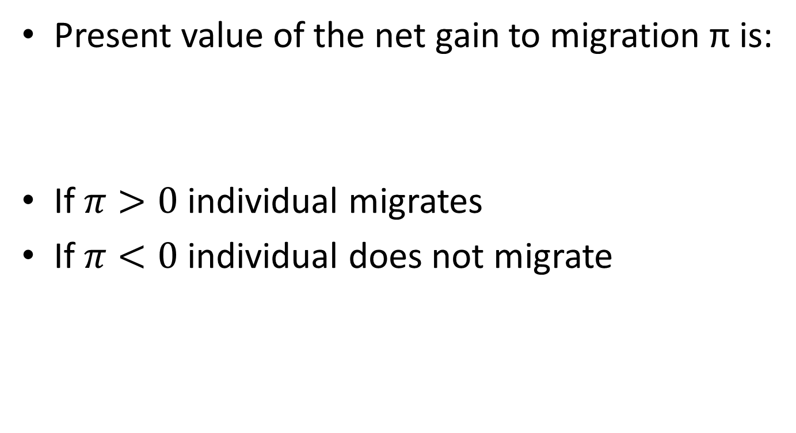
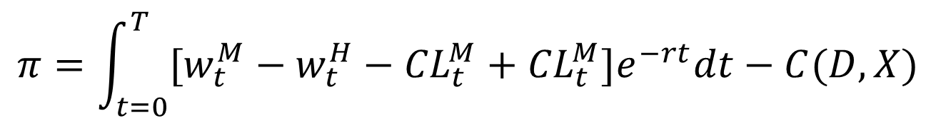
Sjaastad Model: Outcomes
Present value of the net gain to migration π is:
If $π>0$ individual migrates
If $π<0$ individual does not migrate
$$π=\int_{t=0}^{T}{[w_{t}^{M}−w_{t}^{H}−{CL}_{t}^{M}+{CL}_{t}^{M}]e^{−rt}dt}−C(D,X)$$

Slide 31
Sjaastad Model: Limitations
Single period model; cannot explain multiple moves
Accounts only for economic motive of migration
Does not take household into account
Implicit assumption of perfect information
Original model did not consider unemployment

Slide 32
Extensions: costs and benefits
  Taylor 1984 Kinship networks are used to reduce migration risk in presence of uncertainty
  Carrington et al. 1996 Endogenous moving costs: costs of migration to destination reduce with larger number of migrants settled at the destination earlier
  Katz and Stark 1984, 1987 Asymmetric information and statistical discrimination of migrants
  Borjas 1987 Costs depend on skills
  Borjas 1999 Variable and random costs of migration
Clark, Hatton, and Williamson 2007 Four types of costs that include those induced by migration policy

Slide 33
Extensions: dynamic models
Kennan, Walker 2013 (review)
Multi-period models where decision to stay or to move is made each period; expected returns might not coincide with expected because of bounded rationality or uncertainty

Slide 34
Relative deprivation motive
[Stark (1984, 1991), Katz and Stark (1986), Stark and Taylor (1989, 1991) and Stark and Yitzhaki (1984)]
Relative deprivation: a person derives happiness not only from the goods his own income can buy, but also on how his income ranks relative to his peers
High wage inequality would motivate low-income individuals to improve their position in wage distribution via migration

Slide 35
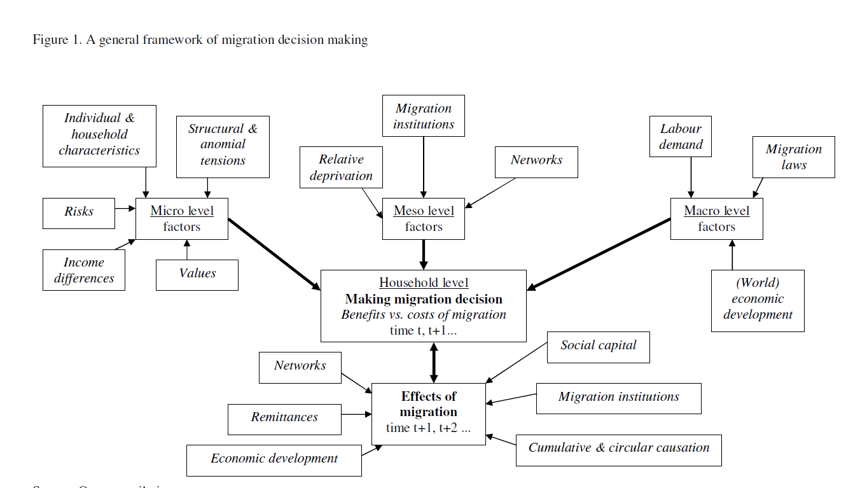

Slide 36
Migration and human capital investment
We look at the connection between the two
Build a life cycle model that looks at the incentive to migrate, to invest in human capital and to the (self) selection of migrants
The model is in the spirit of Harris Todaro: decision are motivated by different returns to work and human capital

Slide 37
Conclusions
There is no a single “general” theory of migration
Wage differential is at the core of economics of migration but many other theoretical contributions showed importance of other factors
Basic theories do not contradict each other, rather they complement each other

