Slide 1


WRITING A WINNING CV
AND COVER LETTER

Slide 2

Curriculum Vitae
The CV shows what best characterizes you and describes your level of preparation.
It is the first source of information that an employer or recruiter uses to evaluate a candidate. It is of the utmost importance to adapt your CV to the position for which you are applying. Make sure that all information on your CV is relevant to the reader.
The CV is a document that presents a concise summary of your education, employment, experiences and skills.

Slide 3

What do recruiters look for?
Recruiters take less than a minute to evaluate each CV. Yours must make a positive impression immediately.
Make sure your CV contains straightforward information. Avoid the use of falsehoods and deception.
Be aware of spelling mistakes and sloppy formatting. Careless mistakes convey an impression that you do not pay attention to details.
Make sure your CV is relevant to the reader: customize your CV for every application by adding, removing or emphasizing pertinent competencies or experiences.

Slide 4
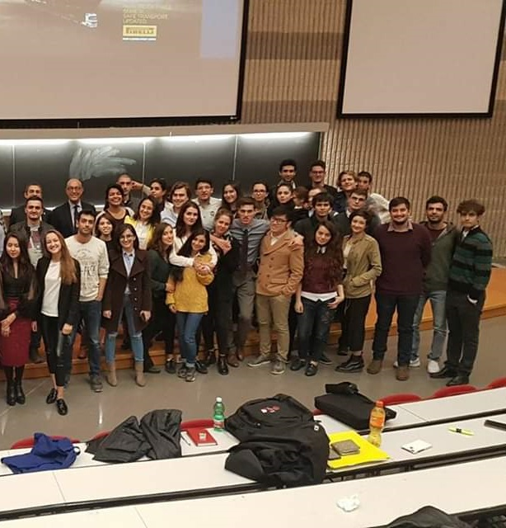
Recruiters look for top students
Avoid abbreviations, contractions and specialized language.
Always attach a motivational letter.
Do not exceed the recommended two-page length; exceptions are made only for those with numerous publications and post-doctoral research to document.
Save it using the .PDF file extension to render it legible for all computers and to preserve the formatting. Put your name and surname in the title of the document (i.e. “Mario Rossi CV”).

Slide 5

Header
At the top of the first page, include your name and surname, as well as “Curriculum vitae” (optional).

Slide 6

Picture
When you decide to include a picture on your CV, make sure to use a picture that portrays a professional attitude. Research has shown that bare arms and shoulders can come across as unprofessional. It is strongly advised that when using a picture on your CV, you use the same picture on LinkedIn.

Slide 7

Personal details
A basic indication of your contact information
First and last name (in case these are not mentioned in the header)
Address and telephone number
Email (you will not seem professional with an address like ninjawarrior95@hotmail.com!)
Date of birth
Nationality (if it is relevant for your application)
Optional: LinkedIn profile (only when the profile is complete. Make sure to create a personal URL)

Slide 8
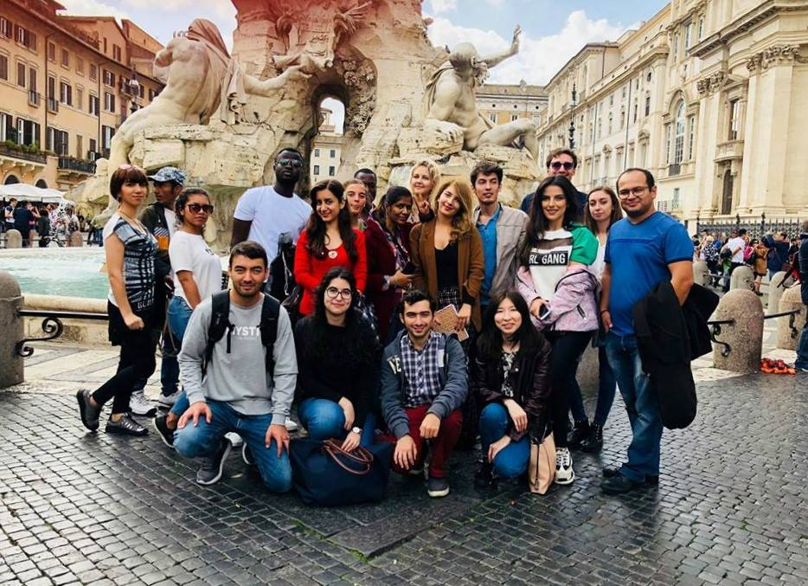
Personal profile
What makes you special?
We encourage you to take your time on this assignment. Be open. Be reflective. Find your individual voice and express it honestly. The length of this part should be a maximum of 6 lines or use bullet points. This section is optional. If you are not able to write a catchy profile, then leave this part out.
This is your opportunity to show a recruiter something about yourself, your hopes, ambitions, life experiences, inspirations.

Slide 9
Education
Include the length of your education, the name of your program, and the educational facility you attended. List these in an anti-chronological order (indicate your most recent education first). You may also include any courses which illustrate your suitability to the position you are applying for. Be aware that if your final grade was not very high and you choose not to insert it, the reader may assume that your grade is even lower than what it really is. Always include the final grade!
Example:
September 2019 – ongoing
September 2015 – July 2018
Master of Science in European Economy and Business Law (LM-90)
University of Rome Tor Vergata, Rome, Italy
(Two-year postgraduate program taught in English)
Relevant courses/Key-courses: ...........
Thesis: ’………………………………………’
GPA: …/30
Bachelor Degree in …
University….
Relevant courses/Key-courses: ...........
Thesis: ’………………………………………’
Final Grade: …/110

Slide 10
Study projects or international experience
A section such as ‘study projects’ on your CV is optional in order for you to emphasize these projects. Think of consultancy projects or internships. If you want to emphasize something else, such as your international experience, create a section in your CV regarding your ‘international experience’.
Example:
August 2019
Sep 2018 – ongoing
February 2018 – July 2018
University…….
Summer School in …
Relevant courses/ Key-courses: ...........
Traineeship at …
Trainee in the … Unit
Erasmus Exchange Programme
KU Leuven, Belgium (6 months)
Courses: …

Slide 11
Work experience
Use the same layout as for education: dates, responsibilities, and company names. You may decide to mention your Internships in this section instead of ‘study projects’. It is up to you.
Example:
September 2018 – ongoing
September 2017 – January 2018
Traineeship at …
Trainee in … Unit
Work-Study Scholarship
University of Rome Tor Vergata
Library assistant, School of Economics
Greeted students and checked IDs at the Reception Desk
Filed documents and sorted books in the Library Archives

Slide 12
Extracurricular activities
Use the same layout as for education: dates, responsibilities, and association names. Especially if you do not have a lot of work experience, this is an important section in your CV. Recruiters pay attention to extracurricular activities and often consider them as work experience.
Example:
2020 - present
Economics Society
University of Rome Tor Vergata, Rome, Italy
Managing five board members
Organizing Career Events (150 participants)
Training of new board members

Slide 13
Languages or language skills
Decide whether your language knowledge is essential for the position for which you are applying. If it is relevant, consider using a long description or a short description. You may also choose to use the CEFR level (ranging from A1 - C2), next to a description such as ‘advanced’ of ‘basic knowledge’.
Example:
Italian: mother tongue
English: advanced (Cambridge Certificate of Proficiency / IELTS 7.0)
German and French: basic knowledge

Slide 14
IT or computer skills
Which programs and packages have you already used? Have you earned any certifications? In your courses, which programs were used? Have you attended IT seminars or workshops?
Example:
Windows Office: Word, Excel, Powerpoint, Outlook, Access (ECDL certification)
Programming and Scripting Languages: Matlab, STATA, Python
Other technical skills: Thomson Reuters Eikon and Datastream for Office Certifications
Online Platforms: Microsoft Teams, Zoom, GoToMeeting

Slide 15
Personal interests
Critically assess which qualities or traits you would like to illustrate with the interests you have selected to include on your CV. Which qualities would you like to highlight? Are you, for instance, a team player? Or are you considering a position that requires leadership skills and would you like to highlight your ability to motivate others?
Example:
Interests include: Volunteering, Music (cellist in Tor Vergata Student Orchestra), Football (captain and referee), Travelling
Additional information: 2017/2018 MAECI scholarship winner

Slide 16
Additional information / knowledge and competencies
Think of conferences, seminars and workshops, your own website or business courses. This section contains extra relevant information, which can increase your chances of an interview.
Example:
CEIS Seminar on Italian economic reforms, October 2022
Global Procurement Conference, July 2021
Seminar on Blockchain and Crypto-currencies, March 2018

Slide 17

How to write a motivation letter
A cover letter, covering letter, motivation letter, motivational letter or a letter of motivation is a letter of introduction attached to, or accompanying another document such as a résumé or curriculum vitae.

Slide 18
How to begin
The main goal of a motivational letter is to expand upon your CV, not re-write it – make sure your motivational letter supports your CV and emphasizes relevant information about your competencies and experience. Key strengths can be internships, other work experience, essays and research (e.g. dissertation, project work, summer school, international experiences, dataset analysis) on topics of interest to the company or the expression of personal interest in the strategic activities of the company. To do this, analyze the vacancy and make sure to gather the information you need to write an impressive motivational letter. Try to understand the company, who they are, what they do, as well as the specific job profile that interests you. LinkedIn can be of help.

Slide 19
General tips
An excellent motivation letter takes time to write. Give yourself that time. It is important.
Use short sentences and active language; be concise and to the point.
Avoid abbreviations and specialized language.
Let your letter connect to your CV, but avoid literal overlap. In your CV, you can identify things that you then explain in your letter.
Each motivational letter should be detailed and tailored specifically to the company and role you are writing it for. If you know the name of the hiring manager or whoever will be reading your letter, address the letter to them. This way you can make the letter even more personalized, and it will prove you are a determined candidate who wants the job.

Slide 20
Avoid clichés: each letter should be personalized, so avoid phrases that recruiters have read a thousand times. Do not just say, “I am a team player”. Instead, choose an example of when you worked well in a team and explain what happened and what you achieved. Be convincing, but never intrusive. Do not put conclusions in your text, but express your arguments so that the recipient can draw a (positive) conclusion.
Put yourself in the reader’s shoes. He wants to know "what's in it for me?" Do not focus on what the company and / or the function can do for you, but on how your competencies can be useful for the company. Indicate your specific skills and avoid vague and generic phrases.

Slide 21
Be truthful and positive.
Try to keep it to one tidy, clear and organized page.
Send your Motivational Letter as a PDF file and put your name in the title of the document.
Once you have written your letter, check it over for mistakes, including font, spacing, color and spelling, and ask someone else to proofread your letter before you send it. Recruiters are not going to take you seriously if you have made silly spelling or grammar mistakes.

Slide 22

Structure of the letter
It begins like this…
Your name and address
Company’s address and name of the contact person
Location and date
Relating to (including vacancy number)
Dear Madam/Sir X, (it is best if you know the name and position of the contact person, otherwise indicate ‘Dear Sir/Madam’, ‘Dear Managing Director’ or ‘To Whom It May Concern’)

Slide 23

Large image
First paragraph:
Grab their attention
Draw attention to your letter by showing that you have conducted research on the company beforehand. You can, for instance, refer to a pleasant phone conversation you have had with someone from within the organization, or indicate any other already existing connections you have established.

Slide 24
Paragraph(s) regarding your motivation
Discuss the main reasons for wanting to work for the organization. Try to be original and focus on why you are qualified for the position. Have you been an intern at a similar organization? To strengthen your motivation, use this internship as an example to illustrate your experience in this field. Have you taken courses that are relevant to the organization’s mission? Explain how the course content piqued your interest and honed your skills in this field.
You should convince the reader that you are the perfect candidate for the job by conveying your motivation as related to your personal experience. For your education, make specific reference to your academic courses that are relevant to the job or that you enjoyed most, Erasmus or study abroad, summer school programs, software packages that you have used, your dissertation topic, or research projects that are related to the job. For your professional experience, consider how past and present work has helped you build your qualities and your skills. Link these aspects to your desired position and to topics of interest to the company, so that the reader will be convinced as to how you will be the solution to any issues an organization may have.

Slide 25
Conclusion
Make sure that the language of the final paragraph matches the content of the letter and your personality.
Example:
I welcome the opportunity to further elaborate on my CV and motivation during a personal interview. I look forward to your reply.
Kind regards,
X X
Attachment: curriculum vitae

Slide 26





Thank you!
Jenny Vieley and Susie White
+39 067259 5744
msc@eebl.uniroma2.it
MSc European Economy and Business Law

